Slide 1
Reminders
WEDNESDAY QUIZ 5 on
  Volume of Revolutions
    Disks (Lesson 14)
    Washers (Lesson 15)
NEXT FRIDAY NO CLASS

Slide 2
MA 16020: Lesson 16
Volume By Revolution
Rotation around any non-Axis
By Alexandra Cuadra

Slide 3
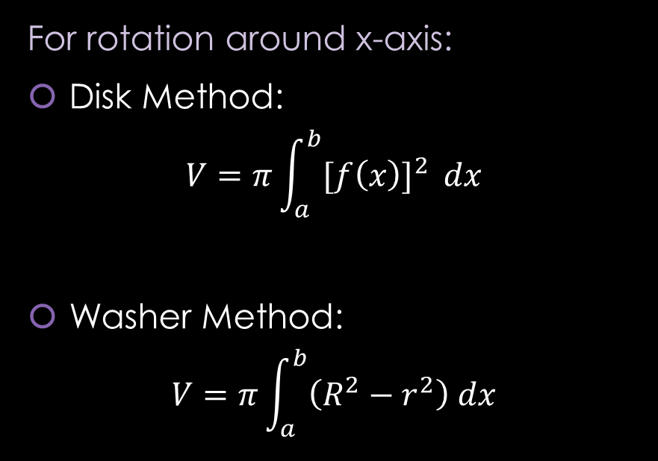
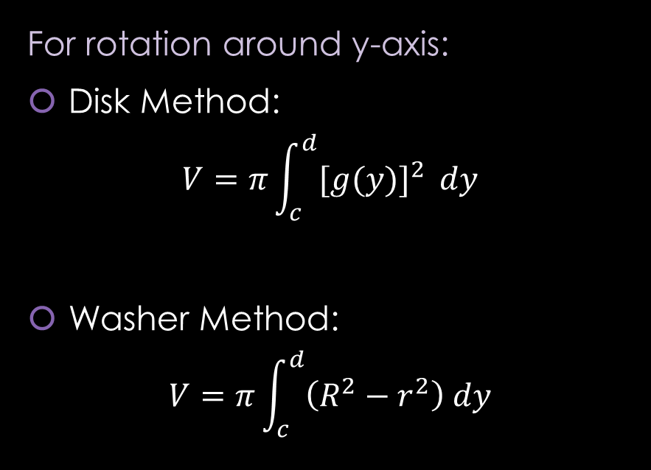
RECAP of Formulas from Lesson 14 and 15
For rotation around x-axis:
Disk Method:
$$V=π\int_{a}^{b}{{[f\left(x\right)]}^{2} }dx$$
Washer Method:
$$V=π\int_{a}^{b}{\left(R^{2}−r^{2}\right) dx}$$
For rotation around y-axis:
Disk Method:
$$V=π\int_{c}^{d}{{[g(y)]}^{2} }dy$$
Washer Method:
$$V=π\int_{c}^{d}{\left(R^{2}−r^{2}\right) dy}$$

Slide 4
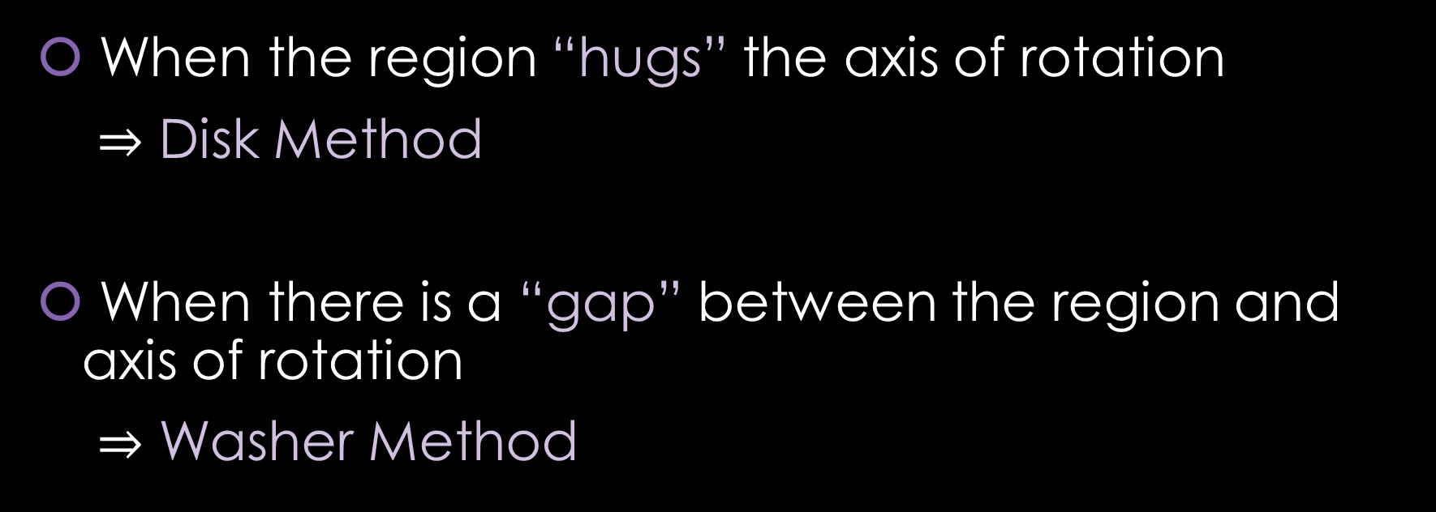
RECAP: When do we apply Disk Method or Washer Method?
When the region “hugs” the axis of rotation
$⇒$ Disk Method
When there is a “gap” between the region and axis of rotation
$⇒$ Washer Method

Slide 5
Today’s Lecture
In the previous two lessons, we looked at rotations around the x-axis or y-axis.
Today we are going to rotate about ANY arbitrary axis.
  Don’t worry. We are going to limit ourselves to any vertical or horizontal line parallel to the x-axis or y-axis

Slide 6

Example 1: Let $R$ be the region of the $xy$-plane bounded by the curves $x^{2}y=4$ below by the line $y=1$, on the left by the line $x=1$. Find the volume of the solid obtained by rotating $R$ around
the x-axis
https://www.geogebra.org/m/wrj2euhf

Slide 7
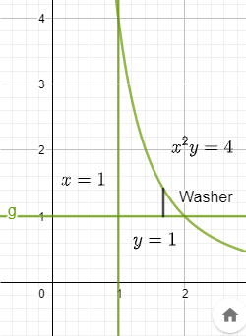

Example 1: Let $R$ be the region of the $xy$-plane bounded by the curves $x^{2}y=4$ below by the line $y=1$, on the left by the line $x=1$. Find the volume of the solid obtained by rotating $R$ around
the x-axis
Draw the region.
https://www.geogebra.org/m/wrj2euhf

Slide 8
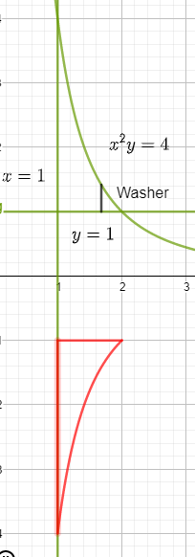


Example 1: Let $R$ be the region of the $xy$-plane bounded by the curves $x^{2}y=4$ below by the line $y=1$, on the left by the line $x=1$. Find the volume of the solid obtained by rotating $R$ around
the x-axis
Rotation about x-axis
https://www.geogebra.org/m/wrj2euhf

Slide 9
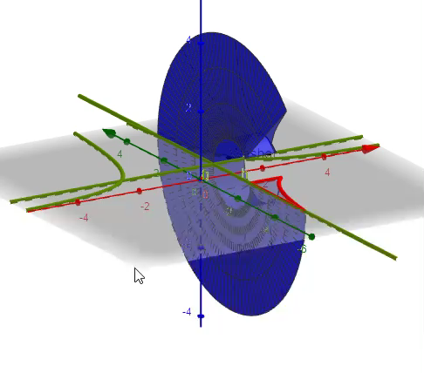
Example 1: Let $R$ be the region of the $xy$-plane bounded by the curves $x^{2}y=4$ below by the line $y=1$, on the left by the line $x=1$. Find the volume of the solid obtained by rotating $R$ around
the x-axis
Furthermore, 3-D
https://www.geogebra.org/m/wrj2euhf

Slide 10
Example 1: Let $R$ be the region of the $xy$-plane bounded by the curves $x^{2}y=4$ below by the line $y=1$, on the left by the line $x=1$. Find the volume of the solid obtained by rotating $R$ around
the x-axis
https://www.geogebra.org/m/wrj2euhf

Slide 11
Example 1: Let $R$ be the region of the $xy$-plane bounded by the curves $x^{2}y=4$ below by the line $y=1$, on the left by the line $x=1$. Find the volume of the solid obtained by rotating $R$ around
the x-axis
https://www.geogebra.org/m/wrj2euhf

Slide 12
Example 1: Let $R$ be the region of the $xy$-plane bounded by the curves $x^{2}y=4$ below by the line $y=1$, on the left by the line $x=1$. Find the volume of the solid obtained by rotating $R$ around
the x-axis
https://www.geogebra.org/m/wrj2euhf

Slide 13
Example 1: Let $R$ be the region of the $xy$-plane bounded by the curves $x^{2}y=4$ below by the line $y=1$, on the left by the line $x=1$. Find the volume of the solid obtained by rotating $R$ around
the x-axis
https://www.geogebra.org/m/wrj2euhf

Slide 14
Example 1: Let $R$ be the region of the $xy$-plane bounded by the curves $x^{2}y=4$ below by the line $y=1$, on the left by the line $x=1$. Find the volume of the solid obtained by rotating $R$ around
the x-axis
You can find the solution in the pdf of the notes. Click here to access it.
https://www.geogebra.org/m/wrj2euhf

Slide 15

Example 1: Let $R$ be the region of the $xy$-plane bounded by the curves $x^{2}y=4$ below by the line $y=1$, on the left by the line $x=1$. Find the volume of the solid obtained by rotating $R$ around
B) the y-axis
https://www.geogebra.org/m/wzbm2xbt

Slide 16

Example 1: Let $R$ be the region of the $xy$-plane bounded by the curves $x^{2}y=4$ below by the line $y=1$, on the left by the line $x=1$. Find the volume of the solid obtained by rotating $R$ around
B) the y-axis
Draw the region.
https://www.geogebra.org/m/wzbm2xbt

Slide 17
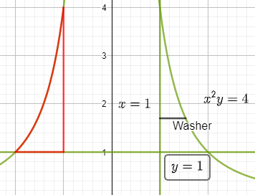


Example 1: Let $R$ be the region of the $xy$-plane bounded by the curves $x^{2}y=4$ below by the line $y=1$, on the left by the line $x=1$. Find the volume of the solid obtained by rotating $R$ around
B) the y-axis
Rotation about y-axis
https://www.geogebra.org/m/wzbm2xbt

Slide 18
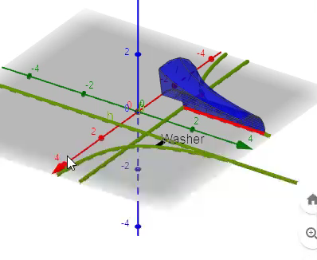
Example 1: Let $R$ be the region of the $xy$-plane bounded by the curves $x^{2}y=4$ below by the line $y=1$, on the left by the line $x=1$. Find the volume of the solid obtained by rotating $R$ around
B) the y-axis
Furthermore, 3-D
https://www.geogebra.org/m/wzbm2xbt

Slide 19
Example 1: Let $R$ be the region of the $xy$-plane bounded by the curves $x^{2}y=4$ below by the line $y=1$, on the left by the line $x=1$. Find the volume of the solid obtained by rotating $R$ around
B) the y-axis
https://www.geogebra.org/m/wzbm2xbt

Slide 20
Example 1: Let $R$ be the region of the $xy$-plane bounded by the curves $x^{2}y=4$ below by the line $y=1$, on the left by the line $x=1$. Find the volume of the solid obtained by rotating $R$ around
B) the y-axis
https://www.geogebra.org/m/wzbm2xbt

Slide 21
Example 1: Let $R$ be the region of the $xy$-plane bounded by the curves $x^{2}y=4$ below by the line $y=1$, on the left by the line $x=1$. Find the volume of the solid obtained by rotating $R$ around
B) the y-axis
https://www.geogebra.org/m/wzbm2xbt

Slide 22
Example 1: Let $R$ be the region of the $xy$-plane bounded by the curves $x^{2}y=4$ below by the line $y=1$, on the left by the line $x=1$. Find the volume of the solid obtained by rotating $R$ around
B) the y-axis
You can find the solution in the pdf of the notes. Click here to access it.
https://www.geogebra.org/m/wzbm2xbt

Slide 23
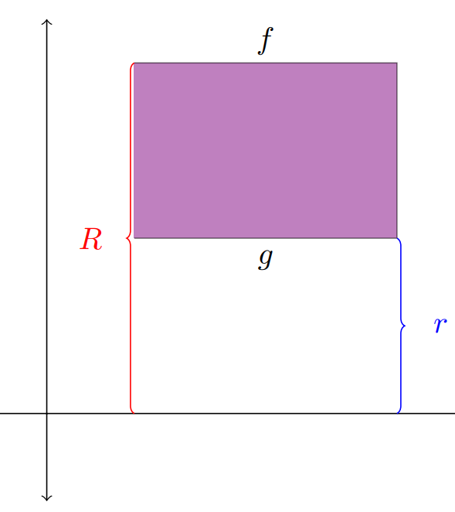

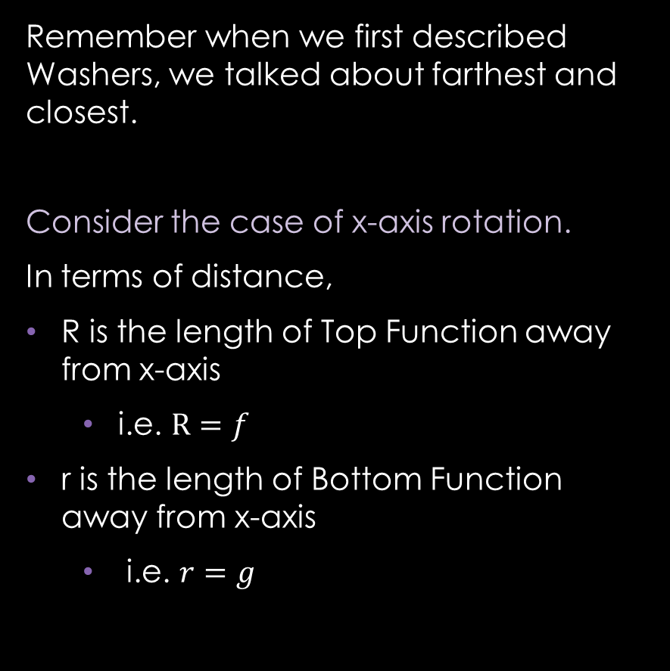
Let’s Backtrack a Bit…
Remember when we first described Washers, we talked about farthest and closest.
Consider the case of x-axis rotation.
In terms of distance,
R is the length of Top Function away from x-axis
  i.e. $R=f$
r is the length of Bottom Function away from x-axis
  i.e. $r=g$

Slide 24
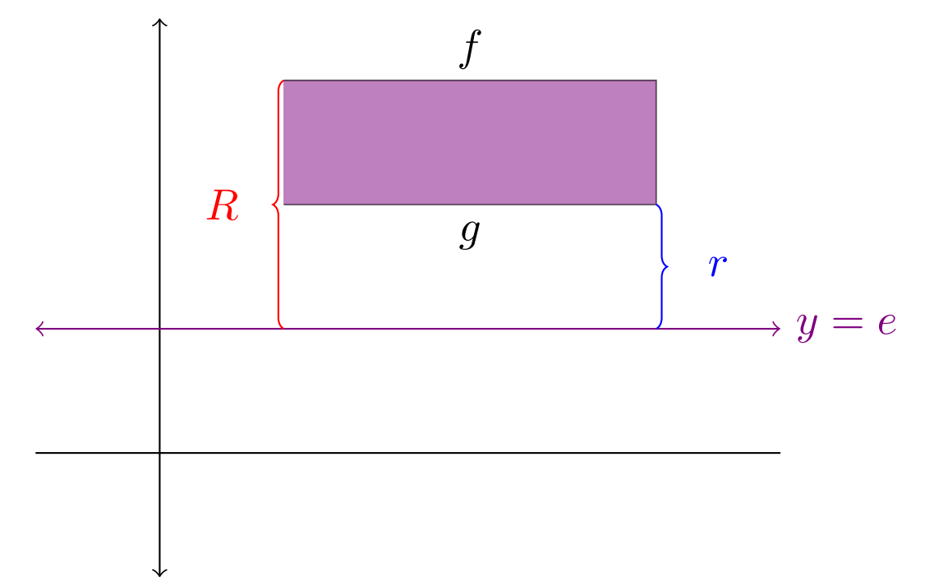
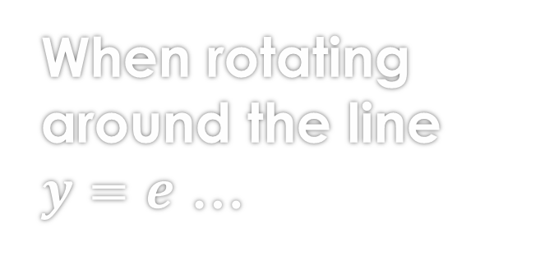


When rotating around the line $y=e$ …
So, what is the distance between $f$ (or $g$) and $y=e$ ?
  Distance b/w $f$ and $y=e$ is
  $$R=f−e$$
  Distance b/w $g$ and $y=e$ is
  $$r=g−e$$
Note this formula is also true for the x-axis case, because the x-axis is simply the line $y=0$

Slide 25
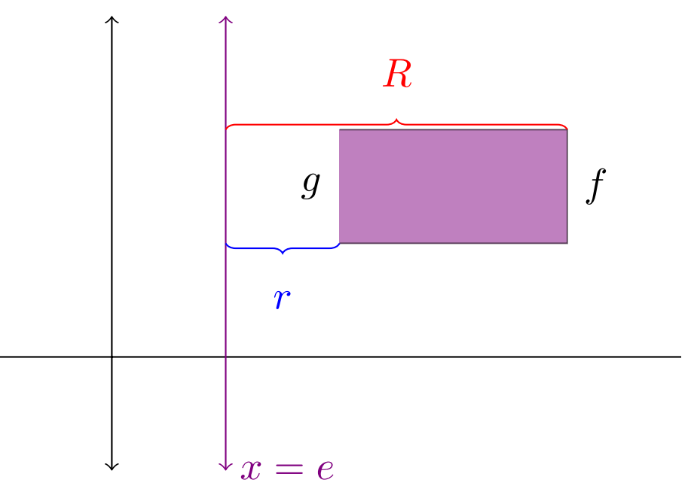
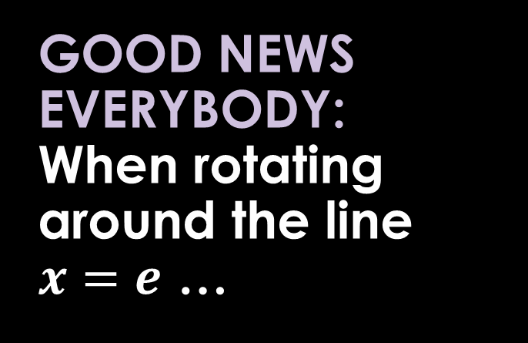

GOOD NEWS EVERYBODY:
When rotating around the line $x=e$ …
The same formulas, for $R$ and $r$, from the case of $y=e$ applies.
So, the distance between $f$ (or $g$) and $x=e$ are as follows:
  $R=f−e$
  $r=g−e$
Note that though we did all this calculation for the Washer Problems; this also applies for the Disk Problems.

Slide 26
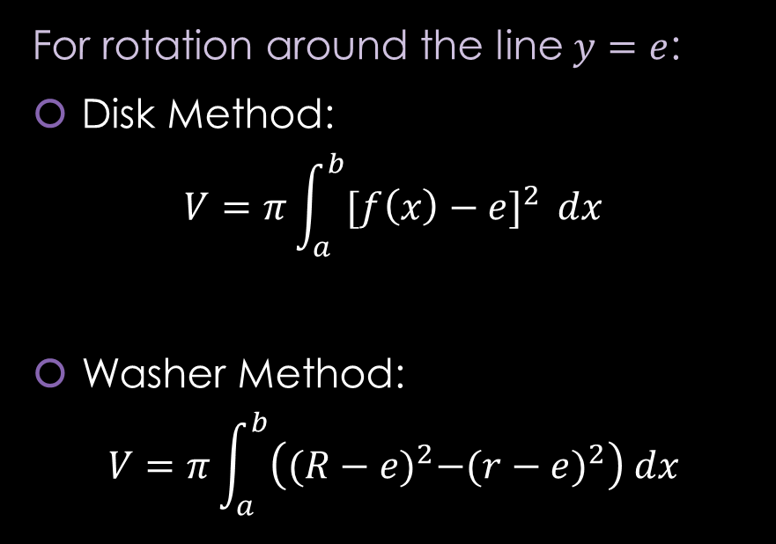
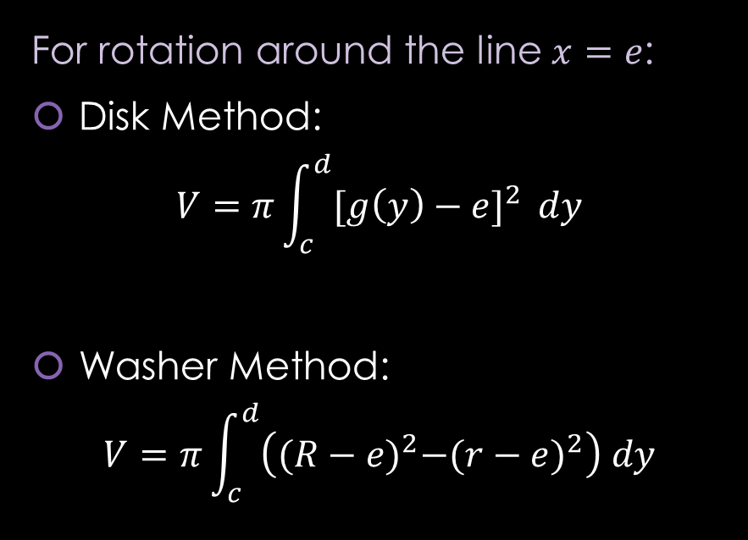
Rotation around any non-Axis Formulas
For rotation around the line $y=e$:
Disk Method:
$$V=π\int_{a}^{b}{{[f\left(x\right)−e]}^{2} }dx$$
Washer Method:
$$V=π\int_{a}^{b}{\left({(R−e)}^{2}−{(r−e)}^{2}\right) dx}$$
For rotation around the line $x=e$:
Disk Method:
$$V=π\int_{c}^{d}{{[g\left(y\right)−e]}^{2} }dy$$
Washer Method:
$$V=π\int_{c}^{d}{\left({(R−e)}^{2}−{(r−e)}^{2}\right) dy}$$
Note: That these formulas work for the case of x-axis ($y=0)$ and y-axis ($x=0$).

Slide 27

Example 1: Let $R$ be the region of the $xy$-plane bounded by the curves $x^{2}y=4$ below by the line $y=1$, on the left by the line $x=1$. Find the volume of the solid obtained by rotating $R$ around
C) the line $y=1$
https://www.geogebra.org/m/n2jzwh8f

Slide 28
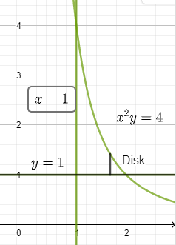

Example 1: Let $R$ be the region of the $xy$-plane bounded by the curves $x^{2}y=4$ below by the line $y=1$, on the left by the line $x=1$. Find the volume of the solid obtained by rotating $R$ around
C) the line $y=1$
Draw the region.
https://www.geogebra.org/m/n2jzwh8f

Slide 29
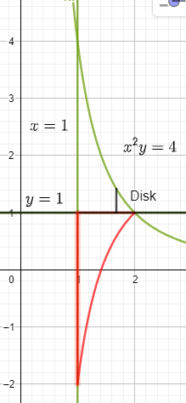

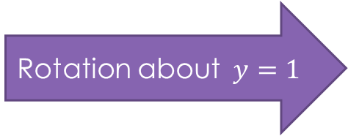
Example 1: Let $R$ be the region of the $xy$-plane bounded by the curves $x^{2}y=4$ below by the line $y=1$, on the left by the line $x=1$. Find the volume of the solid obtained by rotating $R$ around
C) the line $y=1$
Rotation about$y=1$
https://www.geogebra.org/m/n2jzwh8f

Slide 30

Example 1: Let $R$ be the region of the $xy$-plane bounded by the curves $x^{2}y=4$ below by the line $y=1$, on the left by the line $x=1$. Find the volume of the solid obtained by rotating $R$ around
C) the line $y=1$
DISK PROBLEM
Rotation about$y=1$
https://www.geogebra.org/m/n2jzwh8f

Slide 31
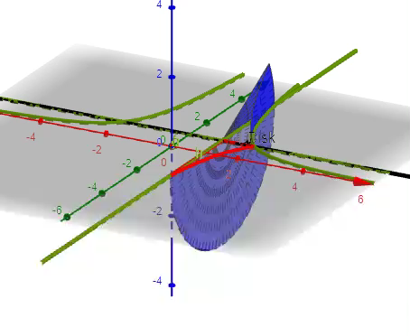
Example 1: Let $R$ be the region of the $xy$-plane bounded by the curves $x^{2}y=4$ below by the line $y=1$, on the left by the line $x=1$. Find the volume of the solid obtained by rotating $R$ around
C) the line $y=1$
DISK PROBLEM
Furthermore, 3-D
https://www.geogebra.org/m/n2jzwh8f

Slide 32
Example 1: Let $R$ be the region of the $xy$-plane bounded by the curves $x^{2}y=4$ below by the line $y=1$, on the left by the line $x=1$. Find the volume of the solid obtained by rotating $R$ around
C) the line $y=1$
https://www.geogebra.org/m/n2jzwh8f

Slide 33
Example 1: Let $R$ be the region of the $xy$-plane bounded by the curves $x^{2}y=4$ below by the line $y=1$, on the left by the line $x=1$. Find the volume of the solid obtained by rotating $R$ around
C) the line $y=1$
https://www.geogebra.org/m/n2jzwh8f

Slide 34
Example 1: Let $R$ be the region of the $xy$-plane bounded by the curves $x^{2}y=4$ below by the line $y=1$, on the left by the line $x=1$. Find the volume of the solid obtained by rotating $R$ around
C) the line $y=1$
You can find the solution in the pdf of the notes. Click here to access it.
https://www.geogebra.org/m/n2jzwh8f

Slide 35

Example 1: Let $R$ be the region of the $xy$-plane bounded by the curves $x^{2}y=4$ below by the line $y=1$, on the left by the line $x=1$. Find the volume of the solid obtained by rotating $R$ around
D) the line $x=1$
https://www.geogebra.org/m/cppyhnqk

Slide 36
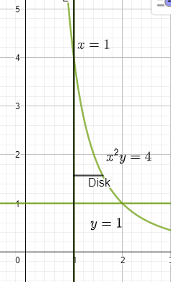

Example 1: Let $R$ be the region of the $xy$-plane bounded by the curves $x^{2}y=4$ below by the line $y=1$, on the left by the line $x=1$. Find the volume of the solid obtained by rotating $R$ around
D) the line $x=1$
Draw the region.
https://www.geogebra.org/m/cppyhnqk

Slide 37
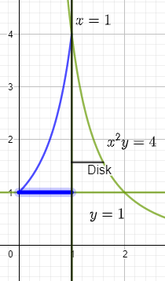
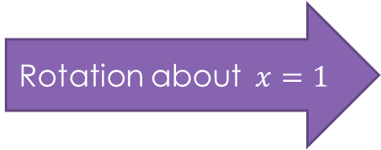

Example 1: Let $R$ be the region of the $xy$-plane bounded by the curves $x^{2}y=4$ below by the line $y=1$, on the left by the line $x=1$. Find the volume of the solid obtained by rotating $R$ around
D) the line $x=1$
Rotation about$x=1$
https://www.geogebra.org/m/cppyhnqk

Slide 38
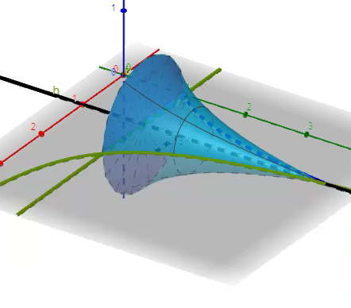

Example 1: Let $R$ be the region of the $xy$-plane bounded by the curves $x^{2}y=4$ below by the line $y=1$, on the left by the line $x=1$. Find the volume of the solid obtained by rotating $R$ around
D) the line $x=1$
DISK PROBLEM
Furthermore, 3-D
https://www.geogebra.org/m/cppyhnqk

Slide 39
Example 1: Let $R$ be the region of the $xy$-plane bounded by the curves $x^{2}y=4$ below by the line $y=1$, on the left by the line $x=1$. Find the volume of the solid obtained by rotating $R$ around
D) the line $x=1$
https://www.geogebra.org/m/cppyhnqk

Slide 40
Example 1: Let $R$ be the region of the $xy$-plane bounded by the curves $x^{2}y=4$ below by the line $y=1$, on the left by the line $x=1$. Find the volume of the solid obtained by rotating $R$ around
D) the line $x=1$
https://www.geogebra.org/m/cppyhnqk

Slide 41
Example 1: Let $R$ be the region of the $xy$-plane bounded by the curves $x^{2}y=4$ below by the line $y=1$, on the left by the line $x=1$. Find the volume of the solid obtained by rotating $R$ around
D) the line $x=1$
You can find the solution in the pdf of the notes. Click here to access it.
https://www.geogebra.org/m/cppyhnqk

Slide 42

Example 2: Find the volume of the solid generated by revolving the given region about the line $x=6$:
$y=\sqrt{x}$ , $y=0$ , $x=4$
https://www.geogebra.org/m/eyabfyya

Slide 43
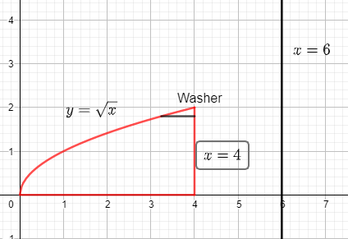

Example 2: Find the volume of the solid generated by revolving the given region about the line $x=6$:
$y=\sqrt{x}$ , $y=0$ , $x=4$
Draw the region.
https://www.geogebra.org/m/eyabfyya

Slide 44
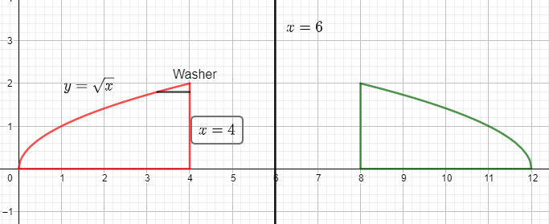

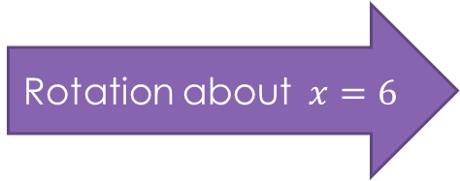
Example 2: Find the volume of the solid generated by revolving the given region about the line $x=6$:
$y=\sqrt{x}$ , $y=0$ , $x=4$
Rotation about$x=6$
https://www.geogebra.org/m/eyabfyya

Slide 45
Example 2: Find the volume of the solid generated by revolving the given region about the line $x=6$:
$y=\sqrt{x}$ , $y=0$ , $x=4$
https://www.geogebra.org/m/eyabfyya

Slide 46
Example 2: Find the volume of the solid generated by revolving the given region about the line $x=6$:
$y=\sqrt{x}$ , $y=0$ , $x=4$
https://www.geogebra.org/m/eyabfyya

Slide 47
Example 2: Find the volume of the solid generated by revolving the given region about the line $x=6$:
$y=\sqrt{x}$ , $y=0$ , $x=4$
https://www.geogebra.org/m/eyabfyya

Slide 48
Example 2: Find the volume of the solid generated by revolving the given region about the line $x=6$:
$y=\sqrt{x}$ , $y=0$ , $x=4$
https://www.geogebra.org/m/eyabfyya

Slide 49
Example 2: Find the volume of the solid generated by revolving the given region about the line $x=6$:
$y=\sqrt{x}$ , $y=0$ , $x=4$
You can find the solution in the pdf of the notes. Click here to access it.
https://www.geogebra.org/m/eyabfyya

Slide 50

Example 3: Find the volume of the solid generated by revolving the given region about the line $y=2$:
$y=2x$ , $x=0$, $y=2$
https://www.geogebra.org/m/z6tjgnn9

Slide 51
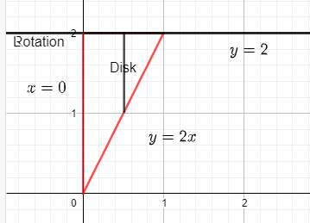

Example 3: Find the volume of the solid generated by revolving the given region about the line $y=2$:
$y=2x$ , $x=0$, $y=2$
Draw the region.
https://www.geogebra.org/m/z6tjgnn9

Slide 52
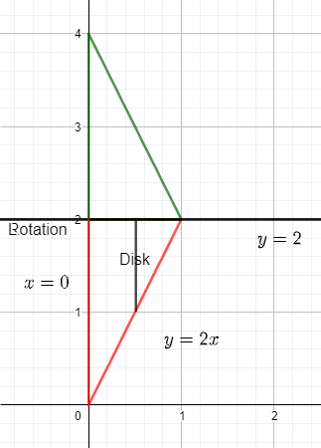
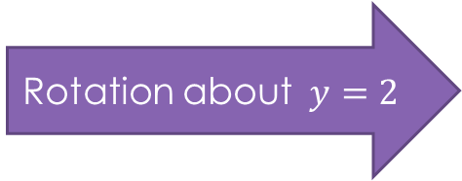
Example 3: Find the volume of the solid generated by revolving the given region about the line $y=2$:
$y=2x$ , $x=0$, $y=2$
Rotation about$y=2$
https://www.geogebra.org/m/z6tjgnn9

Slide 53
Example 3: Find the volume of the solid generated by revolving the given region about the line $y=2$:
$y=2x$ , $x=0$, $y=2$
https://www.geogebra.org/m/z6tjgnn9

Slide 54
Example 3: Find the volume of the solid generated by revolving the given region about the line $y=2$:
$y=2x$ , $x=0$, $y=2$
https://www.geogebra.org/m/z6tjgnn9

Slide 55
Example 3: Find the volume of the solid generated by revolving the given region about the line $y=2$:
$y=2x$ , $x=0$, $y=2$
You can find the solution in the pdf of the notes. Click here to access it.
https://www.geogebra.org/m/z6tjgnn9

Slide 56

Example 4: Find the volume of the solid generated by revolving the given region
$y=x^{2}$ , $x=y^{2}$
A) Around the line $x=2$
https://www.geogebra.org/m/bksc2sjr

Slide 57

Example 4: Find the volume of the solid generated by revolving the given region
$y=x^{2}$ , $x=y^{2}$
B) Around the line $y=3$
https://www.geogebra.org/m/bkadp8pq

Slide 58
GeoGebra Link for Lesson 16
https://www.geogebra.org/m/y4pqm3mr
Note click on the play buttons on the left-most screen and the animation will play/pause.

