Slide 1
Reminders
TODAY QUIZ 6 on Area Between Two Curves
NEXT FRIDAY QUIZ 7 on Volume of Revolutions (Lessons 12 – 13 – 14)

Slide 2
MA 16020: Lesson 12 Volume By Revolution Disk Method
By: Alexandra Cuadra

Slide 3
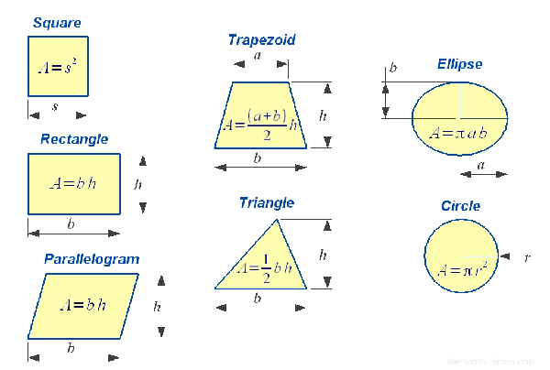
In Geometry,
We first talked about the concept of area.
We did this by going over all the formulas for the area of different polygons.

Slide 4
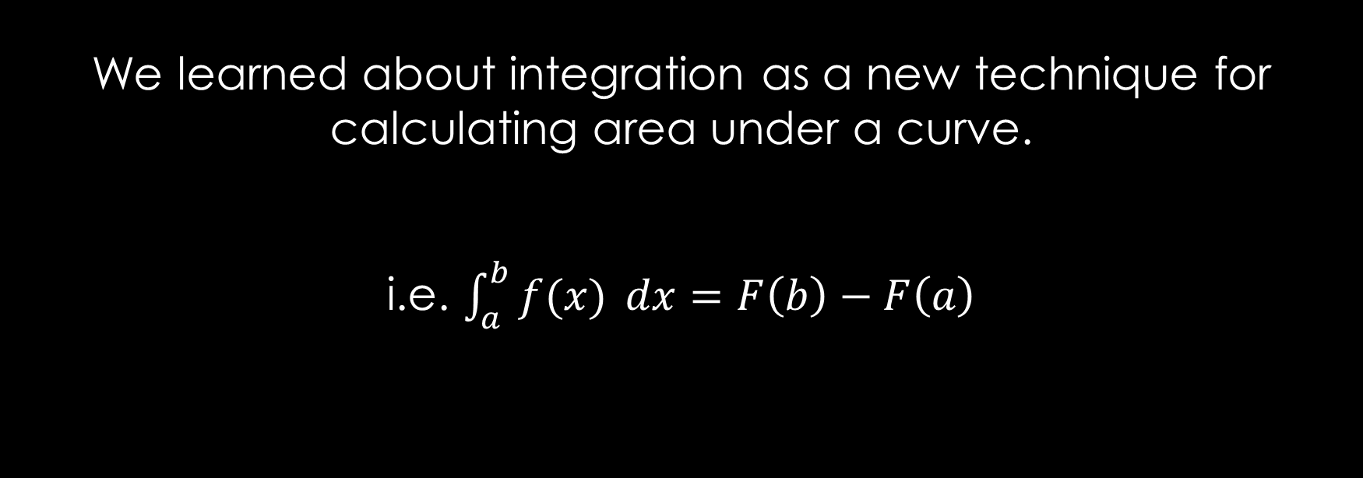
In Calculus I,
We learned about integration as a new technique for calculating area under a curve.
i.e. $\int_{a}^{b}{f(x)} dx=F\left(b\right)−F\left(a\right)$

Slide 5
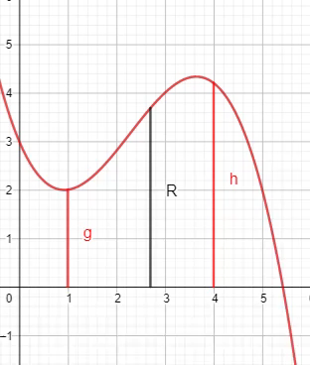
Last Class,
We recapped how to take some region
Between a curve and an axis, or
2 curves
And find it’s area by integration.
Essentially, finding a length and sending it across the region.
`
https://www.geogebra.org/m/tgceabb2#material/tnnhu7gz

Slide 6
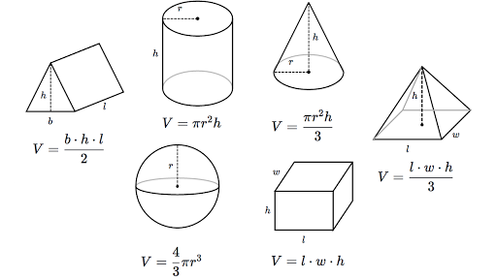
In Geometry,
We also learned about 3-D figures, like cubes and prisms.
We described the volume of these objects by the amount of 3-D space that they contained.
We calculated the volume with useful formulas.

Slide 7
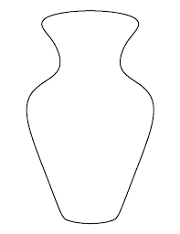
But once curves get involved all these formulas are useless.
For example, there is no formula for this.

Slide 8
Luckily, just the way we run a line segment across a 2-D region to calculate its area, we can run a plane region, or a cross section, across a 3-D region to calculate its volume.
i.e. Running a 2-D plane across a 3-D volume.
`
https://www.geogebra.org/m/tgceabb2#material/tnnhu7gz

Slide 9
This is also integration; just with an extra dimension.
Instead of adding up tiny rectangles under a curve in the limit of infinitely thin rectangles under a curve in the limit of infinitely thin rectangles, we are adding up infinitely thin cross sections, which we can call
Disks (Lesson 12), or
Washers (Lesson 13).
Since each of these disks is a 2-D area, taking the integral of an area function will gives us volume.

Slide 10
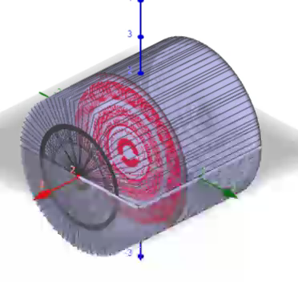
For example, let’s look at a cylinder.
You can see the red circle in the cylinder. We can think of our integral to be summing up all the circles.
`
https://www.geogebra.org/m/tgceabb2#material/qcwutumt

Slide 11
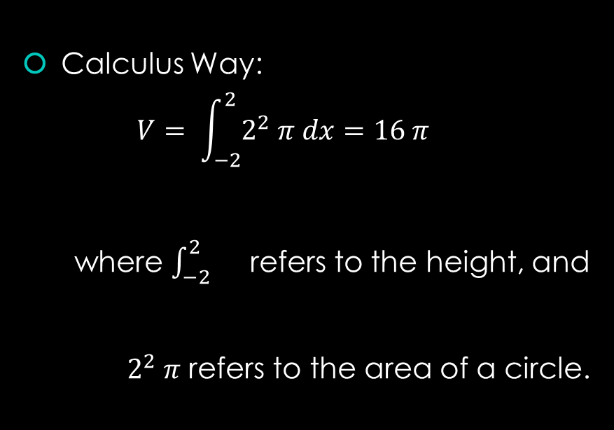
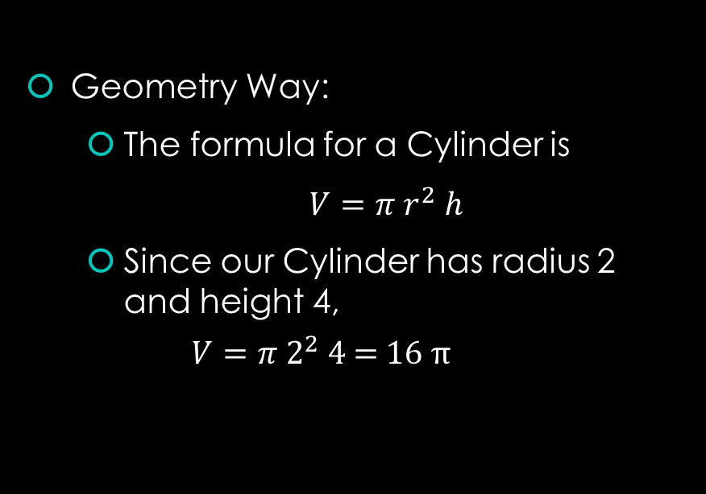
Volume of that Cylinder
Geometry Way:
The formula for a Cylinder is
$V=π r^{2} h$
Since our Cylinder has radius 2 and height 4,
$$V=π 2^{2} \text{4 = 16} π$$
Calculus Way:
$$V= \int_{−2}^{2}{2^{2} π dx}=16 π$$
where $\int_{−2}^{2}{}$ refers to the height, and
$2^{2} π$ refers to the area of a circle.

Slide 12
Purpose of all of this…
So in the case of a cylinder, this might be overkill.
But this is the way we want to think of these questions.
Essentially find the cross section by graphing the lines given and apply the appropriate formula ( founded on the next slide(s). )

Slide 13
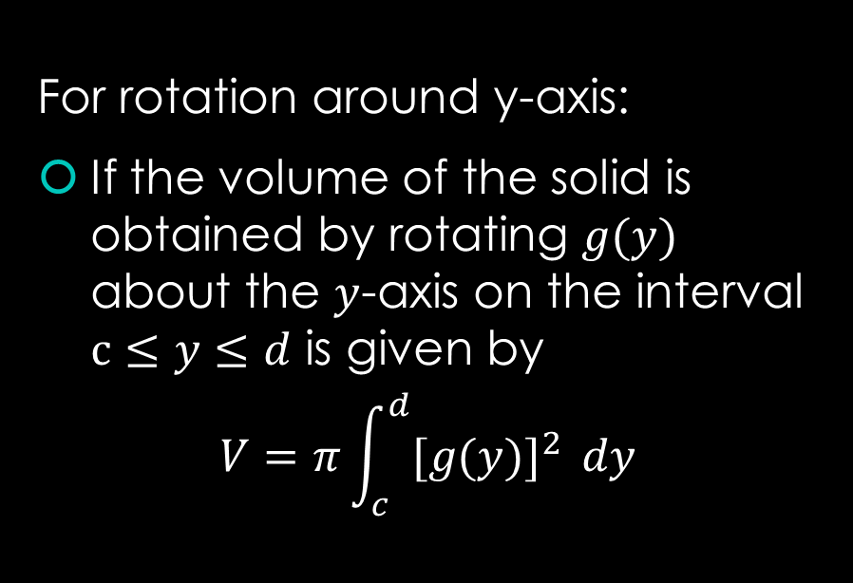
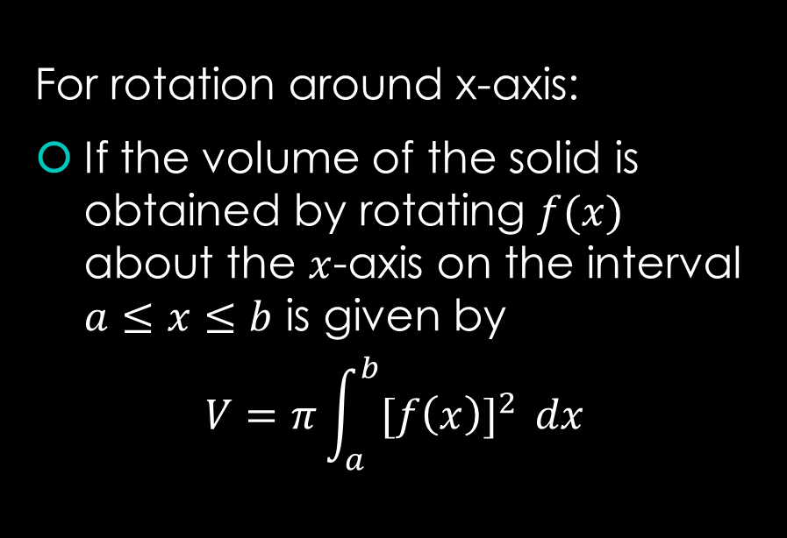
Disk Method Formula(s)
For rotation around x-axis:
If the volume of the solid is obtained by rotating $f(x)$ about the $x$-axis on the interval $a≤x≤b$ is given by
$$V=π\int_{a}^{b}{{[f\left(x\right)]}^{2} }dx$$
For rotation around y-axis:
If the volume of the solid is obtained by rotating $g(y)$ about the $y$-axis on the interval $c≤y≤d$ is given by
$$V=π\int_{c}^{d}{{[g(y)]}^{2} }dy$$

Slide 14
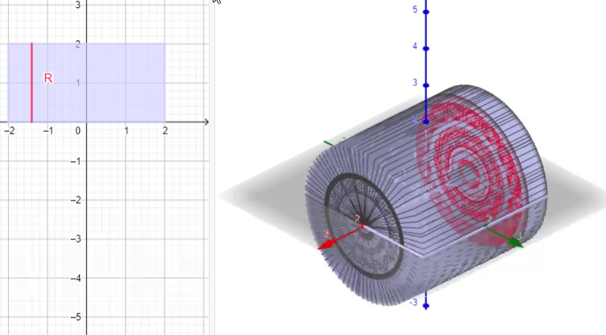

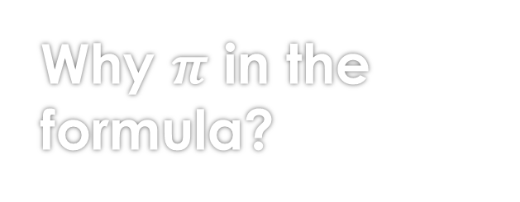
Why $π$ in the formula?
Note this $π$ in both formulas comes from the fact we are playing with Disks.
So you can see the graph on the left shows the radius and the right shows the Disks.
`
https://www.geogebra.org/m/tgceabb2#material/qcwutumt

Slide 15
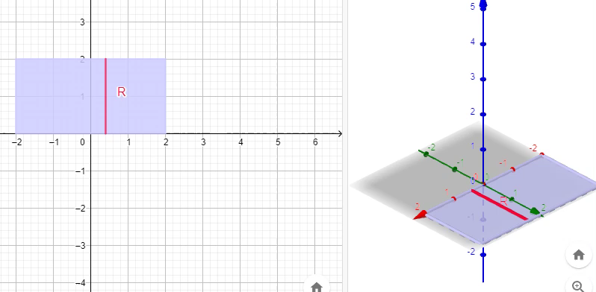
But wait…
How is the left graph becoming the cylinder?
Answer: If you rotate the left graph, you get the cylinder.
`
https://www.geogebra.org/m/tgceabb2#material/qcwutumt

Slide 16
Examples

Slide 17
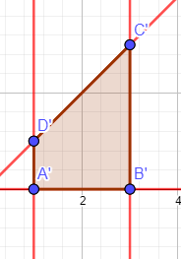

Example 1: Find the volume of the solid that results by revolving the region enclosed by the curves
$y=x$, $y=0$, $x=1$, $x=3$
About the x-axis.
First draw the region.
https://www.geogebra.org/m/tgceabb2#material/w8mk9dgp

Slide 18
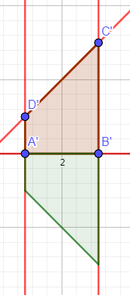

Example 1: Find the volume of the solid that results by revolving the region enclosed by the curves
$y=x$, $y=0$, $x=1$, $x=3$
About the x-axis.
Rotation about x-axis
https://www.geogebra.org/m/tgceabb2#material/w8mk9dgp

Slide 19
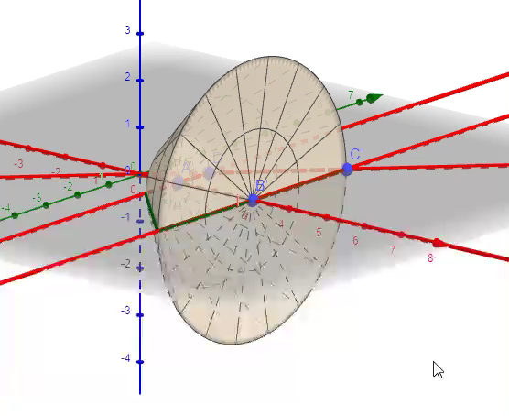
Example 1: Find the volume of the solid that results by revolving the region enclosed by the curves
$y=x$, $y=0$, $x=1$, $x=3$
About the x-axis.
Furthermore, 3-D
https://www.geogebra.org/m/tgceabb2#material/w8mk9dgp

Slide 20
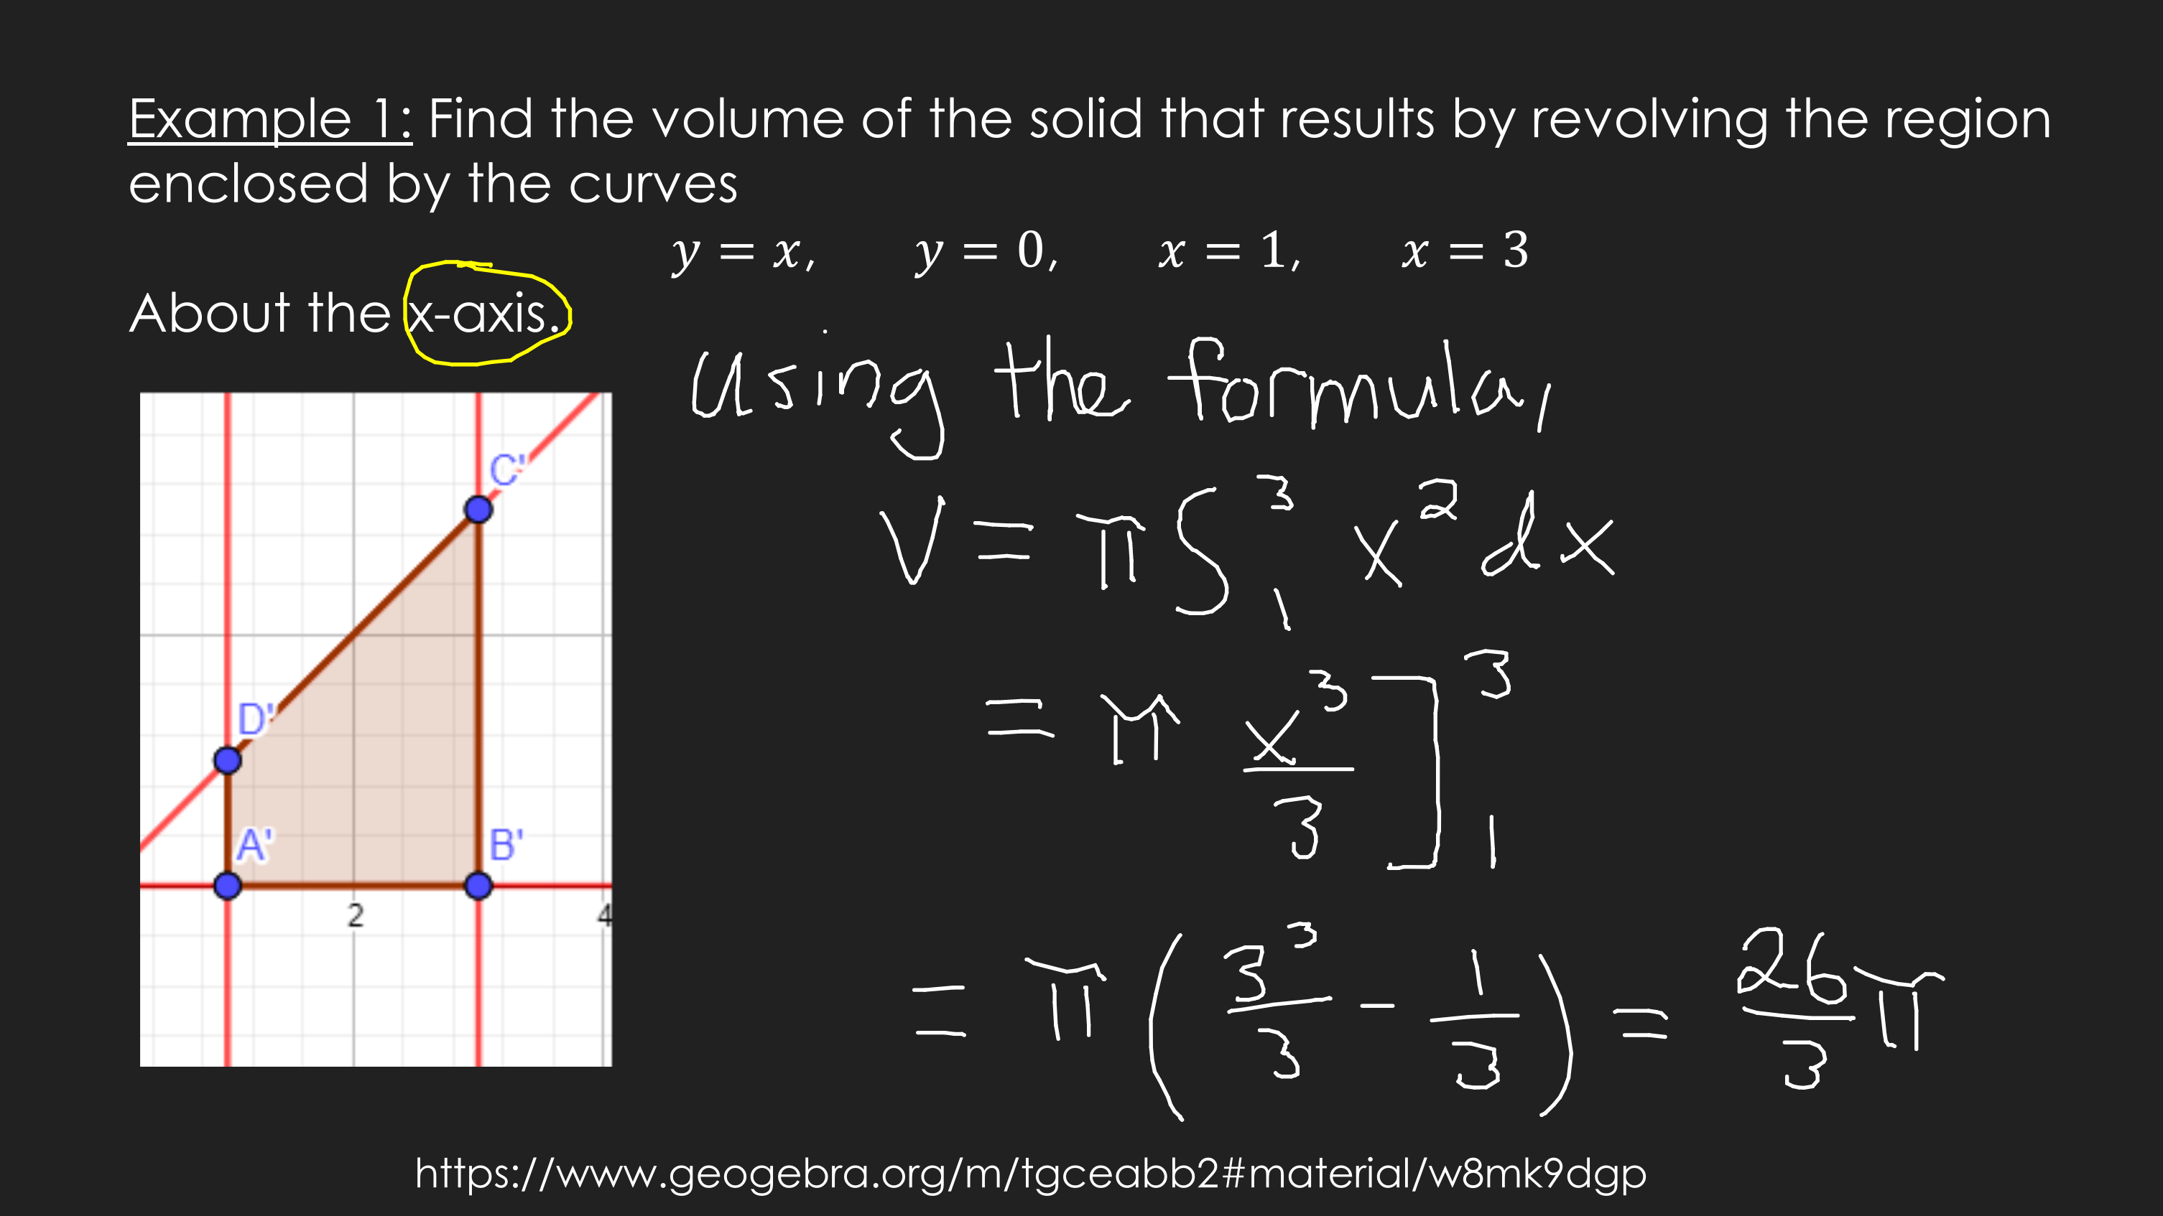

Slide 21
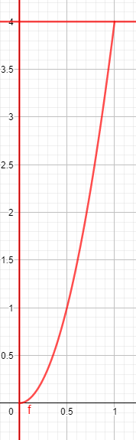

Example 2: Find the volume of the solid that results by revolving the region enclosed by the curves
$y=4x^{2}$, $x=0$, $y=4$
About the y-axis.
First draw the region.
https://www.geogebra.org/m/tgceabb2#material/w8mk9dgp

Slide 22
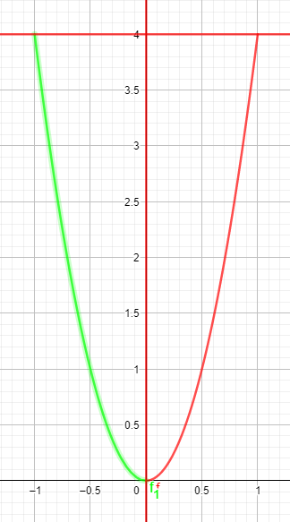
Example 2: Find the volume of the solid that results by revolving the region enclosed by the curves
$y=4x^{2}$, $x=0$, $y=4$
About the y-axis.
First draw the region.
Rotation about y-axis
https://www.geogebra.org/m/tgceabb2#material/w8mk9dgp

Slide 23
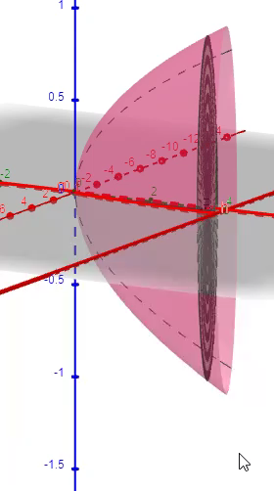
Example 2: Find the volume of the solid that results by revolving the region enclosed by the curves
$y=4x^{2}$, $x=0$, $y=4$
About the y-axis.
First draw the region.
Furthermore, 3-D
https://www.geogebra.org/m/tgceabb2#material/w8mk9dgp

Slide 24
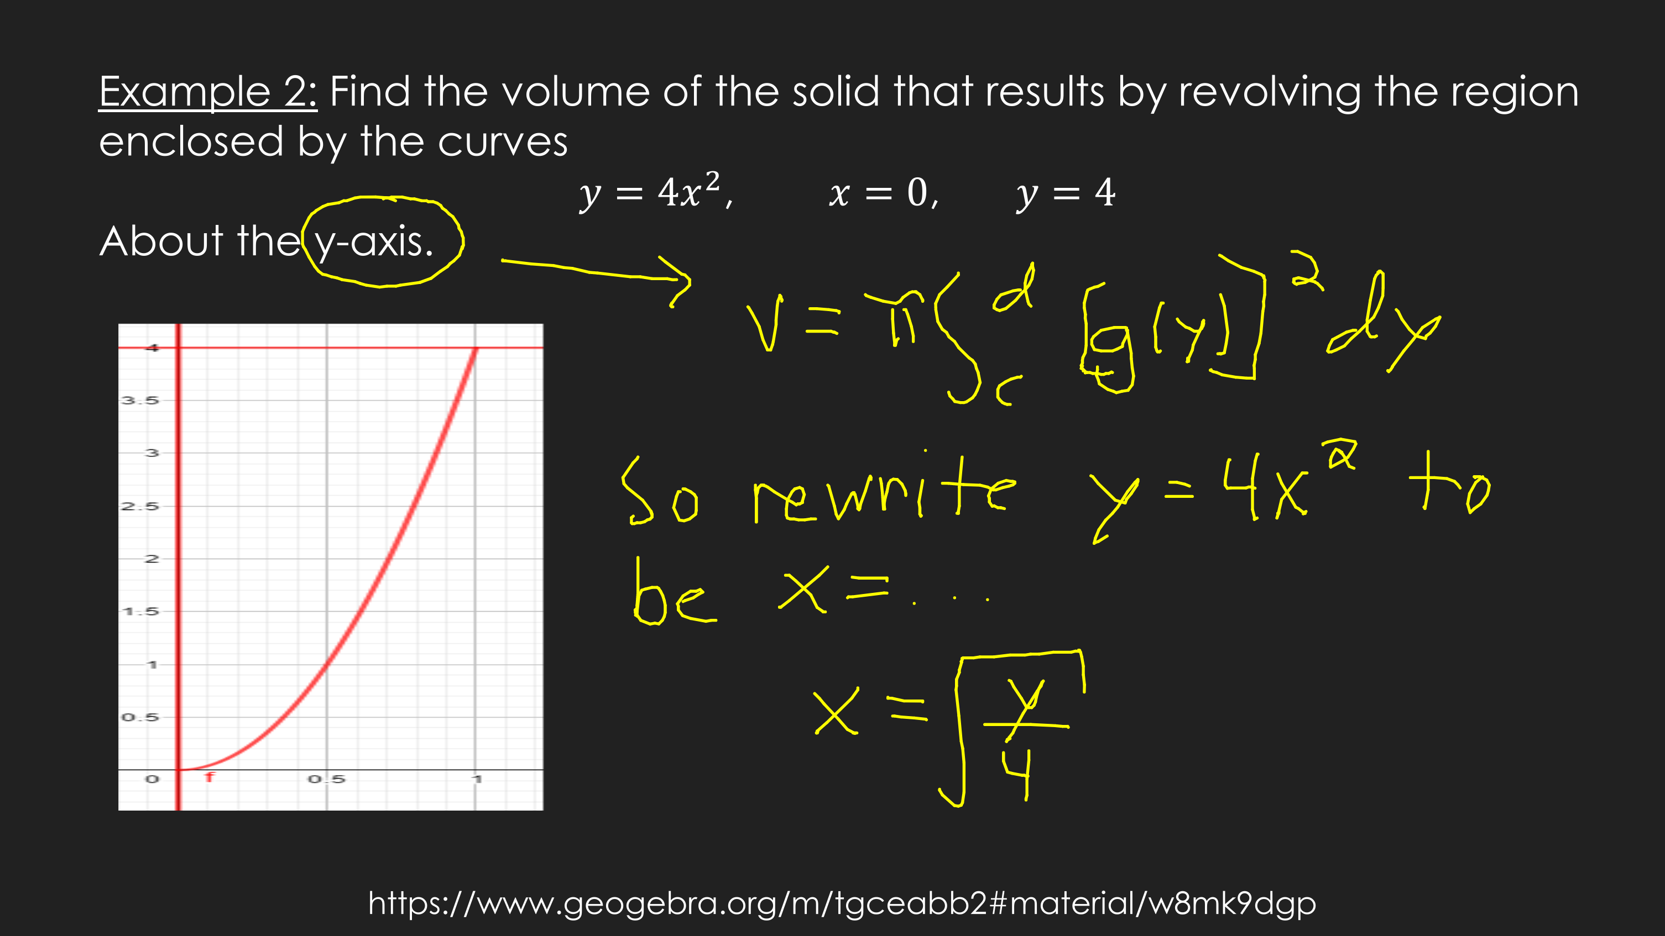

Slide 25
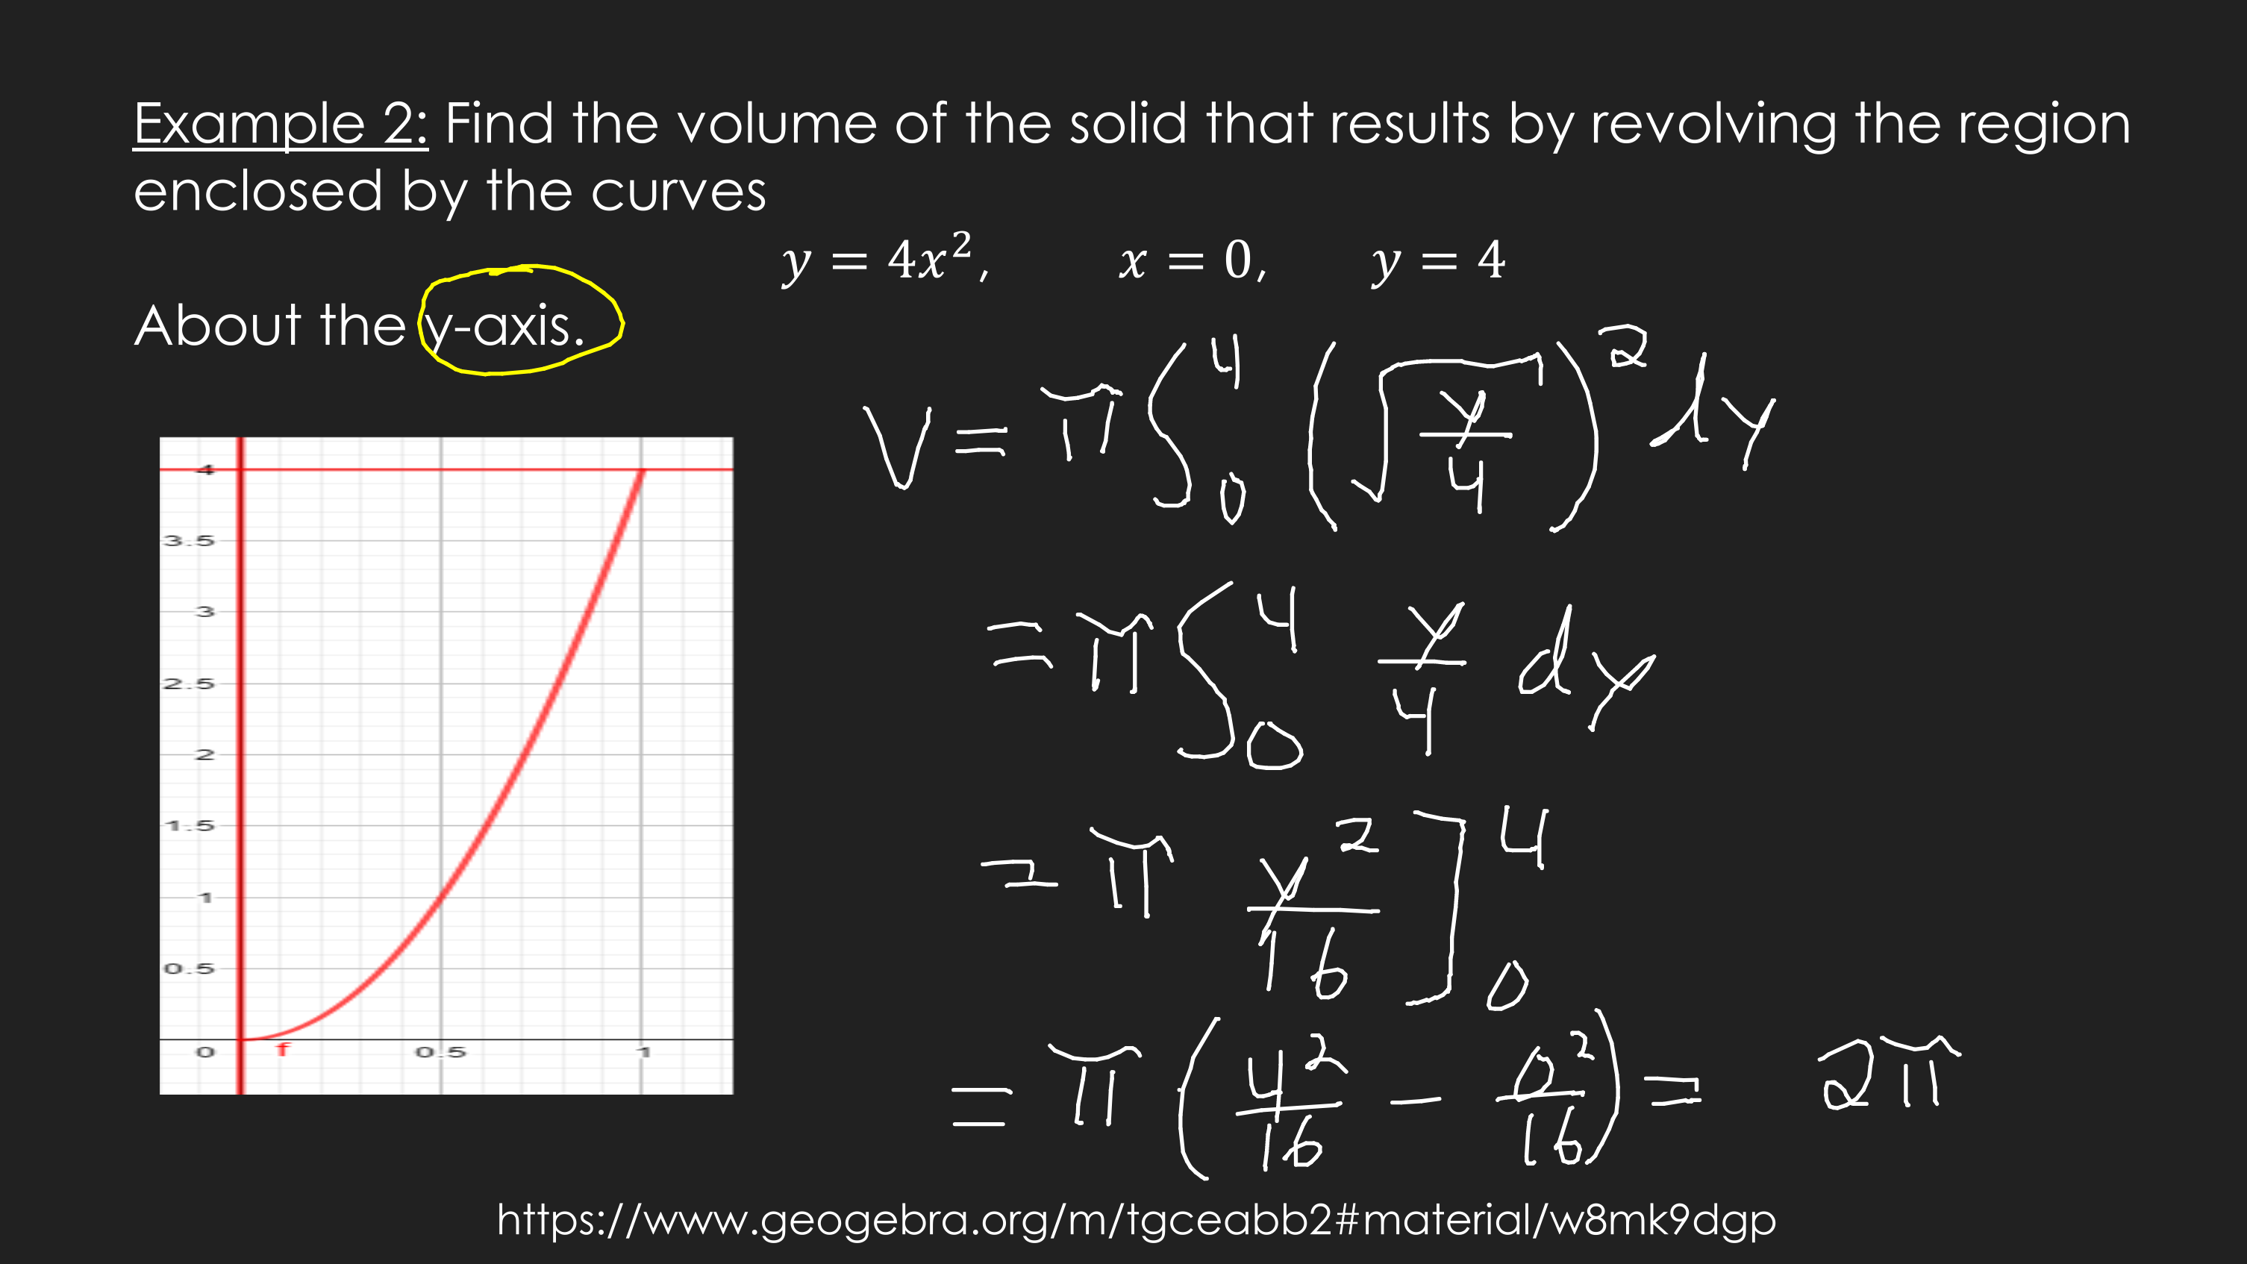

Slide 26
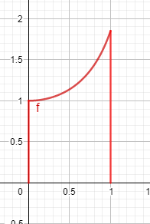

Example 3: Find the volume of the solid that results by revolving the region enclosed by the curves
$y=sec⁡(x)$, $y=0$, $x=0$, $x=1$
About the x-axis.
First draw the region.
https://www.geogebra.org/m/tgceabb2#material/vte3zdjx

Slide 27
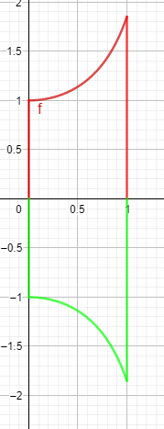
Example 3: Find the volume of the solid that results by revolving the region enclosed by the curves
$y=sec⁡(x)$, $y=0$, $x=0$, $x=1$
About the x-axis.
First draw the region.
Rotation about x-axis
https://www.geogebra.org/m/tgceabb2#material/vte3zdjx

Slide 28
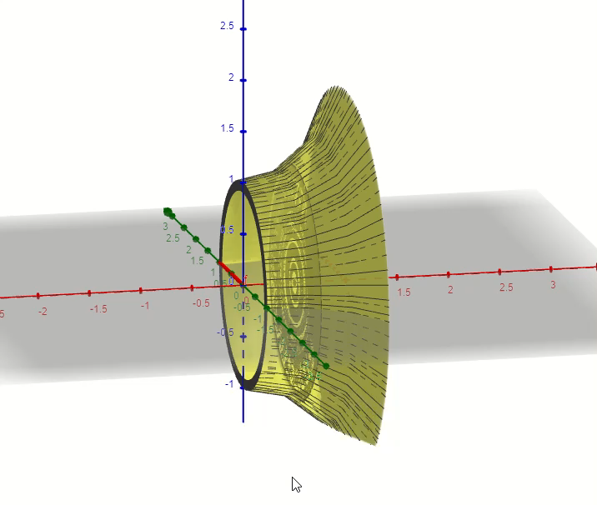
Example 3: Find the volume of the solid that results by revolving the region enclosed by the curves
$y=sec⁡(x)$, $y=0$, $x=0$, $x=1$
About the x-axis.
First draw the region.
Furthermore, 3-D
https://www.geogebra.org/m/tgceabb2#material/vte3zdjx

Slide 29
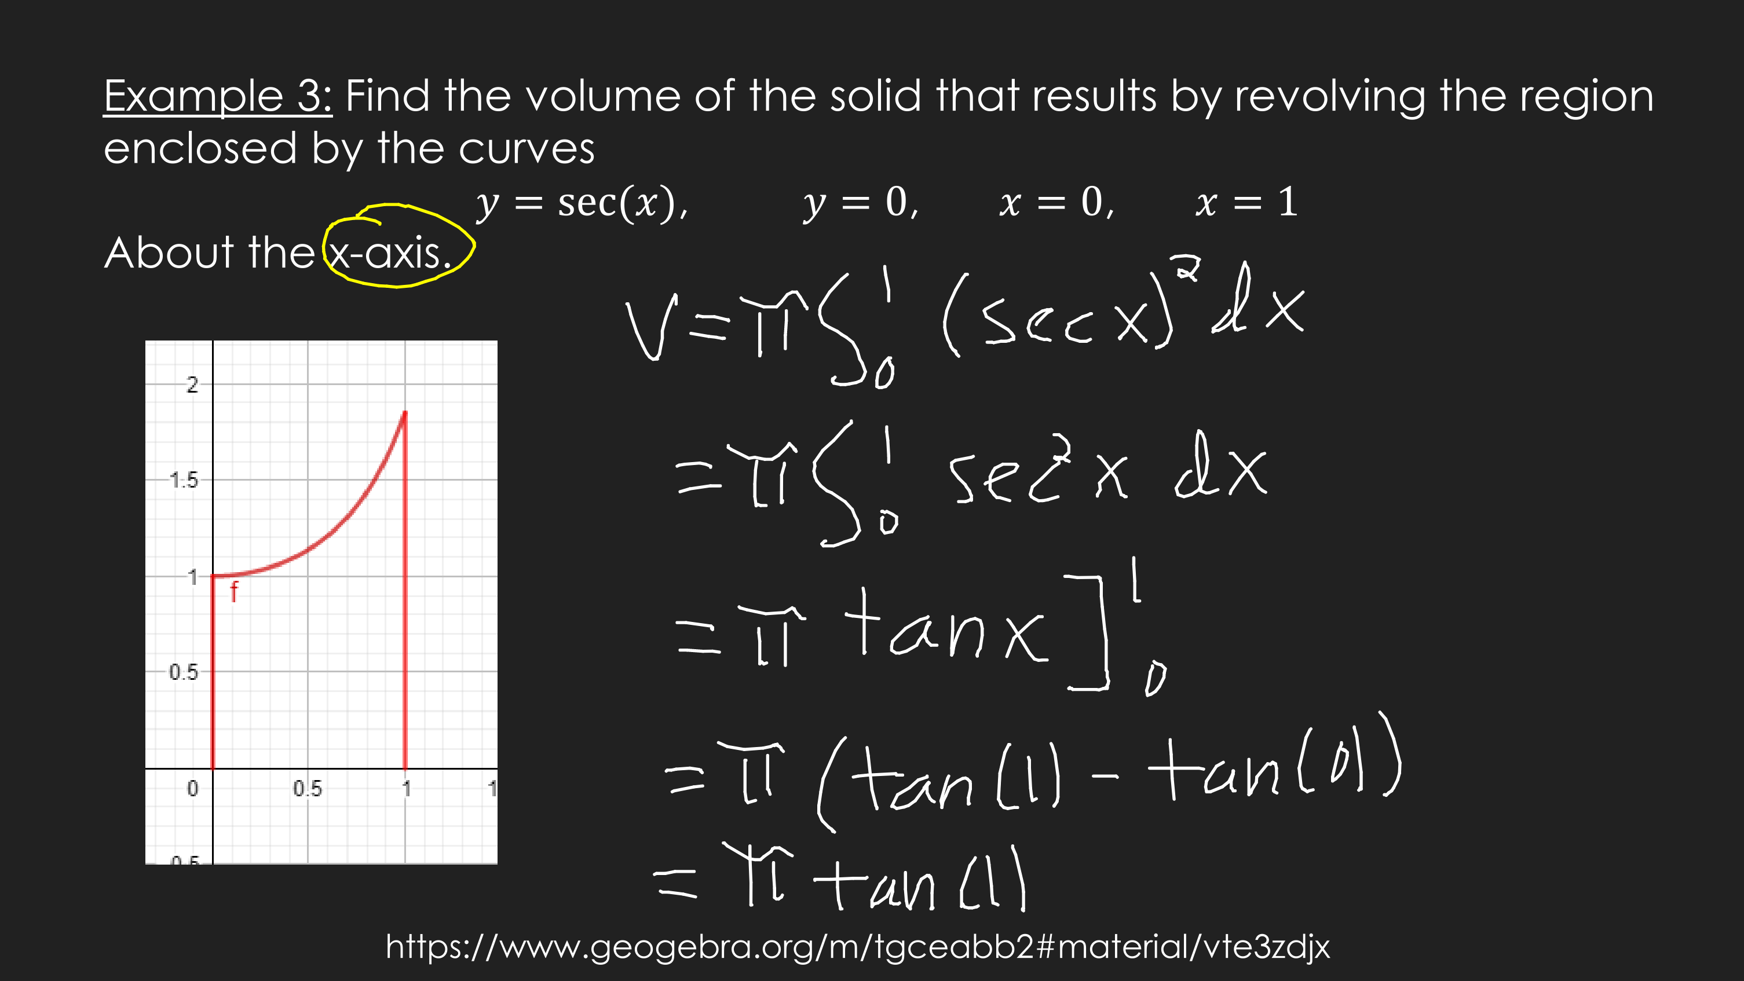

Slide 30
GeoGebra Link for Lesson 12
https://www.geogebra.org/m/tgceabb2
Note click on the play buttons on the left-most screen and the animation will play/pause.

