Slide 1
MA 16020: Lesson 17 Volume By Revolution Shell Method Pt 1: Rotation around the x- or y-axis
By Alexandra Cuadra

Slide 2
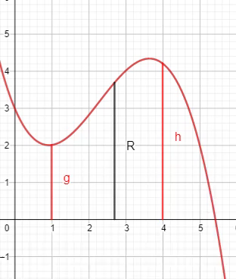
So far…
We have learned how to find the volume of a solid of revolution by integrating
In the same way, we calculate the area under a curve
Running a line segment of varying length across the region, and adding them up
https://www.geogebra.org/m/tgceabb2#material/tnnhu7gz

Slide 3
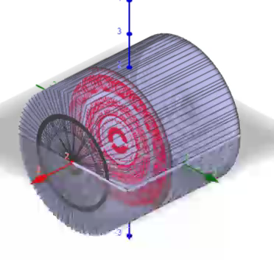
In other words,
We learned to find the volume of a solid of revolution by
Running some area across a shape and add them up.
Like in the case of the cylinder shown on the right.
https://www.geogebra.org/m/tgceabb2#material/qcwutumt

Slide 4


But what were those “shapes”? ANSWER: CROSS-SECTIONS
Sometimes it was a disk
Whose area is $πR^{2}$
Sometimes it was a washer
Whose area is $π{(R}^{2}−r^{2})$
R
R
r

Slide 5
In Today’s Lecture, we will be covering the case, when neither method (Disk nor Washer) is easy.

Slide 6

Example 1: Find the volume obtained by revolving the region bounded by the curves
$y=2x^{2}−x^{3}$ and $y=0$
About the y-axis.
https://www.geogebra.org/m/jqfyndpu

Slide 7
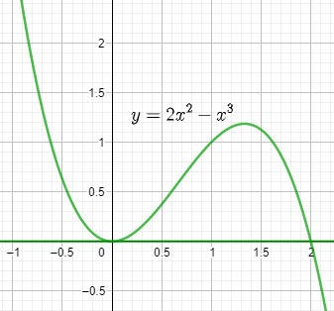
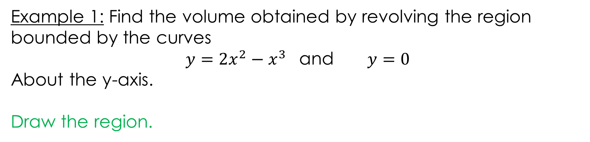
Example 1: Find the volume obtained by revolving the region bounded by the curves
$y=2x^{2}−x^{3}$ and $y=0$
About the y-axis.
Draw the region.
https://www.geogebra.org/m/jqfyndpu

Slide 8
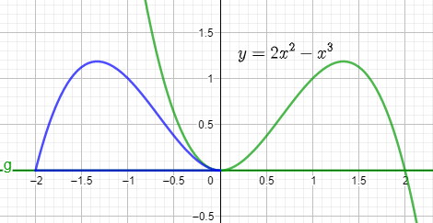
Example 1: Find the volume obtained by revolving the region bounded by the curves
$y=2x^{2}−x^{3}$ and $y=0$
About the y-axis.
Rotation about y-axis
https://www.geogebra.org/m/jqfyndpu

Slide 9
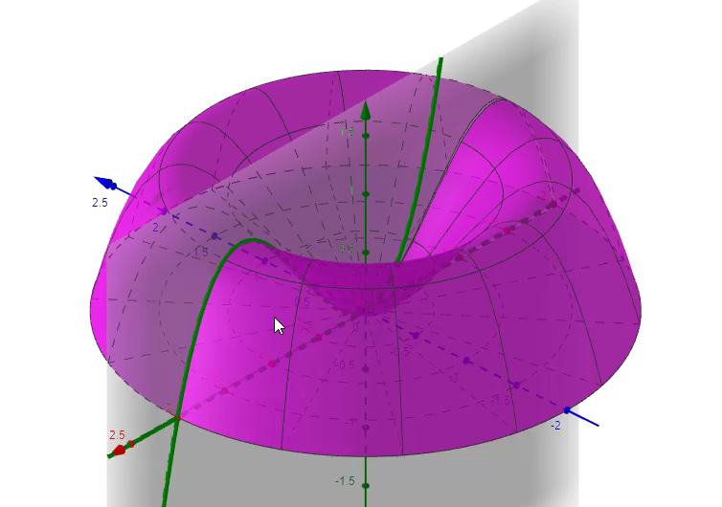
Example 1: Find the volume obtained by revolving the region bounded by the curves
$y=2x^{2}−x^{3}$ and $y=0$
About the y-axis.
WASHER ???
Furthermore, 3-D
https://www.geogebra.org/m/jqfyndpu

Slide 10
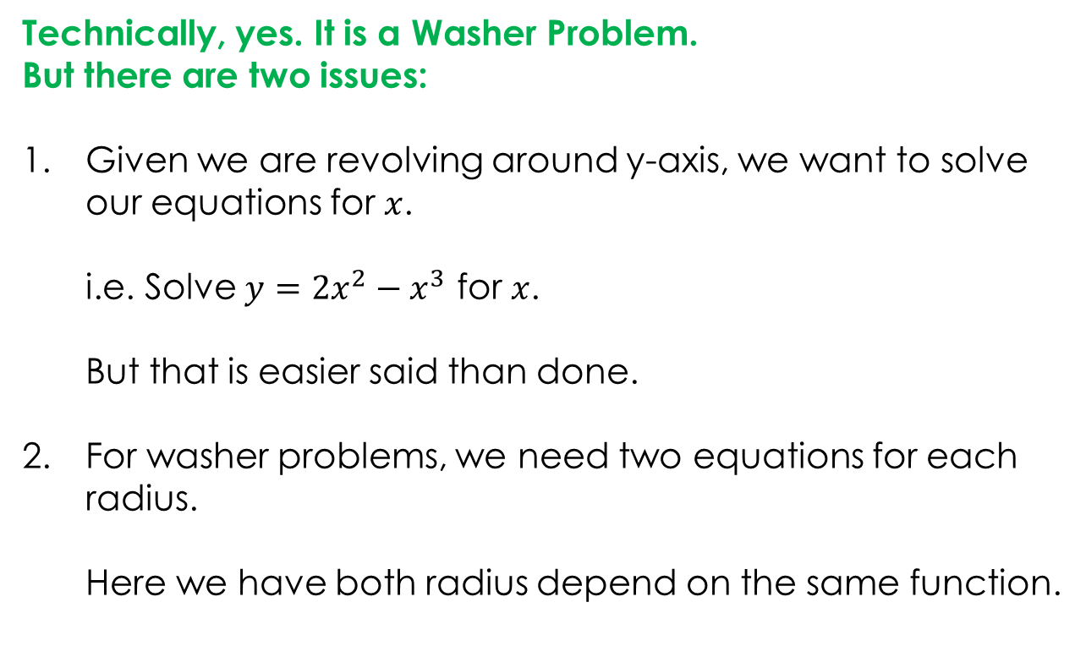
Example 1: Find the volume obtained by revolving the region bounded by the curves
$y=2x^{2}−x^{3}$ and $y=0$
About the y-axis.
Technically, yes. It is a Washer Problem.
But there are two issues:
Given we are revolving around y-axis, we want to solve our equations for $x$.
i.e. Solve $y=2x^{2}−x^{3}$ for $x$.
But that is easier said than done.
For washer problems, we need two equations for each radius.
Here we have both radius depend on the same function.
https://www.geogebra.org/m/jqfyndpu

Slide 11
So how can I do this kind of problem without giving myself a headache?
ANSWER: SHELL METHOD

Slide 12
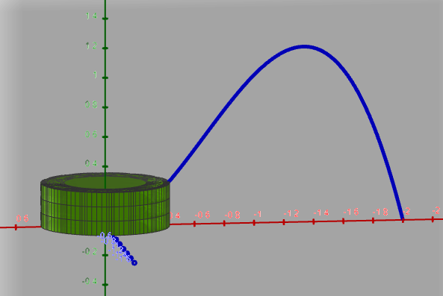
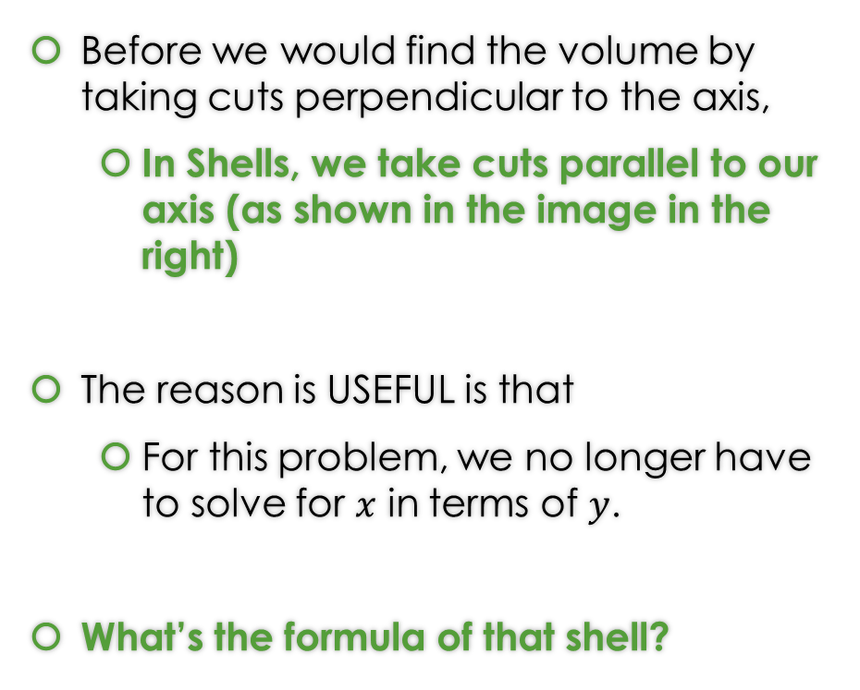
What’s a (Cylindrical) Shell?
Before we would find the volume by taking cuts perpendicular to the axis,
In Shells, we take cuts parallel to our axis (as shown in the image in the right)
The reason is USEFUL is that
For this problem, we no longer have to solve for $x$ in terms of $y$.
What’s the formula of that shell?
https://www.geogebra.org/m/jqfyndpu

Slide 13


Geometry Time: Let’s Flatten the Shell …
Circumference = $2π⋅r(x)$
height
https://www.geogebra.org/m/jqfyndpu
Thickness = $Δx$

Slide 14
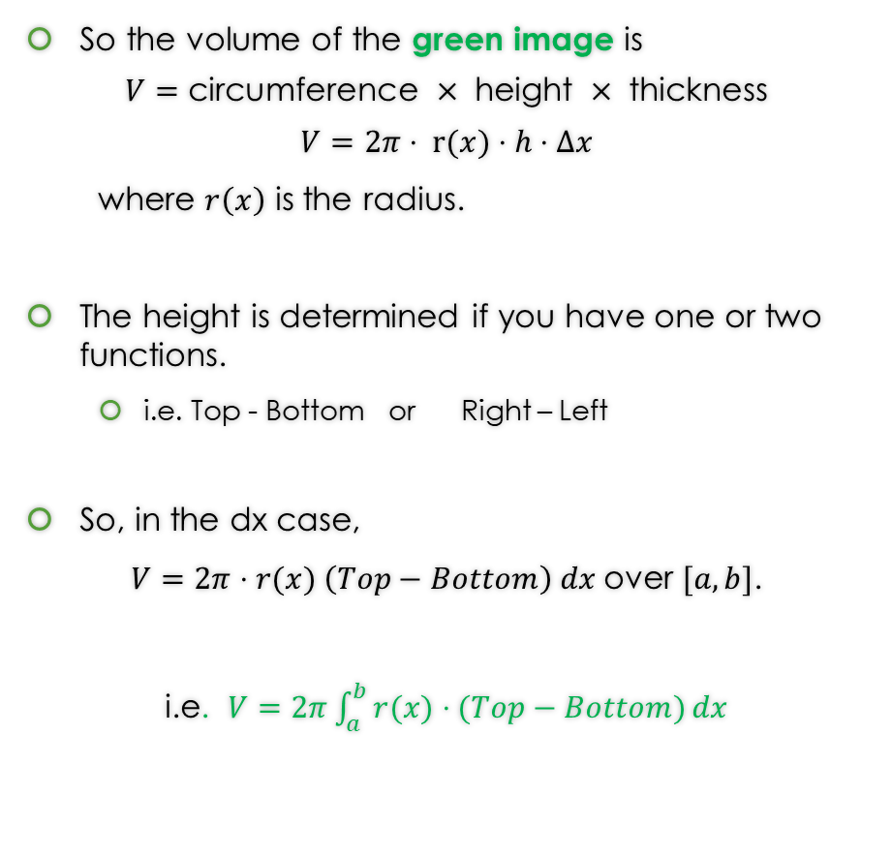


Geometry Time: Let’s Flatten the Shell …
So the volume of the green image is
$$V=\text{circumference} × \text{height} × \text{thickness}$$
$$V=2π⋅ r(x)⋅h⋅Δx$$
where $r\left(x\right)$ is the radius.
The height is determined if you have one or two functions.
i.e. Top - Bottom or Right – Left
So, in the dx case,
$V=2π⋅r(x) \left(Top−Bottom\right) dx$over $[a,b]$.
i.e. $V=2π\int_{a}^{b}{r(x)⋅(Top−Bottom)}dx$
Circumference = $2π⋅radius$
height
Thickness = $Δx$

Slide 15
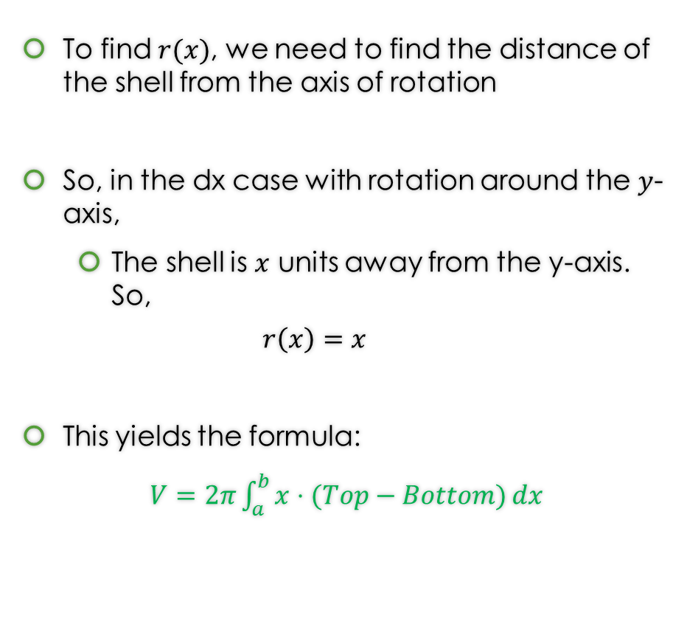

But what is the radius, $r(x)$?
To find $r(x)$, we need to find the distance of the shell from the axis of rotation
So, in the dx case with rotation around the $y$-axis,
The shell is $x$ units away from the y-axis. So,
$$r\left(x\right)=x$$
This yields the formula:
$V=2π\int_{a}^{b}{x⋅(Top−Bottom)}dx$
https://www.geogebra.org/m/jqfyndpu

Slide 16
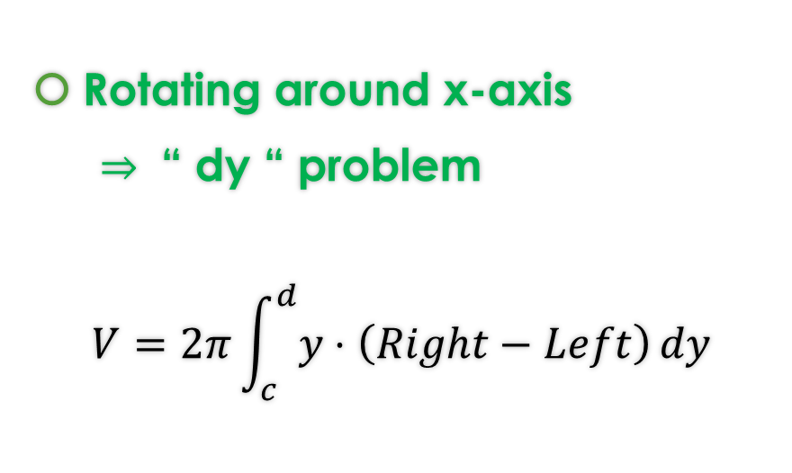

One thing about Shell Method Formulas
Since we are just cutting out parallel to the axis, we choose dx or dy in the following way:
Rotating around y-axis
$⇒$ “ dx “ problem
$$V=2π\int_{a}^{b}{x⋅(Top−Bottom)}dx$$
Rotating around x-axis
$⇒$ “ dy “ problem
$$V=2π\int_{c}^{d}{y⋅\left(Right−Left\right)}dy$$
If you need more of an explanation of where the Shell Method comes look at the hidden slides.

Slide 17
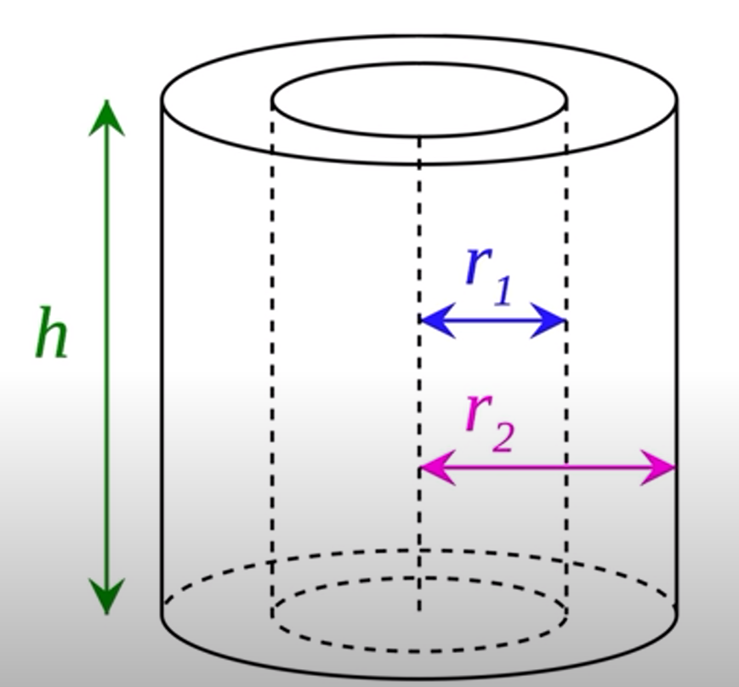
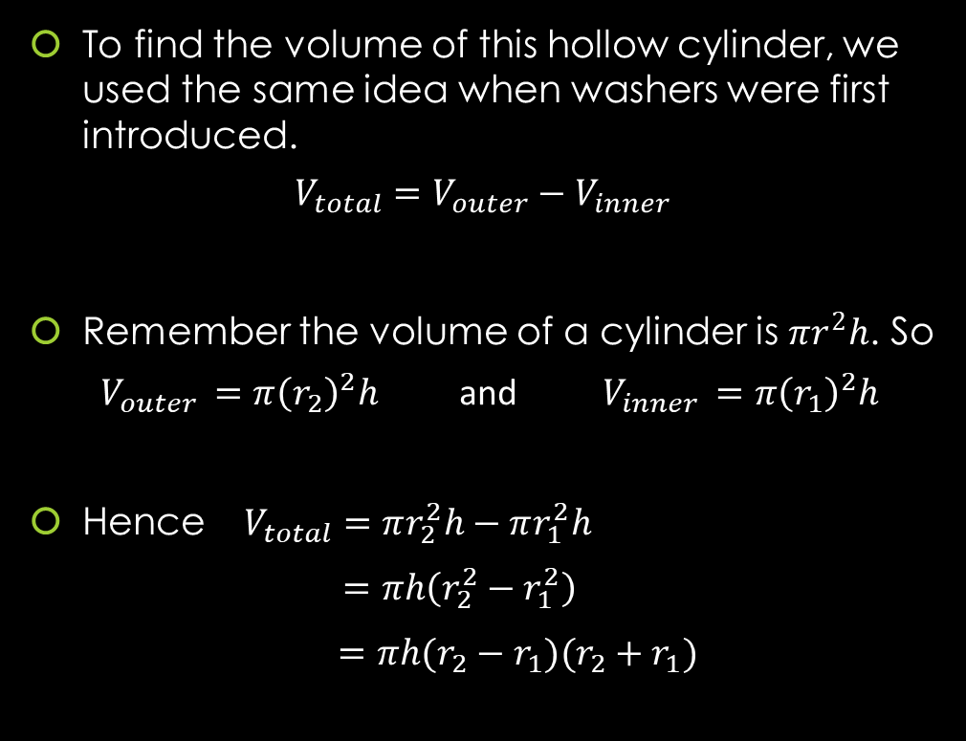
GEOMETRY: Finding The Volume of A Hollow Cylinder
To find the volume of this hollow cylinder, we used the same idea when washers were first introduced.
$$V_{total}=V_{outer}−V_{inner}$$
Remember the volume of a cylinder is $πr^{2}h$. So
$V_{outer }=π{\left(r_{2}\right)}^{2}h$ and $V_{inner }=π{\left(r_{1}\right)}^{2}h$
Hence $V_{total}=πr_{2}^{2}h−πr_{1}^{2}h$
$=πh\left(r_{2}^{2}−r_{1}^{2}\right)$
$=πh(r_{2}−r_{1})(r_{2}+r_{1})$

Slide 18
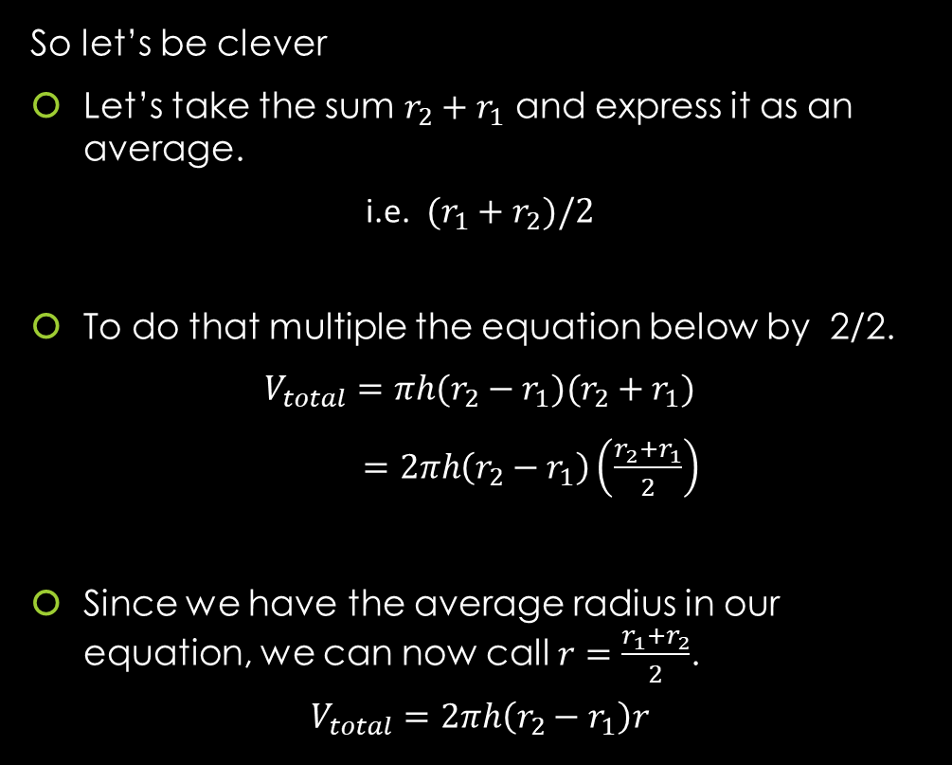
GEOMETRY: Finding The Volume of A Hollow Cylinder
So let’s be clever
Let’s take the sum $r_{2}+r_{1}$ and express it as an average.
i.e. $(r_{1}+r_{2})/2$
To do that multiple the equation below by 2/2.
$$V_{total}=πh(r_{2}−r_{1})(r_{2}+r_{1})$$
$=2πh\left(r_{2}−r_{1}\right)\left(\frac{r_{2}+r_{1}}{2}\right)$
Since we have the average radius in our equation, we can now call $r=\frac{r_{1}+r_{2}}{2}$.
$$V_{total}=2πh\left(r_{2}−r_{1}\right)r$$

Slide 19
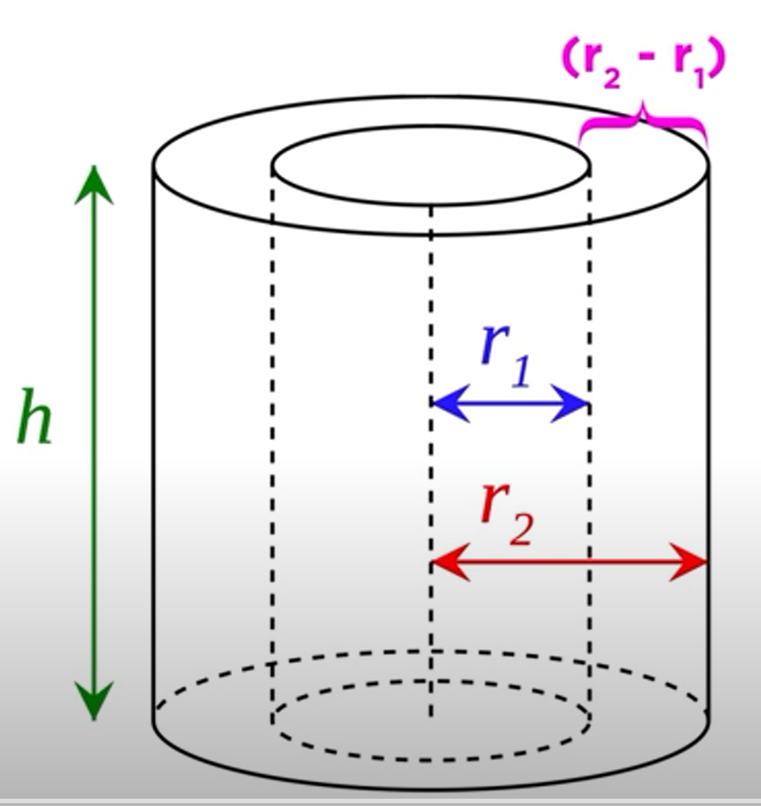
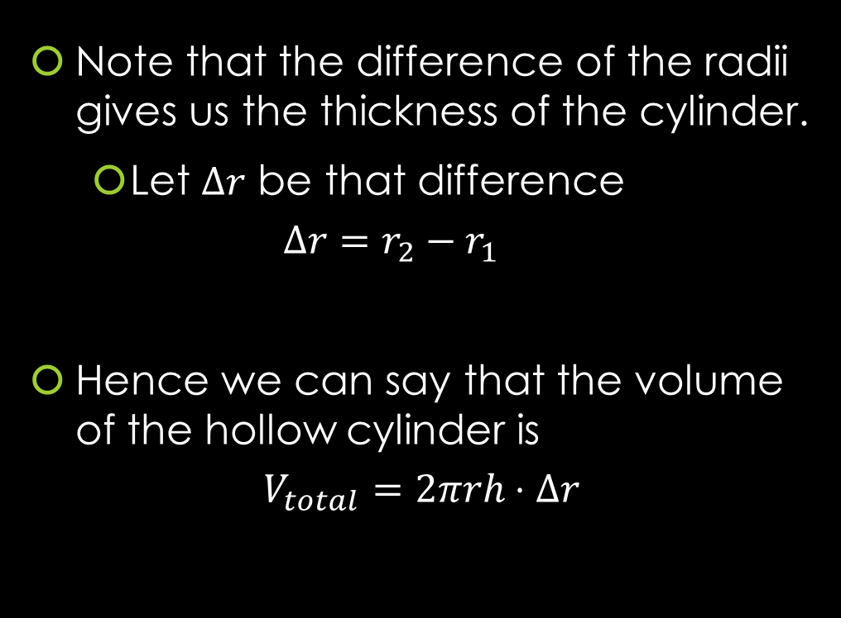
GEOMETRY: Finding The Volume of A Hollow Cylinder
Note that the difference of the radii gives us the thickness of the cylinder.
Let $Δr$ be that difference
$$Δr=r_{2}−r_{1}$$
Hence we can say that the volume of the hollow cylinder is
$$V_{total}=2πrh⋅Δr$$

Slide 20
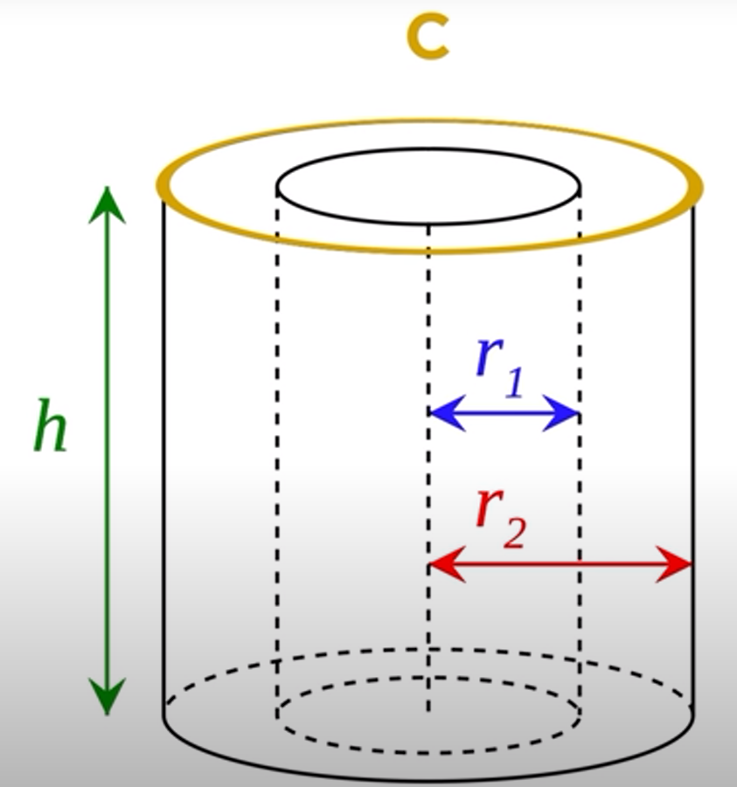
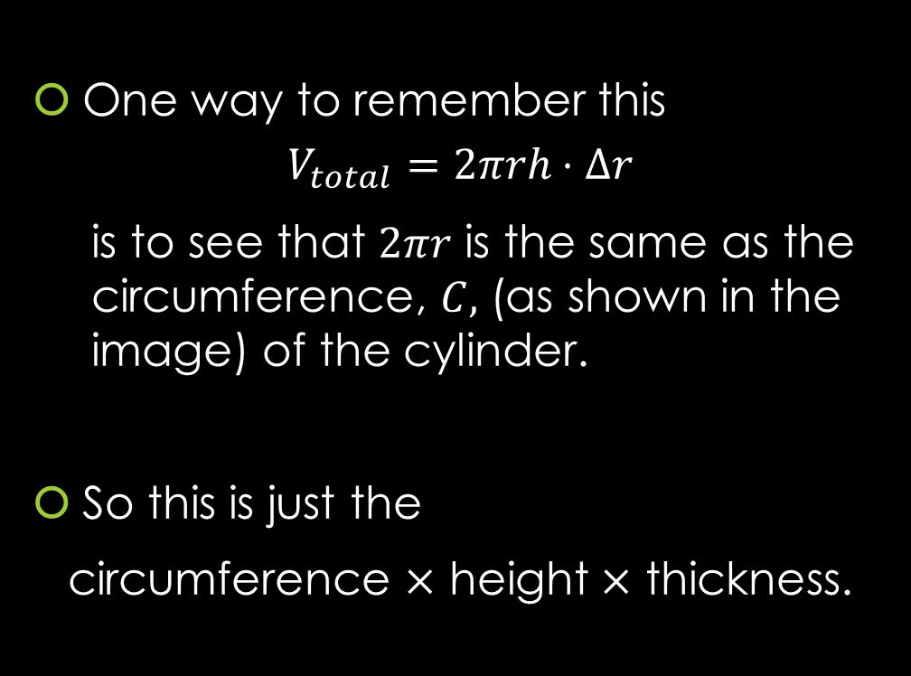
GEOMETRY: Finding The Volume of A Hollow Cylinder
One way to remember this
$$V_{total}=2πrh⋅Δr$$
is to see that $2πr$ is the same as the circumference, $C,$ (as shown in the image) of the cylinder.
So this is just the
circumference $×$ height $×$ thickness.

Slide 21
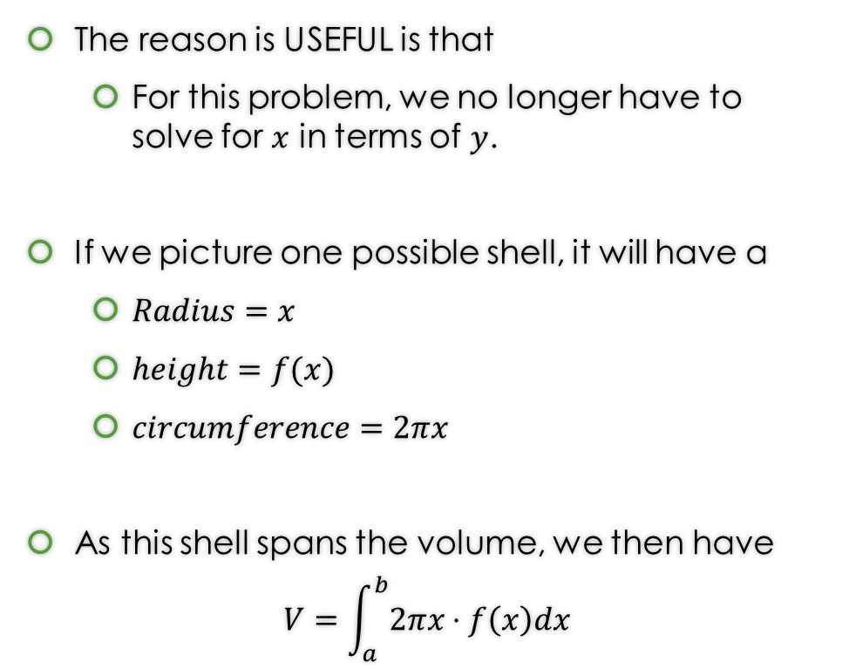
So how does this help us answer Example 1?
The reason is USEFUL is that
For this problem, we no longer have to solve for $x$ in terms of $y$.
If we picture one possible shell, it will have a
$Radius=x$
$height=f(x)$
$circumference=2πx$
As this shell spans the volume, we then have
$$V=\int_{a}^{b}{2πx⋅f\left(x\right)dx}$$
https://www.geogebra.org/m/jqfyndpu

Slide 22
Example 1: Find the volume obtained by revolving the region bounded by the curves
$y=2x^{2}−x^{3}$ and $y=0$
About the y-axis.
https://www.geogebra.org/m/jqfyndpu

Slide 23
Example 1: Find the volume obtained by revolving the region bounded by the curves
$y=2x^{2}−x^{3}$ and $y=0$
About the y-axis.
https://www.geogebra.org/m/jqfyndpu

Slide 24
Example 1: Find the volume obtained by revolving the region bounded by the curves
$y=2x^{2}−x^{3}$ and $y=0$
About the y-axis.
You can find the solution in the pdf of the notes. Click here to access it.
https://www.geogebra.org/m/jqfyndpu

Slide 25
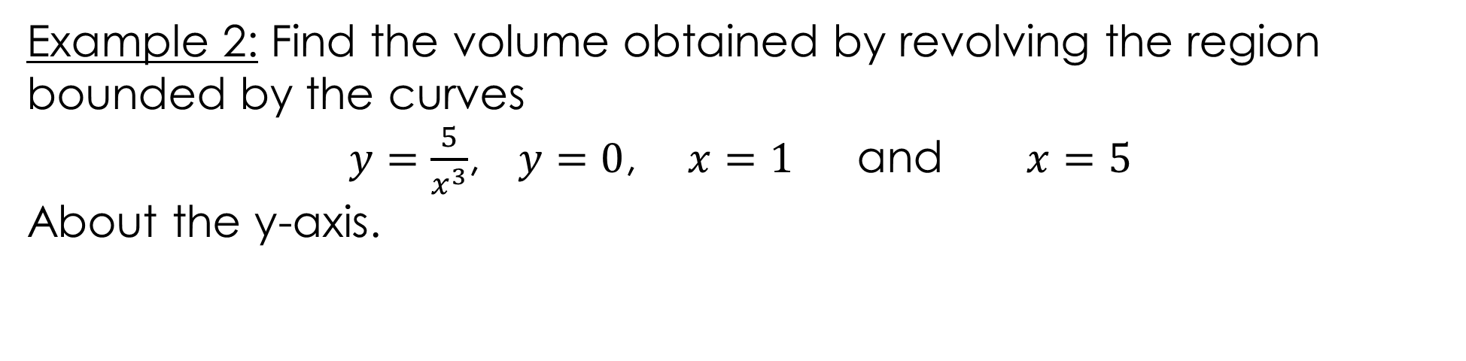
Example 2: Find the volume obtained by revolving the region bounded by the curves
$y=\frac{5}{x^{3}}$, $y=0$, $x=1$ and $x=5$
About the y-axis.
https://www.geogebra.org/m/f3wrypfh#material/aur8qe9f

Slide 26
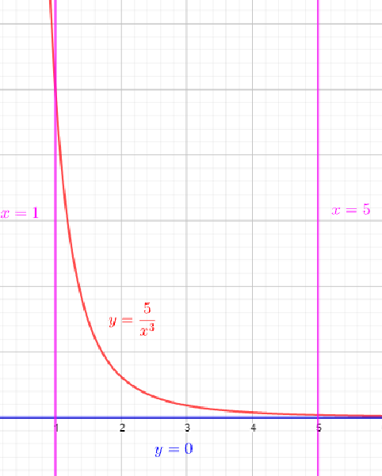
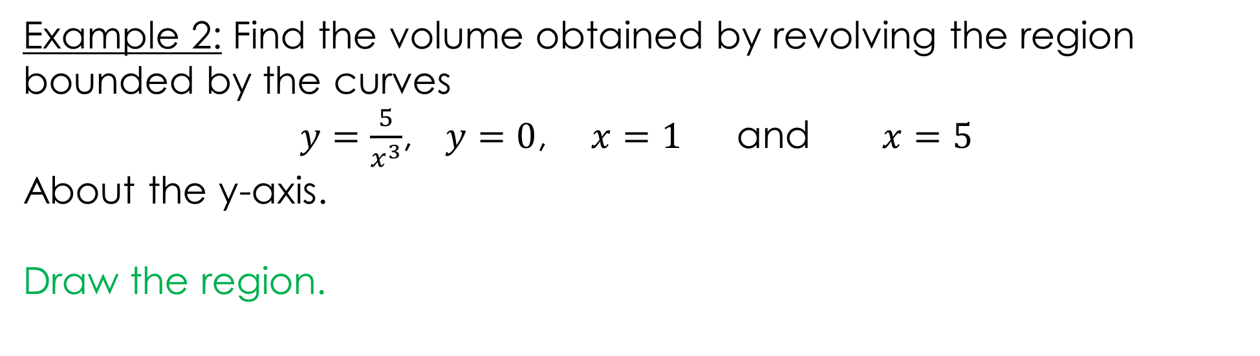
Example 2: Find the volume obtained by revolving the region bounded by the curves
$y=\frac{5}{x^{3}}$, $y=0$, $x=1$ and $x=5$
About the y-axis.
Draw the region.
https://www.geogebra.org/m/f3wrypfh#material/aur8qe9f

Slide 27
Example 2: Find the volume obtained by revolving the region bounded by the curves
$y=\frac{5}{x^{3}}$, $y=0$, $x=1$ and $x=5$
About the y-axis.
https://www.geogebra.org/m/f3wrypfh#material/aur8qe9f

Slide 28
Example 2: Find the volume obtained by revolving the region bounded by the curves
$y=\frac{5}{x^{3}}$, $y=0$, $x=1$ and $x=5$
About the y-axis.
https://www.geogebra.org/m/f3wrypfh#material/aur8qe9f

Slide 29
Example 2: Find the volume obtained by revolving the region bounded by the curves
$y=\frac{5}{x^{3}}$, $y=0$, $x=1$ and $x=5$
About the y-axis.
You can find the solution in the pdf of the notes. Click here to access it.
https://www.geogebra.org/m/f3wrypfh#material/aur8qe9f

Slide 30
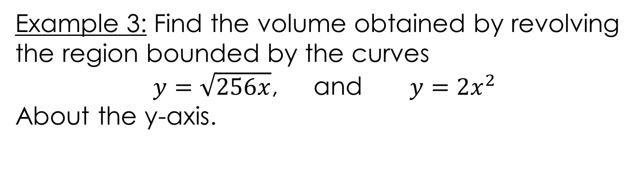
Example 3: Find the volume obtained by revolving the region bounded by the curves
$y=\sqrt{256x}$, and $y=2x^{2}$
About the y-axis.
https://www.geogebra.org/m/f3wrypfh#material/wyuzfqwb

Slide 31
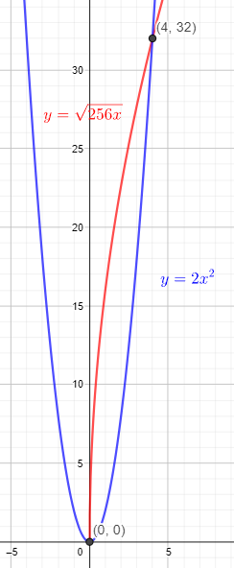
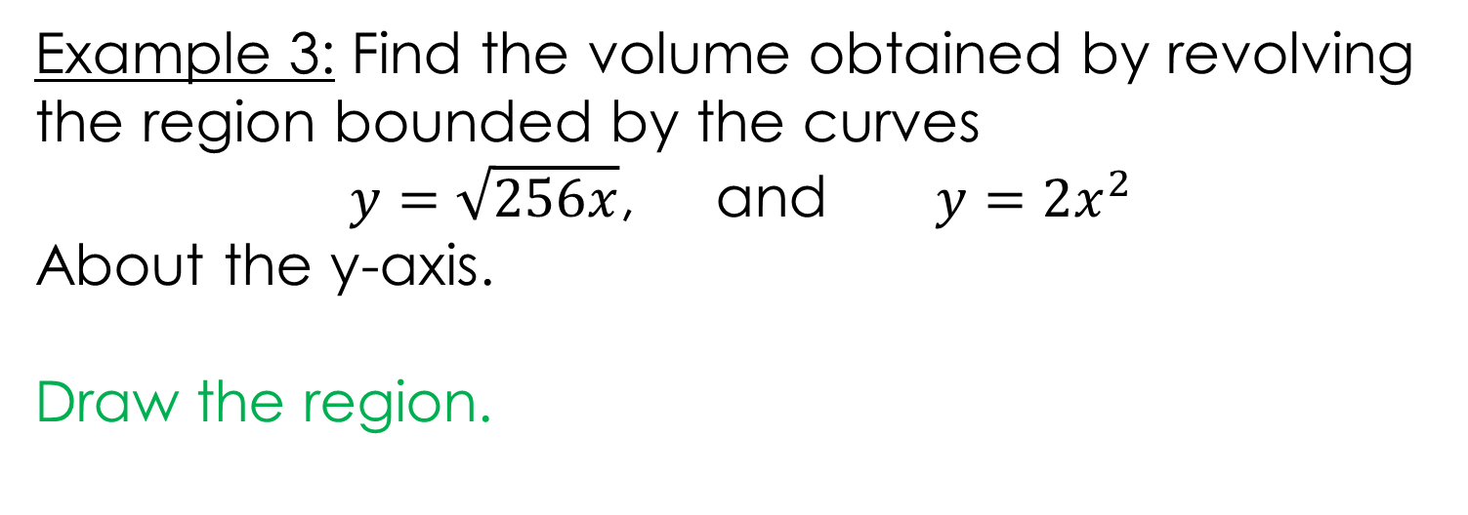
Example 3: Find the volume obtained by revolving the region bounded by the curves
$y=\sqrt{256x}$, and $y=2x^{2}$
About the y-axis.
Draw the region.
https://www.geogebra.org/m/f3wrypfh#material/wyuzfqwb

Slide 32
Example 3: Find the volume obtained by revolving the region bounded by the curves
$y=\sqrt{256x}$, and $y=2x^{2}$
About the y-axis.
https://www.geogebra.org/m/f3wrypfh#material/wyuzfqwb

Slide 33
Example 3: Find the volume obtained by revolving the region bounded by the curves
$y=\sqrt{256x}$, and $y=2x^{2}$
About the y-axis.
https://www.geogebra.org/m/f3wrypfh#material/wyuzfqwb

Slide 34
Example 3: Find the volume obtained by revolving the region bounded by the curves
$y=\sqrt{256x}$, and $y=2x^{2}$
About the y-axis.
https://www.geogebra.org/m/f3wrypfh#material/wyuzfqwb

Slide 35
Example 3: Find the volume obtained by revolving the region bounded by the curves
$y=\sqrt{256x}$, and $y=2x^{2}$
About the y-axis.
You can find the solution in the pdf of the notes. Click here to access it.
https://www.geogebra.org/m/f3wrypfh#material/wyuzfqwb

Slide 36
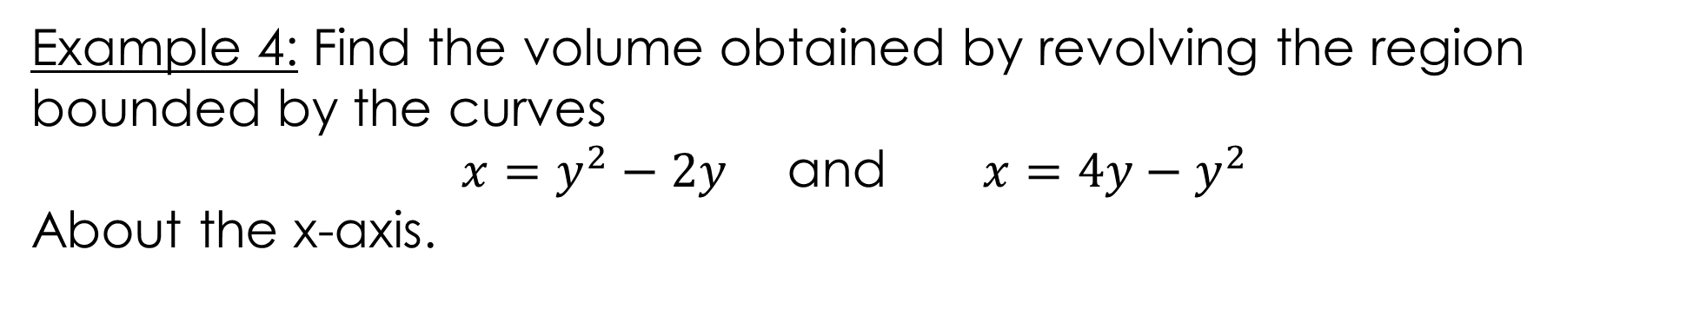
Example 4: Find the volume obtained by revolving the region bounded by the curves
$x=y^{2}−2y$ and $x=4y−y^{2}$
About the x-axis.
https://www.geogebra.org/m/f3wrypfh#material/qrar4br5

Slide 37
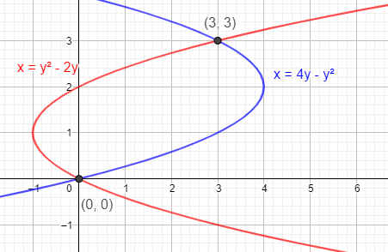
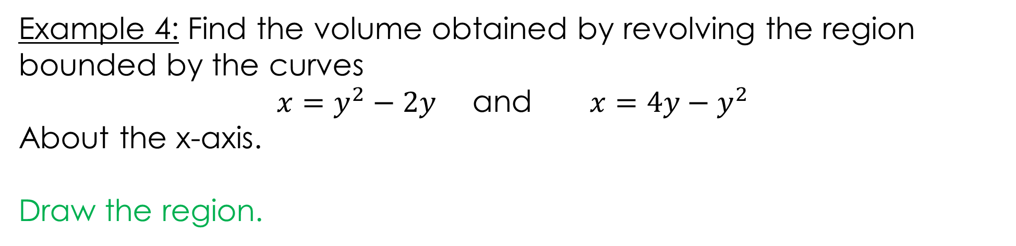

Example 4: Find the volume obtained by revolving the region bounded by the curves
$x=y^{2}−2y$ and $x=4y−y^{2}$
About the x-axis.
Draw the region.
https://www.geogebra.org/m/f3wrypfh#material/qrar4br5

Slide 38
Example 4: Find the volume obtained by revolving the region bounded by the curves
$x=y^{2}−2y$ and $x=4y−y^{2}$
About the x-axis.
https://www.geogebra.org/m/f3wrypfh#material/qrar4br5

Slide 39
Example 4: Find the volume obtained by revolving the region bounded by the curves
$x=y^{2}−2y$ and $x=4y−y^{2}$
About the x-axis.
https://www.geogebra.org/m/f3wrypfh#material/qrar4br5

Slide 40
Example 4: Find the volume obtained by revolving the region bounded by the curves
$x=y^{2}−2y$ and $x=4y−y^{2}$
About the x-axis.
https://www.geogebra.org/m/f3wrypfh#material/qrar4br5

Slide 41
Example 4: Find the volume obtained by revolving the region bounded by the curves
$x=y^{2}−2y$ and $x=4y−y^{2}$
About the x-axis.
You can find the solution in the pdf of the notes. Click here to access it.
https://www.geogebra.org/m/f3wrypfh#material/qrar4br5

Slide 42
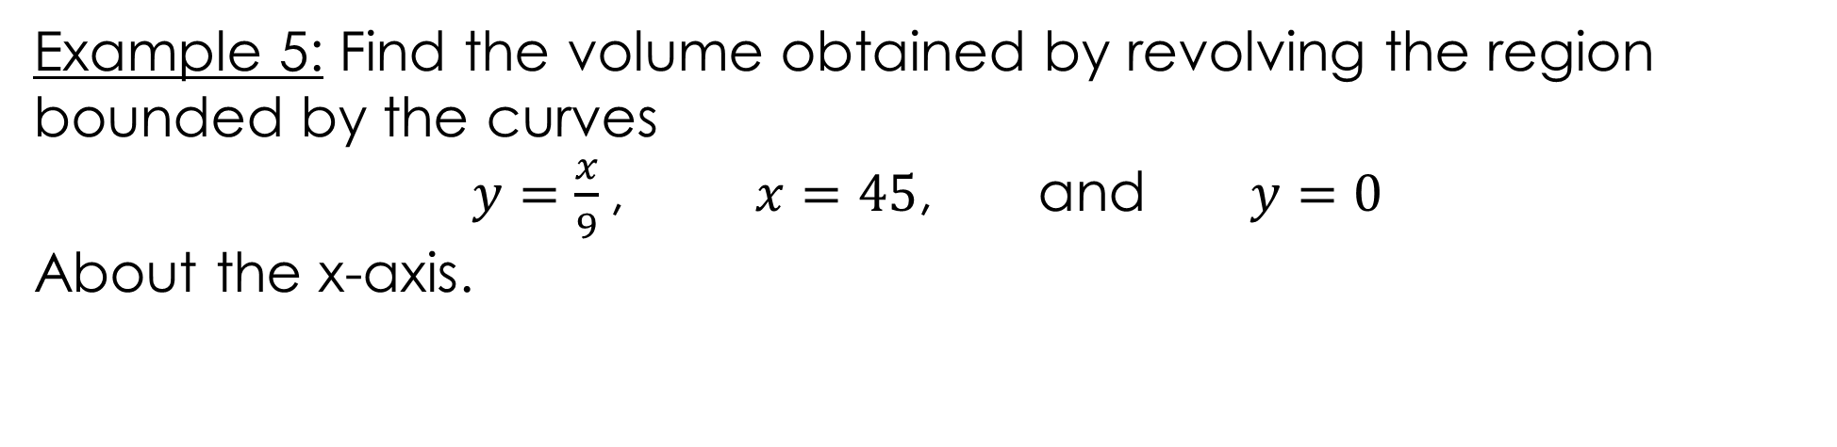
Example 5: Find the volume obtained by revolving the region bounded by the curves
$y=\frac{x}{9}$, $x=45$, and $y=0$
About the x-axis.
https://www.geogebra.org/m/f3wrypfh#material/gvkt6rya

Slide 43
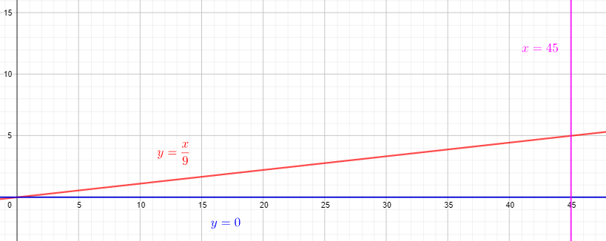

Example 5: Find the volume obtained by revolving the region bounded by the curves
$y=\frac{x}{9}$, $x=45$, and $y=0$
About the x-axis.
Draw the region.
https://www.geogebra.org/m/f3wrypfh#material/gvkt6rya

Slide 44
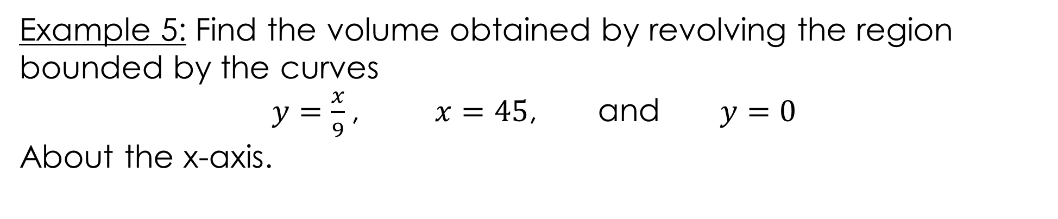
Example 5: Find the volume obtained by revolving the region bounded by the curves
$y=\frac{x}{9}$, $x=45$, and $y=0$
About the x-axis.
https://www.geogebra.org/m/f3wrypfh#material/gvkt6rya

Slide 45
Example 5: Find the volume obtained by revolving the region bounded by the curves
$y=\frac{x}{9}$, $x=45$, and $y=0$
About the x-axis.
https://www.geogebra.org/m/f3wrypfh#material/gvkt6rya

Slide 46
Example 5: Find the volume obtained by revolving the region bounded by the curves
$y=\frac{x}{9}$, $x=45$, and $y=0$
About the x-axis.
You can find the solution in the pdf of the notes. Click here to access it.
https://www.geogebra.org/m/f3wrypfh#material/gvkt6rya

Slide 47
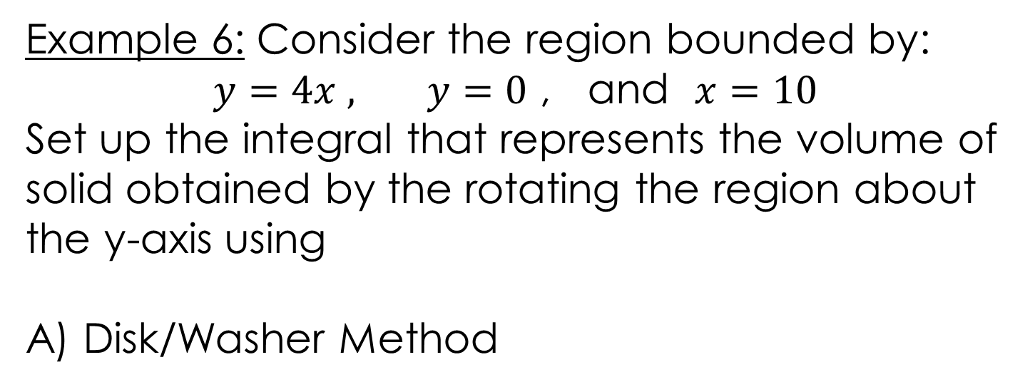
Example 6: Consider the region bounded by:
$y=4x ,$ $y=0$ , and $x=10$
Set up the integral that represents the volume of solid obtained by the rotating the region about the y-axis using
A) Disk/Washer Method
https://www.geogebra.org/m/f3wrypfh#material/cb7tfq8n

Slide 48
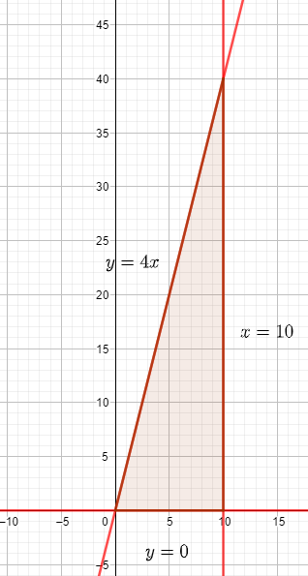
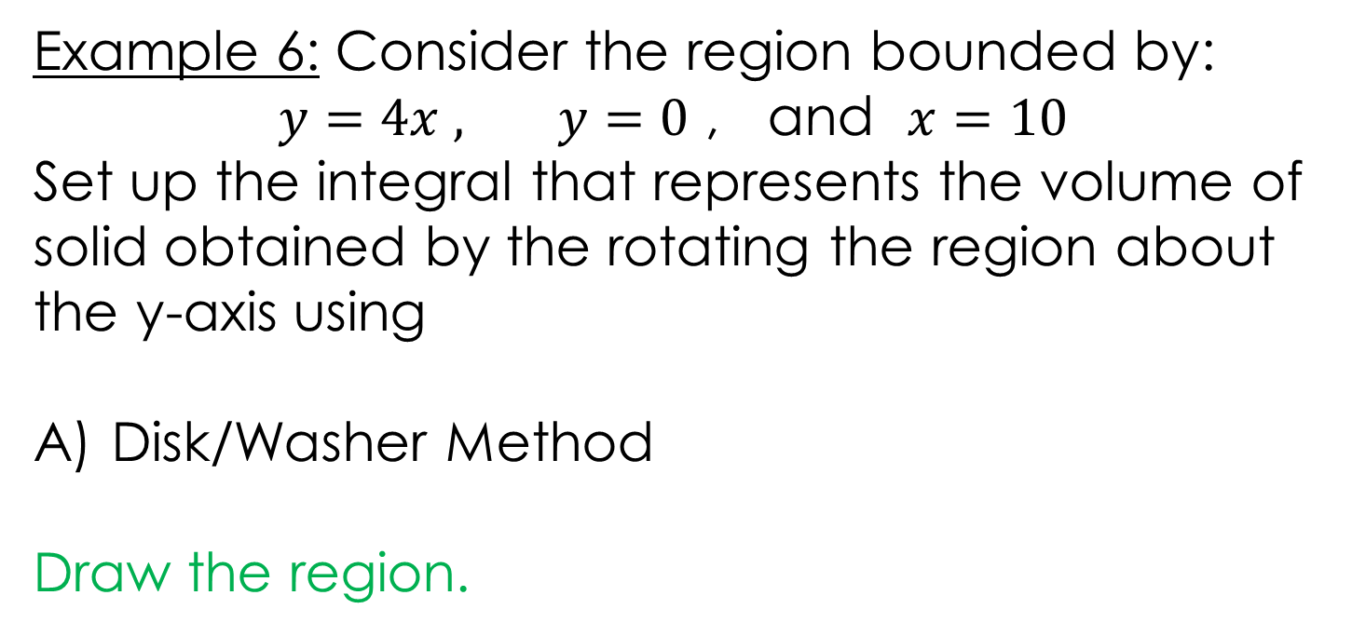

Example 6: Consider the region bounded by:
$y=4x ,$ $y=0$ , and $x=10$
Set up the integral that represents the volume of solid obtained by the rotating the region about the y-axis using
Disk/Washer Method
Draw the region.
https://www.geogebra.org/m/f3wrypfh#material/cb7tfq8n

Slide 49
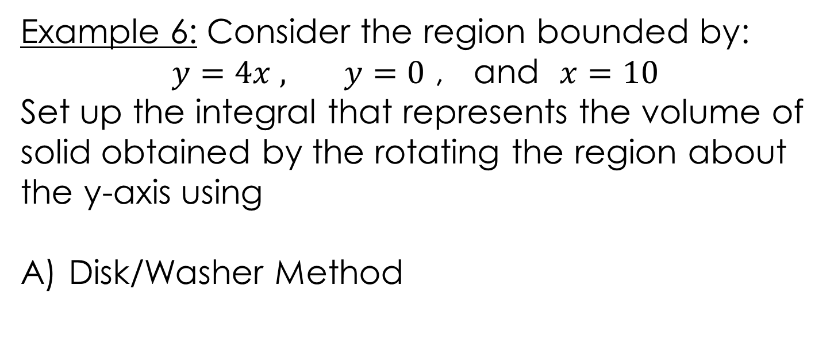
Example 6: Consider the region bounded by:
$y=4x ,$ $y=0$ , and $x=10$
Set up the integral that represents the volume of solid obtained by the rotating the region about the y-axis using
Disk/Washer Method
https://www.geogebra.org/m/f3wrypfh#material/cb7tfq8n

Slide 50
Example 6: Consider the region bounded by:
$y=4x ,$ $y=0$ , and $x=10$
Set up the integral that represents the volume of solid obtained by the rotating the region about the y-axis using
Disk/Washer Method
https://www.geogebra.org/m/f3wrypfh#material/cb7tfq8n

Slide 51
Example 6: Consider the region bounded by:
$y=4x ,$ $y=0$ , and $x=10$
Set up the integral that represents the volume of solid obtained by the rotating the region about the y-axis using
Disk/Washer Method
You can find the solution in the pdf of the notes. Click here to access it.
https://www.geogebra.org/m/f3wrypfh#material/cb7tfq8n

Slide 52
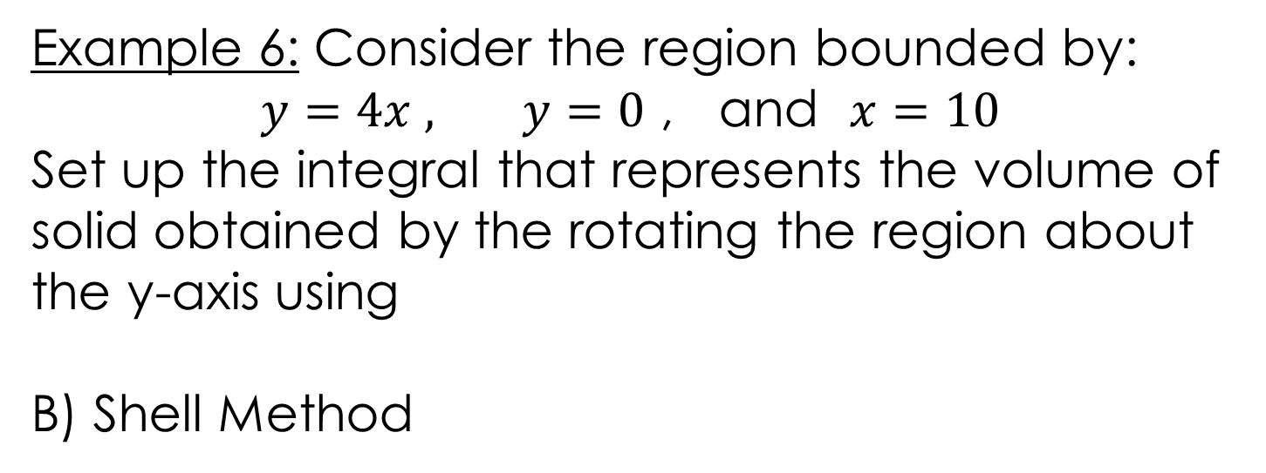
Example 6: Consider the region bounded by:
$y=4x ,$ $y=0$ , and $x=10$
Set up the integral that represents the volume of solid obtained by the rotating the region about the y-axis using
B) Shell Method
https://www.geogebra.org/m/f3wrypfh#material/cb7tfq8n

Slide 53

Example 6: Consider the region bounded by:
$y=4x ,$ $y=0$ , and $x=10$
Set up the integral that represents the volume of solid obtained by the rotating the region about the y-axis using
B) Shell Method
Draw the region.
https://www.geogebra.org/m/f3wrypfh#material/cb7tfq8n

Slide 54
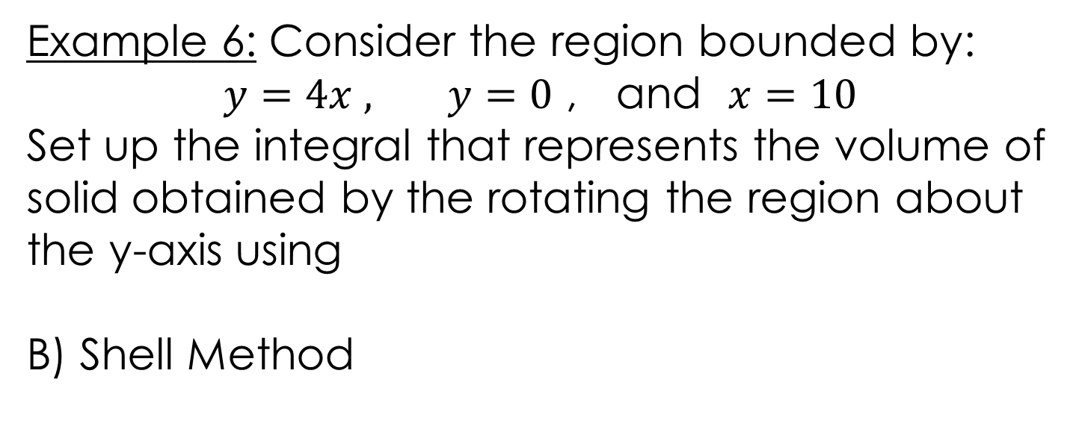
Example 6: Consider the region bounded by:
$y=4x ,$ $y=0$ , and $x=10$
Set up the integral that represents the volume of solid obtained by the rotating the region about the y-axis using
B) Shell Method
https://www.geogebra.org/m/f3wrypfh#material/cb7tfq8n

Slide 55
Example 6: Consider the region bounded by:
$y=4x ,$ $y=0$ , and $x=10$
Set up the integral that represents the volume of solid obtained by the rotating the region about the y-axis using
B) Shell Method
https://www.geogebra.org/m/f3wrypfh#material/cb7tfq8n

Slide 56
Example 6: Consider the region bounded by:
$y=4x ,$ $y=0$ , and $x=10$
Set up the integral that represents the volume of solid obtained by the rotating the region about the y-axis using
B) Shell Method
You can find the solution in the pdf of the notes. Click here to access it.
https://www.geogebra.org/m/f3wrypfh#material/cb7tfq8n

Slide 57
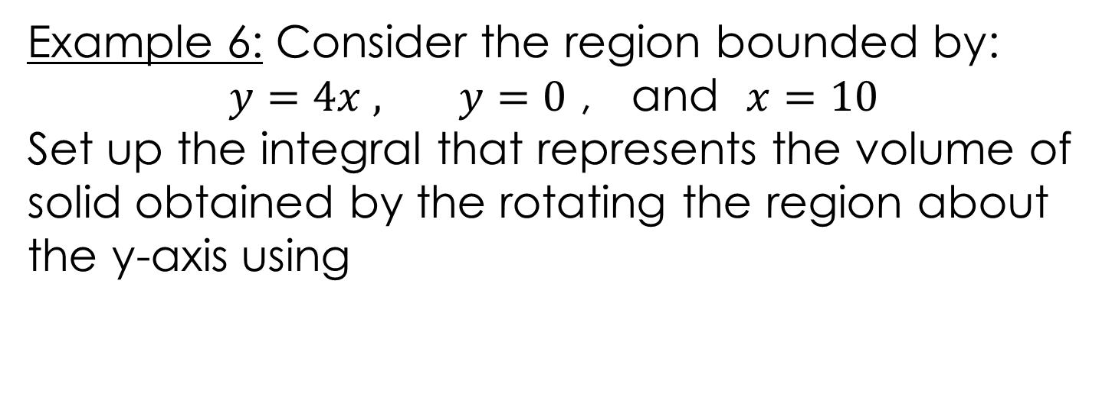
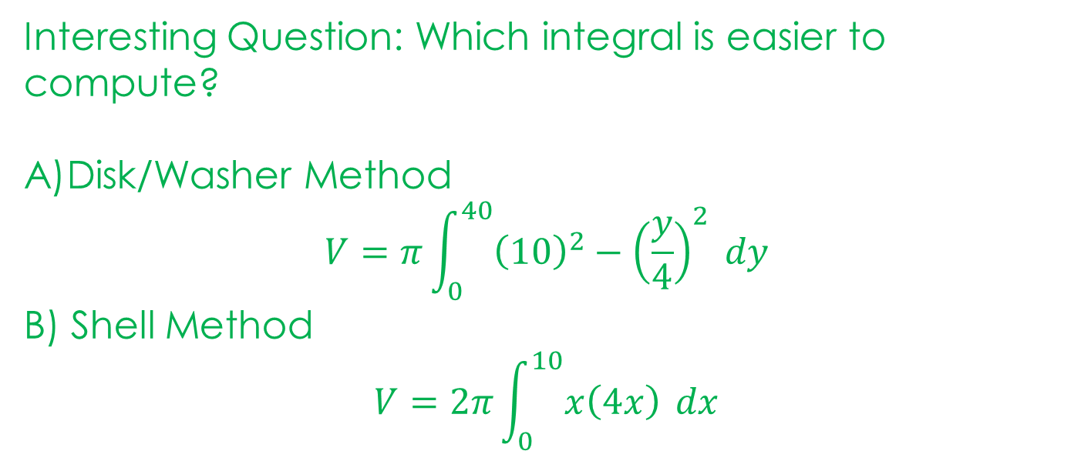
Example 6: Consider the region bounded by:
$y=4x ,$ $y=0$ , and $x=10$
Set up the integral that represents the volume of solid obtained by the rotating the region about the y-axis using
Interesting Question: Which integral is easier to compute?
Disk/Washer Method
$$V=π\int_{0}^{40}{{\left(10\right)}^{2}−{\left(\frac{y}{4}\right)}^{2} dy}$$
B) Shell Method
$$V=2π\int_{0}^{10}{x\left(4x\right)} dx$$
https://www.geogebra.org/m/f3wrypfh#material/cb7tfq8n

Slide 58
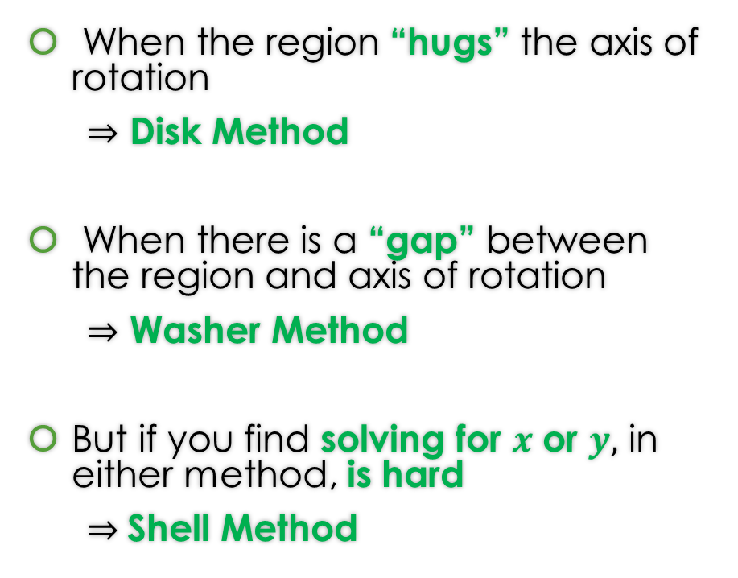
When do we apply Disk Method or Washer Method or Shell Method?
When the region “hugs” the axis of rotation
$⇒$ Disk Method
When there is a “gap” between the region and axis of rotation
$⇒$ Washer Method
But if you find solving for $x$ or $y,$ in either method, is hard
$⇒$Shell Method
 |  | Axis of Rotation
 |  | x-axis | y-axis
Method | Disk/Washer | dx | dy
 | Shells | dy | dx

Slide 59
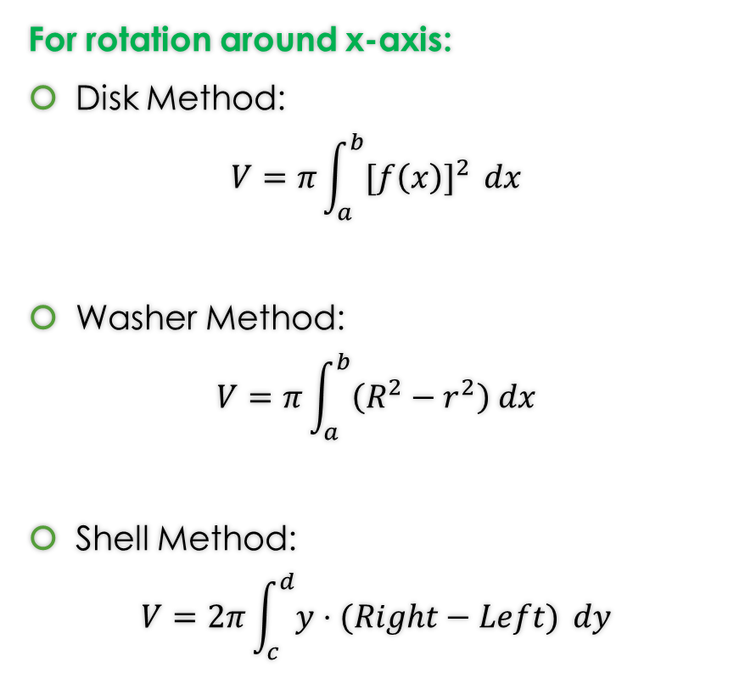

Formulas from Lessons 14 and 15 and 17 Rotation around x-axis or y-axis
For rotation around y-axis:
Disk Method:
$$V=π\int_{c}^{d}{{[g(y)]}^{2} }dy$$
Washer Method:
$$V=π\int_{c}^{d}{\left(R^{2}−r^{2}\right) dy}$$
Shell Method:
$$V=2π\int_{a}^{b}{x⋅(Top−Bottom)} dx$$
For rotation around x-axis:
Disk Method:
$$V=π\int_{a}^{b}{{[f\left(x\right)]}^{2} }dx$$
Washer Method:
$$V=π\int_{a}^{b}{\left(R^{2}−r^{2}\right) dx}$$
Shell Method:
$$V=2π\int_{c}^{d}{y⋅(Right−Left)} dy$$

Slide 60
GeoGebra Link for Lesson 17
https://www.geogebra.org/m/f3wrypfh
Note click on the play buttons on the left-most screen and the animation will play/pause.

