Slide 1
MA 16020: Lesson 18
Volume By Revolution
Shell Method
Pt 2: Rotation around any non-Axis
By Alexandra Cuadra

Slide 2

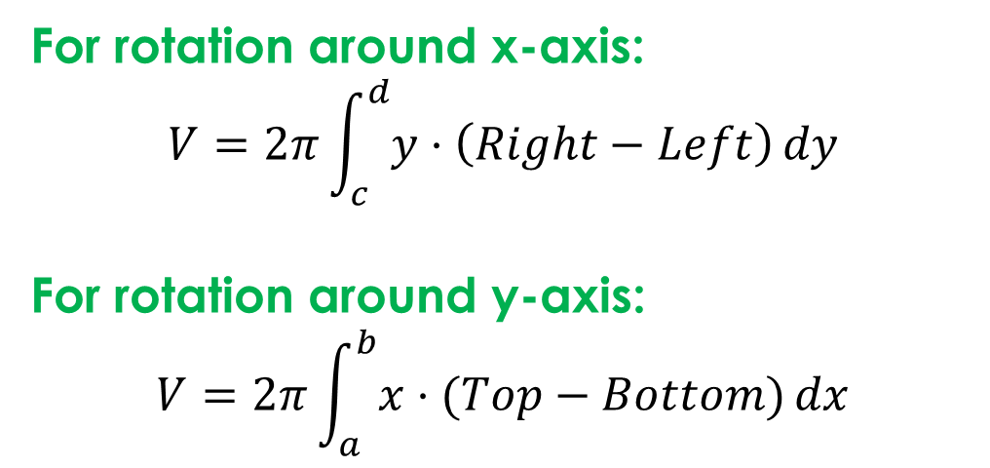
RECAP: When should I use Shell Method?
How do I use Shell Method?
If you find solving for $x$ or $y,$ for either Disk or Washer Method, is hard
$⇒$Shell Method
For rotation around x-axis:
$$V=2π\int_{c}^{d}{y⋅\left(Right−Left\right)}dy$$
For rotation around y-axis:
$$V=2π\int_{a}^{b}{x⋅(Top−Bottom)}dx$$
 |  | Axis of Rotation
 |  | x-axis | y-axis
Method | Disk/Washer | dx | dy
 | Shells | dy | dx

Slide 3
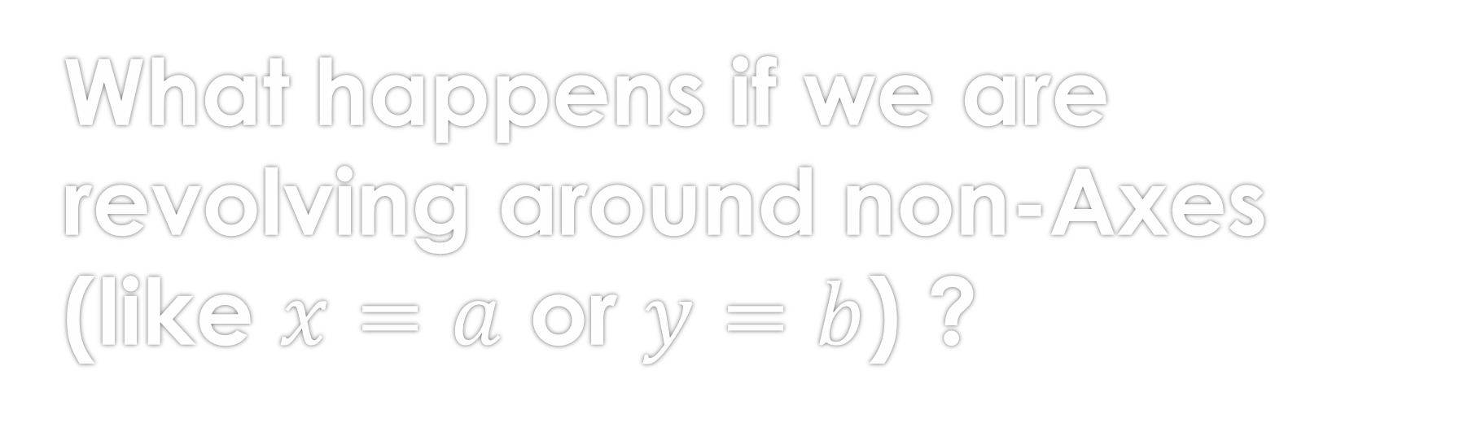
What happens if we are revolving around non-Axes (like $x=a$ or $y=b$) ?
For the most part, everything stays the same except for the RADIUS.

Slide 4
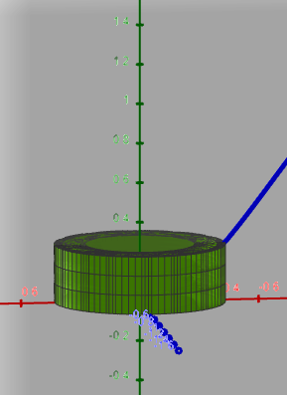
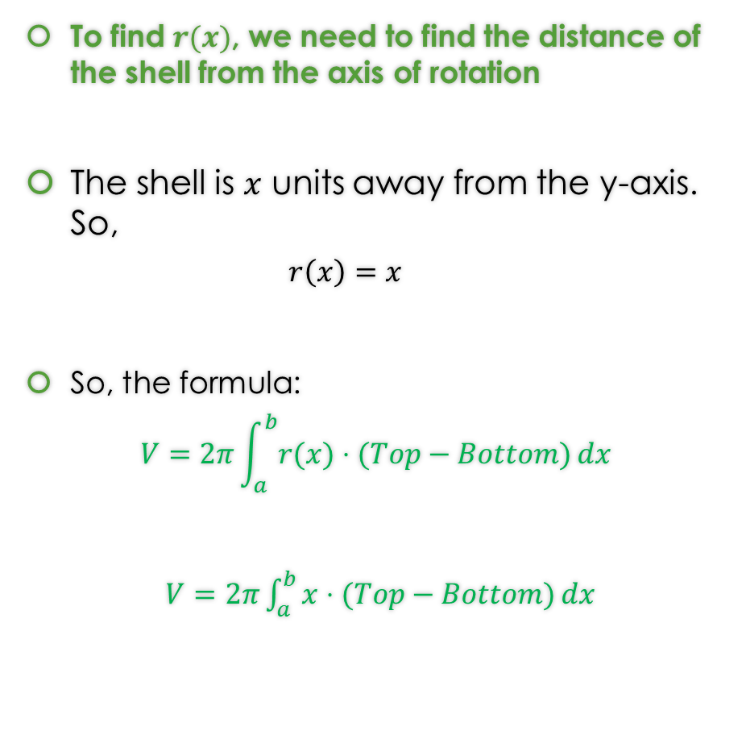

How did I find the radius, $r(x)$, last class?
To find $r(x)$, we need to find the distance of the shell from the axis of rotation
The shell is $x$ units away from the y-axis. So,
  $$r\left(x\right)=x$$
So, the formula:
$$V=2π\int_{a}^{b}{r(x)⋅(Top−Bottom)}dx$$
$V=2π\int_{a}^{b}{x⋅(Top−Bottom)}dx$
https://www.geogebra.org/m/jqfyndpu

Slide 5
How did I find the radius, $r(x)$, last class?
To find $r(x)$, we need to find the distance of the shell from the axis of rotation
The shell is $x$ units away from the y-axis. So,
  $$r\left(x\right)=x$$
So, the formula:
$$V=2π\int_{a}^{b}{r(x)⋅(Top−Bottom)}dx$$
$V=2π\int_{a}^{b}{x⋅(Top−Bottom)}dx$
https://www.geogebra.org/m/jqfyndpu

Slide 6
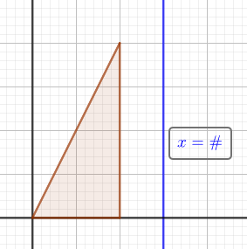


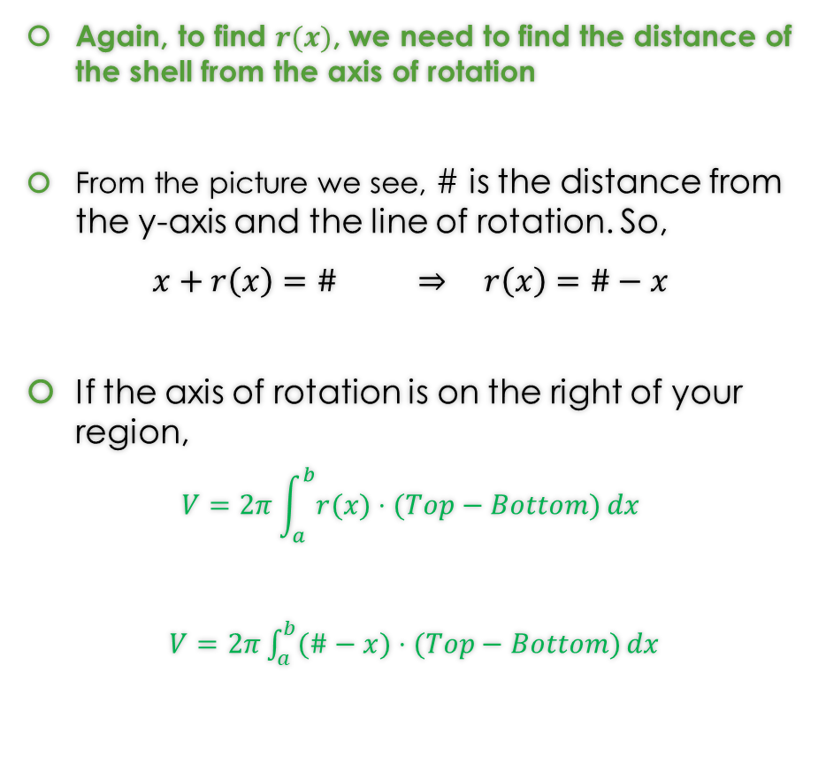
What is $r\left(x\right)$ when we are rotating around something other than y-axis?
Again, to find $r(x)$, we need to find the distance of the shell from the axis of rotation
From the picture we see, # is the distance from the y-axis and the line of rotation. So,
$x+r\left(x\right)=\#$ $⇒$ $r\left(x\right)=\#−x$
If the axis of rotation is on the right of your region,
$$V=2π\int_{a}^{b}{r(x)⋅(Top−Bottom)}dx$$
$V=2π\int_{a}^{b}{(\#−x)⋅(Top−Bottom)}dx$

Slide 7
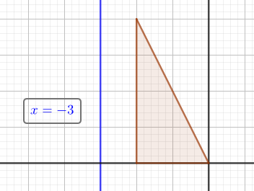
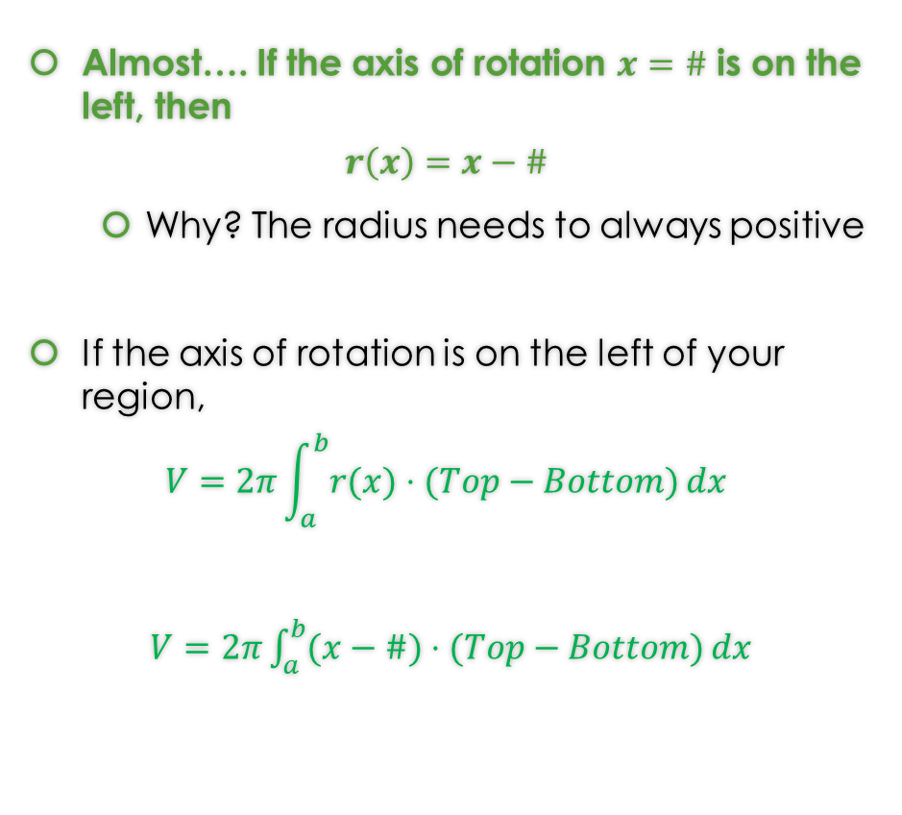

What if the axis of rotation is on the left of the region? Is it the same formula?
Almost…. If the axis of rotation $x=\#$ is on the left, then
$$r\left(x\right)=x−\#$$
  Why? The radius needs to always positive
If the axis of rotation is on the left of your region,
$$V=2π\int_{a}^{b}{r(x)⋅(Top−Bottom)}dx$$
$V=2π\int_{a}^{b}{(x−\#)⋅(Top−Bottom)}dx$
Take the example below:
If $r\left(x\right)=\#−x,$then $r\left(x\right)=−3−x$.
  Choose a value in the region (i.e. triangle).
  Is r(x) still positive? No.
What if $r\left(x\right)=x−\#?$ Yes.

Slide 8
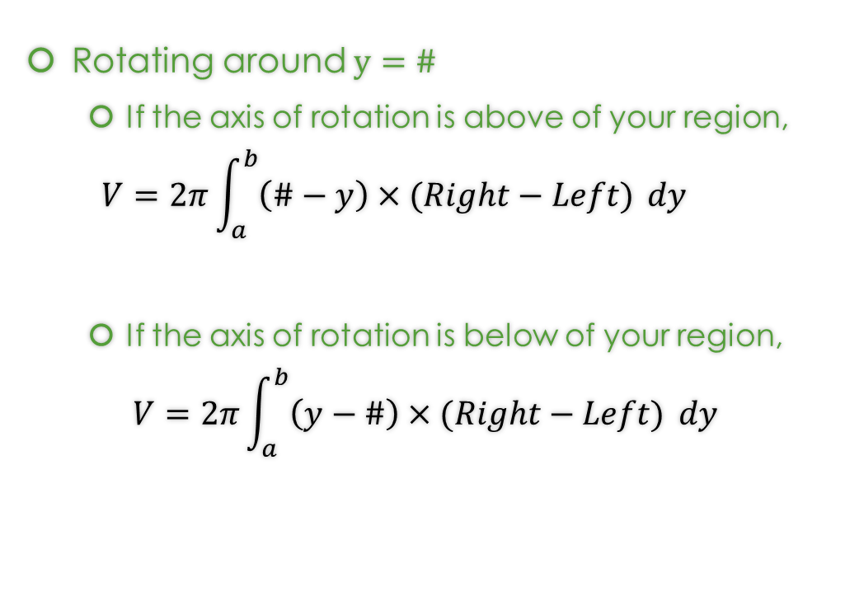
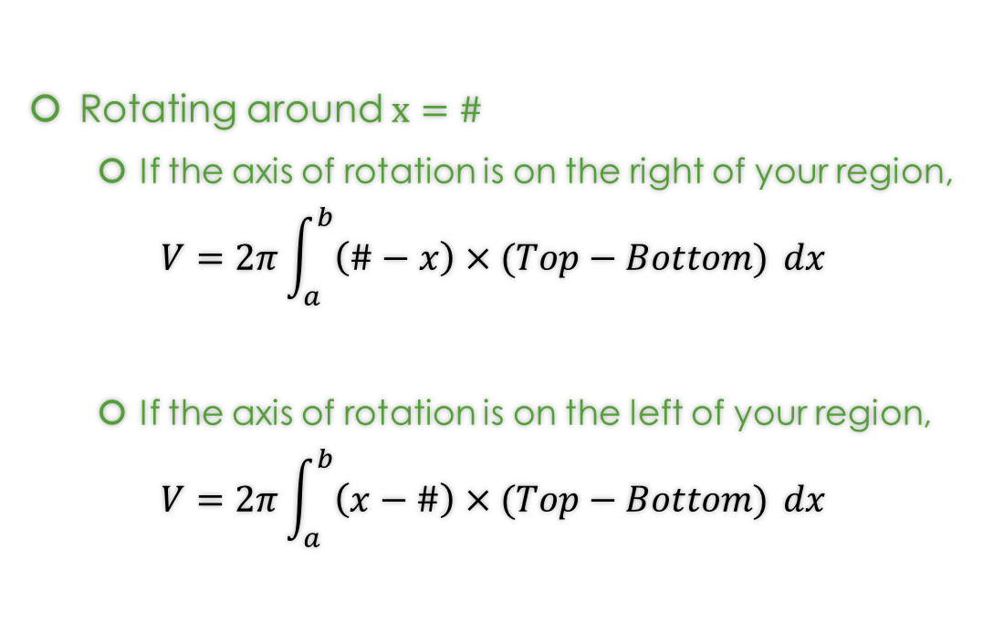
Overall, the Shell Method Formulas around any non-axis are…
Rotating around $x=\#$
  If the axis of rotation is on the right of your region,
$$V=2π\int_{a}^{b}{\left(\#−x\right)×(Top−Bottom)} dx$$
  If the axis of rotation is on the left of your region,
$$V=2π\int_{a}^{b}{\left(x−\#\right)×(Top−Bottom)} dx$$
Rotating around $y=\#$
  If the axis of rotation is above of your region,
  $$V=2π\int_{a}^{b}{\left(\#−y\right)×(Right−Left)} dy$$
  If the axis of rotation is below of your region,
$$V=2π\int_{a}^{b}{\left(y−\#\right)×(Right−Left)} dy$$

Slide 9
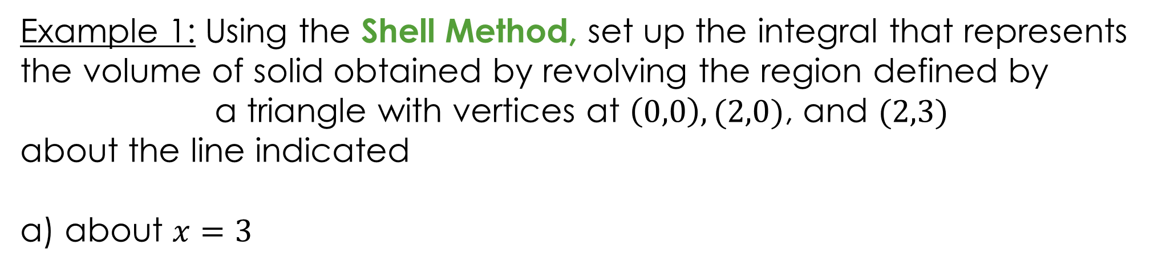
Example 1: Using the Shell Method, set up the integral that represents the volume of solid obtained by revolving the region defined by
a triangle with vertices at $\left(0,0\right), (2,0)$, and $(2,3)$
about the line indicated
a) about $x=3$
https://www.geogebra.org/m/knnfvjub#material/abjaakfk

Slide 10
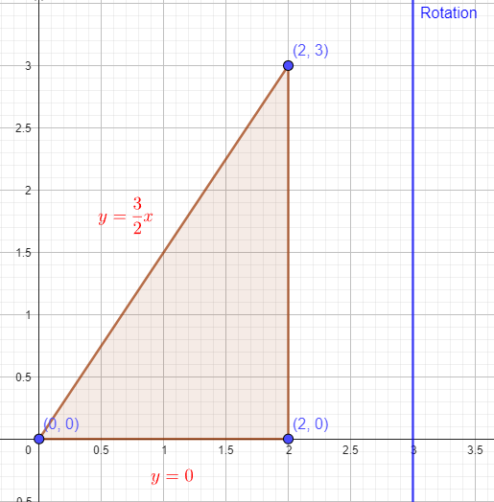
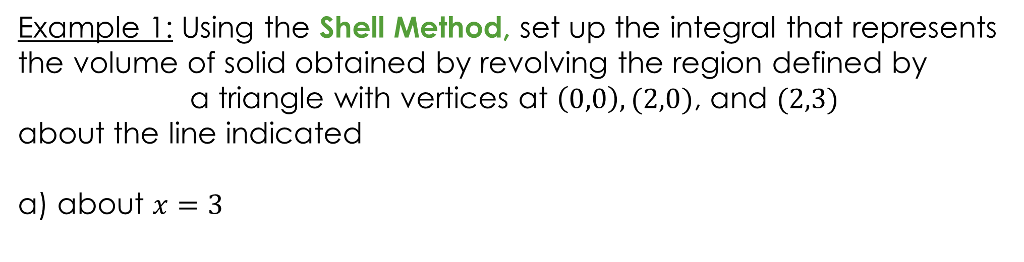
Example 1: Using the Shell Method, set up the integral that represents the volume of solid obtained by revolving the region defined by
a triangle with vertices at $\left(0,0\right), (2,0)$, and $(2,3)$
about the line indicated
a) about $x=3$
Draw the region.
https://www.geogebra.org/m/knnfvjub#material/abjaakfk

Slide 11
Example 1: Using the Shell Method, set up the integral that represents the volume of solid obtained by revolving the region defined by
a triangle with vertices at $\left(0,0\right), (2,0)$, and $(2,3)$
about the line indicated
a) about $x=3$
Draw the region.
https://www.geogebra.org/m/knnfvjub#material/abjaakfk

Slide 12
Example 1: Using the Shell Method, set up the integral that represents the volume of solid obtained by revolving the region defined by
a triangle with vertices at $\left(0,0\right), (2,0)$, and $(2,3)$
about the line indicated
a) about $x=3$
You can find the solution in the pdf of the notes. Click here to access it.
https://www.geogebra.org/m/knnfvjub#material/abjaakfk

Slide 13

Example 1: Using the Shell Method, set up the integral that represents the volume of solid obtained by revolving the region defined by
a triangle with vertices at $\left(0,0\right), (2,0)$, and $(2,3)$
about the line indicated
b) about $x=−1$
https://www.geogebra.org/m/knnfvjub#material/kcw32ctc

Slide 14
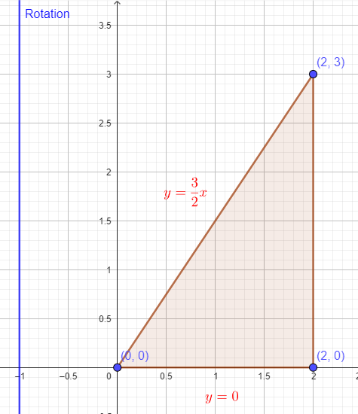

Example 1: Using the Shell Method, set up the integral that represents the volume of solid obtained by revolving the region defined by
a triangle with vertices at $\left(0,0\right), (2,0)$, and $(2,3)$
about the line indicated
b) about $x=−1$
Draw the region.
https://www.geogebra.org/m/knnfvjub#material/kcw32ctc

Slide 15
Example 1: Using the Shell Method, set up the integral that represents the volume of solid obtained by revolving the region defined by
a triangle with vertices at $\left(0,0\right), (2,0)$, and $(2,3)$
about the line indicated
b) about $x=−1$
Draw the region.
https://www.geogebra.org/m/knnfvjub#material/kcw32ctc

Slide 16
Example 1: Using the Shell Method, set up the integral that represents the volume of solid obtained by revolving the region defined by
a triangle with vertices at $\left(0,0\right), (2,0)$, and $(2,3)$
about the line indicated
b) about $x=−1$
You can find the solution in the pdf of the notes. Click here to access it.
https://www.geogebra.org/m/knnfvjub#material/kcw32ctc

Slide 17

Example 2: Using the Shell Method, set up the integral that represents the volume of solid obtained by revolving the region defined by
a triangle with vertices at $\left(0,0\right), (5,0)$, and $(5,6)$
about the line indicated
a) About $y=6$
https://www.geogebra.org/m/knnfvjub#material/e7hwecfx

Slide 18
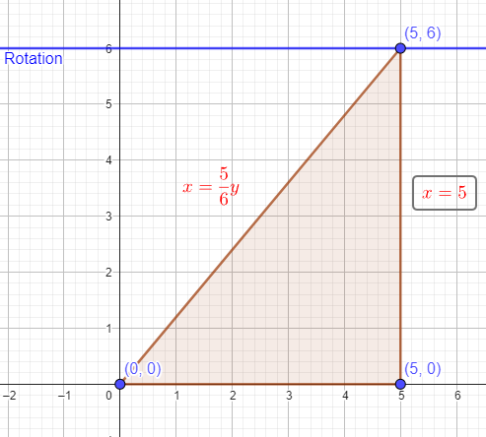
Example 2: Using the Shell Method, set up the integral that represents the volume of solid obtained by revolving the region defined by
a triangle with vertices at $\left(0,0\right), (5,0)$, and $(5,6)$
about the line indicated
a) About $y=6$
Draw the region.
https://www.geogebra.org/m/knnfvjub#material/e7hwecfx

Slide 19
Example 2: Using the Shell Method, set up the integral that represents the volume of solid obtained by revolving the region defined by
a triangle with vertices at $\left(0,0\right), (5,0)$, and $(5,6)$
about the line indicated
a) About $y=6$
Draw the region.
https://www.geogebra.org/m/knnfvjub#material/e7hwecfx

Slide 20

Example 2: Using the Shell Method, set up the integral that represents the volume of solid obtained by revolving the region defined by
a triangle with vertices at $\left(0,0\right), (5,0)$, and $(5,6)$
about the line indicated
About $y=6$
You can find the solution in the pdf of the notes. Click here to access it.
https://www.geogebra.org/m/knnfvjub#material/e7hwecfx

Slide 21

Example 2: Using the Shell Method, set up the integral that represents the volume of solid obtained by revolving the region defined by
a triangle with vertices at $\left(0,0\right), (5,0)$, and $(5,6)$
about the line indicated
b) About $y=−2$
https://www.geogebra.org/m/knnfvjub#material/hqkkjw3b

Slide 22
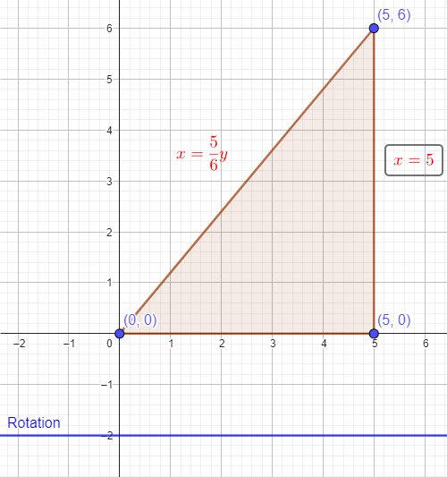
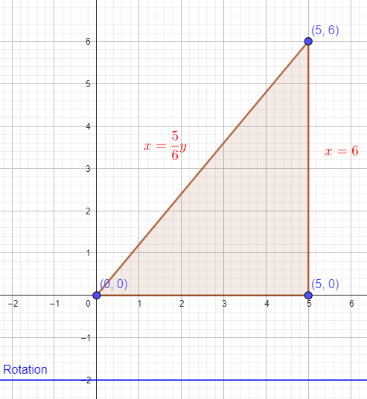
Example 2: Using the Shell Method, set up the integral that represents the volume of solid obtained by revolving the region defined by
a triangle with vertices at $\left(0,0\right), (5,0)$, and $(5,6)$
about the line indicated
b) About $y=−2$
Draw the region.
https://www.geogebra.org/m/knnfvjub#material/hqkkjw3b

Slide 23
Example 2: Using the Shell Method, set up the integral that represents the volume of solid obtained by revolving the region defined by
a triangle with vertices at $\left(0,0\right), (5,0)$, and $(5,6)$
about the line indicated
b) About $y=−2$
Draw the region.
https://www.geogebra.org/m/knnfvjub#material/hqkkjw3b

Slide 24
Example 2: Using the Shell Method, set up the integral that represents the volume of solid obtained by revolving the region defined by
a triangle with vertices at $\left(0,0\right), (5,0)$, and $(5,6)$
about the line indicated
b) About $y=−2$
You can find the solution in the pdf of the notes. Click here to access it.
https://www.geogebra.org/m/knnfvjub#material/hqkkjw3b

Slide 25
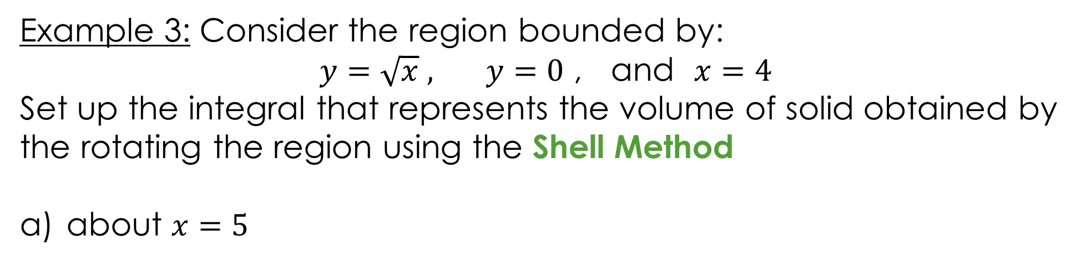
Example 3: Consider the region bounded by:
$y=\sqrt{x} ,$ $y=0$ , and $x=4$
Set up the integral that represents the volume of solid obtained by the rotating the region using the Shell Method
about $x=5$
https://www.geogebra.org/m/knnfvjub#material/ajknmy46

Slide 26
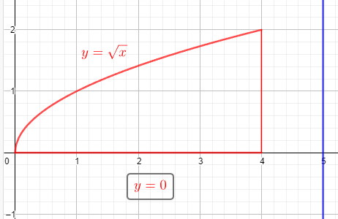
Example 3: Consider the region bounded by:
$y=\sqrt{x} ,$ $y=0$ , and $x=4$
Set up the integral that represents the volume of solid obtained by the rotating the region using the Shell Method
about $x=5$
Draw the region.
https://www.geogebra.org/m/knnfvjub#material/ajknmy46

Slide 27
Example 3: Consider the region bounded by:
$y=\sqrt{x} ,$ $y=0$ , and $x=4$
Set up the integral that represents the volume of solid obtained by the rotating the region using the Shell Method
about $x=5$
Draw the region.
https://www.geogebra.org/m/knnfvjub#material/ajknmy46

Slide 28
Example 3: Consider the region bounded by:
$y=\sqrt{x} ,$ $y=0$ , and $x=4$
Set up the integral that represents the volume of solid obtained by the rotating the region using the Shell Method
about $x=5$
You can find the solution in the pdf of the notes. Click here to access it.
https://www.geogebra.org/m/knnfvjub#material/ajknmy46

Slide 29

Example 3: Consider the region bounded by:
$y=\sqrt{x} ,$ $y=0$ , and $x=4$
Set up the integral that represents the volume of solid obtained by the rotating the region using the Shell Method
b) about $x=−1$
https://www.geogebra.org/m/knnfvjub#material/eb3qfpja

Slide 30
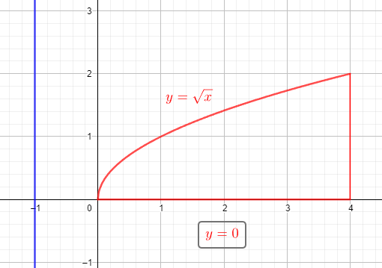
Example 3: Consider the region bounded by:
$y=\sqrt{x} ,$ $y=0$ , and $x=4$
Set up the integral that represents the volume of solid obtained by the rotating the region using the Shell Method
b) about $x=−1$
Draw the region.
https://www.geogebra.org/m/knnfvjub#material/eb3qfpja

Slide 31
Example 3: Consider the region bounded by:
$y=\sqrt{x} ,$ $y=0$ , and $x=4$
Set up the integral that represents the volume of solid obtained by the rotating the region using the Shell Method
b) about $x=−1$
Draw the region.
https://www.geogebra.org/m/knnfvjub#material/eb3qfpja

Slide 32
Example 3: Consider the region bounded by:
$y=\sqrt{x} ,$ $y=0$ , and $x=4$
Set up the integral that represents the volume of solid obtained by the rotating the region using the Shell Method
b) about $x=−1$
You can find the solution in the pdf of the notes. Click here to access it.
https://www.geogebra.org/m/knnfvjub#material/eb3qfpja

Slide 33

Example 4: Consider the region bounded by:
$x=y^{2}+1,$ and $x=2$
Set up the integral that represents the volume of solid obtained by the rotating the region using the Shell Method
about $y=3$
https://www.geogebra.org/m/knnfvjub#material/agxjnwfd

Slide 34
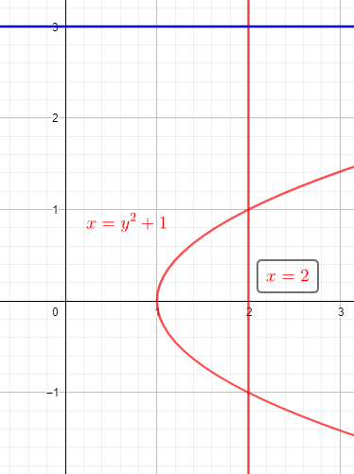
Example 4: Consider the region bounded by:
$x=y^{2}+1,$ and $x=2$
Set up the integral that represents the volume of solid obtained by the rotating the region using the Shell Method
about $y=3$
Draw the region.
https://www.geogebra.org/m/knnfvjub#material/agxjnwfd

Slide 35
Example 4: Consider the region bounded by:
$x=y^{2}+1,$ and $x=2$
Set up the integral that represents the volume of solid obtained by the rotating the region using the Shell Method
about $y=3$
Draw the region.
https://www.geogebra.org/m/knnfvjub#material/agxjnwfd

Slide 36
Example 4: Consider the region bounded by:
$x=y^{2}+1,$ and $x=2$
Set up the integral that represents the volume of solid obtained by the rotating the region using the Shell Method
about $y=3$
You can find the solution in the pdf of the notes. Click here to access it.
https://www.geogebra.org/m/knnfvjub#material/agxjnwfd

Slide 37

Example 4: Consider the region bounded by:
$x=y^{2}+1,$ and $x=2$
Set up the integral that represents the volume of solid obtained by the rotating the region using the Shell Method
b) about $y=−2$
https://www.geogebra.org/m/knnfvjub#material/hjhswuca

Slide 38
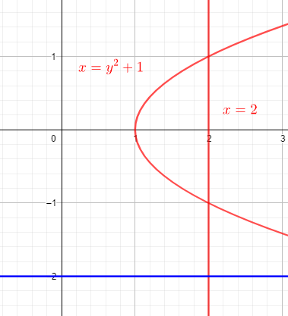
Example 4: Consider the region bounded by:
$x=y^{2}+1,$ and $x=2$
Set up the integral that represents the volume of solid obtained by the rotating the region using the Shell Method
b) about $y=−2$
Draw the region.
https://www.geogebra.org/m/knnfvjub#material/hjhswuca

Slide 39
Example 4: Consider the region bounded by:
$x=y^{2}+1,$ and $x=2$
Set up the integral that represents the volume of solid obtained by the rotating the region using the Shell Method
b) about $y=−2$
Draw the region.
https://www.geogebra.org/m/knnfvjub#material/hjhswuca

Slide 40
Example 4: Consider the region bounded by:
$x=y^{2}+1,$ and $x=2$
Set up the integral that represents the volume of solid obtained by the rotating the region using the Shell Method
b) about $y=−2$
You can find the solution in the pdf of the notes. Click here to access it.
https://www.geogebra.org/m/knnfvjub#material/hjhswuca

Slide 41
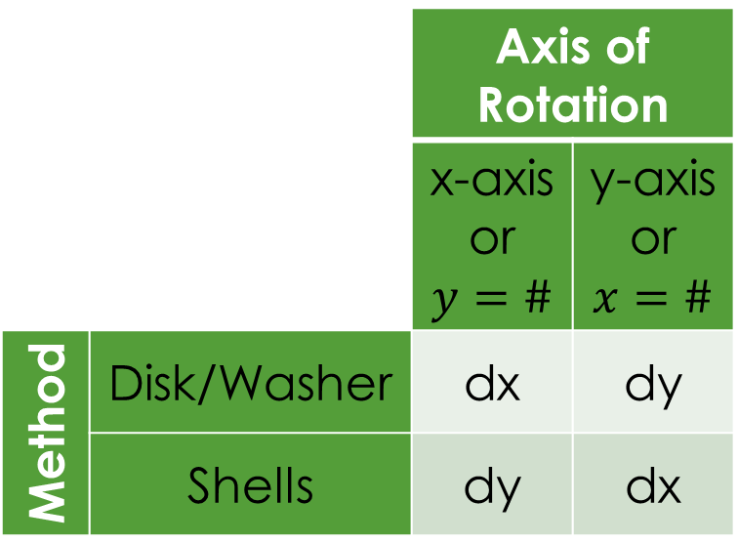
When do we apply Disk Method or Washer Method or Shell Method?
When the region “hugs” the axis of rotation
$⇒$ Disk Method
When there is a “gap” between the region and axis of rotation
$⇒$ Washer Method
But if you find solving for $x$ or $y,$ in either method, is hard
$⇒$Shell Method
 |  | Axis of Rotation
 |  | x-axis or $y=\#$ | y-axis or $x=\#$
Method | Disk/Washer | dx | dy
 | Shells | dy | dx

Slide 42
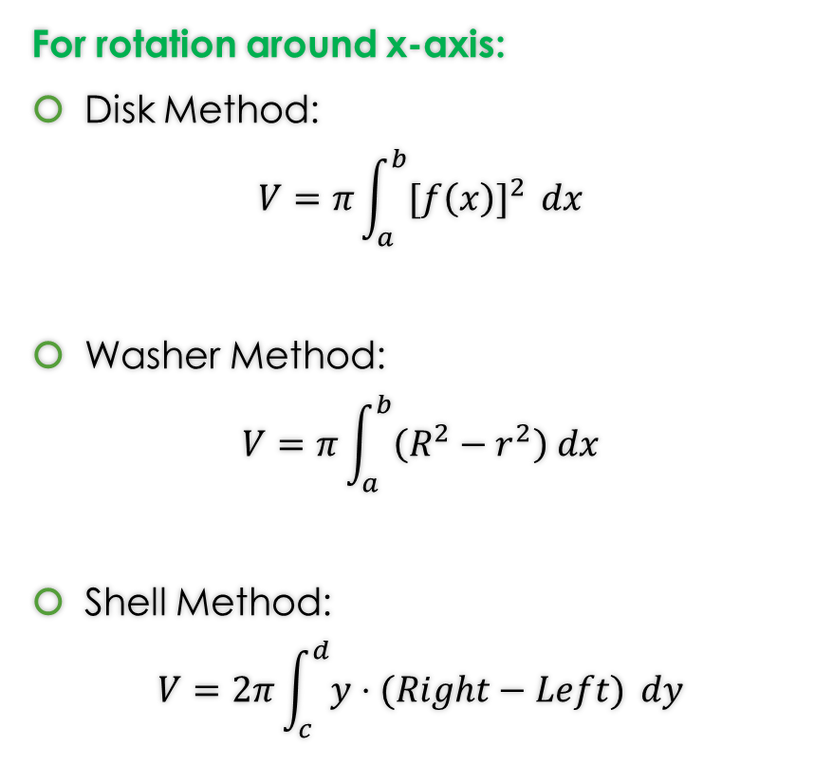

Formulas from Lessons 14 and 15 and 17
Rotation around x-axis or y-axis
For rotation around y-axis:
Disk Method:
$$V=π\int_{c}^{d}{{[g(y)]}^{2} }dy$$
Washer Method:
$$V=π\int_{c}^{d}{\left(R^{2}−r^{2}\right) dy}$$
Shell Method:
$$V=2π\int_{a}^{b}{x⋅(Top−Bottom)} dx$$
For rotation around x-axis:
Disk Method:
$$V=π\int_{a}^{b}{{[f\left(x\right)]}^{2} }dx$$
Washer Method:
$$V=π\int_{a}^{b}{\left(R^{2}−r^{2}\right) dx}$$
Shell Method:
$$V=2π\int_{c}^{d}{y⋅(Right−Left)} dy$$

Slide 43
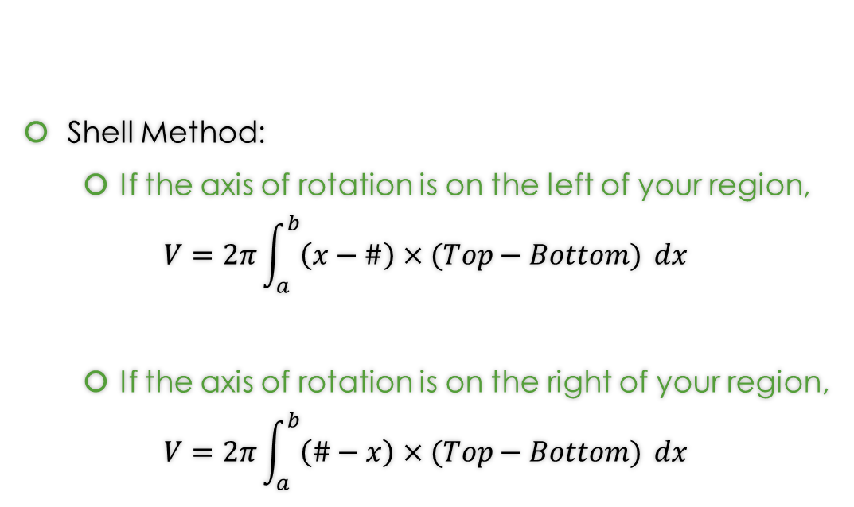
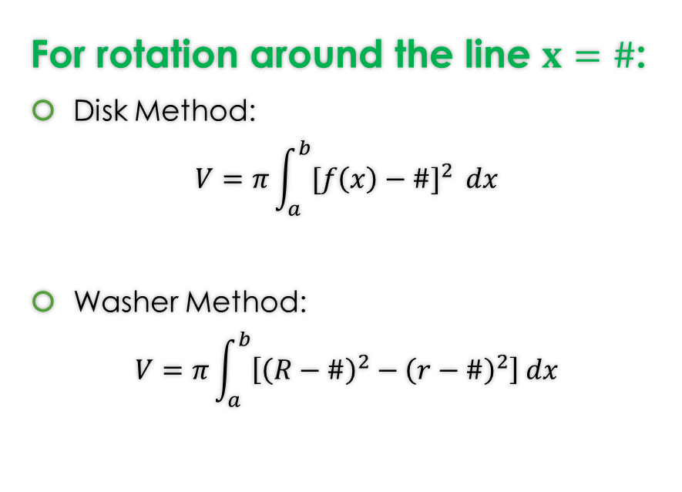
Formulas from Lesson 15 and 18
Rotation around any non-Axis Formulas
For rotation around the line $x=\#$:
Disk Method:
$$V=π\int_{a}^{b}{{[f\left(x\right)−\#]}^{2} }dx$$
Washer Method:
$$V=π\int_{a}^{b}{\left[{\left(R−\#\right)}^{2}−{\left(r−\#\right)}^{2}\right] dx}$$
Shell Method:
  If the axis of rotation is on the left of your region,
$$V=2π\int_{a}^{b}{\left(x−\#\right)×(Top−Bottom)} dx$$
  If the axis of rotation is on the right of your region,
$$V=2π\int_{a}^{b}{\left(\#−x\right)×(Top−Bottom)} dx$$
Note: That these formulas work for the case of x-axis ($y=0)$ and y-axis ($x=0$).

Slide 44
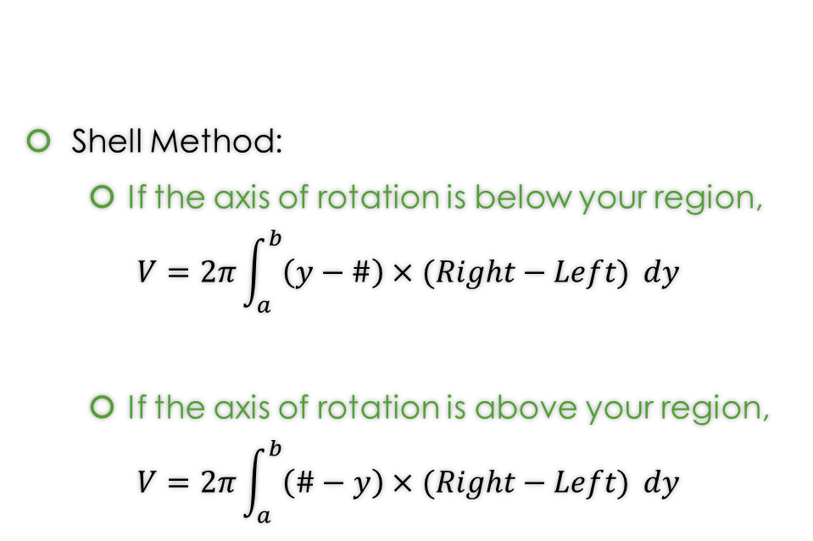

Formulas from Lesson 15 and 18
Rotation around any non-Axis Formulas
For rotation around the line $y=\#$:
Disk Method:
$$V=π\int_{c}^{d}{{[g\left(y\right)−\#]}^{2} }dy$$
Washer Method:
$$V=π\int_{c}^{d}{\left[{\left(R−\#\right)}^{2}−{\left(r−\#\right)}^{2}\right] dy}$$
Shell Method:
  If the axis of rotation is below your region,
$$V=2π\int_{a}^{b}{\left(y−\#\right)×(Right−Left)} dy$$
  If the axis of rotation is above your region,
$$V=2π\int_{a}^{b}{\left(\#−y\right)×(Right−Left)} dy$$
Note: That these formulas work for the case of x-axis ($y=0)$ and y-axis ($x=0$).

Slide 45
GeoGebra Link for Lesson 18
https://www.geogebra.org/m/knnfvjub
Note click on the play buttons on the left-most screen and the animation will play/pause.

