Slide 1
Reminders
TODAY QUIZ 6 on
  Volume of Revolutions
    Disks (Lesson 14)
    Washers (Lesson 15)
1-WEEK REMINDER
  Exam 2 on WEDNESDAY March 1 @ 6:30pm – 7:30pm
  Location: LILY 1105

Slide 2
MA 16020: Lesson 17
Volume By Revolution
Shell Method
By Alexandra Cuadra

Slide 3
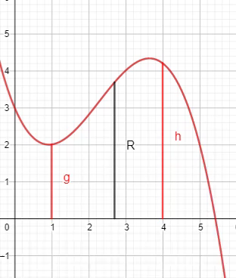
So far…
We have learned how to find the volume of a solid of revolution by integrating
  In the same way, we calculate the area under a curve
    Running a line segment of varying length across the region, and adding them up
https://www.geogebra.org/m/tgceabb2#material/tnnhu7gz

Slide 4
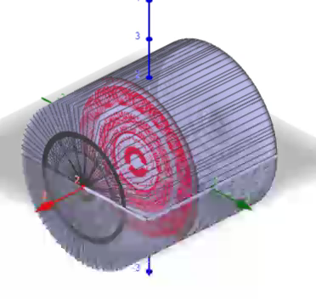
In other words,
We learned to find the volume of a solid of revolution by
  Running some area across a shape and add them up.
  Like in the case of the cylinder shown on the right.
https://www.geogebra.org/m/tgceabb2#material/qcwutumt

Slide 5


But what were those “shapes”?
ANSWER: CROSS-SECTIONS
Sometimes it was a disk
Whose area is $πR^{2}$
Sometimes it was a washer
Whose area is $π{(R}^{2}−r^{2})$
R
R
r

Slide 6
In Today’s Lecture, we will be covering the case, when neither method (Disk nor Washer) is easy.

Slide 7

Example 1: Find the volume obtained by revolving the region bounded by the curves
$y=2x^{2}−x^{3}$ and $y=0$
About the y-axis.
https://www.geogebra.org/m/jqfyndpu

Slide 8
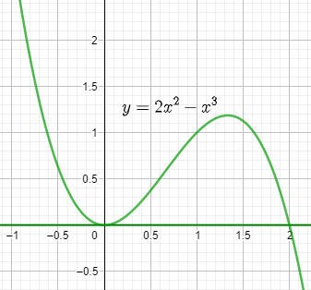

Example 1: Find the volume obtained by revolving the region bounded by the curves
$y=2x^{2}−x^{3}$ and $y=0$
About the y-axis.
Draw the region.
https://www.geogebra.org/m/jqfyndpu

Slide 9
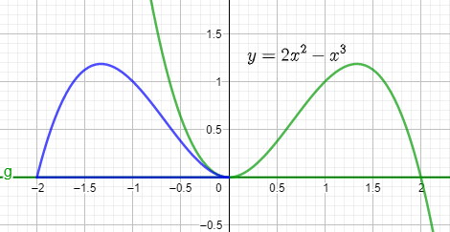
Example 1: Find the volume obtained by revolving the region bounded by the curves
$y=2x^{2}−x^{3}$ and $y=0$
About the y-axis.
Rotation about y-axis
https://www.geogebra.org/m/jqfyndpu

Slide 10
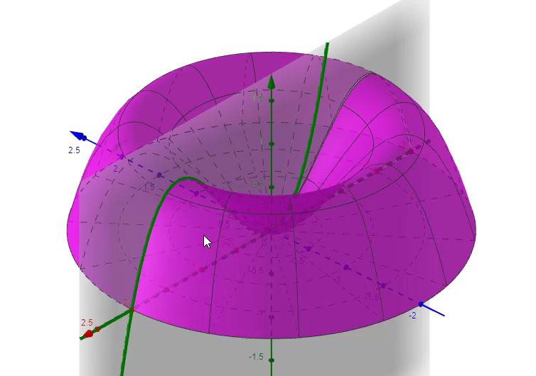
Example 1: Find the volume obtained by revolving the region bounded by the curves
$y=2x^{2}−x^{3}$ and $y=0$
About the y-axis.
WASHER ???
Furthermore, 3-D
https://www.geogebra.org/m/jqfyndpu

Slide 11

Example 1: Find the volume obtained by revolving the region bounded by the curves
$y=2x^{2}−x^{3}$ and $y=0$
About the y-axis.
Technically, yes. It is a Washer Problem.
But there are two issues:
Given we are revolving around y-axis, we want to solve our equations for $x$.
i.e. Solve $y=2x^{2}−x^{3}$ for $x$.
But that is easier said than done.
For washer problems, we need two equations for each radius.
Here we have both radius depend on the same function.
https://www.geogebra.org/m/jqfyndpu

Slide 12
So how can I do this kind of problem without giving myself a headache?
ANSWER: SHELL METHOD

Slide 13
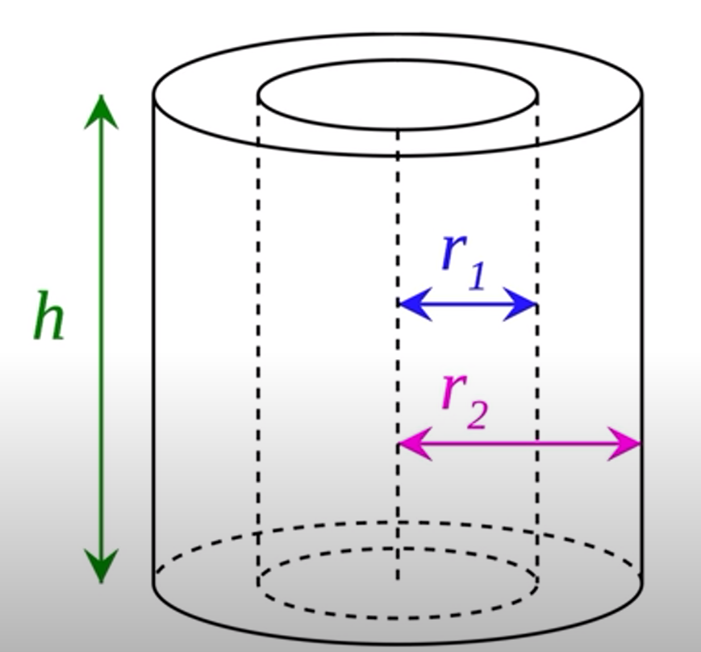
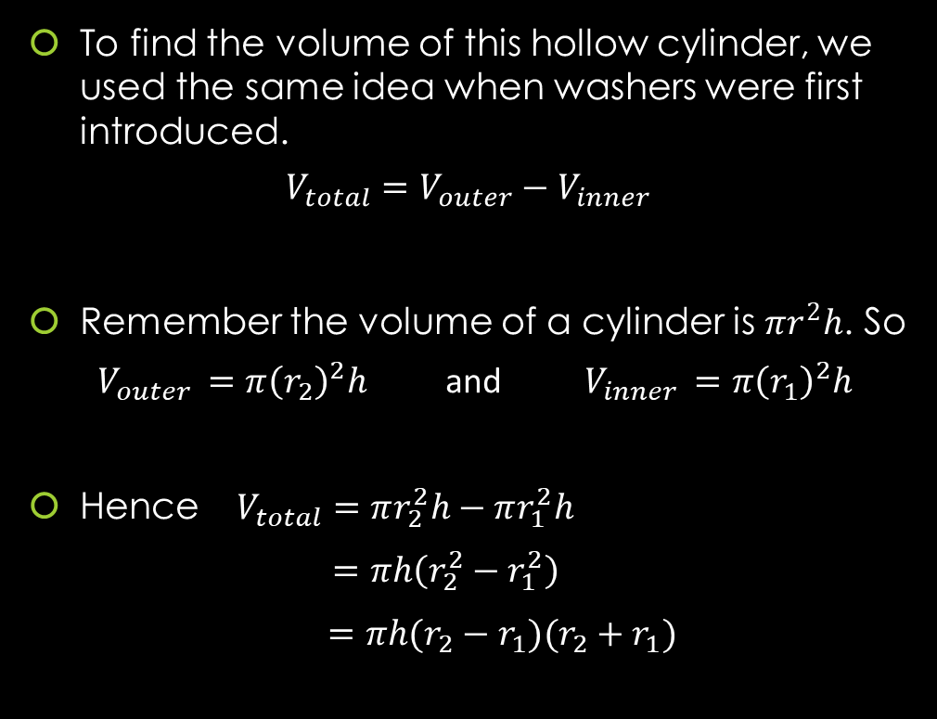
GEOMETRY: Finding The Volume of A Hollow Cylinder
To find the volume of this hollow cylinder, we used the same idea when washers were first introduced.
$$V_{total}=V_{outer}−V_{inner}$$
Remember the volume of a cylinder is $πr^{2}h$. So
$V_{outer }=π{\left(r_{2}\right)}^{2}h$ and $V_{inner }=π{\left(r_{1}\right)}^{2}h$
Hence $V_{total}=πr_{2}^{2}h−πr_{1}^{2}h$
$=πh\left(r_{2}^{2}−r_{1}^{2}\right)$
$=πh(r_{2}−r_{1})(r_{2}+r_{1})$

Slide 14
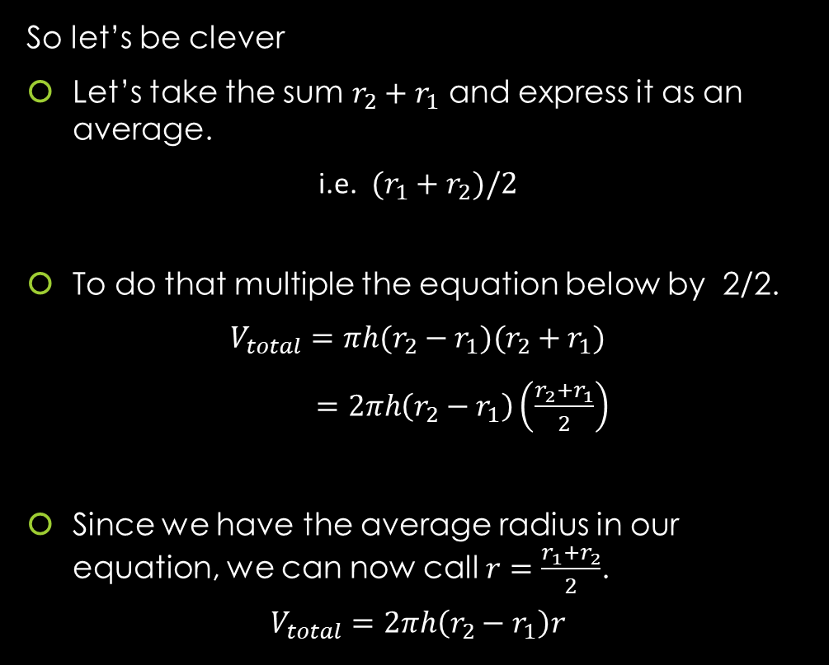
GEOMETRY: Finding The Volume of A Hollow Cylinder
So let’s be clever
Let’s take the sum $r_{2}+r_{1}$ and express it as an average.
i.e. $(r_{1}+r_{2})/2$
To do that multiple the equation below by 2/2.
$$V_{total}=πh(r_{2}−r_{1})(r_{2}+r_{1})$$
$=2πh\left(r_{2}−r_{1}\right)\left(\frac{r_{2}+r_{1}}{2}\right)$
Since we have the average radius in our equation, we can now call $r=\frac{r_{1}+r_{2}}{2}$.
$$V_{total}=2πh\left(r_{2}−r_{1}\right)r$$

Slide 15
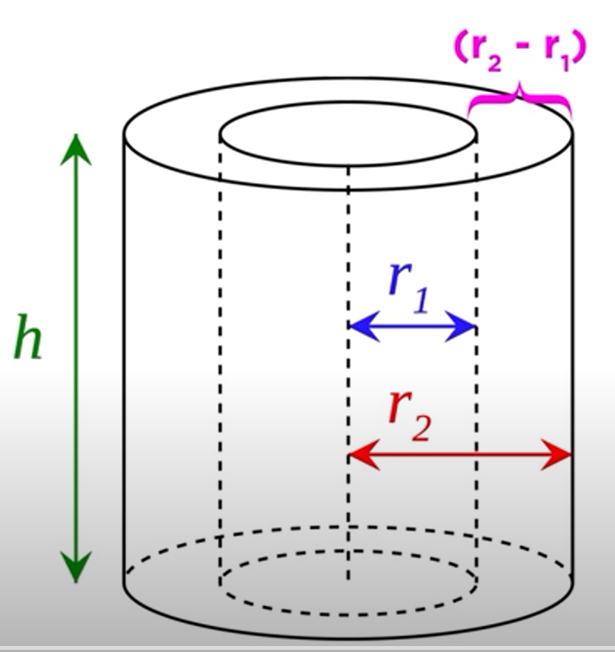
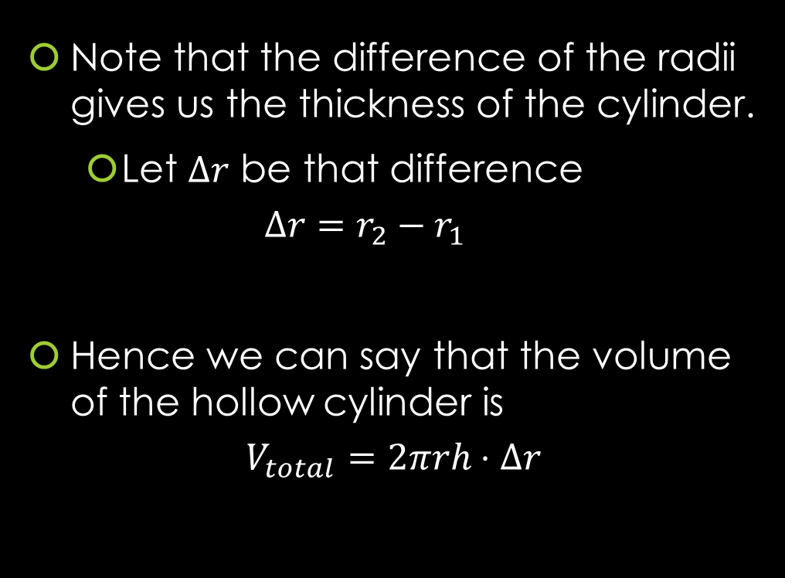
GEOMETRY: Finding The Volume of A Hollow Cylinder
Note that the difference of the radii gives us the thickness of the cylinder.
  Let $Δr$ be that difference
  $$Δr=r_{2}−r_{1}$$
Hence we can say that the volume of the hollow cylinder is
$$V_{total}=2πrh⋅Δr$$

Slide 16
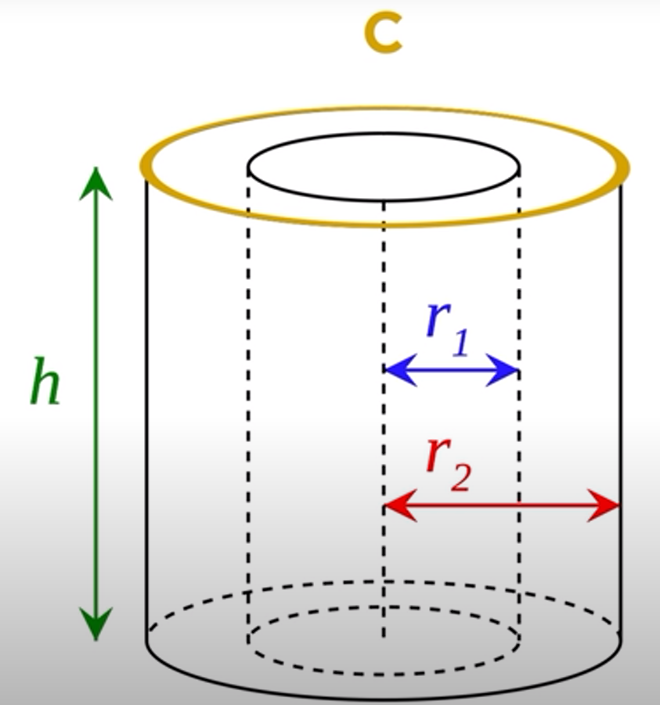
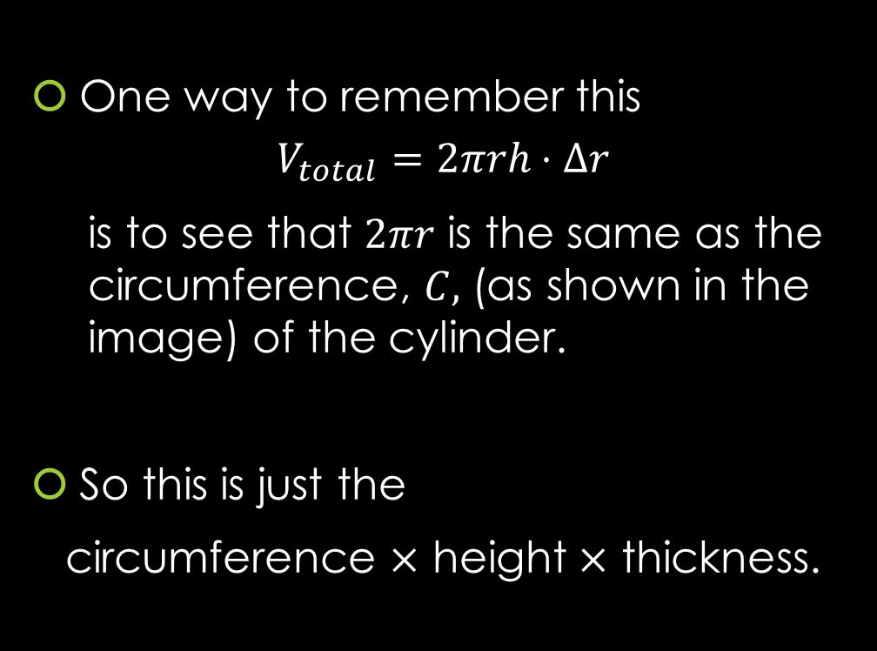
GEOMETRY: Finding The Volume of A Hollow Cylinder
One way to remember this
$$V_{total}=2πrh⋅Δr$$
    is to see that $2πr$ is the same as the circumference, $C,$ (as shown in the image) of the cylinder.
So this is just the
circumference $×$ height $×$ thickness.

Slide 17
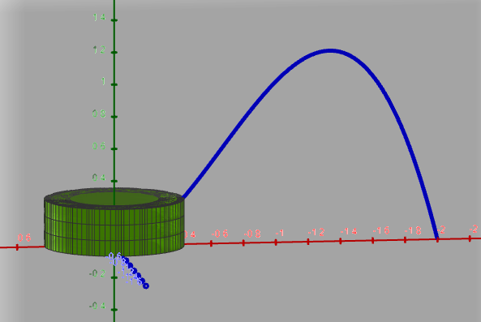
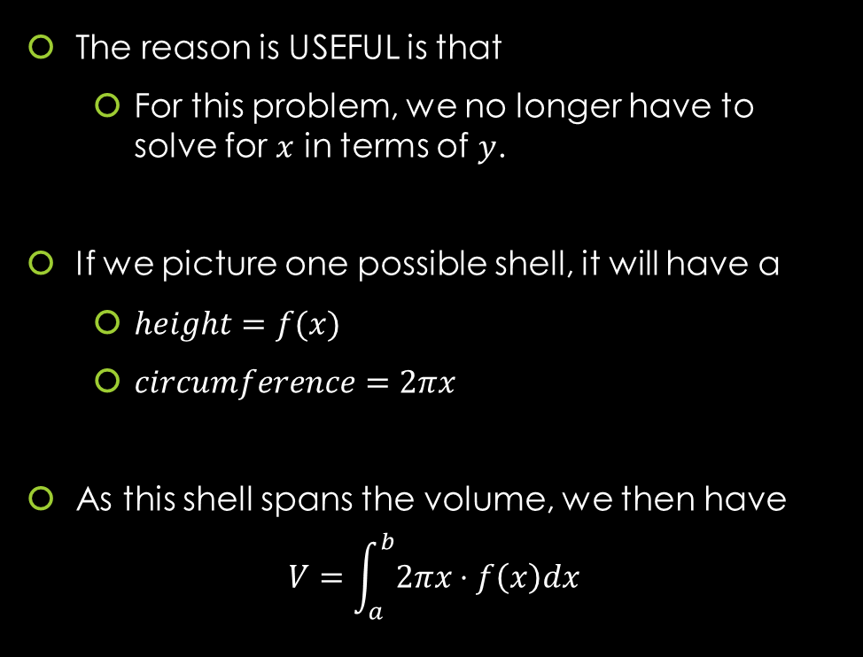
So how does this help us answer Example 1?
The reason is USEFUL is that
  For this problem, we no longer have to solve for $x$ in terms of $y$.
If we picture one possible shell, it will have a
  $height=f(x)$
  $circumference=2πx$
As this shell spans the volume, we then have
$$V=\int_{a}^{b}{2πx⋅f\left(x\right)dx}$$
https://www.geogebra.org/m/jqfyndpu

Slide 18
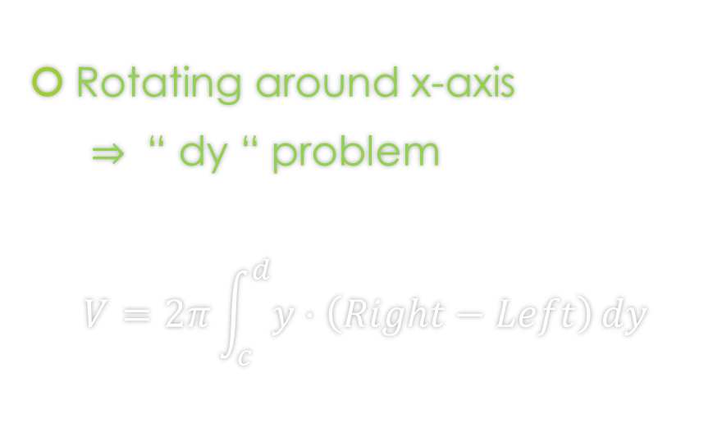
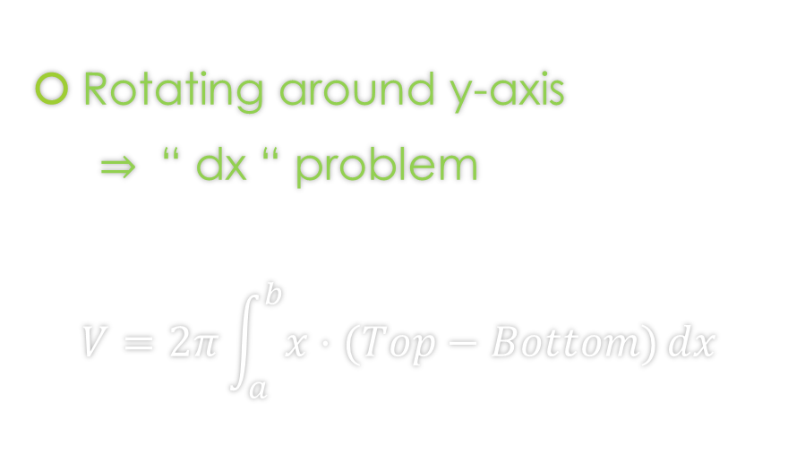
Even more… Shell Method Formulas
Since we are just cutting out parallel to the axis, we choose dx or dy in the following way:
Rotating around y-axis
$⇒$ “ dx “ problem
$$V=2π\int_{a}^{b}{x⋅(Top−Bottom)}dx$$
Rotating around x-axis
$⇒$ “ dy “ problem
$$V=2π\int_{c}^{d}{y⋅\left(Right−Left\right)}dy$$

Slide 19
Example 1: Find the volume obtained by revolving the region bounded by the curves
$y=2x^{2}−x^{3}$ and $y=0$
About the y-axis.
https://www.geogebra.org/m/jqfyndpu

Slide 20
Example 1: Find the volume obtained by revolving the region bounded by the curves
$y=2x^{2}−x^{3}$ and $y=0$
About the y-axis.
https://www.geogebra.org/m/jqfyndpu

Slide 21
Example 1: Find the volume obtained by revolving the region bounded by the curves
$y=2x^{2}−x^{3}$ and $y=0$
About the y-axis.
You can find the solution in the pdf of the notes. Click here to access it.
https://www.geogebra.org/m/jqfyndpu

Slide 22

Example 2: Find the volume obtained by revolving the region bounded by the curves
$x=y^{2}−2y$ and $x=4y−y^{2}$
About the x-axis.
https://www.geogebra.org/m/f3wrypfh#material/qrar4br5

Slide 23
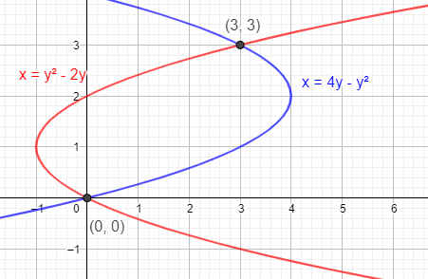


Example 2: Find the volume obtained by revolving the region bounded by the curves
$x=y^{2}−2y$ and $x=4y−y^{2}$
About the x-axis.
Draw the region.
https://www.geogebra.org/m/f3wrypfh#material/qrar4br5

Slide 24
Example 2: Find the volume obtained by revolving the region bounded by the curves
$x=y^{2}−2y$ and $x=4y−y^{2}$
About the x-axis.
https://www.geogebra.org/m/f3wrypfh#material/qrar4br5

Slide 25
Example 2: Find the volume obtained by revolving the region bounded by the curves
$x=y^{2}−2y$ and $x=4y−y^{2}$
About the x-axis.
https://www.geogebra.org/m/f3wrypfh#material/qrar4br5

Slide 26
Example 2: Find the volume obtained by revolving the region bounded by the curves
$x=y^{2}−2y$ and $x=4y−y^{2}$
About the x-axis.
https://www.geogebra.org/m/f3wrypfh#material/qrar4br5

Slide 27
Example 2: Find the volume obtained by revolving the region bounded by the curves
$x=y^{2}−2y$ and $x=4y−y^{2}$
About the x-axis.
You can find the solution in the pdf of the notes. Click here to access it.
https://www.geogebra.org/m/f3wrypfh#material/qrar4br5

Slide 28

Example 3: Consider the region bounded by:
$y=4x ,$ $y=0$ , and $x=10$
Set up the integral that represents the volume of solid obtained by the rotating the region about the y-axis using
A) Disk/Washer Method
https://www.geogebra.org/m/f3wrypfh#material/cb7tfq8n

Slide 29
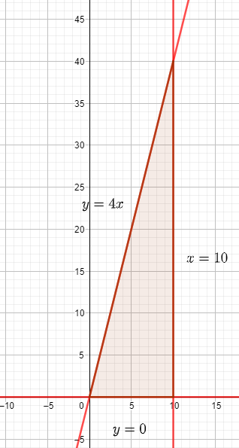


Example 3: Consider the region bounded by:
$y=4x ,$ $y=0$ , and $x=10$
Set up the integral that represents the volume of solid obtained by the rotating the region about the y-axis using
Disk/Washer Method
Draw the region.
https://www.geogebra.org/m/f3wrypfh#material/cb7tfq8n

Slide 30

Example 3: Consider the region bounded by:
$y=4x ,$ $y=0$ , and $x=10$
Set up the integral that represents the volume of solid obtained by the rotating the region about the y-axis using
Disk/Washer Method
https://www.geogebra.org/m/f3wrypfh#material/cb7tfq8n

Slide 31
Example 3: Consider the region bounded by:
$y=4x ,$ $y=0$ , and $x=10$
Set up the integral that represents the volume of solid obtained by the rotating the region about the y-axis using
Disk/Washer Method
https://www.geogebra.org/m/f3wrypfh#material/cb7tfq8n

Slide 32
Example 3: Consider the region bounded by:
$y=4x ,$ $y=0$ , and $x=10$
Set up the integral that represents the volume of solid obtained by the rotating the region about the y-axis using
Disk/Washer Method
You can find the solution in the pdf of the notes. Click here to access it.
https://www.geogebra.org/m/f3wrypfh#material/cb7tfq8n

Slide 33

Example 3: Consider the region bounded by:
$y=4x ,$ $y=0$ , and $x=10$
Set up the integral that represents the volume of solid obtained by the rotating the region about the y-axis using
B) Shell Method
https://www.geogebra.org/m/f3wrypfh#material/cb7tfq8n

Slide 34

Example 3: Consider the region bounded by:
$y=4x ,$ $y=0$ , and $x=10$
Set up the integral that represents the volume of solid obtained by the rotating the region about the y-axis using
B) Shell Method
Draw the region.
https://www.geogebra.org/m/f3wrypfh#material/cb7tfq8n

Slide 35

Example 3: Consider the region bounded by:
$y=4x ,$ $y=0$ , and $x=10$
Set up the integral that represents the volume of solid obtained by the rotating the region about the y-axis using
B) Shell Method
https://www.geogebra.org/m/f3wrypfh#material/cb7tfq8n

Slide 36
Example 3: Consider the region bounded by:
$y=4x ,$ $y=0$ , and $x=10$
Set up the integral that represents the volume of solid obtained by the rotating the region about the y-axis using
B) Shell Method
https://www.geogebra.org/m/f3wrypfh#material/cb7tfq8n

Slide 37
Example 3: Consider the region bounded by:
$y=4x ,$ $y=0$ , and $x=10$
Set up the integral that represents the volume of solid obtained by the rotating the region about the y-axis using
B) Shell Method
You can find the solution in the pdf of the notes. Click here to access it.
https://www.geogebra.org/m/f3wrypfh#material/cb7tfq8n

Slide 38

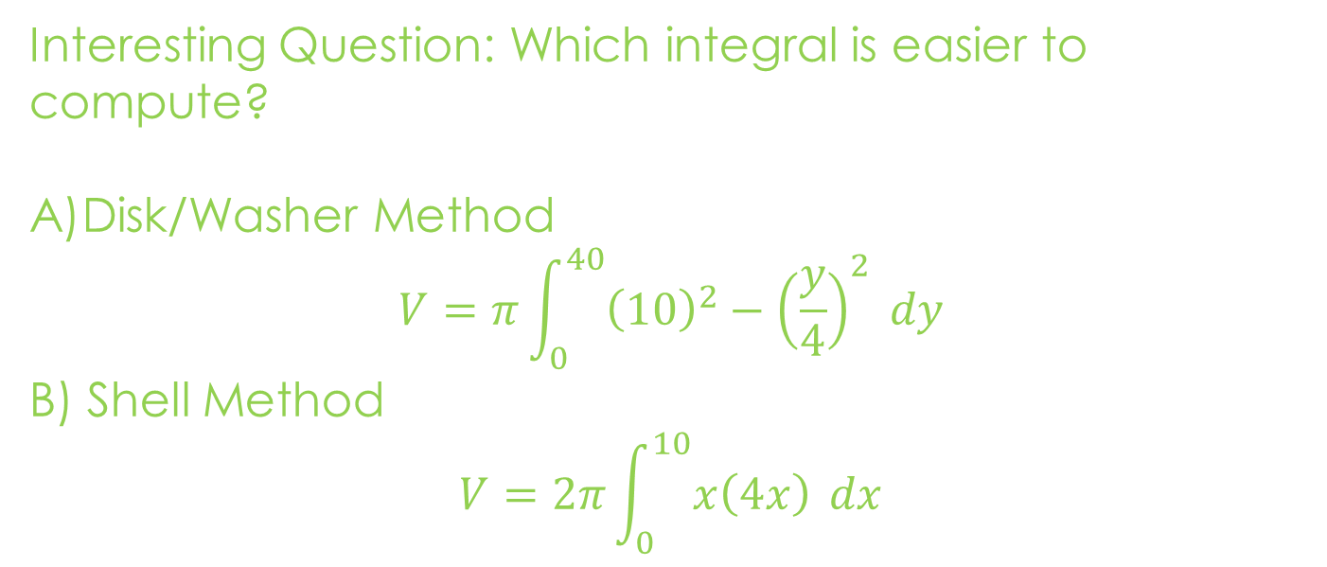
Example 3: Consider the region bounded by:
$y=4x ,$ $y=0$ , and $x=10$
Set up the integral that represents the volume of solid obtained by the rotating the region about the y-axis using
Interesting Question: Which integral is easier to compute?
Disk/Washer Method
$$V=π\int_{0}^{40}{{\left(10\right)}^{2}−{\left(\frac{y}{4}\right)}^{2} dy}$$
B) Shell Method
$$V=2π\int_{0}^{10}{x\left(4x\right)} dx$$
https://www.geogebra.org/m/f3wrypfh#material/cb7tfq8n

Slide 39
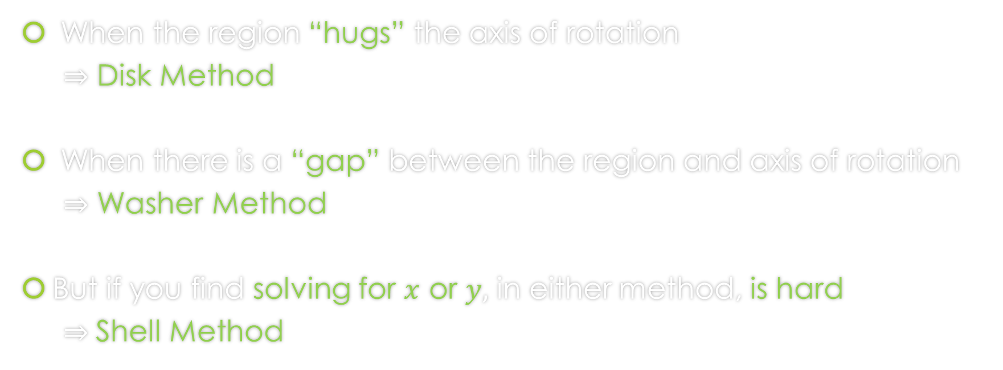
When do we apply Disk Method or Washer Method or Shell Method?
When the region “hugs” the axis of rotation
$⇒$ Disk Method
When there is a “gap” between the region and axis of rotation
$⇒$ Washer Method
But if you find solving for $x$ or $y,$ in either method, is hard
$⇒$Shell Method

Slide 40
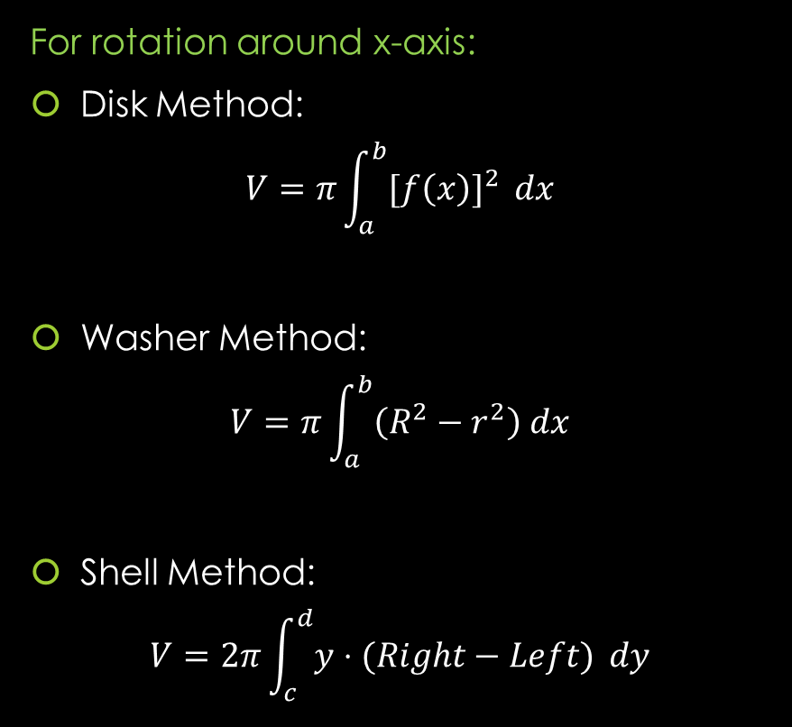
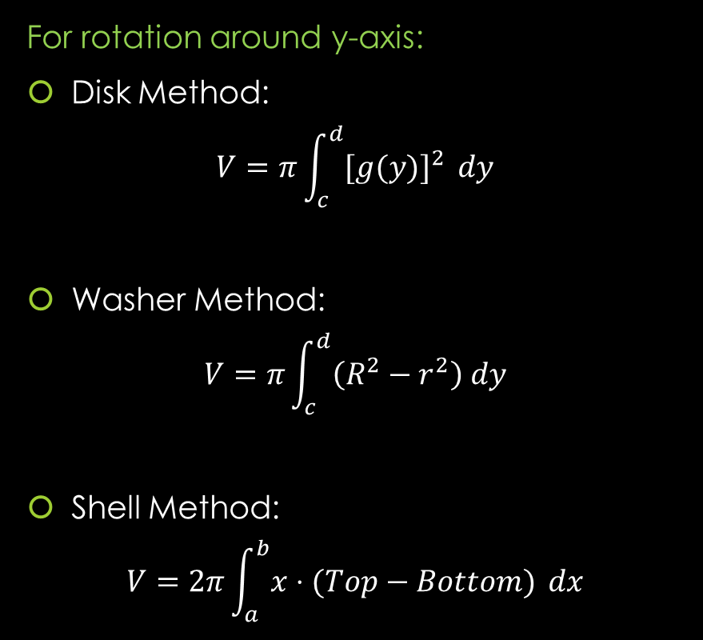
Formulas from Lessons 14 and 15 and 17
For rotation around y-axis:
Disk Method:
$$V=π\int_{c}^{d}{{[g(y)]}^{2} }dy$$
Washer Method:
$$V=π\int_{c}^{d}{\left(R^{2}−r^{2}\right) dy}$$
Shell Method:
$$V=2π\int_{a}^{b}{x⋅(Top−Bottom)} dx$$
For rotation around x-axis:
Disk Method:
$$V=π\int_{a}^{b}{{[f\left(x\right)]}^{2} }dx$$
Washer Method:
$$V=π\int_{a}^{b}{\left(R^{2}−r^{2}\right) dx}$$
Shell Method:
$$V=2π\int_{c}^{d}{y⋅(Right−Left)} dy$$

Slide 41
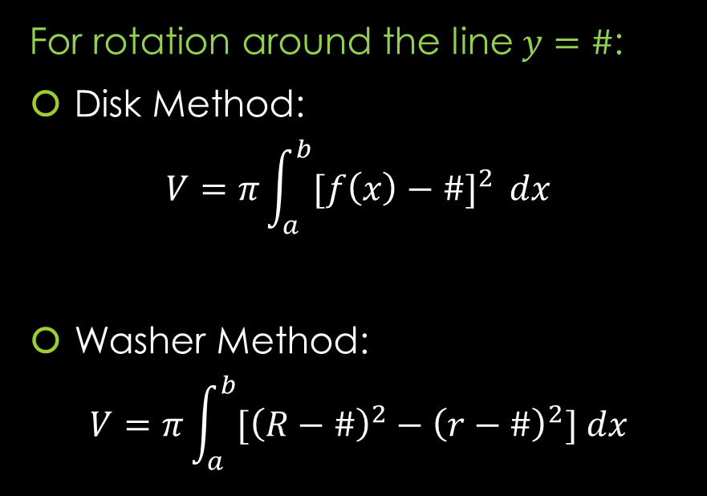
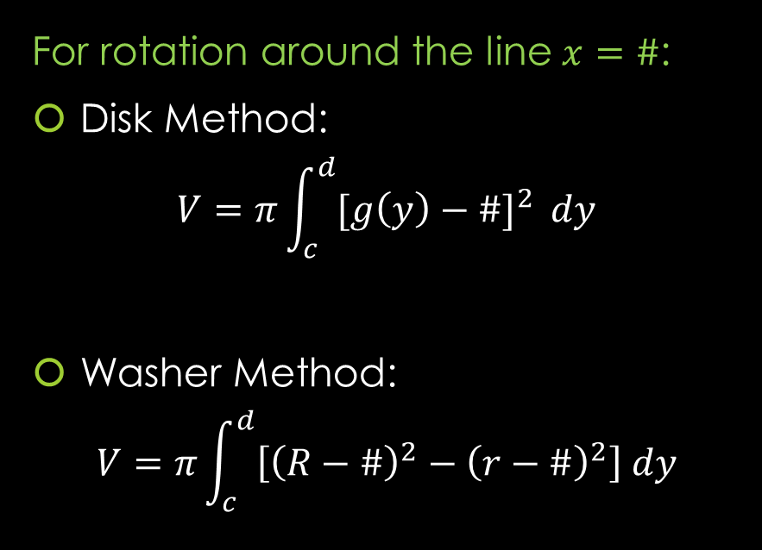
Formulas from Lesson 16
Rotation around any non-Axis Formulas
For rotation around the line $y=\#$:
Disk Method:
$$V=π\int_{a}^{b}{{[f\left(x\right)−\#]}^{2} }dx$$
Washer Method:
$$V=π\int_{a}^{b}{[{\left(R−\#\right)}^{2}−{\left(r−\#\right)}^{2}] dx}$$
For rotation around the line $x=\#$:
Disk Method:
$$V=π\int_{c}^{d}{{[g\left(y\right)−\#]}^{2} }dy$$
Washer Method:
$$V=π\int_{c}^{d}{\left[{\left(R−\#\right)}^{2}−{\left(r−\#\right)}^{2}\right] dy}$$
Note: That these formulas work for the case of x-axis ($y=0)$ and y-axis ($x=0$).

Slide 42
GeoGebra Link for Lesson 17
https://www.geogebra.org/m/f3wrypfh
Note click on the play buttons on the left-most screen and the animation will play/pause.

