Slide 1
Reminders
NO CLASS ON MONDAY 7/3 or TUESDAY 7/4
CLASS RESUMES ON WEDNESDAY 7/5
1-WEEK REMINDER
  Exam 2 on FRIDAY 7/7 @ 9:30 – 11 am
  Location: HAMP 3144
  Duration: 1 hour

Slide 2
MA 16020: Lesson 13
Volume By Revolution
Shell Method
By Alexandra Cuadra

Slide 3
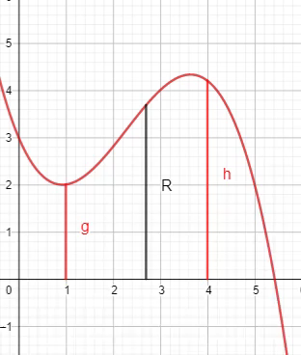
So far…
We have learned how to find the volume of a solid of revolution by integrating
  In the same way, we calculate the area under a curve
    Running a line segment of varying length across the region, and adding them up
https://www.geogebra.org/m/tgceabb2#material/tnnhu7gz

Slide 4
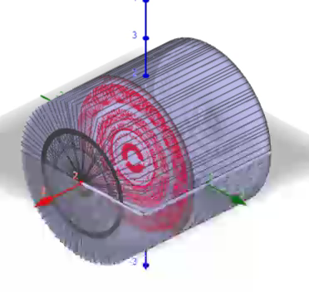
In other words,
We learned to find the volume of a solid of revolution by
  Running some area across a shape and add them up.
  Like in the case of the cylinder shown on the right.
https://www.geogebra.org/m/tgceabb2#material/qcwutumt

Slide 5


But what were those “shapes”?
ANSWER: CROSS-SECTIONS
Sometimes it was a disk
Whose area is $πR^{2}$
Sometimes it was a washer
Whose area is $π{(R}^{2}−r^{2})$
R
R
r

Slide 6
In Today’s Lecture, we will be covering the case, when neither method (Disk nor Washer) is easy.

Slide 7

Example 1: Find the volume obtained by revolving the region bounded by the curves
$y=2x^{2}−x^{3}$ and $y=0$
About the y-axis.
https://www.geogebra.org/m/jqfyndpu

Slide 8
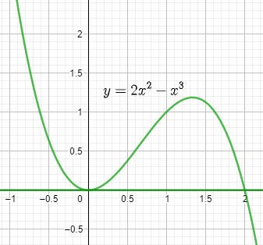
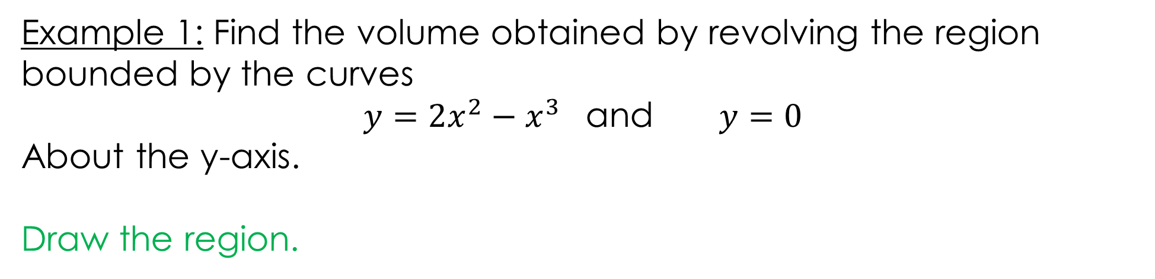
Example 1: Find the volume obtained by revolving the region bounded by the curves
$y=2x^{2}−x^{3}$ and $y=0$
About the y-axis.
Draw the region.
https://www.geogebra.org/m/jqfyndpu

Slide 9
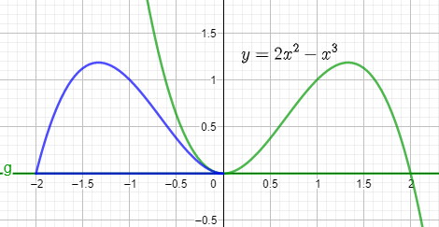
Example 1: Find the volume obtained by revolving the region bounded by the curves
$y=2x^{2}−x^{3}$ and $y=0$
About the y-axis.
Rotation about y-axis
https://www.geogebra.org/m/jqfyndpu

Slide 10
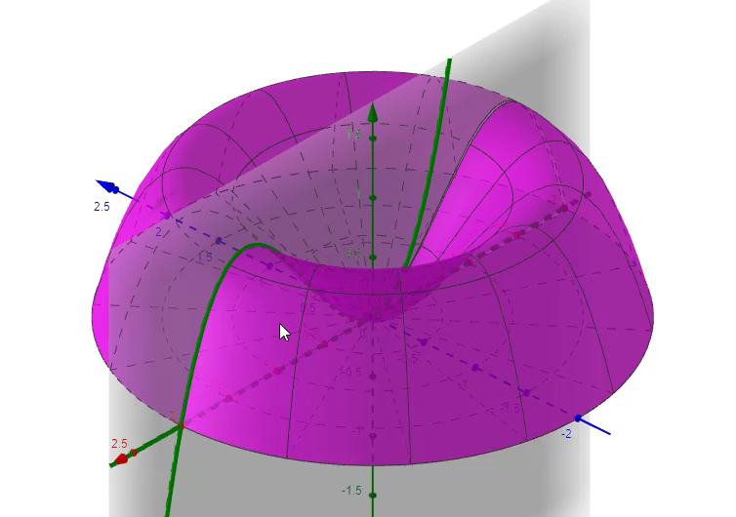
Example 1: Find the volume obtained by revolving the region bounded by the curves
$y=2x^{2}−x^{3}$ and $y=0$
About the y-axis.
WASHER ???
Furthermore, 3-D
https://www.geogebra.org/m/jqfyndpu

Slide 11
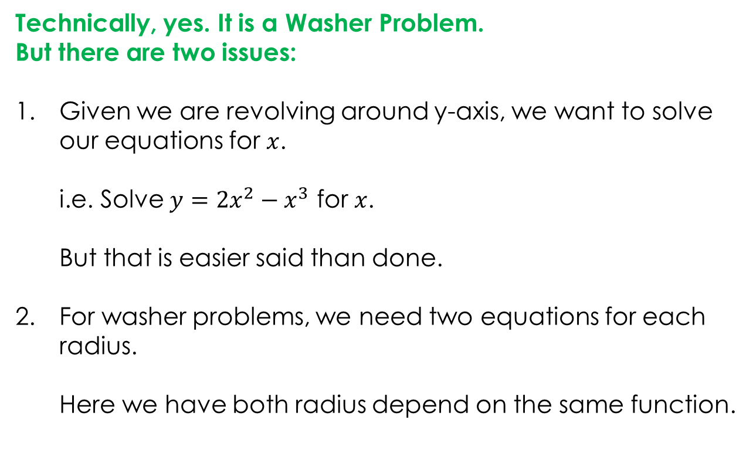
Example 1: Find the volume obtained by revolving the region bounded by the curves
$y=2x^{2}−x^{3}$ and $y=0$
About the y-axis.
Technically, yes. It is a Washer Problem.
But there are two issues:
Given we are revolving around y-axis, we want to solve our equations for $x$.
i.e. Solve $y=2x^{2}−x^{3}$ for $x$.
But that is easier said than done.
For washer problems, we need two equations for each radius.
Here we have both radius depend on the same function.
https://www.geogebra.org/m/jqfyndpu

Slide 12
So how can I do this kind of problem without giving myself a headache?
ANSWER: SHELL METHOD

Slide 13
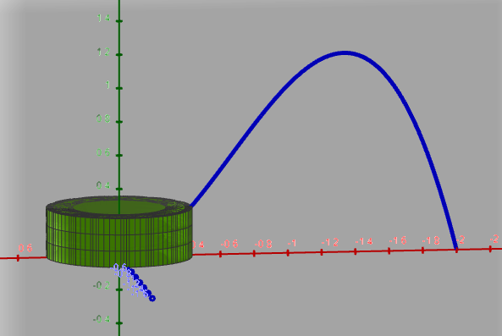
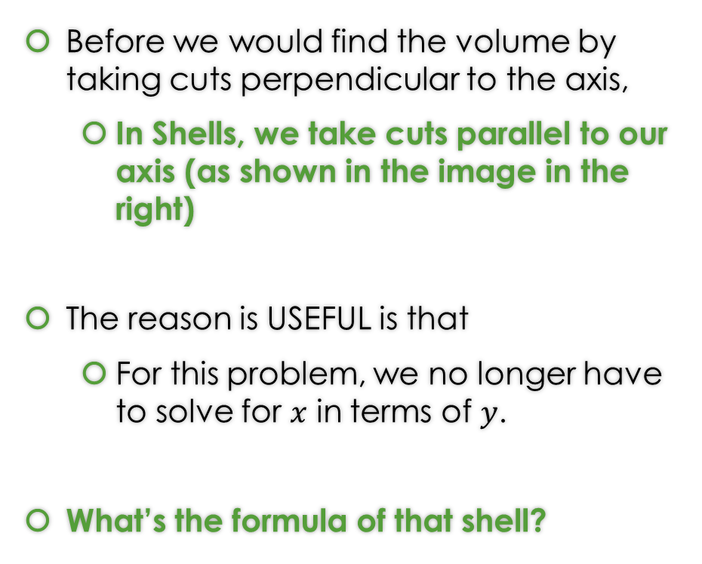
What’s a (Cylindrical) Shell?
Before we would find the volume by taking cuts perpendicular to the axis,
  In Shells, we take cuts parallel to our axis (as shown in the image in the right)
The reason is USEFUL is that
  For this problem, we no longer have to solve for $x$ in terms of $y$.
What’s the formula of that shell?
https://www.geogebra.org/m/jqfyndpu

Slide 14


Geometry Time: Let’s Flatten the Shell on the Right…
Circumference = $2π Δx$
height
Radius = $Δx$
https://www.geogebra.org/m/jqfyndpu

Slide 15
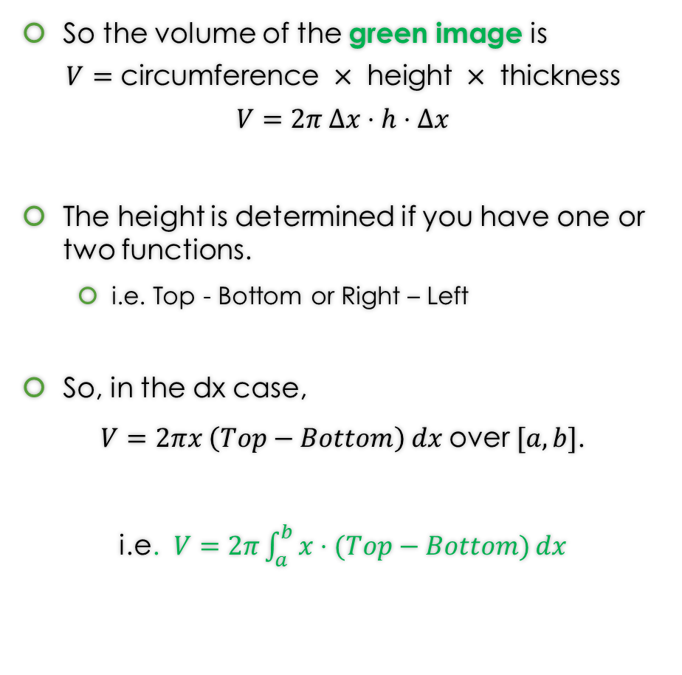
Geometry Time: Let’s Flatten the Shell on the Right…
So the volume of the green image is
$$V=\text{circumference} × \text{height} × \text{thickness}$$
$$V=2π Δx⋅h⋅Δx$$
The height is determined if you have one or two functions.
  i.e. Top - Bottom or Right – Left
So, in the dx case,
$V=2πx \left(Top−Bottom\right) dx$over $[a,b]$.
i.e. $V=2π\int_{a}^{b}{x⋅(Top−Bottom)}dx$
Circumference = $2π Δx$
height
Radius = $Δx$

Slide 16
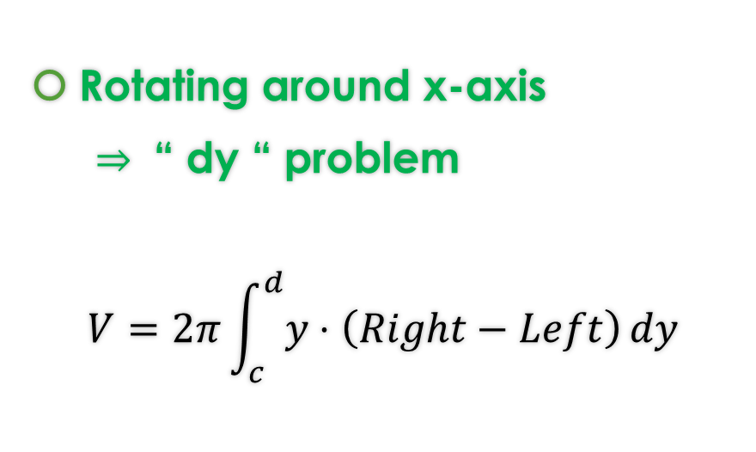

One thing about Shell Method Formulas
Since we are just cutting out parallel to the axis, we choose dx or dy in the following way:
Rotating around y-axis
$⇒$ “ dx “ problem
$$V=2π\int_{a}^{b}{x⋅(Top−Bottom)}dx$$
Rotating around x-axis
$⇒$ “ dy “ problem
$$V=2π\int_{c}^{d}{y⋅\left(Right−Left\right)}dy$$
If you need more of an explanation of where the Shell Method comes look at the hidden slides.

Slide 17
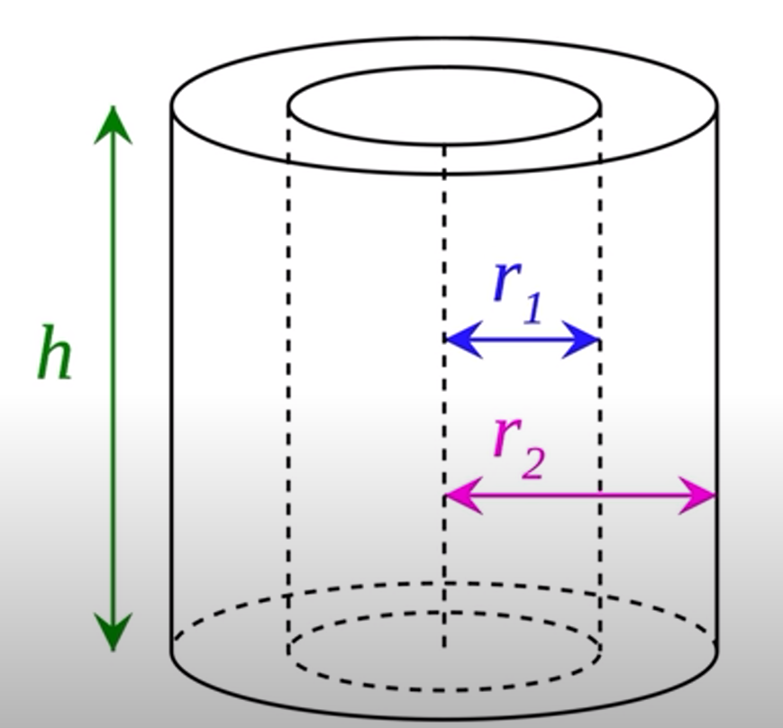
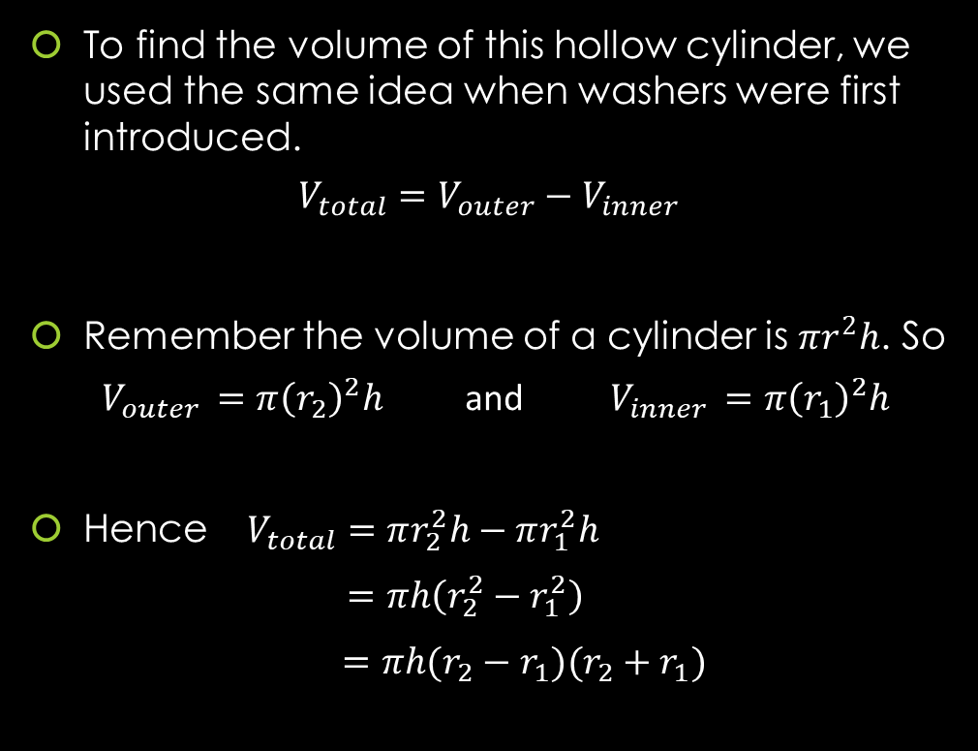
GEOMETRY: Finding The Volume of A Hollow Cylinder
To find the volume of this hollow cylinder, we used the same idea when washers were first introduced.
$$V_{total}=V_{outer}−V_{inner}$$
Remember the volume of a cylinder is $πr^{2}h$. So
$V_{outer }=π{\left(r_{2}\right)}^{2}h$ and $V_{inner }=π{\left(r_{1}\right)}^{2}h$
Hence $V_{total}=πr_{2}^{2}h−πr_{1}^{2}h$
$=πh\left(r_{2}^{2}−r_{1}^{2}\right)$
$=πh(r_{2}−r_{1})(r_{2}+r_{1})$

Slide 18
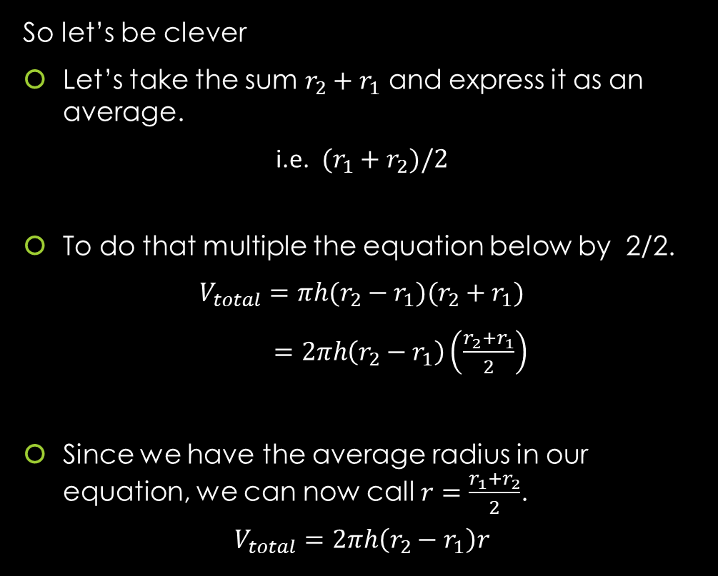
GEOMETRY: Finding The Volume of A Hollow Cylinder
So let’s be clever
Let’s take the sum $r_{2}+r_{1}$ and express it as an average.
i.e. $(r_{1}+r_{2})/2$
To do that multiple the equation below by 2/2.
$$V_{total}=πh(r_{2}−r_{1})(r_{2}+r_{1})$$
$=2πh\left(r_{2}−r_{1}\right)\left(\frac{r_{2}+r_{1}}{2}\right)$
Since we have the average radius in our equation, we can now call $r=\frac{r_{1}+r_{2}}{2}$.
$$V_{total}=2πh\left(r_{2}−r_{1}\right)r$$

Slide 19
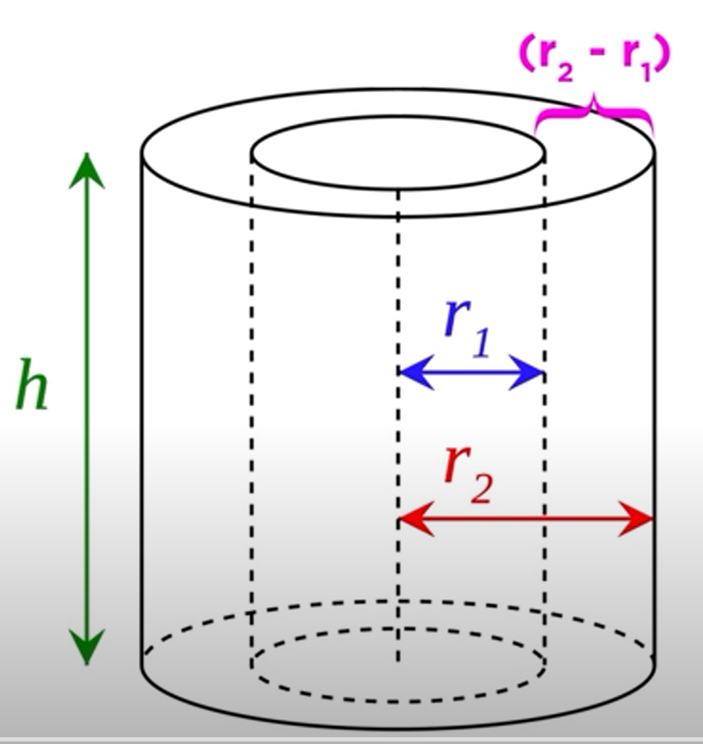
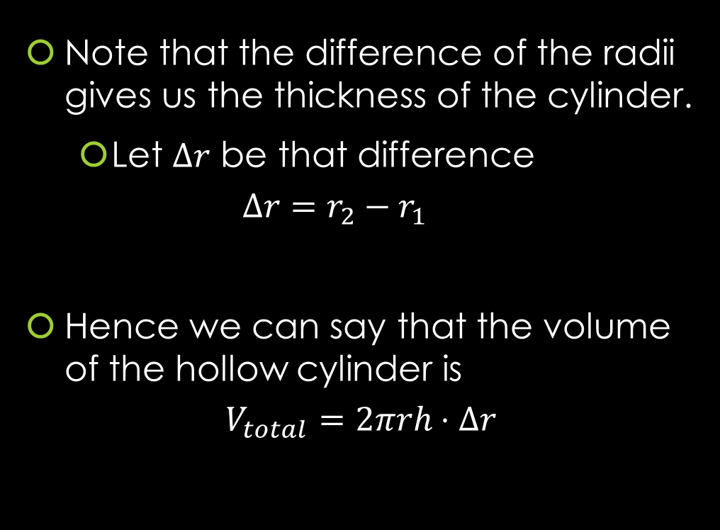
GEOMETRY: Finding The Volume of A Hollow Cylinder
Note that the difference of the radii gives us the thickness of the cylinder.
  Let $Δr$ be that difference
  $$Δr=r_{2}−r_{1}$$
Hence we can say that the volume of the hollow cylinder is
$$V_{total}=2πrh⋅Δr$$

Slide 20
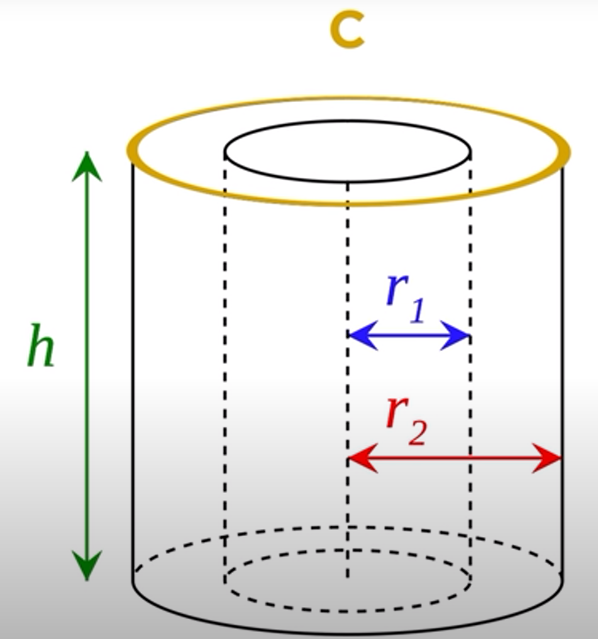
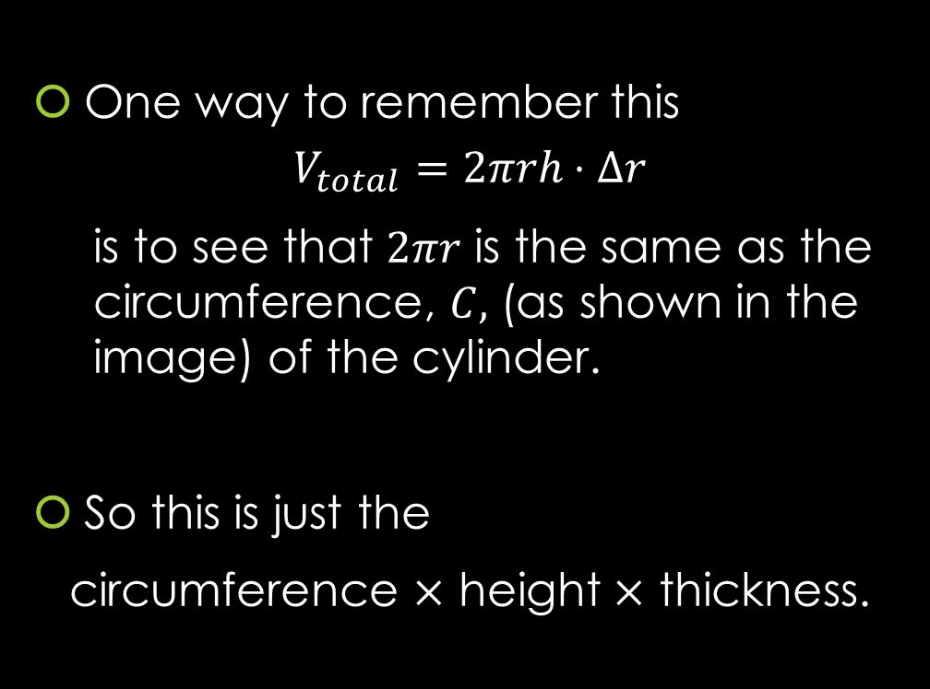
GEOMETRY: Finding The Volume of A Hollow Cylinder
One way to remember this
$$V_{total}=2πrh⋅Δr$$
    is to see that $2πr$ is the same as the circumference, $C,$ (as shown in the image) of the cylinder.
So this is just the
circumference $×$ height $×$ thickness.

Slide 21
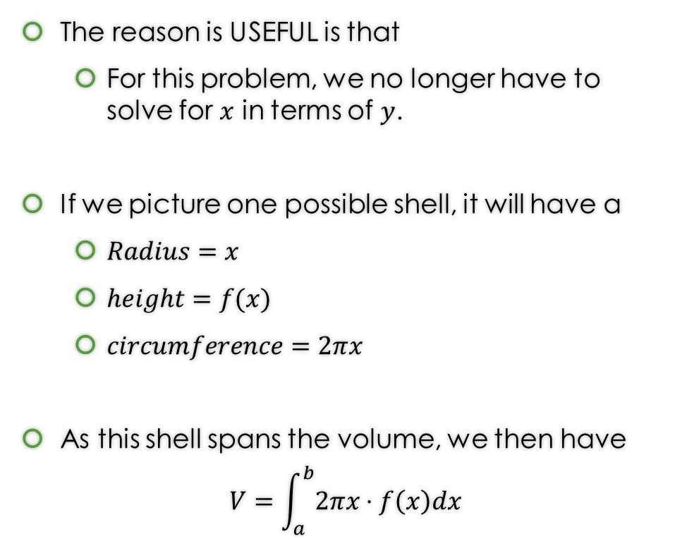
So how does this help us answer Example 1?
The reason is USEFUL is that
  For this problem, we no longer have to solve for $x$ in terms of $y$.
If we picture one possible shell, it will have a
  $Radius=x$
  $height=f(x)$
  $circumference=2πx$
As this shell spans the volume, we then have
$$V=\int_{a}^{b}{2πx⋅f\left(x\right)dx}$$
https://www.geogebra.org/m/jqfyndpu

Slide 22
Example 1: Find the volume obtained by revolving the region bounded by the curves
$y=2x^{2}−x^{3}$ and $y=0$
About the y-axis.
https://www.geogebra.org/m/jqfyndpu

Slide 23
Example 1: Find the volume obtained by revolving the region bounded by the curves
$y=2x^{2}−x^{3}$ and $y=0$
About the y-axis.
https://www.geogebra.org/m/jqfyndpu

Slide 24
Example 1: Find the volume obtained by revolving the region bounded by the curves
$y=2x^{2}−x^{3}$ and $y=0$
About the y-axis.
You can find the solution in the pdf of the notes. Click here to access it.
https://www.geogebra.org/m/jqfyndpu

Slide 25

Example 2: Find the volume obtained by revolving the region bounded by the curves
$x=y^{2}−2y$ and $x=4y−y^{2}$
About the x-axis.
https://www.geogebra.org/m/f3wrypfh#material/qrar4br5

Slide 26
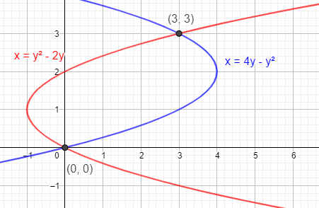
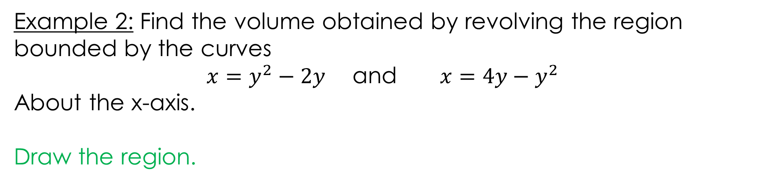

Example 2: Find the volume obtained by revolving the region bounded by the curves
$x=y^{2}−2y$ and $x=4y−y^{2}$
About the x-axis.
Draw the region.
https://www.geogebra.org/m/f3wrypfh#material/qrar4br5

Slide 27
Example 2: Find the volume obtained by revolving the region bounded by the curves
$x=y^{2}−2y$ and $x=4y−y^{2}$
About the x-axis.
https://www.geogebra.org/m/f3wrypfh#material/qrar4br5

Slide 28
Example 2: Find the volume obtained by revolving the region bounded by the curves
$x=y^{2}−2y$ and $x=4y−y^{2}$
About the x-axis.
https://www.geogebra.org/m/f3wrypfh#material/qrar4br5

Slide 29
Example 2: Find the volume obtained by revolving the region bounded by the curves
$x=y^{2}−2y$ and $x=4y−y^{2}$
About the x-axis.
https://www.geogebra.org/m/f3wrypfh#material/qrar4br5

Slide 30
Example 2: Find the volume obtained by revolving the region bounded by the curves
$x=y^{2}−2y$ and $x=4y−y^{2}$
About the x-axis.
You can find the solution in the pdf of the notes. Click here to access it.
https://www.geogebra.org/m/f3wrypfh#material/qrar4br5

Slide 31

Example 3: Consider the region bounded by:
$y=4x ,$ $y=0$ , and $x=10$
Set up the integral that represents the volume of solid obtained by the rotating the region about the y-axis using
A) Disk/Washer Method
https://www.geogebra.org/m/f3wrypfh#material/cb7tfq8n

Slide 32
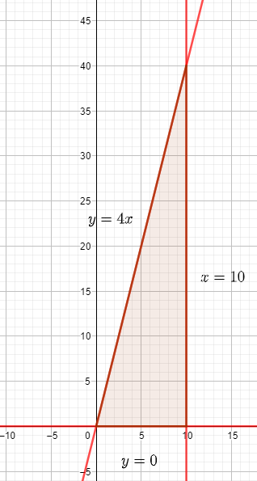
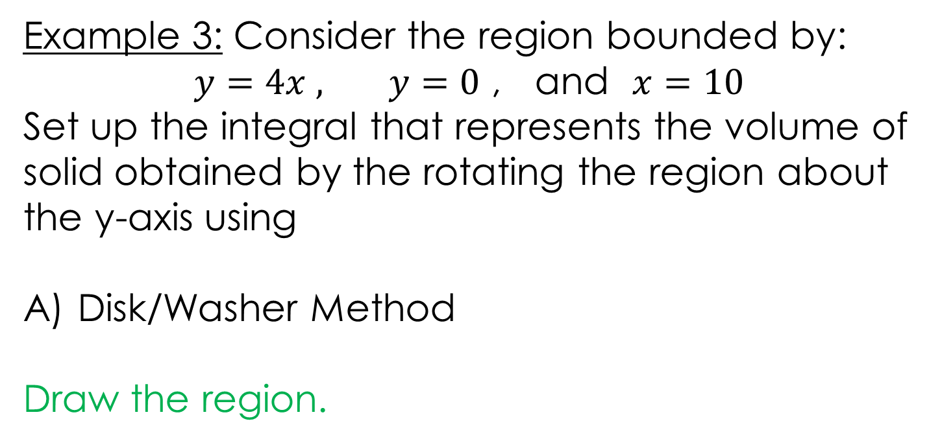

Example 3: Consider the region bounded by:
$y=4x ,$ $y=0$ , and $x=10$
Set up the integral that represents the volume of solid obtained by the rotating the region about the y-axis using
Disk/Washer Method
Draw the region.
https://www.geogebra.org/m/f3wrypfh#material/cb7tfq8n

Slide 33

Example 3: Consider the region bounded by:
$y=4x ,$ $y=0$ , and $x=10$
Set up the integral that represents the volume of solid obtained by the rotating the region about the y-axis using
Disk/Washer Method
https://www.geogebra.org/m/f3wrypfh#material/cb7tfq8n

Slide 34
Example 3: Consider the region bounded by:
$y=4x ,$ $y=0$ , and $x=10$
Set up the integral that represents the volume of solid obtained by the rotating the region about the y-axis using
Disk/Washer Method
https://www.geogebra.org/m/f3wrypfh#material/cb7tfq8n

Slide 35
Example 3: Consider the region bounded by:
$y=4x ,$ $y=0$ , and $x=10$
Set up the integral that represents the volume of solid obtained by the rotating the region about the y-axis using
Disk/Washer Method
You can find the solution in the pdf of the notes. Click here to access it.
https://www.geogebra.org/m/f3wrypfh#material/cb7tfq8n

Slide 36

Example 3: Consider the region bounded by:
$y=4x ,$ $y=0$ , and $x=10$
Set up the integral that represents the volume of solid obtained by the rotating the region about the y-axis using
B) Shell Method
https://www.geogebra.org/m/f3wrypfh#material/cb7tfq8n

Slide 37

Example 3: Consider the region bounded by:
$y=4x ,$ $y=0$ , and $x=10$
Set up the integral that represents the volume of solid obtained by the rotating the region about the y-axis using
B) Shell Method
Draw the region.
https://www.geogebra.org/m/f3wrypfh#material/cb7tfq8n

Slide 38

Example 3: Consider the region bounded by:
$y=4x ,$ $y=0$ , and $x=10$
Set up the integral that represents the volume of solid obtained by the rotating the region about the y-axis using
B) Shell Method
https://www.geogebra.org/m/f3wrypfh#material/cb7tfq8n

Slide 39
Example 3: Consider the region bounded by:
$y=4x ,$ $y=0$ , and $x=10$
Set up the integral that represents the volume of solid obtained by the rotating the region about the y-axis using
B) Shell Method
https://www.geogebra.org/m/f3wrypfh#material/cb7tfq8n

Slide 40
Example 3: Consider the region bounded by:
$y=4x ,$ $y=0$ , and $x=10$
Set up the integral that represents the volume of solid obtained by the rotating the region about the y-axis using
B) Shell Method
You can find the solution in the pdf of the notes. Click here to access it.
https://www.geogebra.org/m/f3wrypfh#material/cb7tfq8n

Slide 41

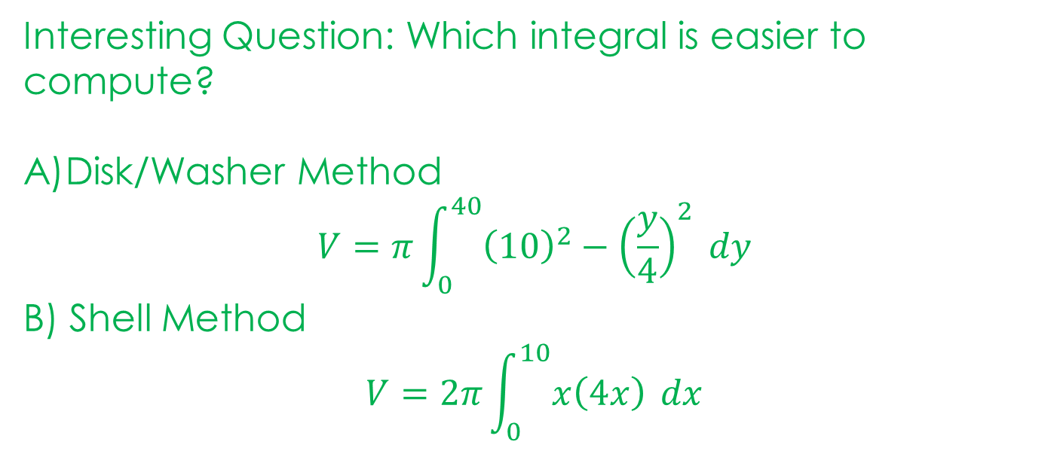
Example 3: Consider the region bounded by:
$y=4x ,$ $y=0$ , and $x=10$
Set up the integral that represents the volume of solid obtained by the rotating the region about the y-axis using
Interesting Question: Which integral is easier to compute?
Disk/Washer Method
$$V=π\int_{0}^{40}{{\left(10\right)}^{2}−{\left(\frac{y}{4}\right)}^{2} dy}$$
B) Shell Method
$$V=2π\int_{0}^{10}{x\left(4x\right)} dx$$
https://www.geogebra.org/m/f3wrypfh#material/cb7tfq8n

Slide 42
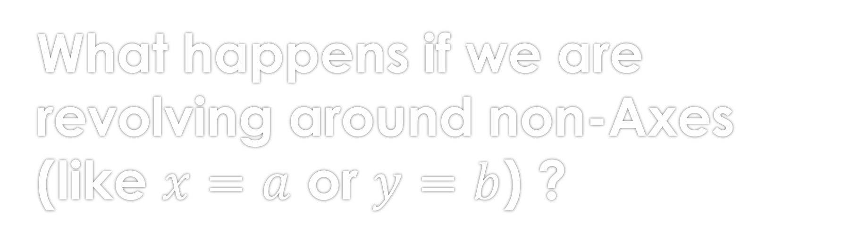
What happens if we are revolving around non-Axes (like $x=a$ or $y=b$) ?
For the most part, everything stays the same except for the RADIUS.

Slide 43
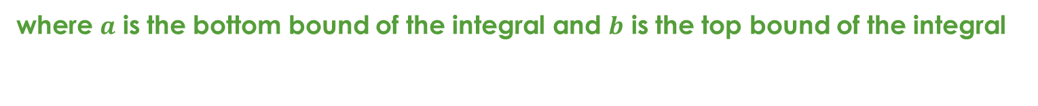
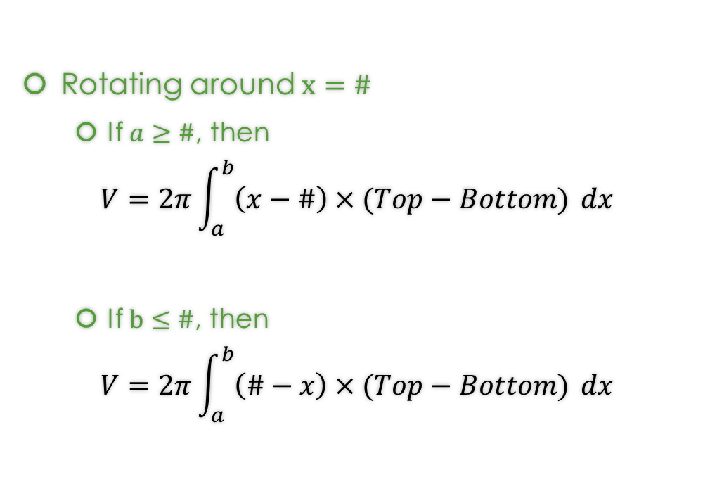
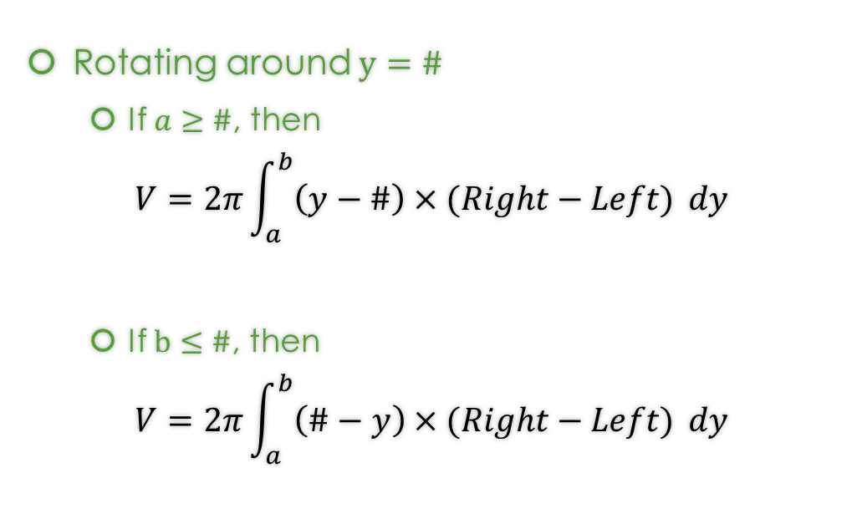
Well there are more formulas…
Rotating around $x=\#$
  If $a≥\#$, then
$$V=2π\int_{a}^{b}{\left(x−\#\right)×(Top−Bottom)} dx$$
  If $b≤\#$, then
$$V=2π\int_{a}^{b}{\left(\#−x\right)×(Top−Bottom)} dx$$
Rotating around $y=\#$
  If $a≥\#$, then
$$V=2π\int_{a}^{b}{\left(y−\#\right)×(Right−Left)} dy$$
  If $b≤\#$, then
$$V=2π\int_{a}^{b}{\left(\#−y\right)×(Right−Left)} dy$$
where $a$ is the bottom bound of the integral and $b$ is the top bound of the integral

Slide 44

Why do we need to consider whether $x=\#$ (or $y=\#$) is less than a or more than b?
Remember radiis are always positive, so we need to ensure that.

Slide 45
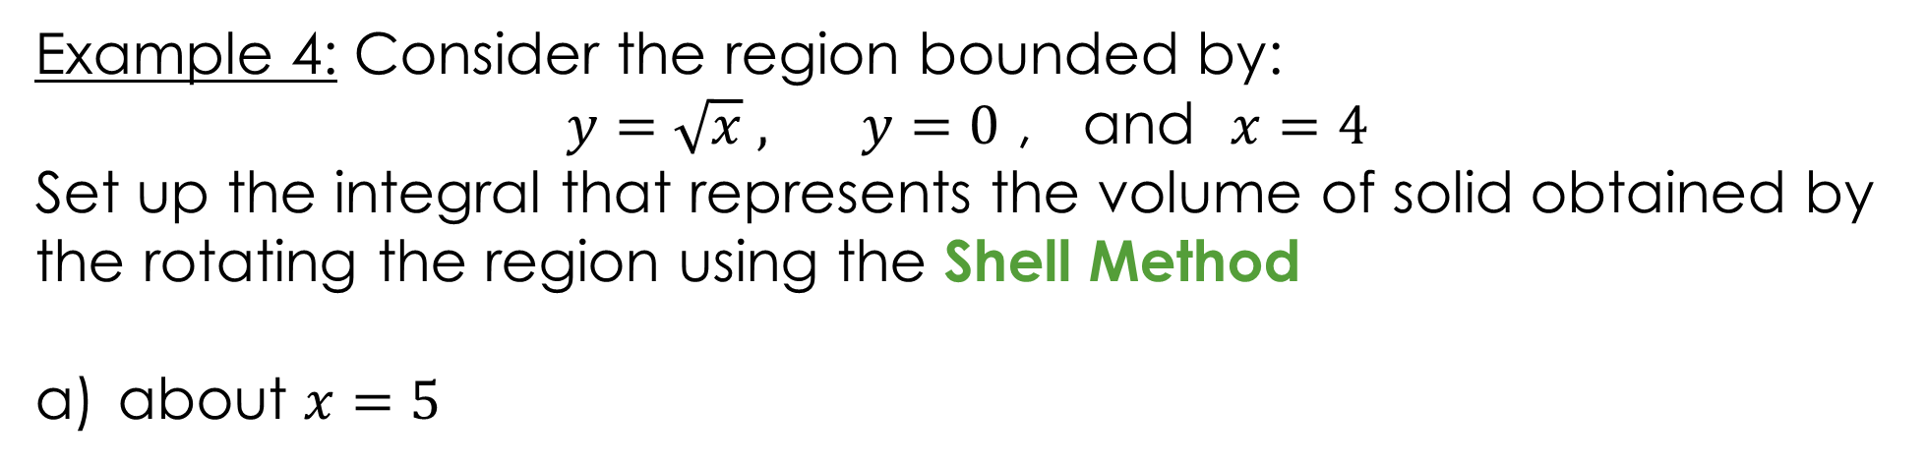
Example 4: Consider the region bounded by:
$y=\sqrt{x} ,$ $y=0$ , and $x=4$
Set up the integral that represents the volume of solid obtained by the rotating the region using the Shell Method
about $x=5$
https://www.geogebra.org/m/f3wrypfh#material/ttnatysu

Slide 46
Example 4: Consider the region bounded by:
$y=\sqrt{x} ,$ $y=0$ , and $x=4$
Set up the integral that represents the volume of solid obtained by the rotating the region using the Shell Method
about $x=5$
https://www.geogebra.org/m/f3wrypfh#material/ttnatysu

Slide 47
Example 4: Consider the region bounded by:
$y=\sqrt{x} ,$ $y=0$ , and $x=4$
Set up the integral that represents the volume of solid obtained by the rotating the region using the Shell Method
about $x=5$
You can find the solution in the pdf of the notes. Click here to access it.
https://www.geogebra.org/m/f3wrypfh#material/ttnatysu

Slide 48

Example 4: Consider the region bounded by:
$y=\sqrt{x} ,$ $y=0$ , and $x=4$
Set up the integral that represents the volume of solid obtained by the rotating the region using the Shell Method
b) about $x=−1$
https://www.geogebra.org/m/f3wrypfh#material/q38jv7yy

Slide 49
Example 4: Consider the region bounded by:
$y=\sqrt{x} ,$ $y=0$ , and $x=4$
Set up the integral that represents the volume of solid obtained by the rotating the region using the Shell Method
b) about $x=−1$
https://www.geogebra.org/m/f3wrypfh#material/q38jv7yy

Slide 50
Example 4: Consider the region bounded by:
$y=\sqrt{x} ,$ $y=0$ , and $x=4$
Set up the integral that represents the volume of solid obtained by the rotating the region using the Shell Method
b) about $x=−1$
You can find the solution in the pdf of the notes. Click here to access it.
https://www.geogebra.org/m/f3wrypfh#material/q38jv7yy

Slide 51

Example 5: Consider the region bounded by:
$x=y^{2}+1,$ and $x=2$
Set up the integral that represents the volume of solid obtained by the rotating the region using the Shell Method
about $y=3$
https://www.geogebra.org/m/f3wrypfh#material/gwgncmp2

Slide 52
Example 5: Consider the region bounded by:
$x=y^{2}+1,$ and $x=2$
Set up the integral that represents the volume of solid obtained by the rotating the region using the Shell Method
about $y=3$
https://www.geogebra.org/m/f3wrypfh#material/gwgncmp2

Slide 53
Example 5: Consider the region bounded by:
$x=y^{2}+1,$ and $x=2$
Set up the integral that represents the volume of solid obtained by the rotating the region using the Shell Method
about $y=3$
You can find the solution in the pdf of the notes. Click here to access it.
https://www.geogebra.org/m/f3wrypfh#material/gwgncmp2

Slide 54

Example 5: Consider the region bounded by:
$x=y^{2}+1,$ and $x=2$
Set up the integral that represents the volume of solid obtained by the rotating the region using the Shell Method
b) about $y=−2$
https://www.geogebra.org/m/f3wrypfh#material/wz7r6nxy

Slide 55
Example 5: Consider the region bounded by:
$x=y^{2}+1,$ and $x=2$
Set up the integral that represents the volume of solid obtained by the rotating the region using the Shell Method
b) about $y=−2$
https://www.geogebra.org/m/f3wrypfh#material/wz7r6nxy

Slide 56
Example 5: Consider the region bounded by:
$x=y^{2}+1,$ and $x=2$
Set up the integral that represents the volume of solid obtained by the rotating the region using the Shell Method
b) about $y=−2$
You can find the solution in the pdf of the notes. Click here to access it.
https://www.geogebra.org/m/f3wrypfh#material/wz7r6nxy

Slide 57
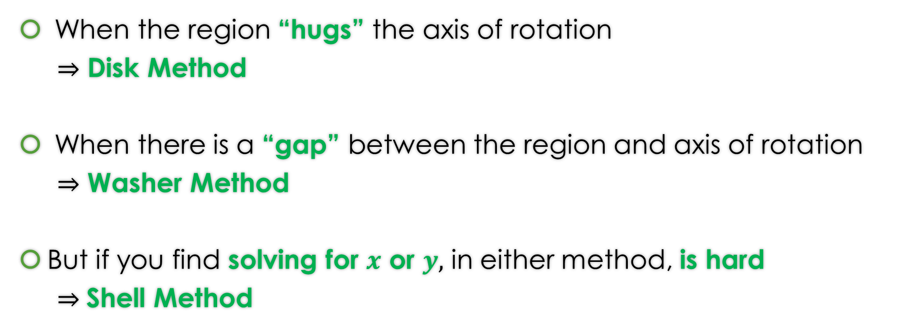
When do we apply Disk Method or Washer Method or Shell Method?
When the region “hugs” the axis of rotation
$⇒$ Disk Method
When there is a “gap” between the region and axis of rotation
$⇒$ Washer Method
But if you find solving for $x$ or $y,$ in either method, is hard
$⇒$Shell Method

Slide 58
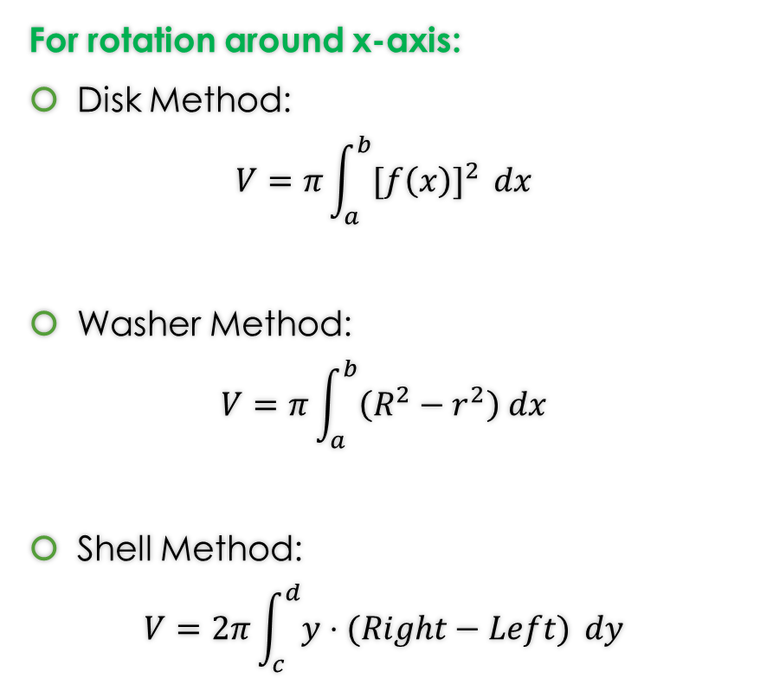

Formulas from Lessons 10 and 11 and 13
Rotation around x-axis or y-axis
For rotation around y-axis:
Disk Method:
$$V=π\int_{c}^{d}{{[g(y)]}^{2} }dy$$
Washer Method:
$$V=π\int_{c}^{d}{\left(R^{2}−r^{2}\right) dy}$$
Shell Method:
$$V=2π\int_{a}^{b}{x⋅(Top−Bottom)} dx$$
For rotation around x-axis:
Disk Method:
$$V=π\int_{a}^{b}{{[f\left(x\right)]}^{2} }dx$$
Washer Method:
$$V=π\int_{a}^{b}{\left(R^{2}−r^{2}\right) dx}$$
Shell Method:
$$V=2π\int_{c}^{d}{y⋅(Right−Left)} dy$$

Slide 59
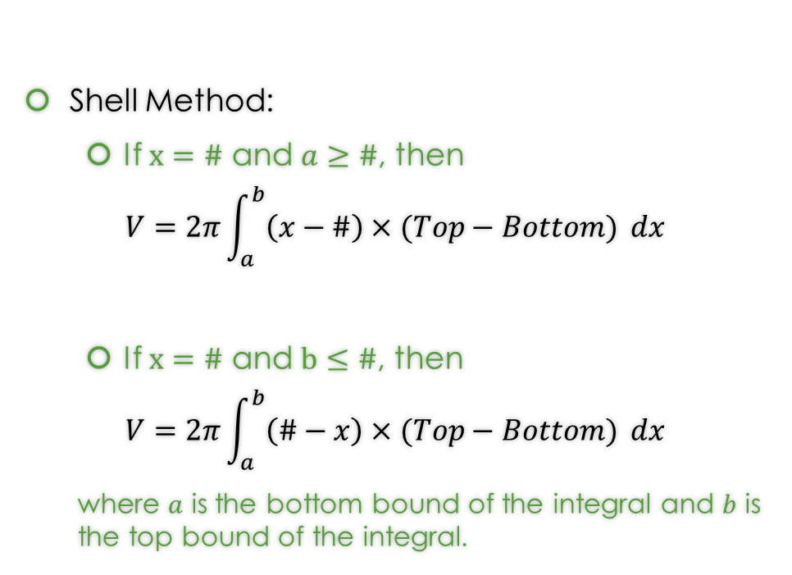
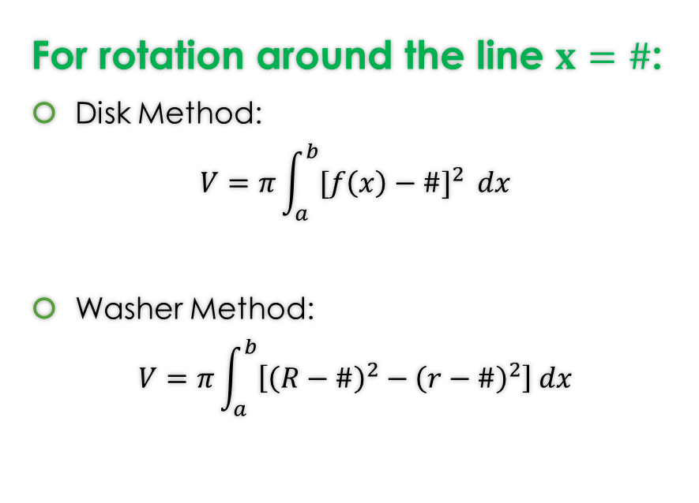
Formulas from Lesson 12 and 13
Rotation around any non-Axis Formulas
For rotation around the line $x=\#$:
Disk Method:
$$V=π\int_{a}^{b}{{[f\left(x\right)−\#]}^{2} }dx$$
Washer Method:
$$V=π\int_{a}^{b}{\left[{\left(R−\#\right)}^{2}−{\left(r−\#\right)}^{2}\right] dx}$$
Shell Method:
  If $x=\#$ and $a≥\#$, then
$$V=2π\int_{a}^{b}{\left(x−\#\right)×(Top−Bottom)} dx$$
  If $x=\#$ and $b≤\#$, then
$$V=2π\int_{a}^{b}{\left(\#−x\right)×(Top−Bottom)} dx$$
  where $a$ is the bottom bound of the integral and $b$ is the top bound of the integral.
Note: That these formulas work for the case of x-axis ($y=0)$ and y-axis ($x=0$).

Slide 60
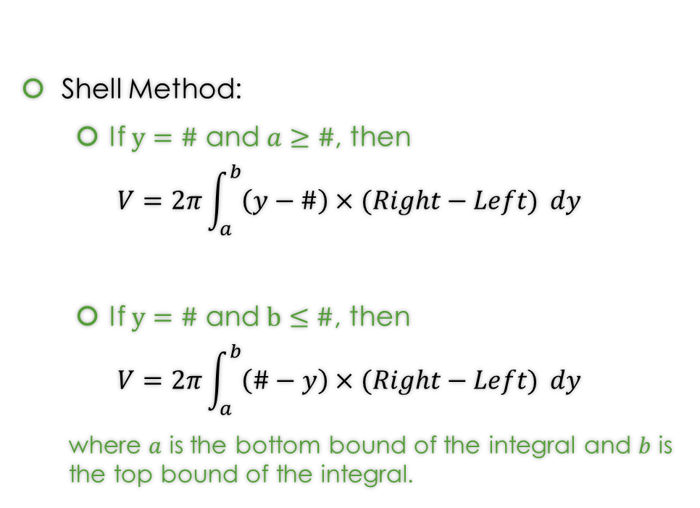

Formulas from Lesson 12 and 13
Rotation around any non-Axis Formulas
For rotation around the line $y=\#$:
Disk Method:
$$V=π\int_{c}^{d}{{[g\left(y\right)−\#]}^{2} }dy$$
Washer Method:
$$V=π\int_{c}^{d}{\left[{\left(R−\#\right)}^{2}−{\left(r−\#\right)}^{2}\right] dy}$$
Shell Method:
  If $y=\#$ and $a≥\#$, then
$$V=2π\int_{a}^{b}{\left(y−\#\right)×(Right−Left)} dy$$
  If $y=\#$ and $b≤\#$, then
$$V=2π\int_{a}^{b}{\left(\#−y\right)×(Right−Left)} dy$$
  where $a$ is the bottom bound of the integral and $b$ is the top bound of the integral.
Note: That these formulas work for the case of x-axis ($y=0)$ and y-axis ($x=0$).

Slide 61
GeoGebra Link for Lesson 13
https://www.geogebra.org/m/f3wrypfh
Note click on the play buttons on the left-most screen and the animation will play/pause.

