Slide 1
MA 16020: Lesson 15
Volume By Revolution
Washer Method
By: Alexandra Cuadra

Slide 2
Last Time, we talked about…
How Geometry gave us formulas for simple shapes and solids to find their area or volume, and
How Integration can allow us to find area or volume of ANYTHING !
  How?
  We introduced this notion of cross-sections which can be of the form of
    Disks (Lessons 14 + 16), or
    Washers (Lessons 15 + 16), or
    Shells (Lessons 17 + 18)

Slide 3
Geometry: How to Calculate The Area of a Shaded Region
Suppose we are asked to find the area of a rectangle with a triangle missing from the middle.
How do we calculate that area?

Slide 4
Geometry: How to Calculate The Area of a Shaded Region
First, we would find the area of the rectangle and the area of the triangle separately.

Slide 5
Geometry: How to Calculate The Area of a Shaded Region
Then we would subtract these two values …

Slide 6
Geometry: How to Calculate The Area of a Shaded Region
… to find the remaining area.

Slide 7
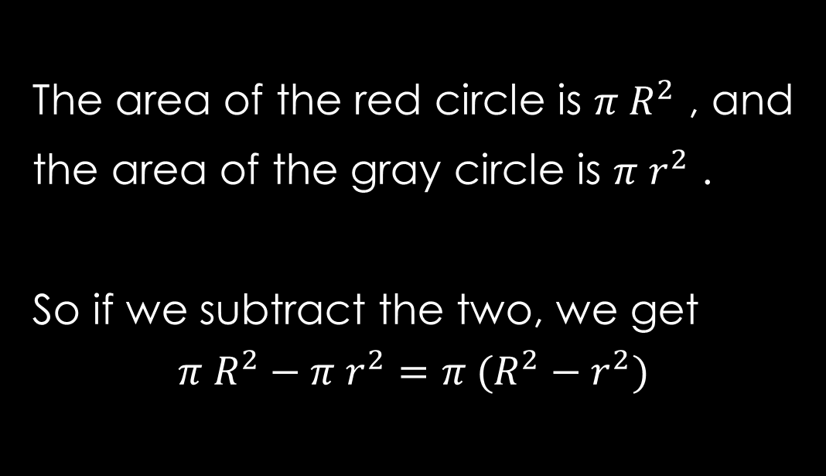
What if we did this with disks?
Let’s find the area of the red annulus.
The area of the red circle is $π R^{2}$ , and
the area of the gray circle is $π r^{2}$ .
So if we subtract the two, we get
$$π R^{2}−π r^{2}=π (R^{2}−r^{2})$$
R
r

Slide 8
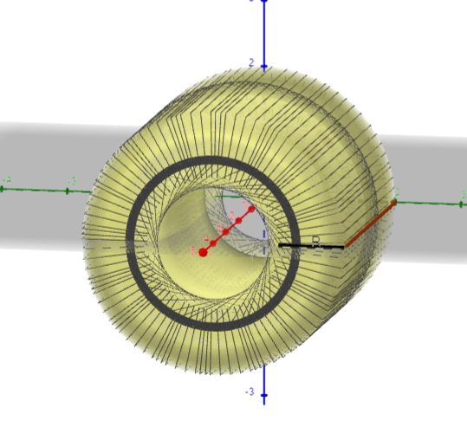
Today’s Lecture
In this lesson, we are going to play with disks, but remove a portion of it.
This method is called the washer method.
https://www.geogebra.org/m/uym6dwyd

Slide 9
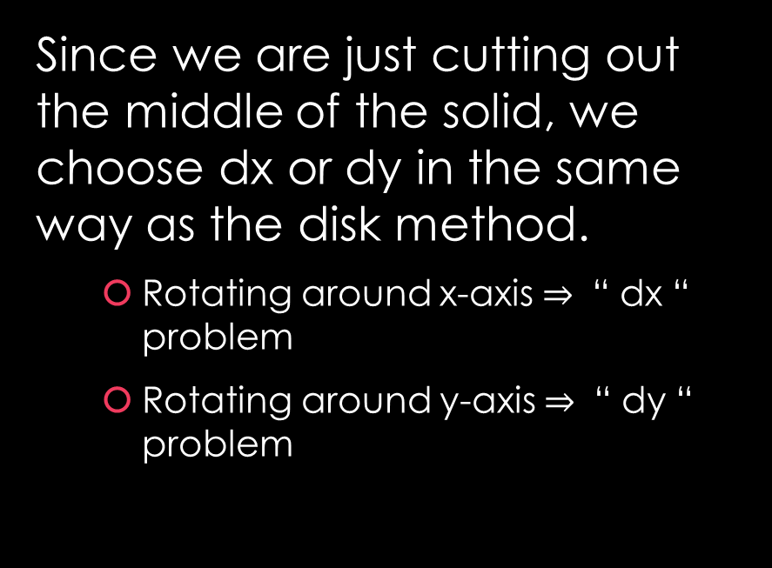
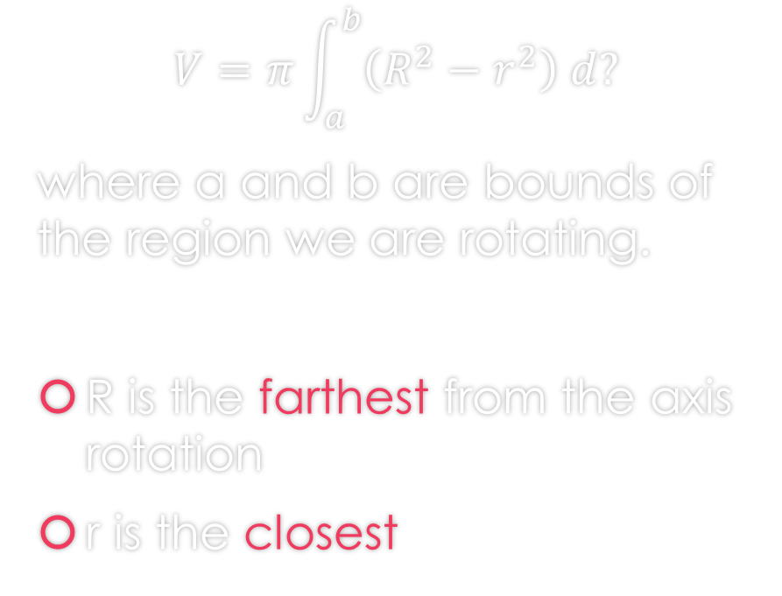
Washer Method Formula
Since we are just cutting out the middle of the solid, we choose dx or dy in the same way as the disk method.
  Rotating around x-axis $⇒$ “ dx “ problem
  Rotating around y-axis $⇒$ “ dy “ problem
$$V=π\int_{a}^{b}{\left(R^{2}−r^{2}\right) d?}$$
where a and b are bounds of the region we are rotating.
R is the farthest from the axis rotation
r is the closest

Slide 10
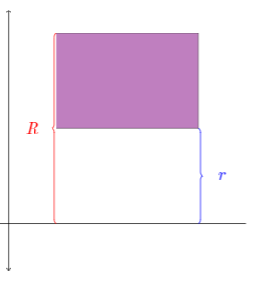
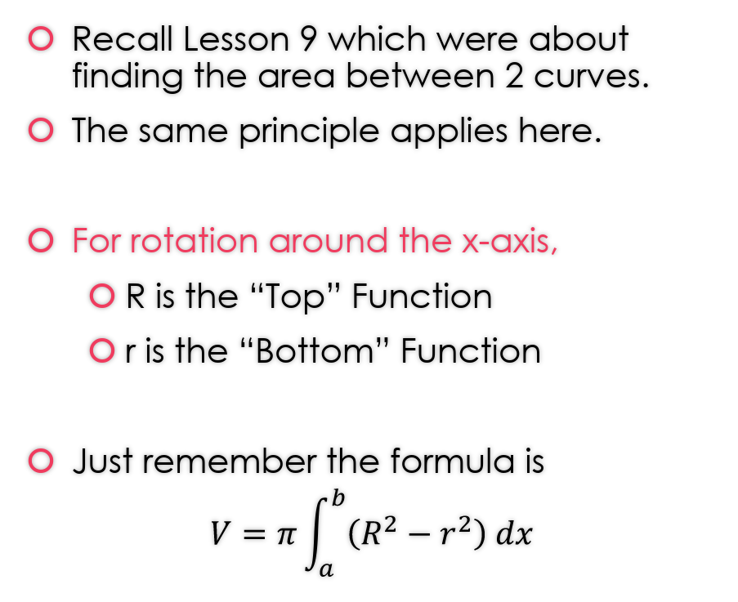
Let’s talk a bit more about R and r
Recall Lesson 9 which were about finding the area between 2 curves.
The same principle applies here.
For rotation around the x-axis,
  R is the “Top” Function
  r is the “Bottom” Function
Just remember the formula is
$$V=π\int_{a}^{b}{\left(R^{2}−r^{2}\right) dx}$$

Slide 11
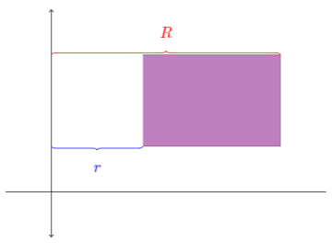
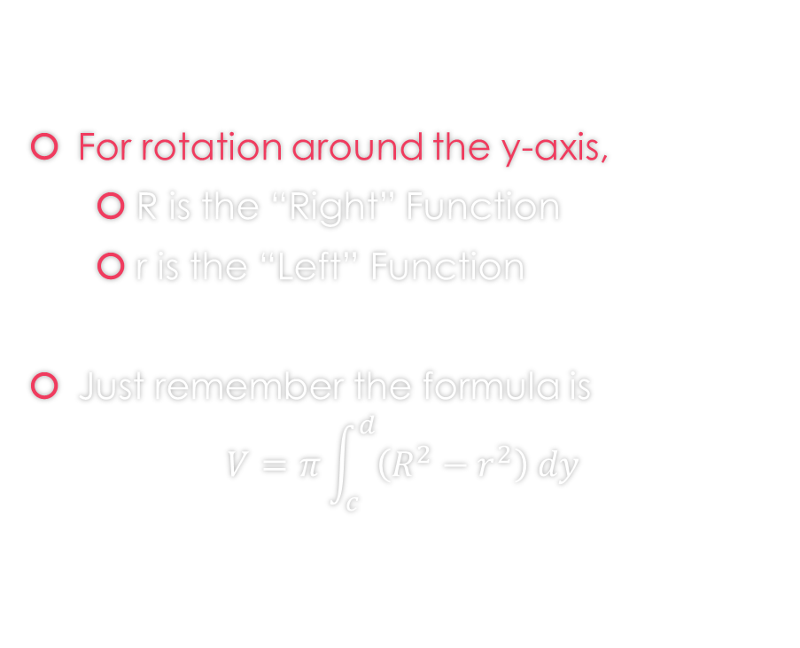
Let’s talk a bit more about R and r
For rotation around the y-axis,
  R is the “Right” Function
  r is the “Left” Function
Just remember the formula is
$$V=π\int_{c}^{d}{\left(R^{2}−r^{2}\right) dy}$$

Slide 12
How to Proceed with Washer Problems
Draw the region
Determine which axis you are rotating on
  If x - axis: Determine Top and Bottom Function
    R is Top
    r is Bottom
  If y - axis: Determine Right and Left Function
    R is Right
    r is Left
Finally, apply the washer formula

Slide 13
Examples

Slide 14

Example 1: Find the volume of the solid that results by revolving the region enclosed by the curves
$y=\frac{x}{2}$, $y=3x$, and $x=2$
About the x-axis.
https://www.geogebra.org/m/m2p2kdmp

Slide 15
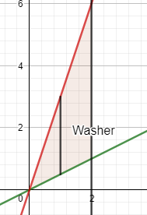
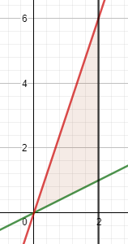

Example 1: Find the volume of the solid that results by revolving the region enclosed by the curves
$y=\frac{x}{2}$, $y=3x$, and $x=2$
About the x-axis.
First draw the region.
https://www.geogebra.org/m/m2p2kdmp

Slide 16
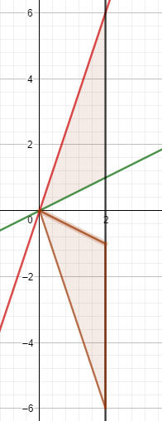

Example 1: Find the volume of the solid that results by revolving the region enclosed by the curves
$y=\frac{x}{2}$, $y=3x$, and $x=2$
About the x-axis.
Rotation about x-axis
https://www.geogebra.org/m/m2p2kdmp

Slide 17
Example 1: Find the volume of the solid that results by revolving the region enclosed by the curves
$y=\frac{x}{2}$, $y=3x$, and $x=2$
About the x-axis.
https://www.geogebra.org/m/m2p2kdmp

Slide 18

Example 1: Find the volume of the solid that results by revolving the region enclosed by the curves
$y=\frac{x}{2}$, $y=3x$, and $x=2$
About the x-axis.
https://www.geogebra.org/m/m2p2kdmp

Slide 19
Example 1: Find the volume of the solid that results by revolving the region enclosed by the curves
$y=\frac{x}{2}$, $y=3x$, and $x=2$
About the x-axis.
You can find the solution in the pdf of the notes. Click here to access it.
https://www.geogebra.org/m/m2p2kdmp

Slide 20

Example 2: Find the volume of the solid that results by revolving the region enclosed by the curves
$y=e^{−x}$, $y=2$, and $x=3$
About the x-axis.
https://www.geogebra.org/m/jfta4b52

Slide 21
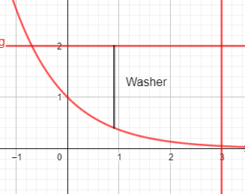

Example 2: Find the volume of the solid that results by revolving the region enclosed by the curves
$y=e^{−x}$, $y=2$, and $x=3$
About the x-axis.
First draw the region.
https://www.geogebra.org/m/jfta4b52

Slide 22
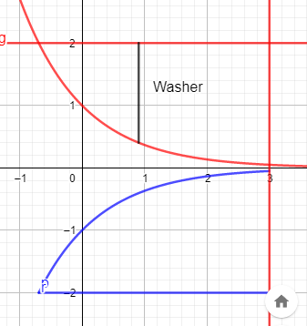

Example 2: Find the volume of the solid that results by revolving the region enclosed by the curves
$y=e^{−x}$, $y=2$, and $x=3$
About the x-axis.
Rotation about x-axis
https://www.geogebra.org/m/jfta4b52

Slide 23
Example 2: Find the volume of the solid that results by revolving the region enclosed by the curves
$y=e^{−x}$, $y=2$, and $x=3$
About the x-axis.
https://www.geogebra.org/m/jfta4b52

Slide 24
Example 2: Find the volume of the solid that results by revolving the region enclosed by the curves
$y=e^{−x}$, $y=2$, and $x=3$
About the x-axis.
https://www.geogebra.org/m/jfta4b52

Slide 25
Example 2: Find the volume of the solid that results by revolving the region enclosed by the curves
$y=e^{−x}$, $y=2$, and $x=3$
About the x-axis.
https://www.geogebra.org/m/jfta4b52

Slide 26
Example 2: Find the volume of the solid that results by revolving the region enclosed by the curves
$y=e^{−x}$, $y=2$, and $x=3$
About the x-axis.
You can find the solution in the pdf of the notes. Click here to access it.
https://www.geogebra.org/m/jfta4b52

Slide 27

Example 3: Find the volume of the solid that results by revolving the region enclosed by the curves
$y=x^{2}$, $x=2$, and $y=0$
About the y-axis.
https://www.geogebra.org/m/znzmhqq7

Slide 28
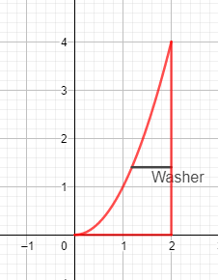

Example 3: Find the volume of the solid that results by revolving the region enclosed by the curves
$y=x^{2}$, $x=2$, and $y=0$
About the y-axis.
First draw the region.
https://www.geogebra.org/m/znzmhqq7

Slide 29
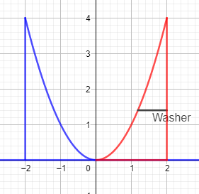

Example 3: Find the volume of the solid that results by revolving the region enclosed by the curves
$y=x^{2}$, $x=2$, and $y=0$
About the y-axis.
Rotation about y-axis
https://www.geogebra.org/m/znzmhqq7

Slide 30
Example 3: Find the volume of the solid that results by revolving the region enclosed by the curves
$y=x^{2}$, $x=2$, and $y=0$
About the y-axis.
https://www.geogebra.org/m/znzmhqq7

Slide 31
Example 3: Find the volume of the solid that results by revolving the region enclosed by the curves
$y=x^{2}$, $x=2$, and $y=0$
About the y-axis.
https://www.geogebra.org/m/znzmhqq7

Slide 32
Example 3: Find the volume of the solid that results by revolving the region enclosed by the curves
$y=x^{2}$, $x=2$, and $y=0$
About the y-axis.
https://www.geogebra.org/m/znzmhqq7

Slide 33
Example 3: Find the volume of the solid that results by revolving the region enclosed by the curves
$y=x^{2}$, $x=2$, and $y=0$
About the y-axis.
You can find the solution in the pdf of the notes. Click here to access it.
https://www.geogebra.org/m/znzmhqq7

Slide 34

Example 4: Find the volume of the solid that results by revolving the region inside the circle $x^{2}+y^{2}=9$ and to the right of the line $x=1$ about the y-axis.
https://www.geogebra.org/m/c2wzbrbf

Slide 35
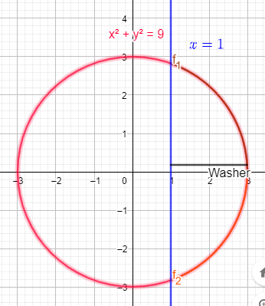

Example 4: Find the volume of the solid that results by revolving the region inside the circle $x^{2}+y^{2}=9$ and to the right of the line $x=1$ about the y-axis.
First draw the region.
https://www.geogebra.org/m/c2wzbrbf

Slide 36
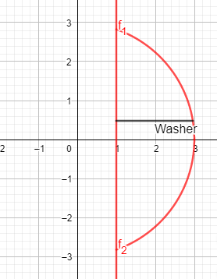
Example 4: Find the volume of the solid that results by revolving the region inside the circle $x^{2}+y^{2}=9$ and to the right of the line $x=1$ about the y-axis.
First draw the region.
Note we are only looking at the right of x=1
https://www.geogebra.org/m/c2wzbrbf

Slide 37
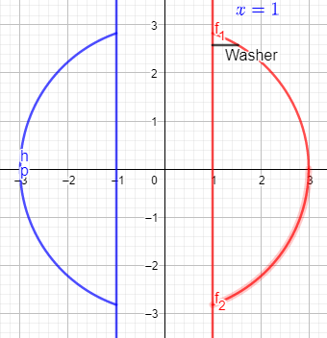
Example 4: Find the volume of the solid that results by revolving the region inside the circle $x^{2}+y^{2}=9$ and to the right of the line $x=1$ about the y-axis.
Rotation about y-axis
https://www.geogebra.org/m/c2wzbrbf

Slide 38
Example 4: Find the volume of the solid that results by revolving the region inside the circle $x^{2}+y^{2}=9$ and to the right of the line $x=1$ about the y-axis.
https://www.geogebra.org/m/c2wzbrbf

Slide 39
Example 4: Find the volume of the solid that results by revolving the region inside the circle $x^{2}+y^{2}=9$ and to the right of the line $x=1$ about the y-axis.
https://www.geogebra.org/m/c2wzbrbf

Slide 40
Example 4: Find the volume of the solid that results by revolving the region inside the circle $x^{2}+y^{2}=9$ and to the right of the line $x=1$ about the y-axis.
https://www.geogebra.org/m/c2wzbrbf

Slide 41
Example 4: Find the volume of the solid that results by revolving the region inside the circle $x^{2}+y^{2}=9$ and to the right of the line $x=1$ about the y-axis.
https://www.geogebra.org/m/c2wzbrbf

Slide 42
Example 4: Find the volume of the solid that results by revolving the region inside the circle $x^{2}+y^{2}=9$ and to the right of the line $x=1$ about the y-axis.
You can find the solution in the pdf of the notes. Click here to access it.
https://www.geogebra.org/m/c2wzbrbf

Slide 43

Example 5: Find the volume of the solid obtained by revolving the region enclosed by the curves
$y^{2}=x$, and $x=y$
a) About the y-axis
https://www.geogebra.org/m/qtt49cqx

Slide 44
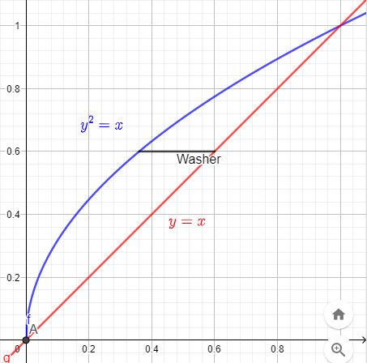
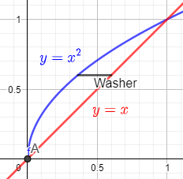

Example 5: Find the volume of the solid obtained by revolving the region enclosed by the curves
$y^{2}=x$, and $x=y$
a) About the y-axis
First draw the region.
https://www.geogebra.org/m/qtt49cqx

Slide 45
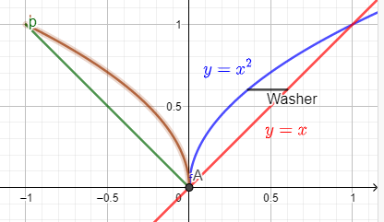
Example 5: Find the volume of the solid obtained by revolving the region enclosed by the curves
$y^{2}=x$, and $x=y$
a) About the y-axis
Rotation about y-axis
https://www.geogebra.org/m/qtt49cqx

Slide 46
Example 5: Find the volume of the solid obtained by revolving the region enclosed by the curves
$y^{2}=x$, and $x=y$
a) About the y-axis
https://www.geogebra.org/m/qtt49cqx

Slide 47
Example 5: Find the volume of the solid obtained by revolving the region enclosed by the curves
$y^{2}=x$, and $x=y$
a) About the y-axis
You can find the solution in the pdf of the notes. Click here to access it.
https://www.geogebra.org/m/qtt49cqx

Slide 48

Example 5: Find the volume of the solid obtained by revolving the region enclosed by the curves
$y^{2}=x$, and $x=y$
b) About the x-axis
https://www.geogebra.org/m/esmxtp7s

Slide 49
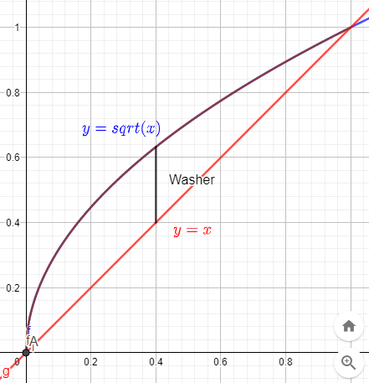

Example 5: Find the volume of the solid obtained by revolving the region enclosed by the curves
$y^{2}=x$, and $x=y$
b) About the x-axis
First draw the region.
https://www.geogebra.org/m/esmxtp7s

Slide 50
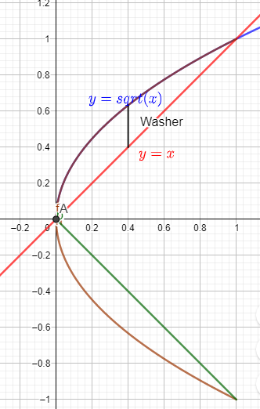
Example 5: Find the volume of the solid obtained by revolving the region enclosed by the curves
$y^{2}=x$, and $x=y$
b) About the x-axis
Rotation about x-axis
https://www.geogebra.org/m/esmxtp7s

Slide 51
Example 5: Find the volume of the solid obtained by revolving the region enclosed by the curves
$y^{2}=x$, and $x=y$
b) About the x-axis
https://www.geogebra.org/m/esmxtp7s

Slide 52
Example 5: Find the volume of the solid obtained by revolving the region enclosed by the curves
$y^{2}=x$, and $x=y$
b) About the x-axis
https://www.geogebra.org/m/esmxtp7s

Slide 53
Example 5: Find the volume of the solid obtained by revolving the region enclosed by the curves
$y^{2}=x$, and $x=y$
b) About the x-axis
You can find the solution in the pdf of the notes. Click here to access it.
https://www.geogebra.org/m/esmxtp7s

Slide 54
When do we apply Disk Method or Washer Method?

Slide 55
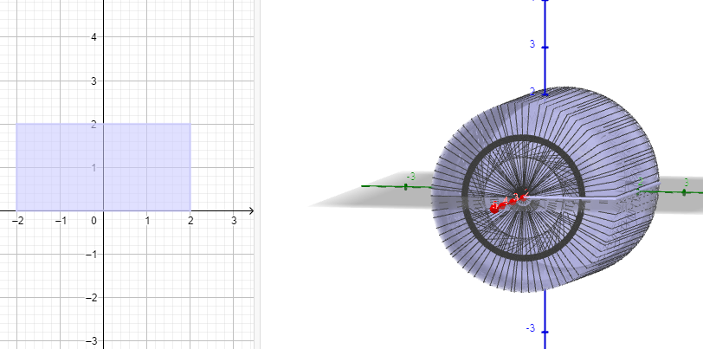
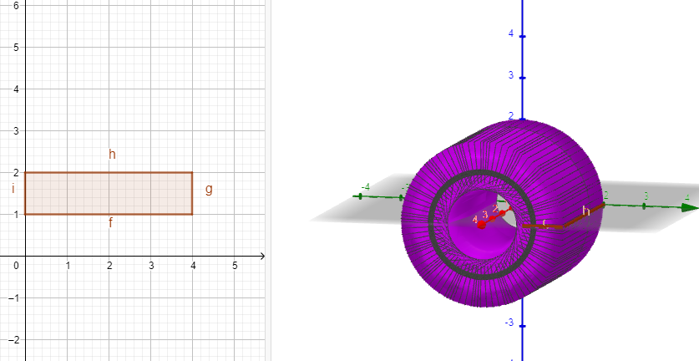
When do apply Disk Method or Washer Method?
Disk Method
Washer Method

Slide 56
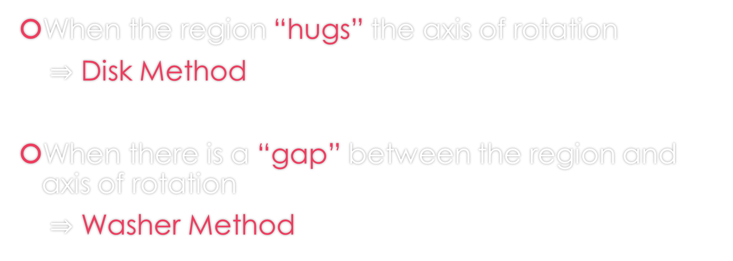
When do we apply Disk Method or Washer Method?
When the region “hugs” the axis of rotation
$⇒$ Disk Method
When there is a “gap” between the region and axis of rotation
$⇒$ Washer Method

Slide 57
GeoGebra Link for Lesson 15
https://www.geogebra.org/m/f73zjxfe
Note click on the play buttons on the left-most screen and the animation will play/pause.

