Slide 1
Math Success Workshop

Slide 2
Learn to relax efficiently.
Ways to relax:
  Breathing techniques
  Perfect place visualization
  Progressive muscle relaxation
Want or overlearn these techniques so you can:
  Do them automatically
  Become relaxed in a minute or two

Slide 3
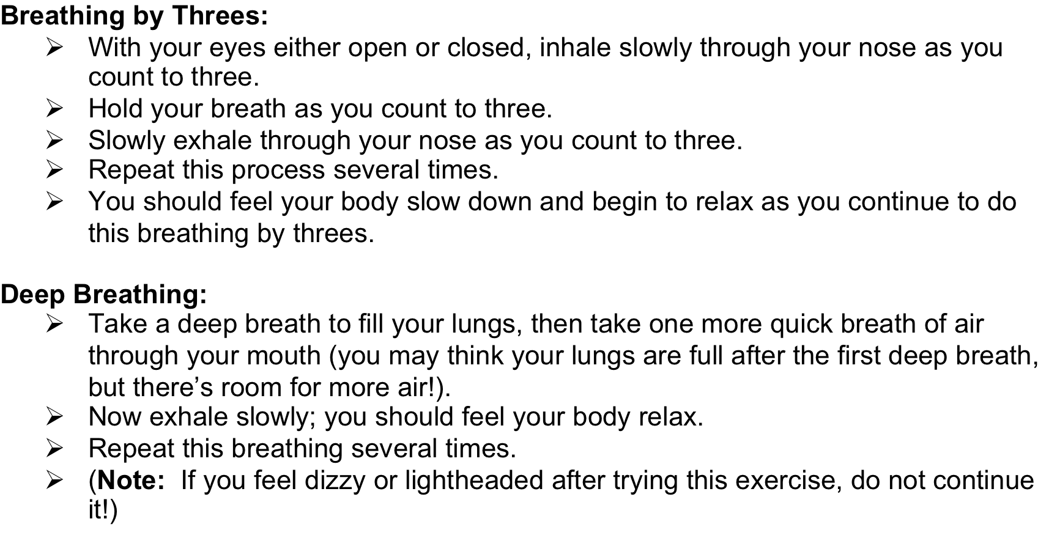

Slide 4
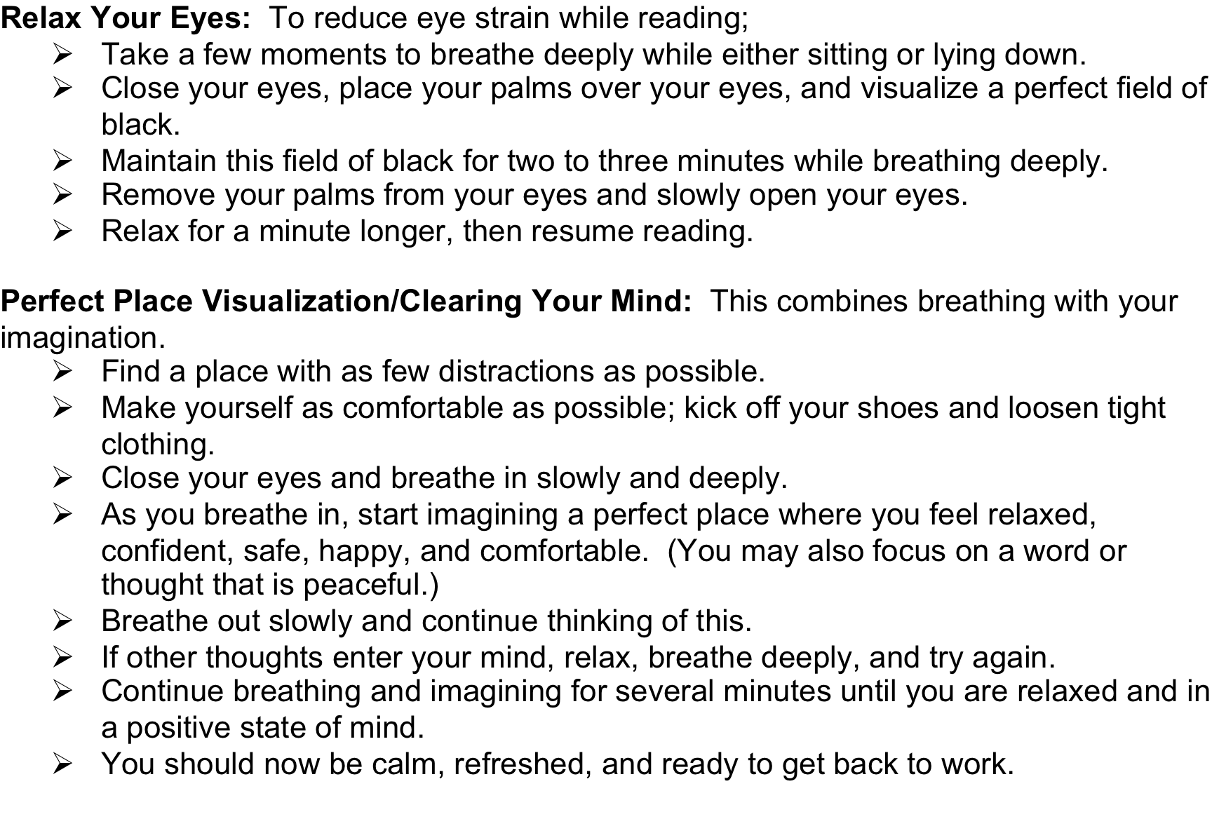

Slide 5

I’m sooooo there!

Slide 6
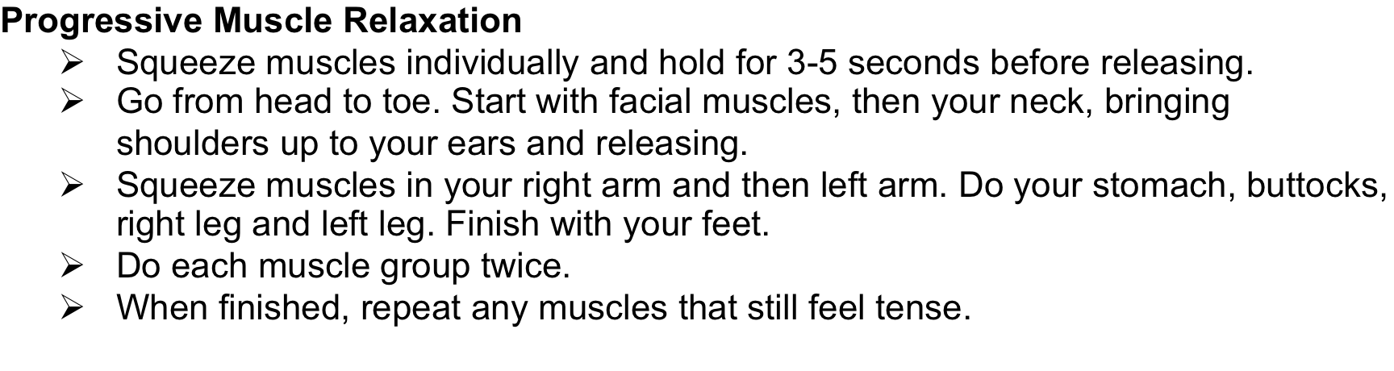

Slide 7


How to stay relaxed when you hear “Test next week”
From this:
To this!

Slide 8
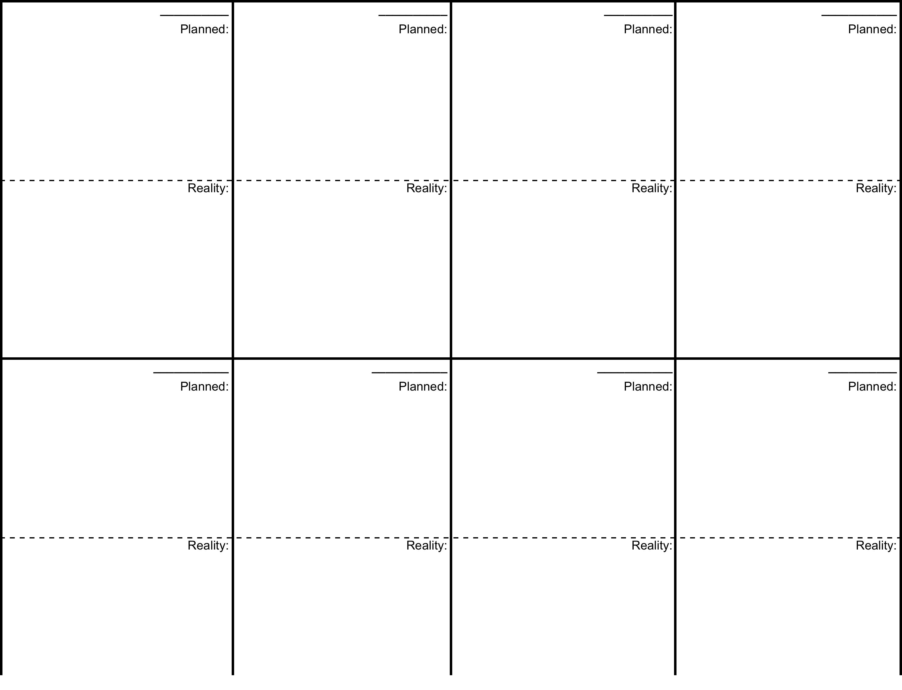

Slide 10
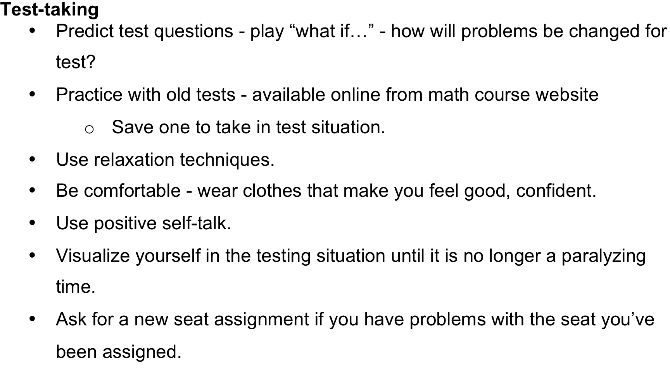

Slide 11
The Night Before
Review- Make sure you are the most prepared you can be
Focus on integrating and synthesizing
Self-testing
No all-nighters
Try to avoid cramming- it’s not actually letting you truly learn the material
Do not try to do anything that will keep you out late
  Social activities (Movies, parties, etc.)

Slide 12
It’s show time!
What to eat and drink
before exam
What to wear
When to go to the exam
Where to sit
How to do the exam
When can you panic

Slide 13
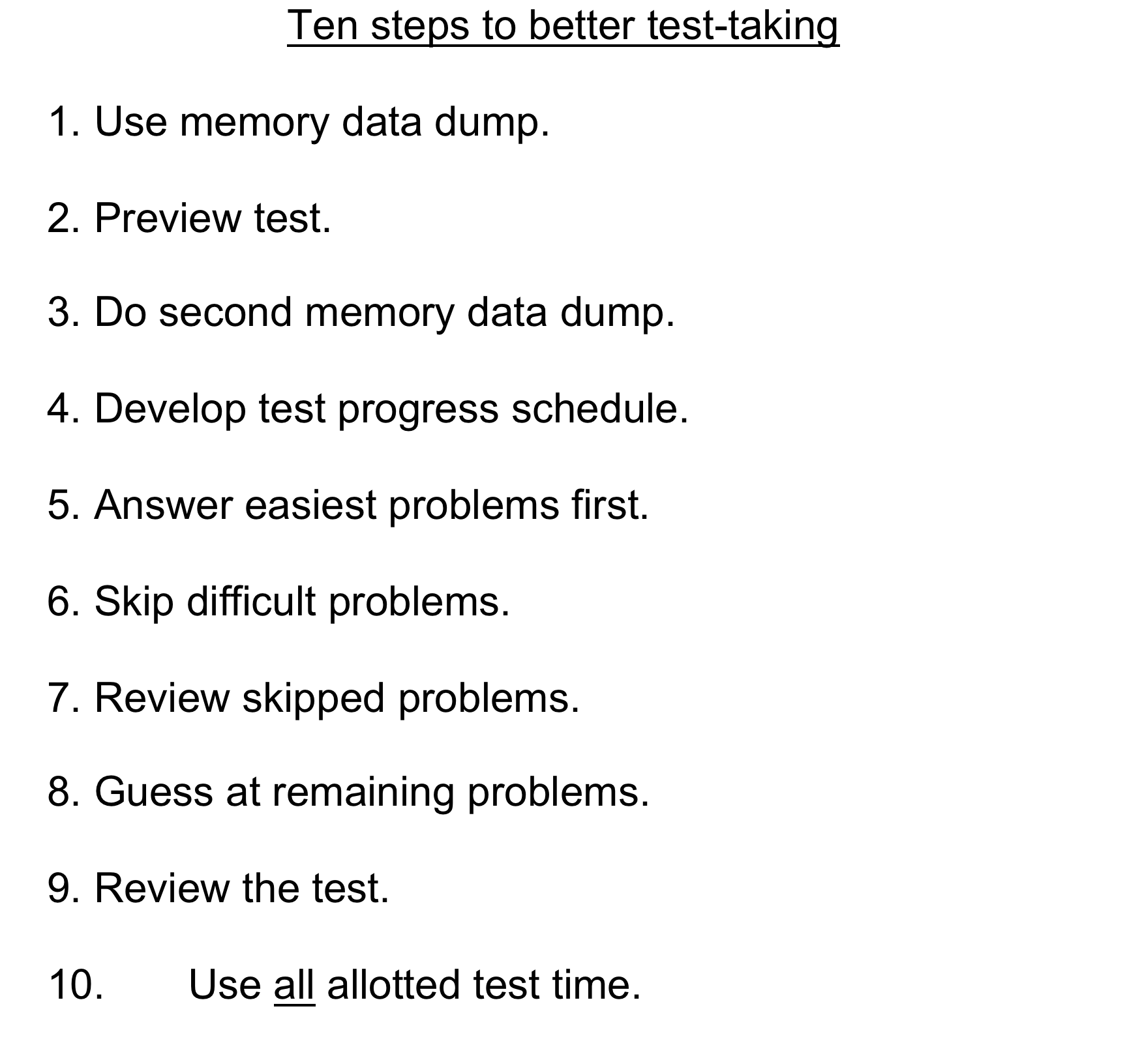

Slide 14
After the exam
Important to analyze results to learn from mistakes
How to study better for the next exam

Slide 15
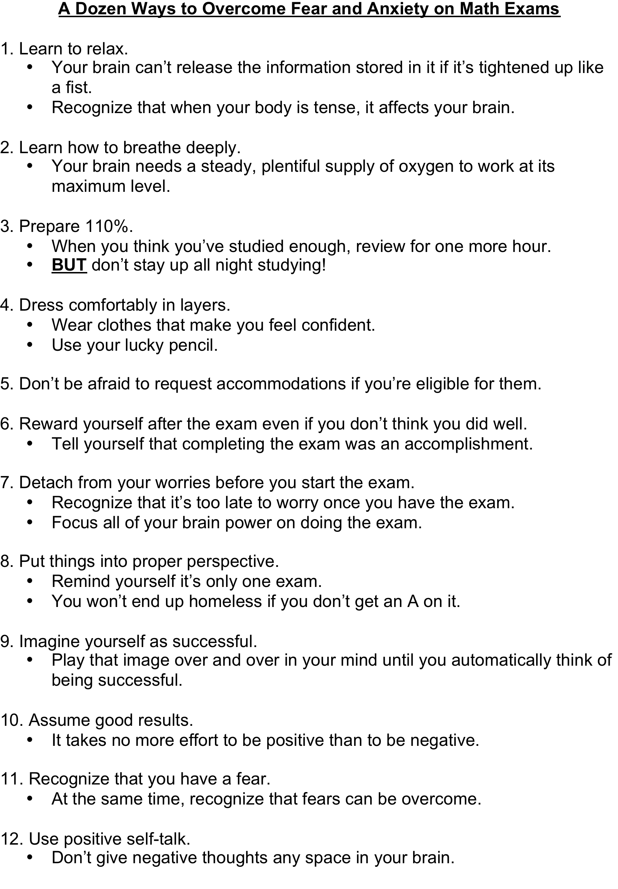

Slide 16
Maggie Selo
Academic Success Center
BRNG 3268
494-3705 mselo@purdue.edu

