Slide 1
Introduction to MA 22000
A Brief Calculus Course

Slide 2
Name: Charlotte Bailey Office: MATH 802 Office Phone: (765) 496-3145 email: baileycm@purdue.edu

Slide 3
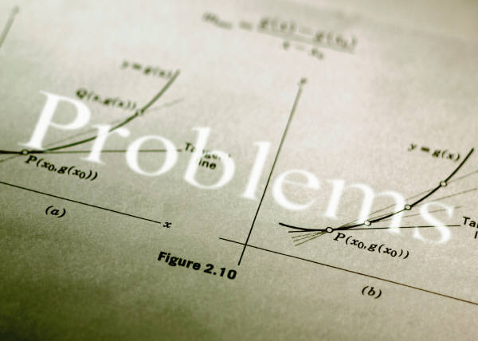
Course Web Page Address www.math.purdue.edu/MA22000

Slide 4
Important Information on Web Page
The course information (syllabus)
The assignment list
The class schedule
Directions for Registration (or enrolling in a new class) for MyMathLab
Information on how to use MyMathLab

Slide 5
My Office Hours
Monday through Friday:
9:30 – 11:30
M, W, F: 2:30 – 3:30
Or by appointment

Slide 6
MATH HELP ROOM
The math help room (MATH 211)
Usually open Monday – Thursday from 10:30 until 5:30 and open on Friday from 10:30 until 2:30
The schedule for these help rooms (MATH 205 and MATH 211) should eventually be on the web page

Slide 7
Brief Course Information
Going over this brief information in class does not replace your responsibility to read and understand all policies/procedures on the syllabus (class information).
To view the schedule, syllabus (class info), and assignment sheet (and other information) go to the web page. www.math.purdue.edu/MA22000

Slide 8
Attendance Policy
Students are expected to attend class.
Students cannot take a quiz or turn in papers without attending class (with the exception of very unusual extenuating circumstances).
I recommend students print the lesson notes and bring to class.
Lesson notes will be found on the course web page or sent to you via your Purdue email address.

Slide 9
Online and Paper Homework/Assignments
Most lessons have online homework and possibly a few paper homework problems (bold problems on sheet, may be collected and scored as a quiz).
First online homework completed on MyMathLab is due 1/17 at 11 PM.
All online homework deadlines are usually due at 11:00 PM on the day of the next class meeting. Any paper homework, if collected, is generally due at the next class.

Slide 10
No homework scores are dropped or excused.
Only the course coordinator can extend a deadline of an assignment for a student.
You have unlimited attempts at most online problems until the deadline.
Information about registration in MyMathLab, enrolling in a new MyMathLab class (for previous MyMathLab users), and using MyMathLab is found on the course web page.
Online homework is scaled to 75 points at the end of the semester.
Completing and understand your homework is the best way to prepare for exams and quizzes. Students who do not understand homework rarely succeed on quizzes or exams!

Slide 11
Quizzes
There will be a short quiz about twice a week.
First quiz is this Friday, 01/17.
No make-up quizzes (or early quizzes) are given. One quiz is excused or the lowest dropped at the end of the semester.
For more than one to be excused or dropped, there must be documented and extenuating circumstances for ALL absences.
Quizzes are scaled to 75 points at the end of the semester.
Paper homework problems may be collected and scored as a quiz.

Slide 12
EXAMS
The 3 regular exams are evening exams at 8:00 PM. Details will be given on the web page before each exam.
The final exam is written by the math department and the course coordinator.
Before each exam, an exam memo with extra review problems and ways to prepare will be available on the web page. There may or may not be some ‘old’ exams available.

Slide 13
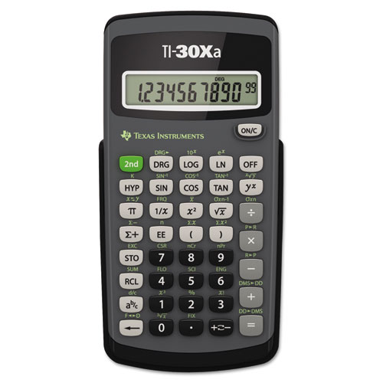
Calculator Policy
A one-line basic scientific calculator is the only calculator allowed on quizzes or exams.
The recommended calculator is TI-30Xa.
A calculator is needed for many homework, quiz, and exam problems.
Students should always bring their calculators to class and exams. The instructor will not usually loan calculators to students. No calculators may be shared during quizzes/exams.

Slide 14
Needed Supplies
Textbook and MyMathLab access code
There are 2 textbooks on reserve in the MATH library (3rd floor of MATH).
A 1-line scientific calculator
Usual paper, pencils, erasers, a few sheets of graph paper
A 3-ring binder to keep notes
and other papers organized
(optional) a 3-hole punch
(optional) a stapler
A straight-edge
(optional) printed notes

Slide 15
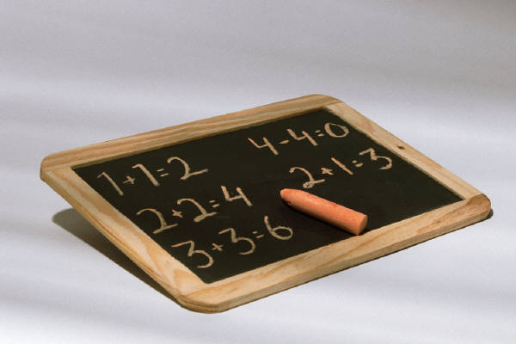
Office Hours
My usual weekly schedule is found on the web page and on my office door. My office hours are listed on it.
The MATH help room (MATH 211) is open Monday through Thursday from 10:30 until 5:30 and on Friday from 10:30 until 2:30.

Slide 16
Academic Adjustments
The Department of Mathematics offers alternative testing environments for students who are registered with the Disability Resource Center. Students who need accommodations must deliver a copy of their Accommodation Notification memorandum to the Undergraduate Services Office (MATH 242) and request an information sheet for their course. Memorandums should be delivered to that office within one week of receipt from the Disability Resource Center. The information Sheet explains the process for receiving exam accommodations for your mathematics course. Enlarged copies of the information sheets are available upon request. Students currently undergoing evaluation through the DRC should also request an information sheet.

Slide 17
If you have been certified by the Disability Resource Center (DRC) as eligible for academic adjustments on exams or quizzes see http://www.math.purdue.edu/ada for exam and quiz procedures for your mathematics course or go to MATH 242 for paper copies. In the event that you are waiting to be certified by the Disability Resource Center we encourage you to review our procedures prior to being certified. For all in-class accommodations please see your instructors outside class hours – before or after class or during office hours – to share your Accommodation Memorandum for the current semester and discuss your accommodations as soon as possible.

Slide 18
Grades
Your goal should be to earn as many points as you can. (possible 600 points total)
Homework and quizzes are each scaled to 75 points.
Each of the 3 mid-term exams is worth 100 pts.
Final exam is worth 150 points.
There is a procedure for ‘borderline’ cases.
Grades are assigned based on a math department curve.

Slide 19
Cheating Policy
The mathematics department will not tolerate cheating of any sort. Grade penalties will always be imposed by the department and all cases are reported to the Dean of Students Office for disciplinary action.
At an exam, students may be asked to sign that they have read and understand an academic integrity statement.

Slide 20
Placement
Please monitor your course work during the first few weeks. Should you decide that you need to drop this course and add an algebra/trig course, the last date you can do so is Monday, March 24th at 5:00 PM.
The sooner you make the move, the better. See your academic advisor and the course coordinator for the course you want to add.

Slide 21
Course Evaluation
You will be provided an opportunity to evaluate this course and your instructor during the last couple of weeks of the semester. This evaluation is completed online.

Slide 22
Campus Emergency Policy
In the event of a major campus emergency; course requirement, deadlines, and grading percentages are subject to changes that may be necessitated by a revised semester calendar or other circumstances beyond the instructor’s control. To get information about any such changes, please see the course web page or read an official email message from your instructor.

Slide 23
Helpful Suggestions
Attend Class!
Complete the majority of online homework prior to the next class meeting.
Seek help as soon as you determine you do not fully understand a topic.
Take responsibility for your learning!

