Slide 1
Registration
MyMathLab
Online HW
MA 22000

Slide 2
Registration MyMathLab
Need your MyMathLab card or access code (purchased with text or online)
Need a Valid E-Mail Address (recommend use your Purdue email address)
Need to know Purdue’s zip code is 47907 and your course ID for your Class
You may use an ITaP computer or on your own computer (need Adobe FlashPlayer).
Notes:
2

Slide 3
MyMathLab
Register with your access code the first time only that you enter MyMathLab.
Each successive time (once you are confirmed as registered), you go to www.mylabandmastering.com, and click Sign in.
For your username, use your Purdue email address (with the @purdue.edu).
Select a password that you will remember
(minimum 8 characters, at least 1 letter and 1 number)
Write your login name and password down in your textbook or another safe place. Remember them!
Notes:
3

Slide 4
These slides will explain how to register in Pearson’s MyMathLab, if you are a student who has never used MyMathLab before for a MA 11100, MA 15200 class, MA 22000 or any other math class at Purdue.
If you have used PearsonMyLab or MyMathLab (previously called coursecompass), you simply need to enroll in your current class. Refer to the other PowerPoint presentation to explain how to enroll in your new class.

Slide 5
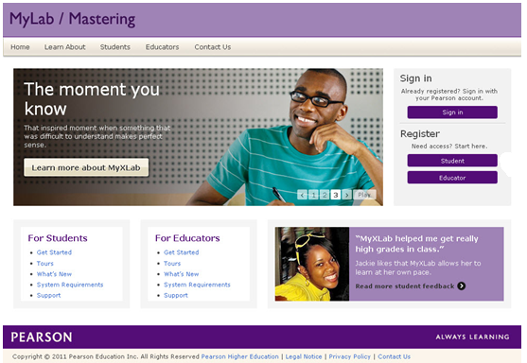
Go to www.pearsonmylabandmatering.com
First time only: Click on Register as a student
5
Notes:
5
5

Slide 6
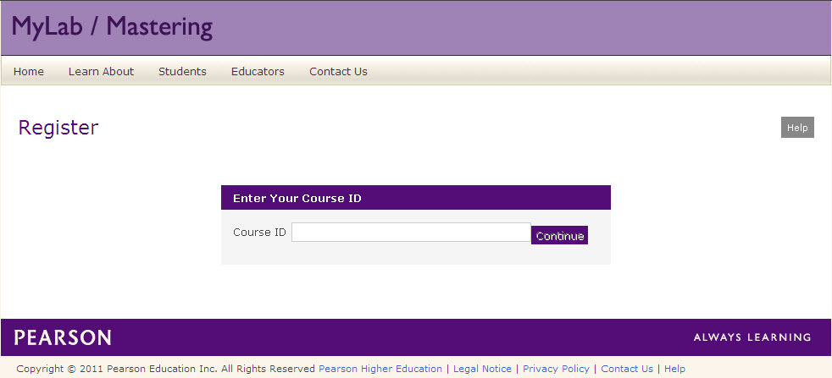
Enter your Course ID
Enter the Course ID given from your instructor.
6
Temporary Access Feature – CourseCompass and MyLab / Mastering New Design
Notes:
6
6

Slide 7
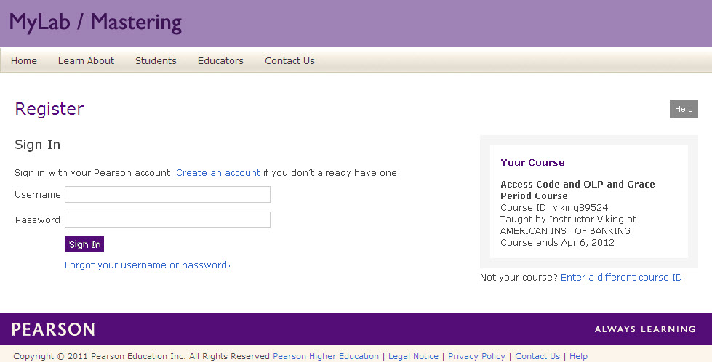
Sign In or Create Account
1st time Registration:
Click on ‘Create an Account’
If you’ve used MyMathLab before, use your Username and Password to SignIn
7
Temporary Access Feature – CourseCompass and MyLab / Mastering New Design
Notes:
7
7
Learn who you are first.
Sign in has main focus -- encourages users with existing accounts to use them
Then determine payment options.

Slide 8
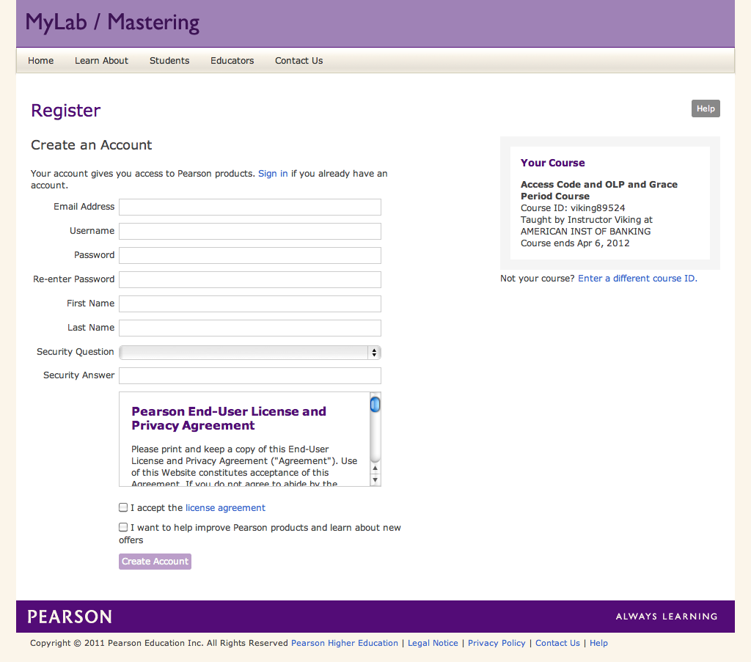
Create Account
Enter your information and agree to the license.
8
Temporary Access Feature – CourseCompass and MyLab / Mastering New Design
Notes:
8
8
All account information on one page.
Student inherits school relationship from the course instructor
Uses web standard for license presentation. Clicking the license agreement text link opens an overlay window making it easier to read.

Slide 9
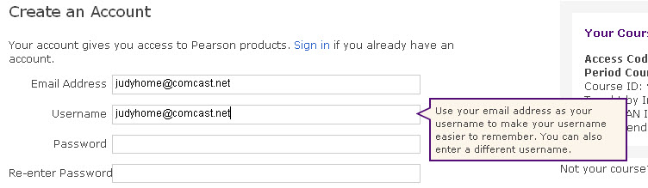
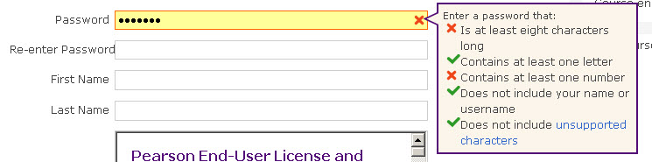
Create Account: Reminders
If your password does not meet the specifications listed above, you will see a red X and you need to make the changes.
9
Temporary Access Feature – CourseCompass and MyLab / Mastering New Design
Notes:
9
9

Slide 10
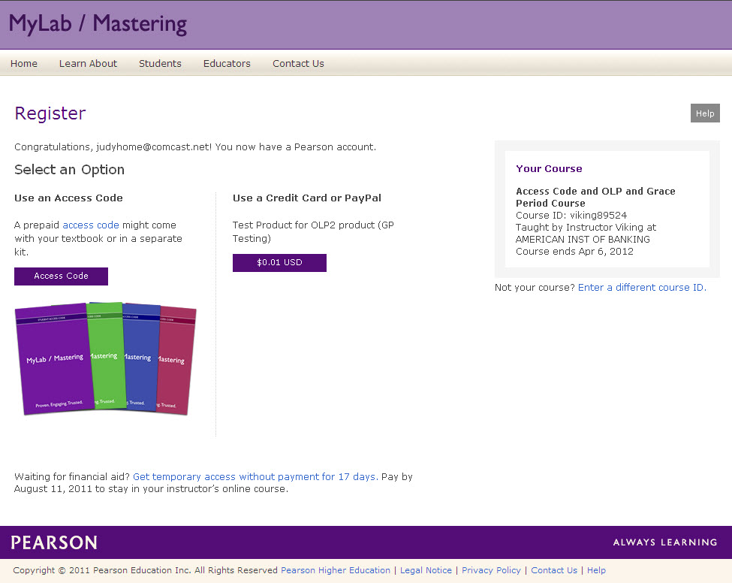
You can get temporary access without purchasing textbook/MyMathLab for 17 days, but you must update your account (purchase the book/MyMathLab) by the end of the 17 day.s (or bad things happen).

Slide 11
Payment Options
Enter your access code or pay now.
Temporary Access for 17 days
11
Temporary Access Feature – CourseCompass and MyLab / Mastering New Design
Notes:
11
11
Upon submission of the account creation page, user account is created whether or not the user completes the ‘payment’ piece of the process.
User does not have access to the course, but they do have a Pearson account and can complete enrollment steps as a returning user if they need to stop and come back later.
Temporary access option is intended to assist students waiting on financial aid. It enables all students to gain access to course on the first day and start coursework immediately.
Encourage students to pay, but if need some leeway, temp access is available.

Slide 12
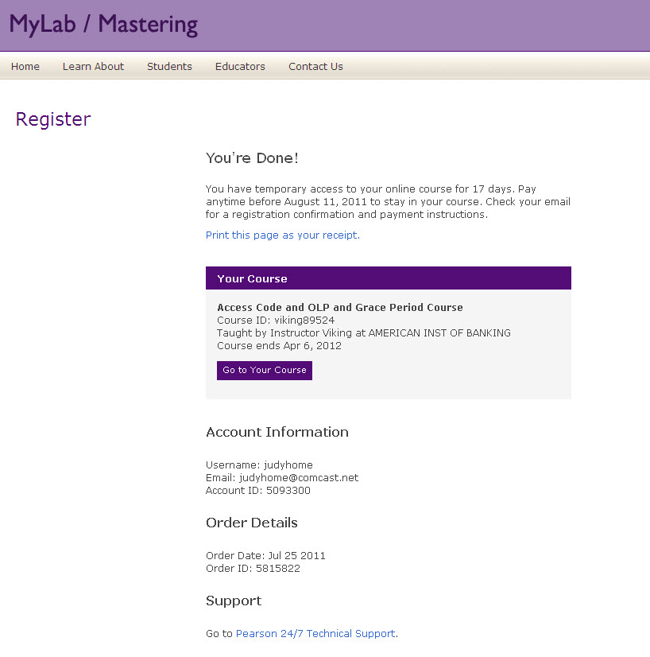
Confirmation
You will get confirmation that your have temporary access for 17 days, if you choose that option. You will be reminded each time you login to MyMathLab how many days remain. You must update your account with payment before the end of the 17 days.
12
Temporary Access Feature – CourseCompass and MyLab / Mastering New Design
Notes:
12
12

Slide 13
Once you receive confirmation that you are registered or enrolled in the class; each successive time you go to MyMathLab, you will SIGN IN using your username and password. Write down your login name and password!

Slide 14
Sign In
Once you are registered and enrolled in the class, each time you go to PearsonMyLabandMatering.com, you will see the ‘sign in’ page. Click on SIGN IN and enter your login name
and password.

Slide 15
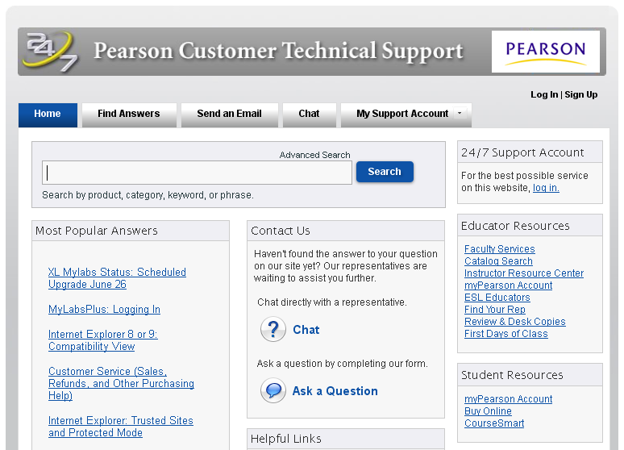
http://247pearsoned.custhelp.com
If you need help, go to the address above.

Slide 16
Problems???
Contact Student Support at
1-800-677-6337 for technical
support 24 hours a day.
For math tutoring at the Pearson Tutor Center call 1-800-435-4084 between 5 PM and midnight Sunday through Thursday.
You might be asked for your MyMathLab course ID or student access code. Keep the course ID and your access code handy.
Notes:
16

