Slide 1
These slides are to help those students who have previously used MyMathLab (previously called CourseCompass) in MA 15200, MA 22000, MA 11100, or another math course here at Purdue. (If you used MathXL; it is different than MyMathLab.) You would need to view the presentation to register for the first time if you’ve never used MyMathLab.

Slide 2
Follow the steps explained in the following slides.

Slide 3
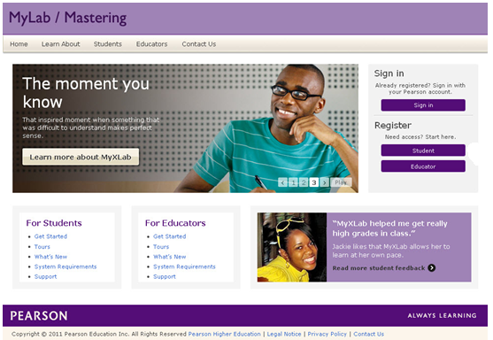
If you used MyMathLab ( or coursecompass) previously in any math course at Purdue and you remember your login name and password, you can login as usual. The site is www.pearsonmylabandmastering.com.
Sign in

Slide 4
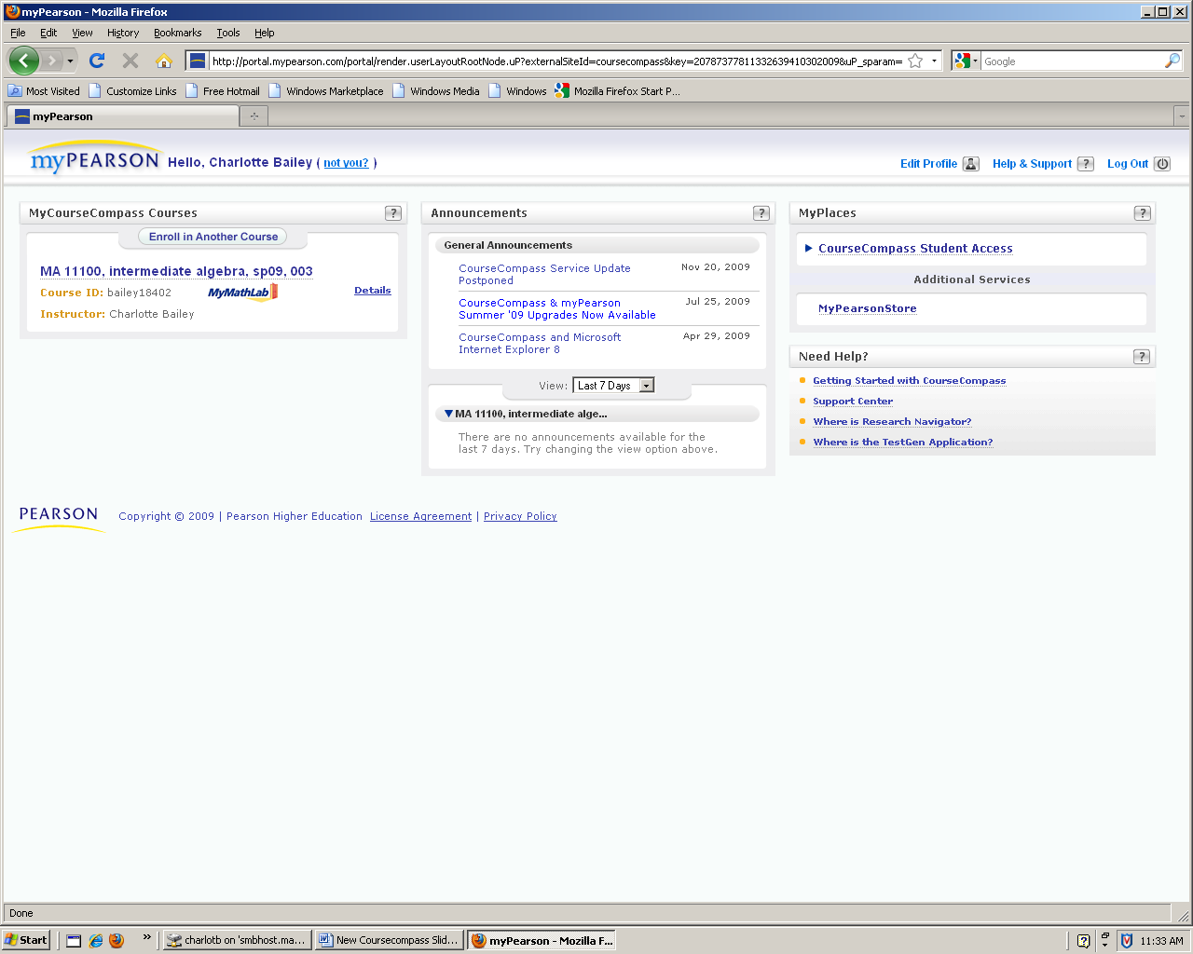
You will see whatever class or classes you had been enrolled in previously. Above that class, click on
‘Enroll in Another Course’.

Slide 5
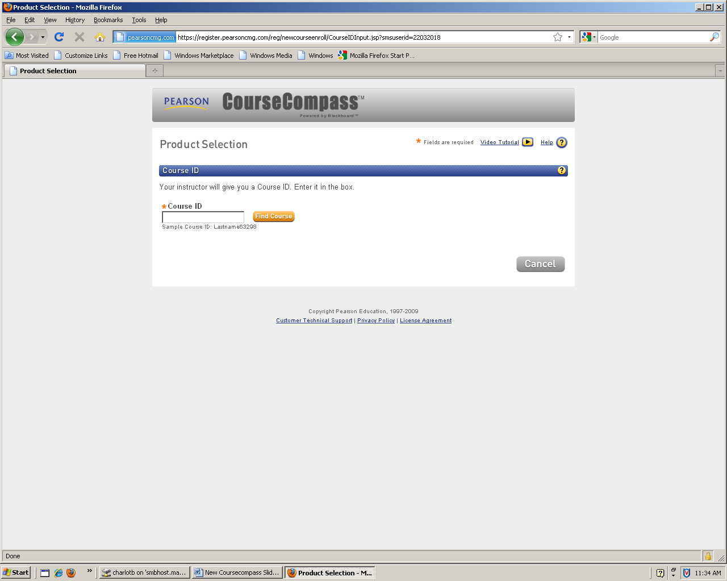
Simply enter your new Course ID that is given to you by your instructor for your new class. Note: If you do not receive the course ID via paper from your instructor, he/she might have those ID’s on the course web page (www.math.purdue.edu/MA22000).

Slide 6
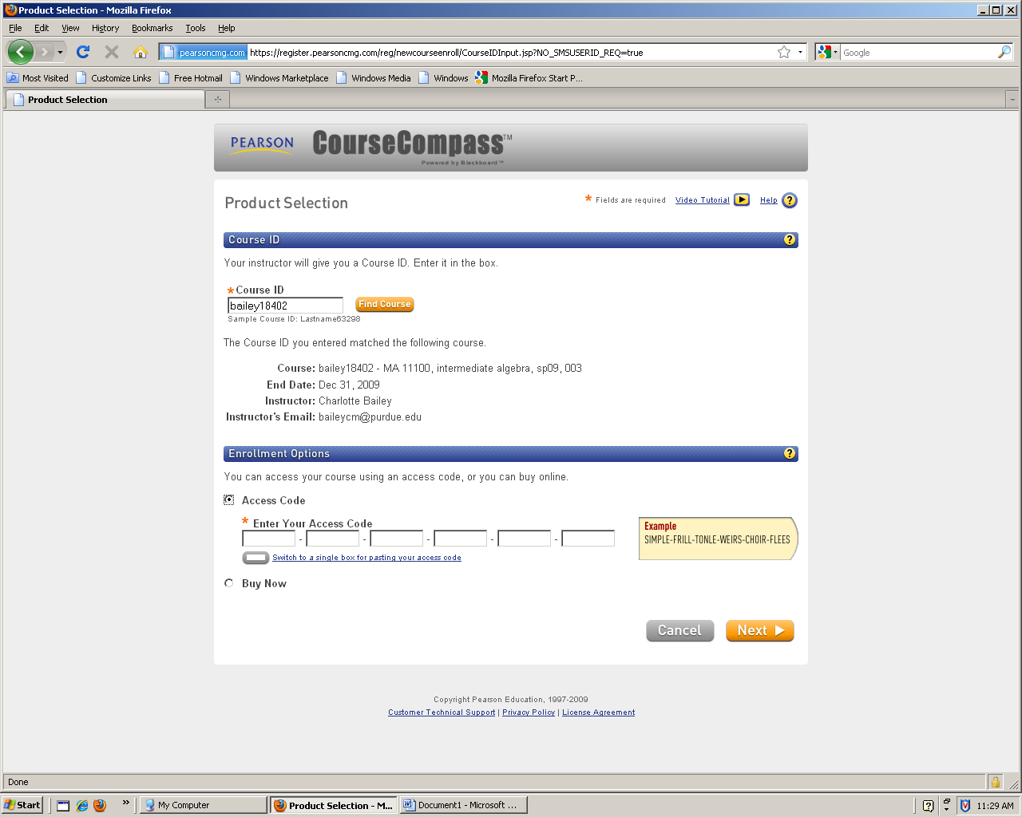
If you were previously using a different textbook or were in a different course, you will have to enter your new access code.
If you were in the same course, you do not need to purchase a new textbook and access code. You will not be asked for an access code here, but will simply be enrolled in the new class.

Slide 7
Simply follow whatever directions may remain until you receive confirmation that you are in the new class. If you need help, see your instructor or the course coordinator.

