Slide 1

Using MyMathLab
Features
You must already be registered or enrolled in a current class in order to use MyMathLab. If you are not registered or enrolled in a new class, see another PowerPoint for directions.

Slide 2
Open up an internet browser. MyMathLab especially likes Explorer.
Go to www.pearsonmylabandmastering.com
Login with your login name and password.
‘Click’ on your course name to get to the home page with the menu.

Slide 3
Whenever you are ready to:
Do your homework
View your textbook online
View your grade book
Use any other features of MyMathLab
The next group of slides explain how to do all of the above.

Slide 4
If you want to work homework problems from your home computer, you will need to install any necessary software!!!
Adobe FlashPlayer (newest version) is all that is needed on your home computer or laptop computer.

Slide 5
The following slides may look slightly different than what you may see in your current version of MyMathLab.
(Some slides may have been copied from previous versions of MyMathLab or different mathematic courses here at Purdue.)

Slide 6
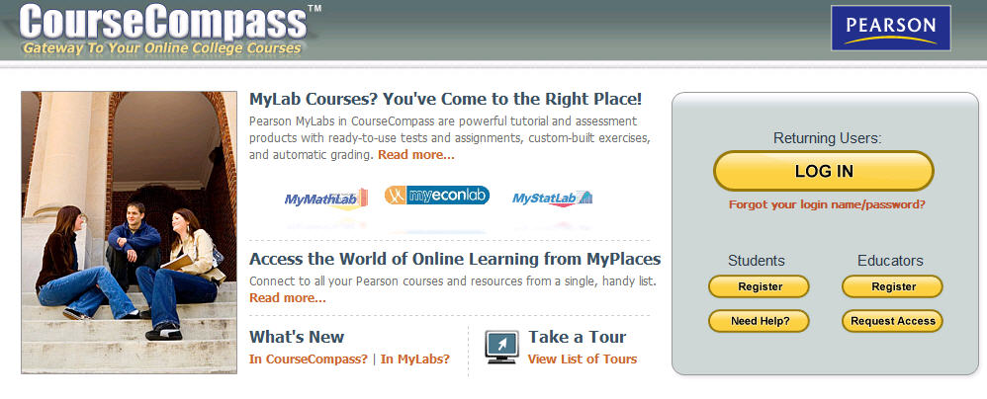
To access your resources, go to:
www.pearsonmylabandmastering.com
Under Returning Users, click Log In
Notes:
We wish you success in your course!

Slide 7
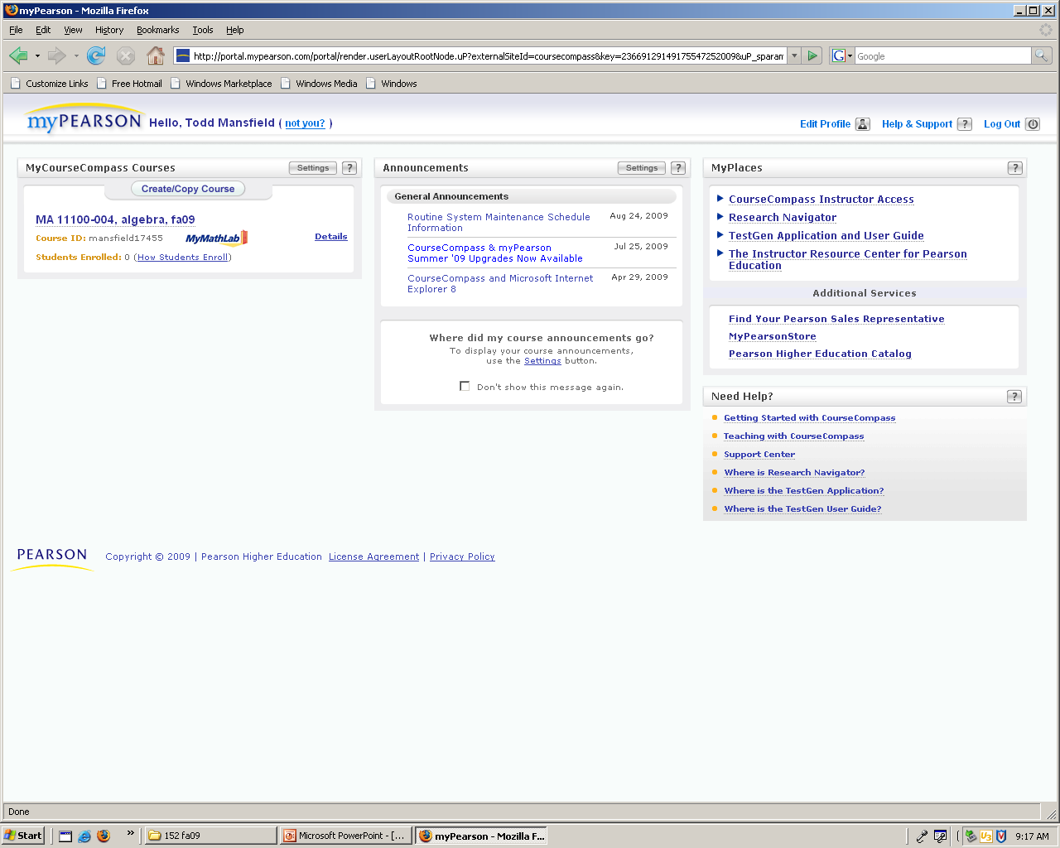
After logging in, click on the course to get to the home page.
Note: For those of you that have used MyMathLab (or originally CourseCompass) more than a few years ago, there is a ‘new look’ to the home page (as of summer 2010).

Slide 8
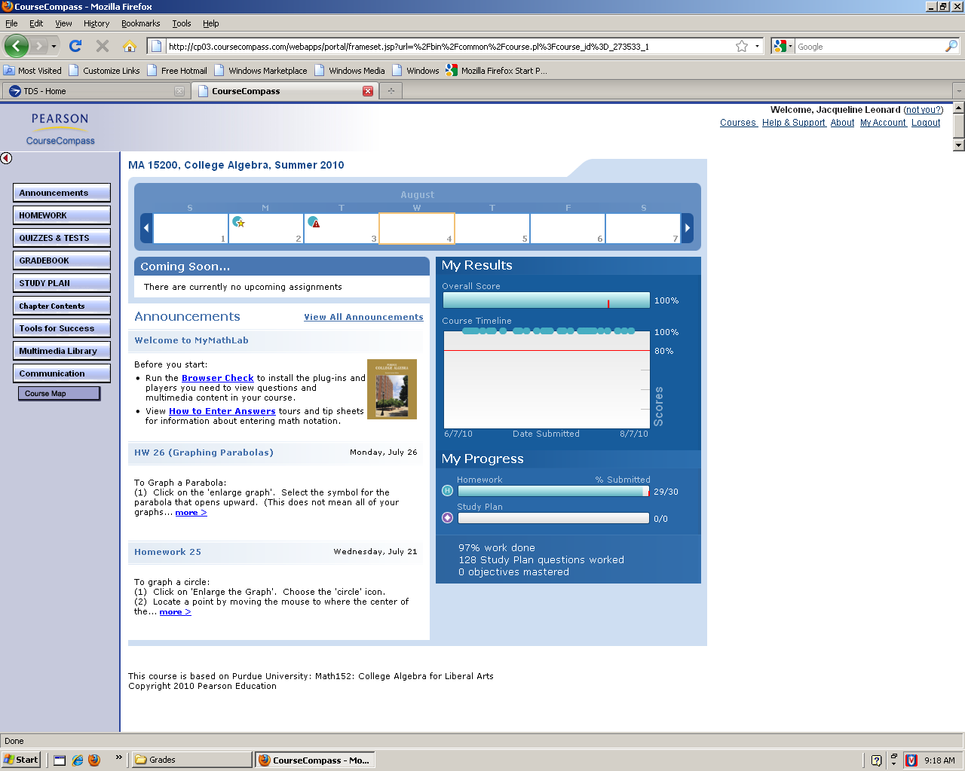
This is the ‘home page’ you will see.
At the top is a weekly dateline. On the right is an overall score line and information showing your progress throughout the semester. You may be able to see a few announcements at the lower left. **Click on ‘View All Announcements’ to see all announcements to date.**

Slide 9
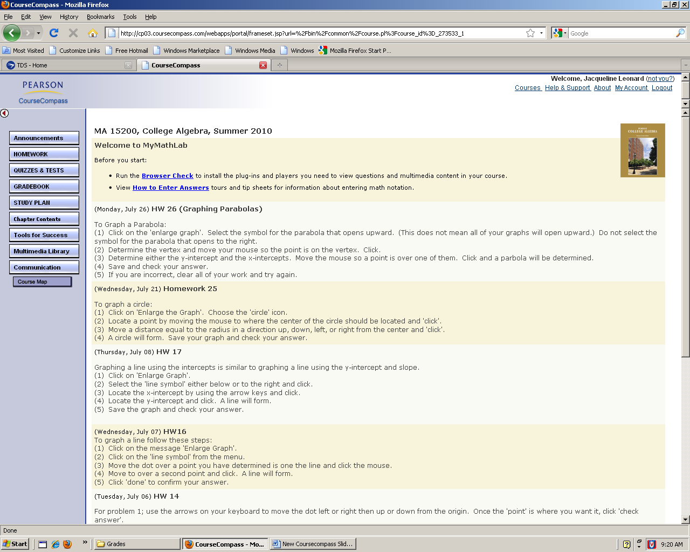
Several announcements will describe how to enter some answers or give other hints that will help you complete your online homework.

Slide 10
The menu is on the left. Click ‘homework’ to do your online homework, ‘quizzes and tests’ to do a practice test, ‘gradebook’ to view your online homework grades, ‘study plan’ for possible extra practice, or ‘chapter contents or online textbook (etext)’ to view the online textbook.

Slide 11
Homework
Never work more than 1 homework assignment ahead.
You have unlimited tries of a problem, up to the deadline.
Every student should be able to score a 100% on each homework assignment.

Slide 12
When you wish to work
homework, click on the
DO HOMEWORK link.

Slide 13
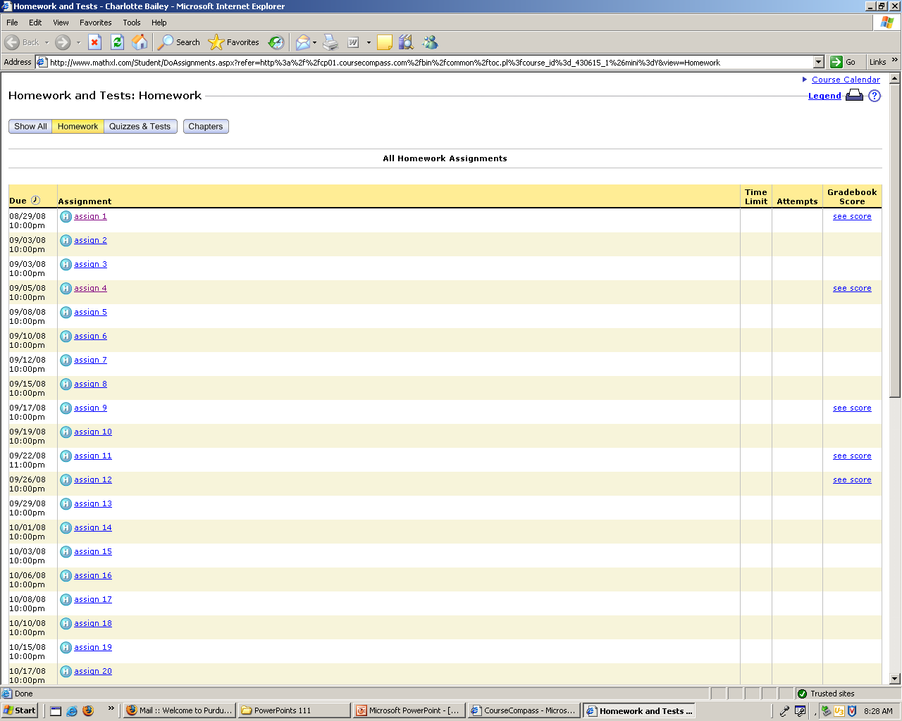
Select which HW assignment and click on it.

Slide 14
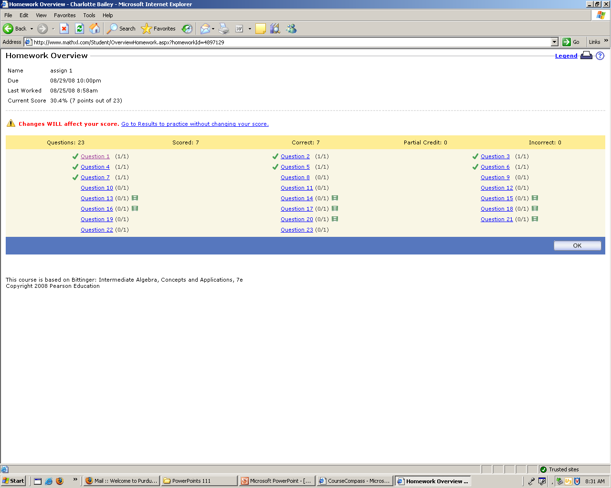
Click on the Problem # to view the problem. You do NOT have to work all problems at the same time. Answers are automatically saved if you logout and return later to finish the HW. You can always see at this overview which problems are correct, incorrect, or not started (problems correctly answered are checked problems).

Slide 15
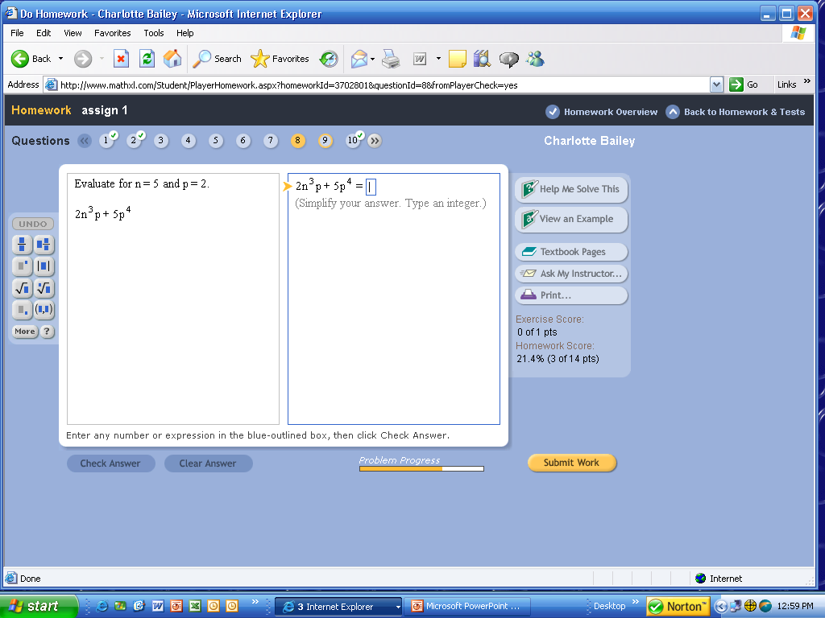
Work your problem on paper, then enter your answer. You will notice a toolbox at the left to help enter fractions, exponents, roots, etc. Enter ‘Check Answer’.
Notes:
15

Slide 16
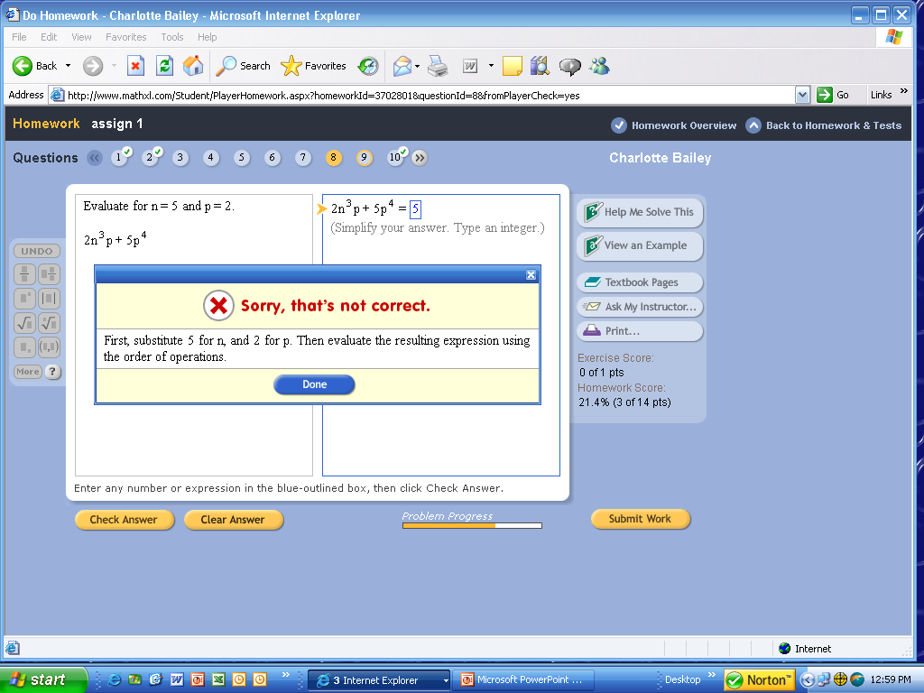
If you give an incorrect answer, try again. Or use some ‘helps’ listed at the right.
Notes:
16

Slide 17
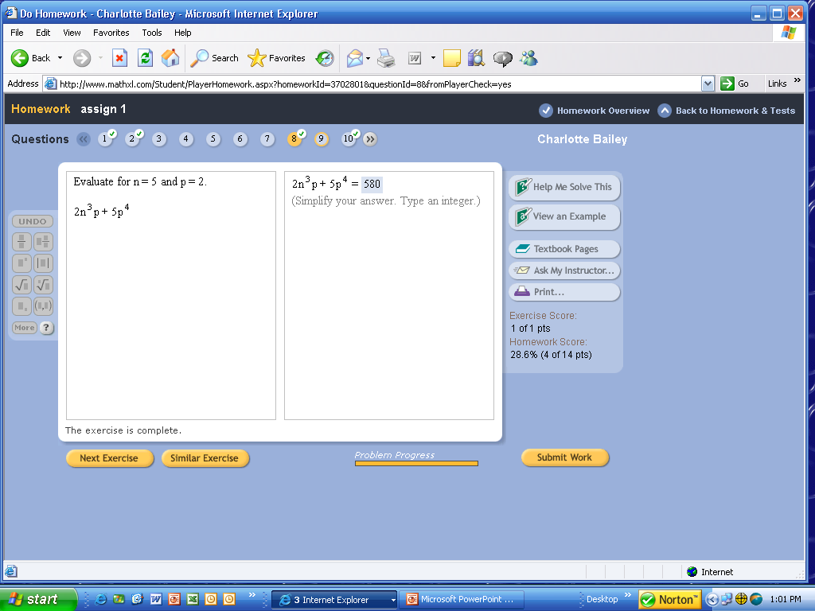
If you want to see a similar problem solution, click on ‘View an Example’.
Notes:
17

Slide 18
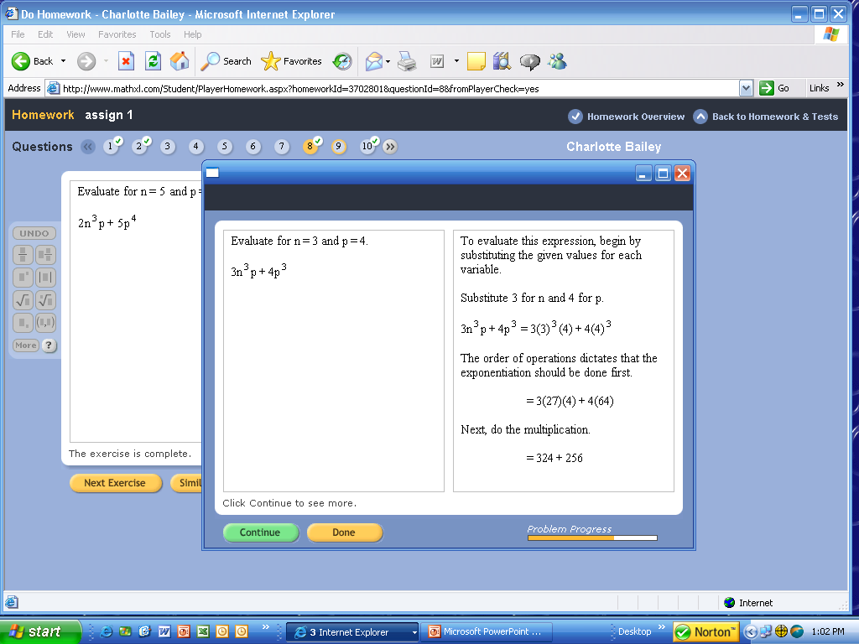
You can view how the problem should be worked.
Notes:
18

Slide 19
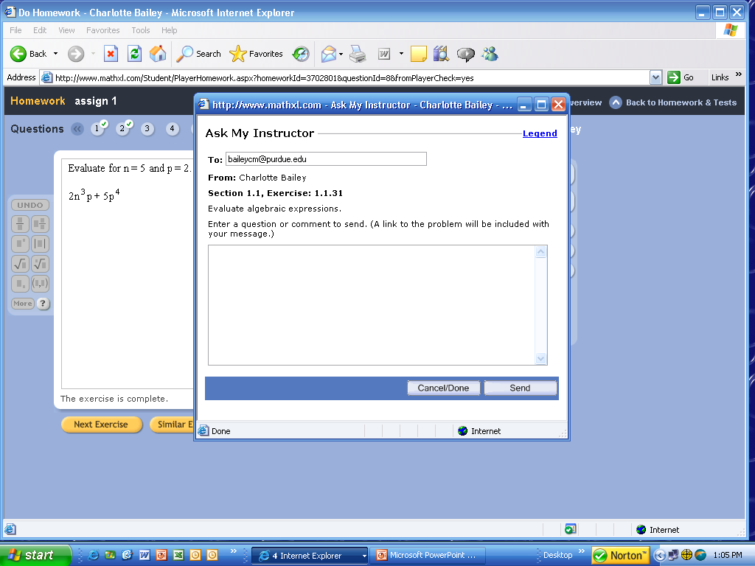
You could also ‘Ask’ your instructor for help. Just type your message and send.
Notes:
19

Slide 20
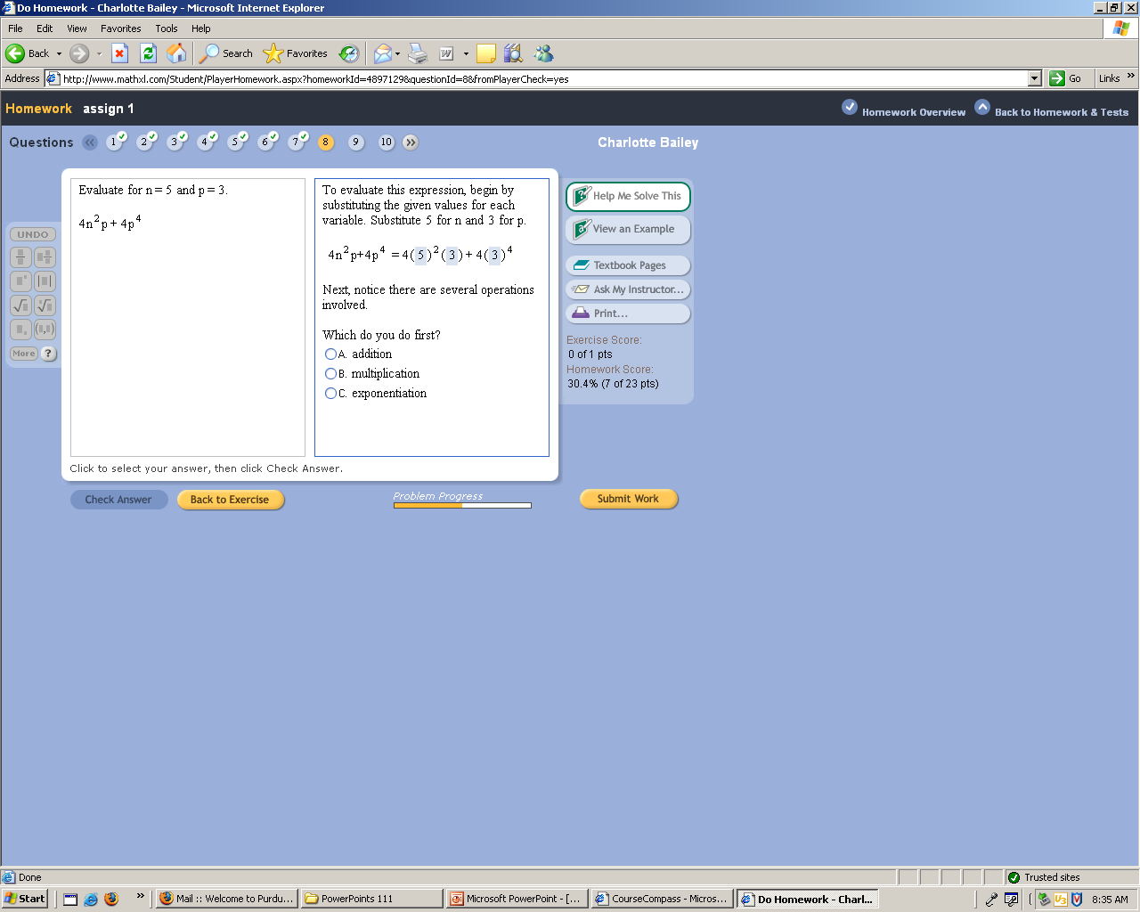
If you want to be given ‘hint’ to help you solve the problem, click on ‘Help Me Solve This’.

Slide 21
If you would like to print the problem to take to class, to the Math Help Room, or to an instructor’s (or coordinator’s) office hours for help; click on Print. Only that problem will be printed.

Slide 22
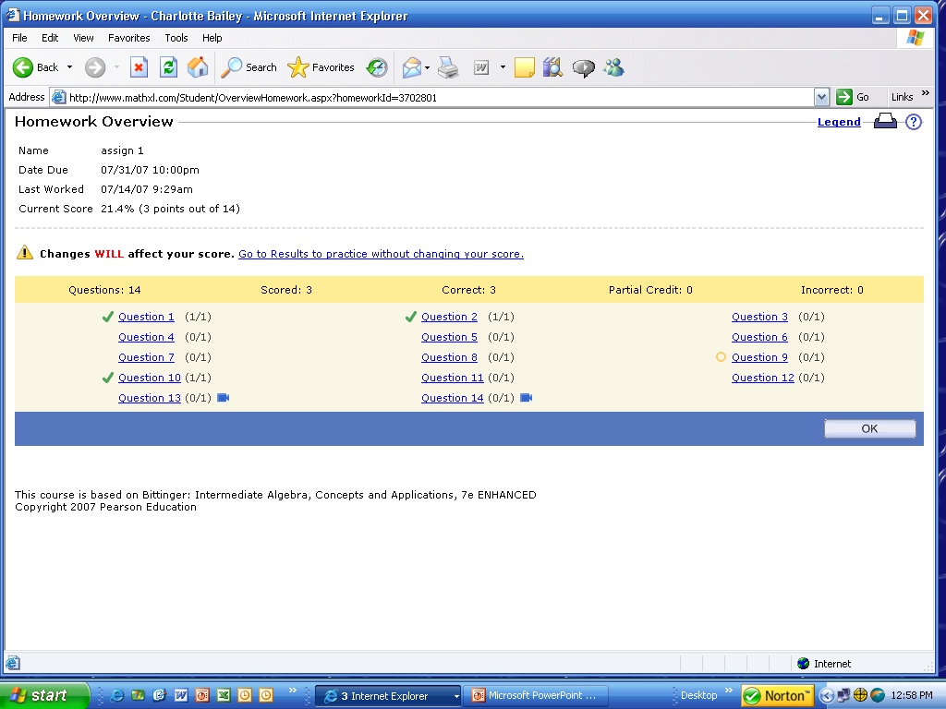
You get immediate feedback. The homework overview page keeps track of your progress. The check means you answered correctly.
If you want to print ALL of the homework problems, click on the print icon from this homework overview page.
Notes:
22

Slide 23
Your OnlineTextbook
You have a soft covered textbook. You also have an online text.
From the menu: Click on Chapter Contents or ebook and select the chapter and lesson you want.
(Or, there is a link to the textbook pages while working a homework problem.)
Notes:
23

Slide 24
Online Textbook
Online Book

Slide 25
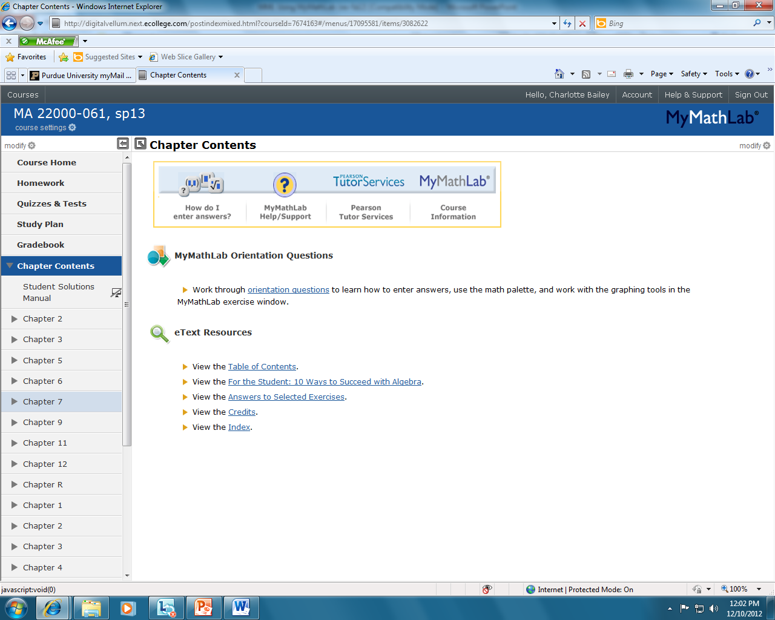
You will be given an opportunity to answer some orientation questions that may help you understand more clearly MyMathLab. There is also a list of other resources that you can view.

Slide 26
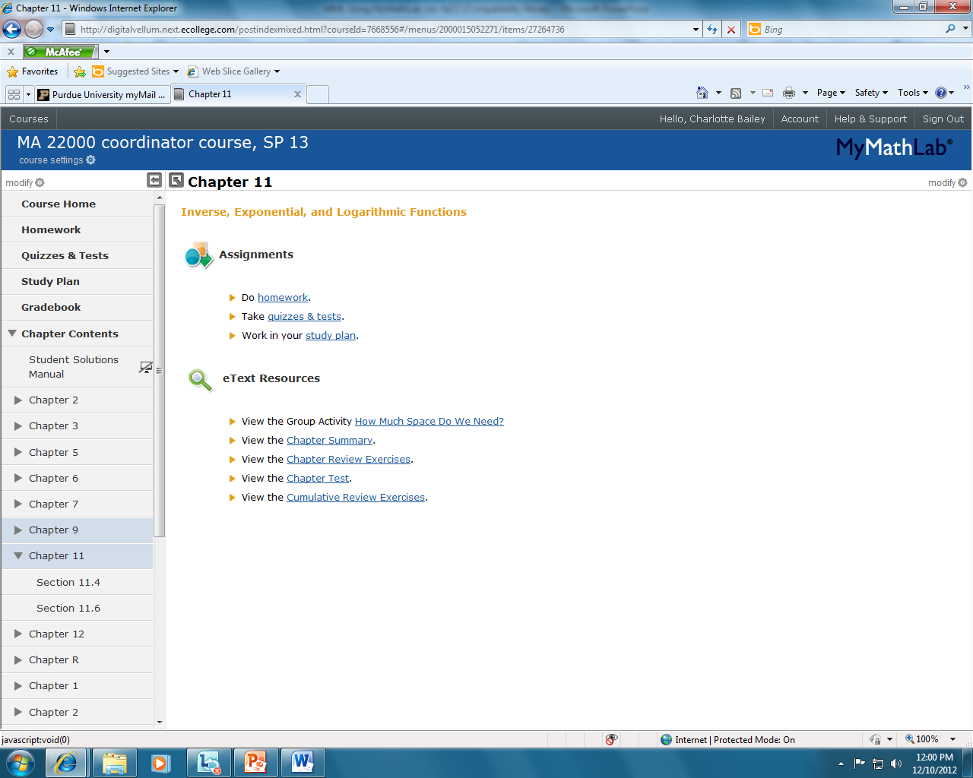
You will have a drop down menu that lists all chapters. Select the chapter of the lesson you want to view. Notice on this page, it also gives the options of going to homework, quizzes or tests, or the study plan. You can also go to the chapter summary, review exercises, chapter test, or cumulative review exercises.

Slide 27
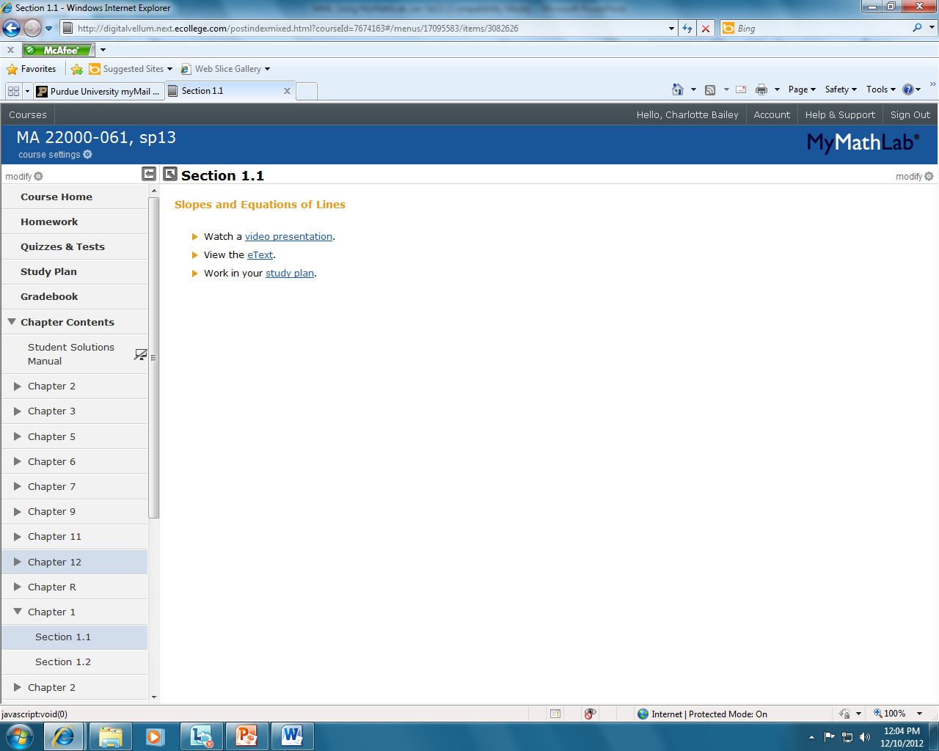
After selecting a chapter, you will then have to select a lesson from that chapter that you wish to view. A list of topics covered in that section are listed.

Slide 28
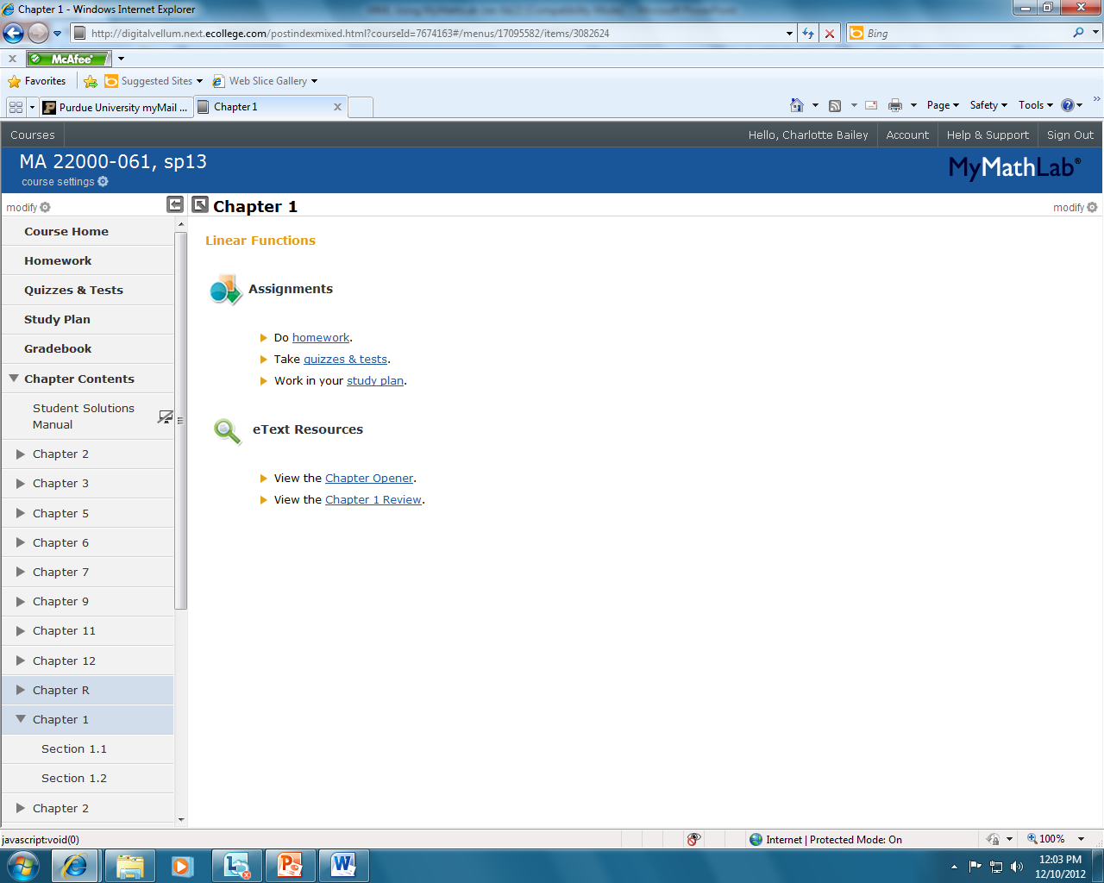
Notice: There is a link to a student solutions manual online. Do not become dependent on this manual.

Slide 29
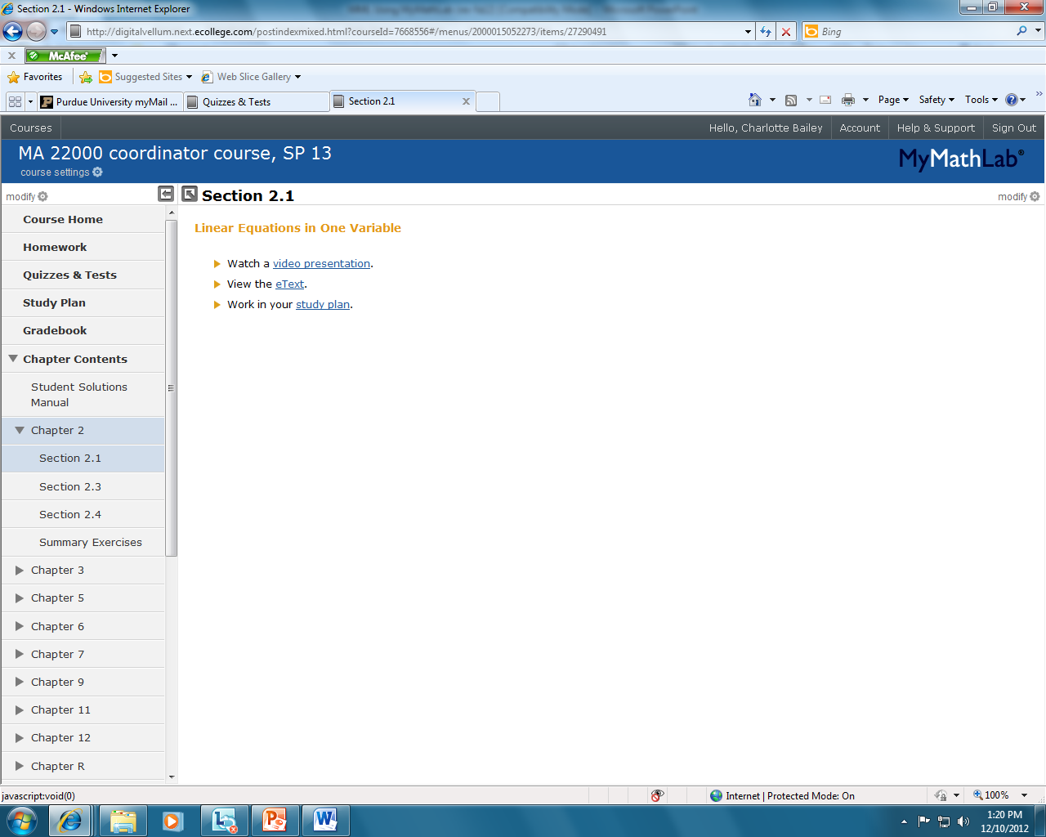
For each section of the online textbook, you can view the textbook pages (etext). There are also links to the study plan for extra practice and there is a video presentation of the lesson. This video could be used in an emergency when missing class. IT IS BEST TO ATTEND CLASS HOWEVER. I may explain the material differently that the online instructor from Pearson.

Slide 30
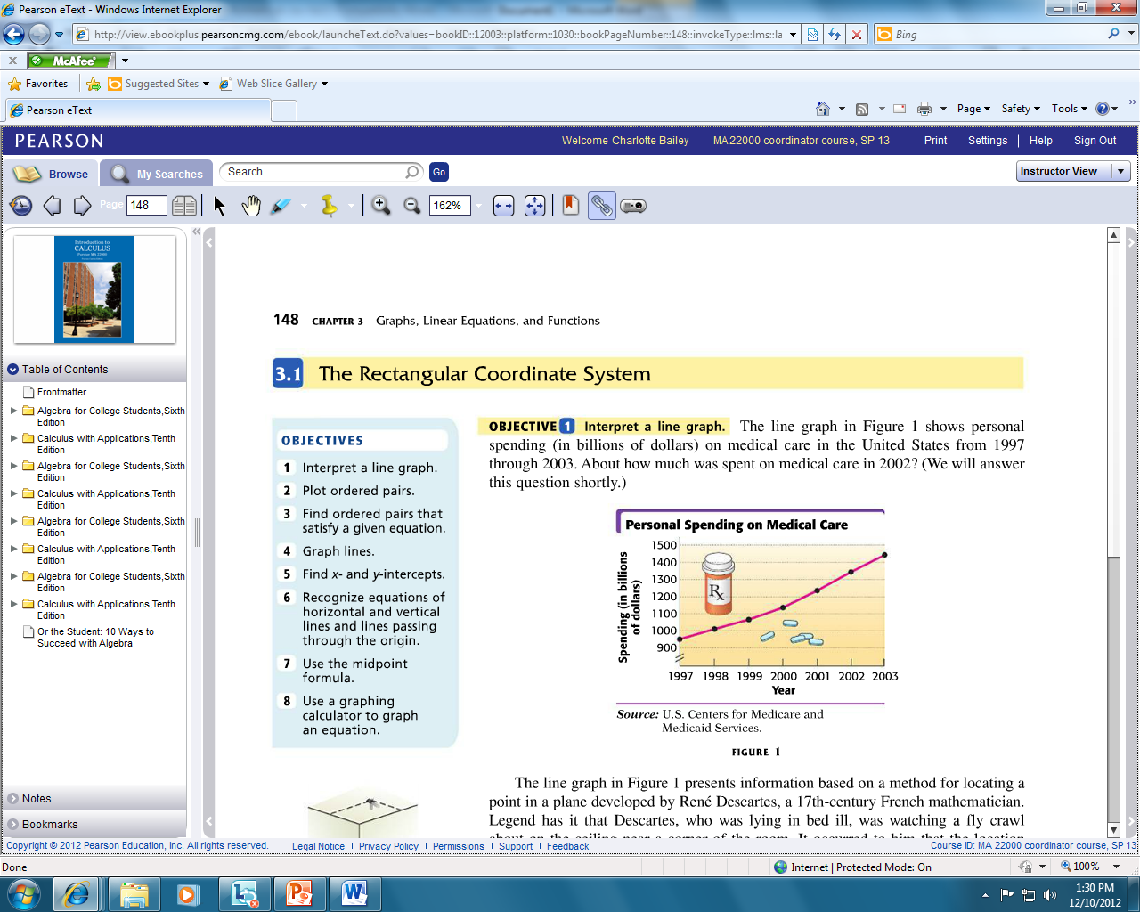
The page forward and page back arrows will be at the top left.
You can access all textbook pages from this site!!
Notes:
30

Slide 31
There is also a link to the textbook while doing HW. Click on Textbook Pages. It takes you to the pages where this type of problem was discussed.
Notes:
31

Slide 32
Practice Tests
There are two practice texts for each chapter.
One can be used as a pre-test and one as a post-test.
The scores you receive for these practice texts do not count for or against your grade.

Slide 33
There is also extra practice available if you click on
‘TAKE A TEST’. There are 2 practice tests for each chapter.

Slide 34
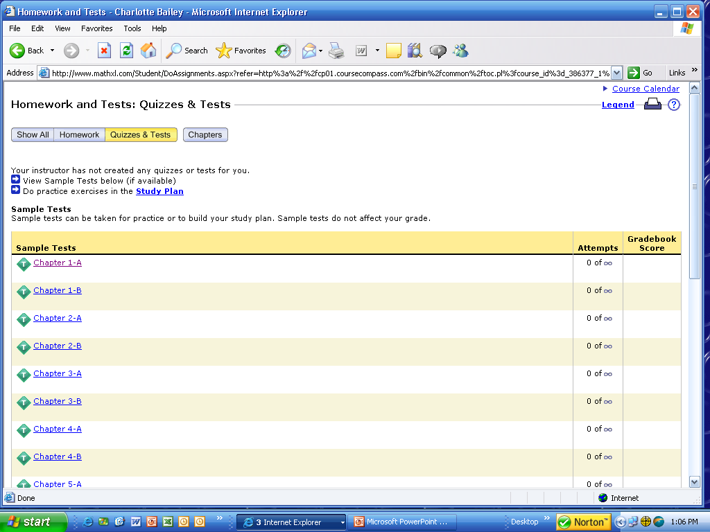
From the home page of MyMathLab there is a link to quizzes&tests. There are 2 tests for every chapter. This can help indicate how well you understand the material in that chapter.
Notes:
34

Slide 35
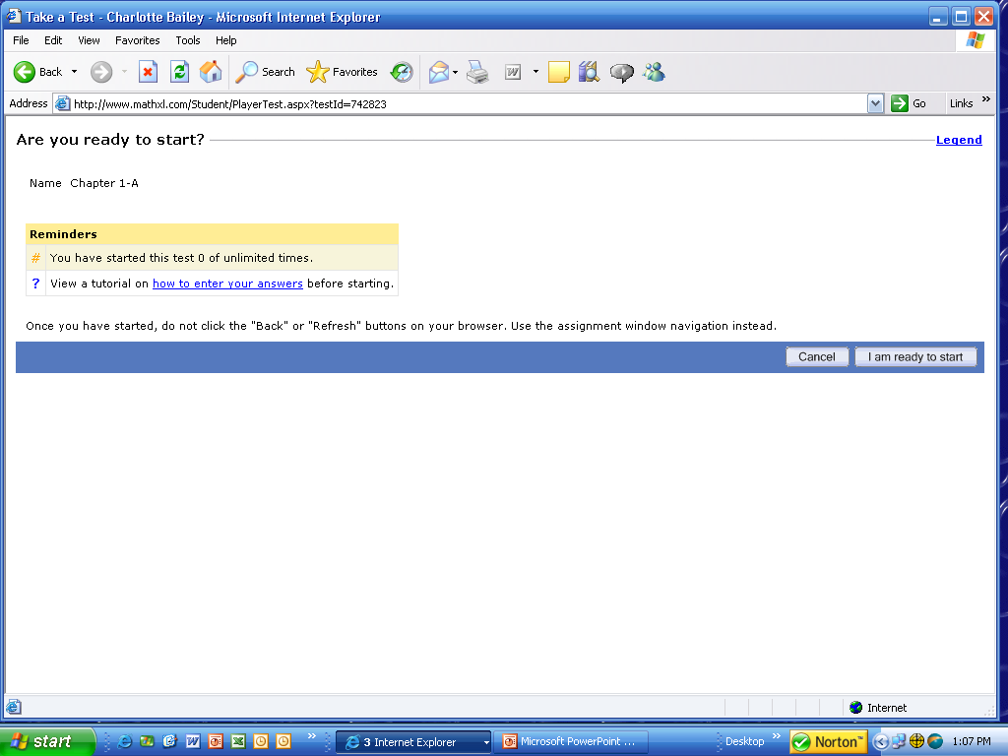
Click on ‘I am ready to start’ when trying a test. You may take a practice test an unlimited number of times.
These ‘tests’ do not count as a grade.
Notes:
35

Slide 36
Study Plan
The study plan allows you to practice more problems.
Any problems completed in the study plan will not score toward your grade.
You can use the study plan to determine what objectives you have not achieved and show you what you need to study.

Slide 37
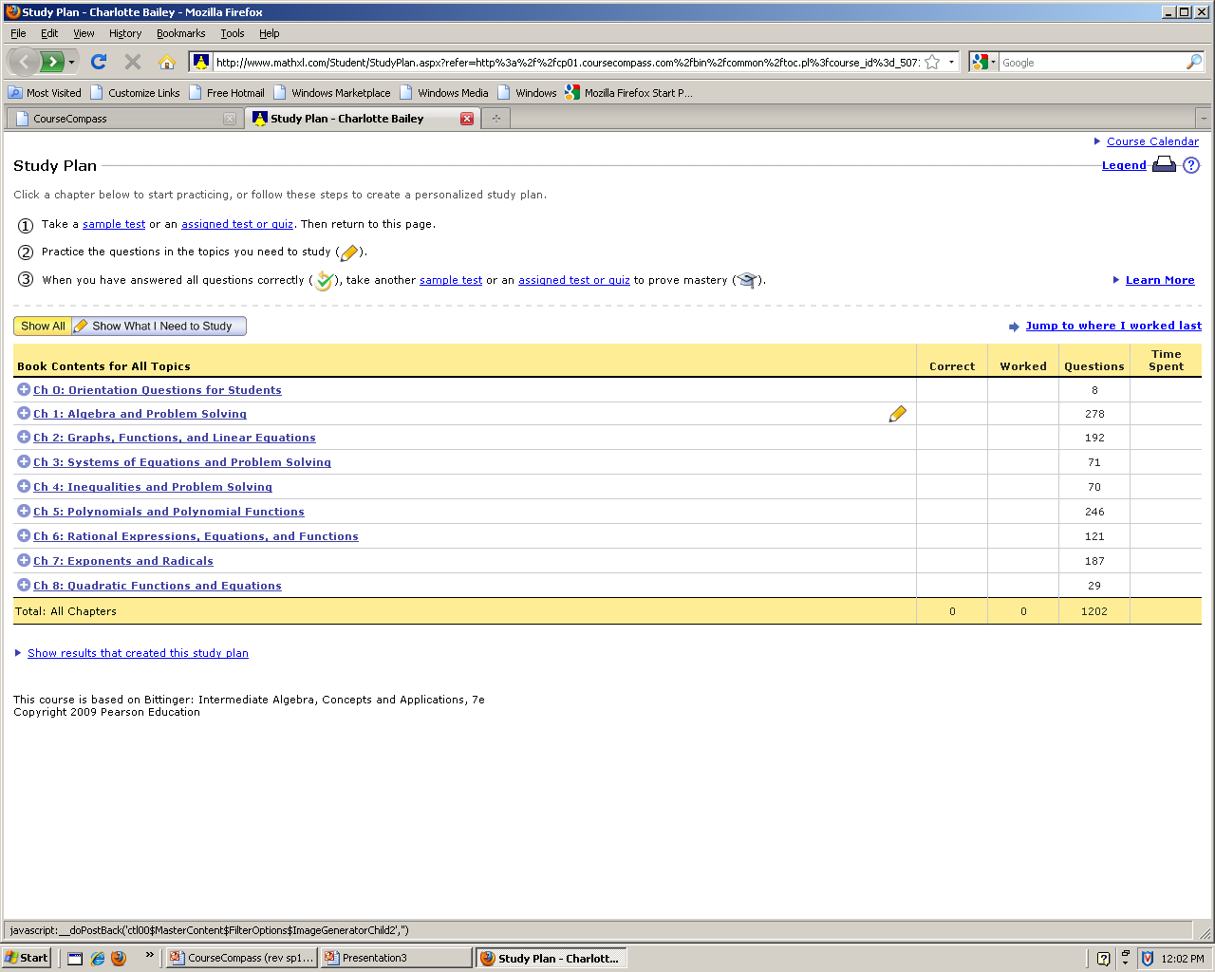
You can select a chapter.

Slide 38
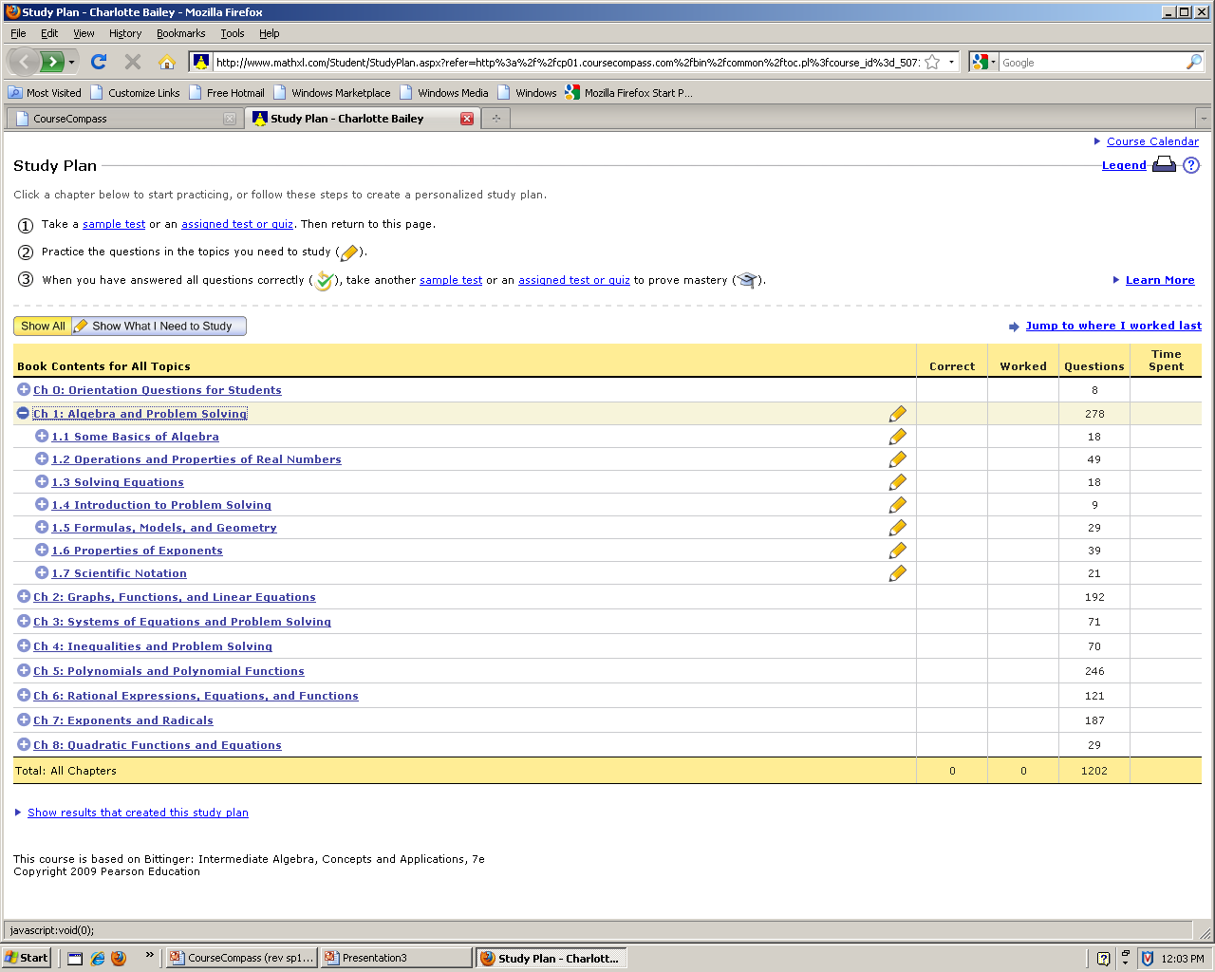
A drop down menu will then let you select a lesson.

Slide 39
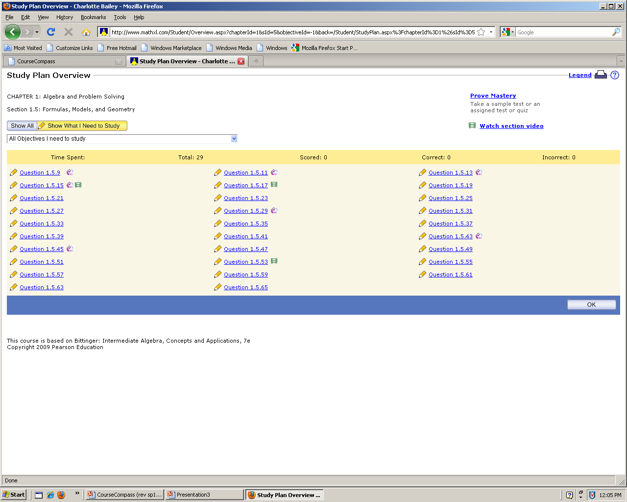
The problems are numbered corresponding to the numbers found in the textbook, not the problem numbers as listed in MyMathLab. This is a great way to review and find what you need to study. When reviewing for an exam, look at the assignment list and work those problems from the study plan.

Slide 40
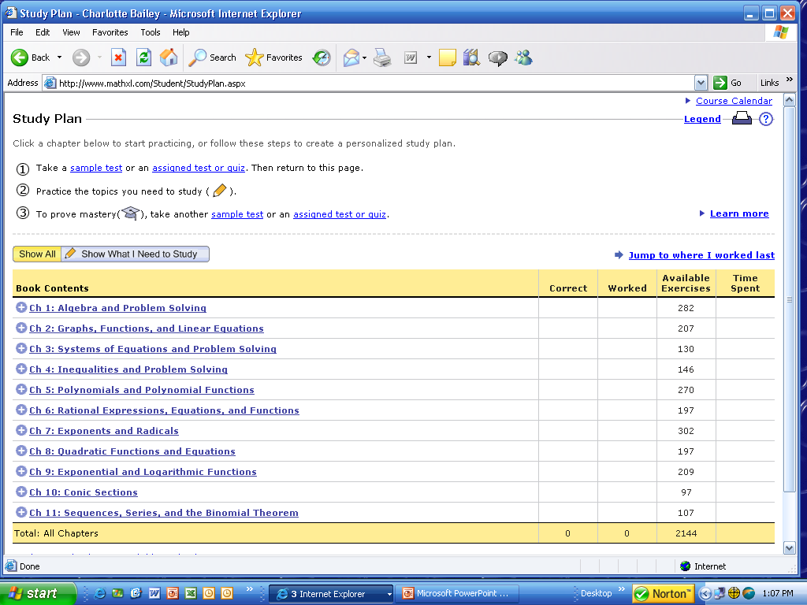
MyMathLab provides a Study Plan that offers lots of practice and feedback. You must take a practice test first.
Here is where you click to see what you need to study.
Notes:
40

Slide 41
GradeBook
Click on Grade Book from the menu on the home page. You can view your most recent HW, the past couple of week’s, or all of the HW grades.
If you did not attempt a homework assignment, it may read ‘past due’ or there may be a zero with * if the deadline has passed without you completing a problem.

Slide 42
To check your scores for each assignment, click on
GRADEBOOK.

Slide 43
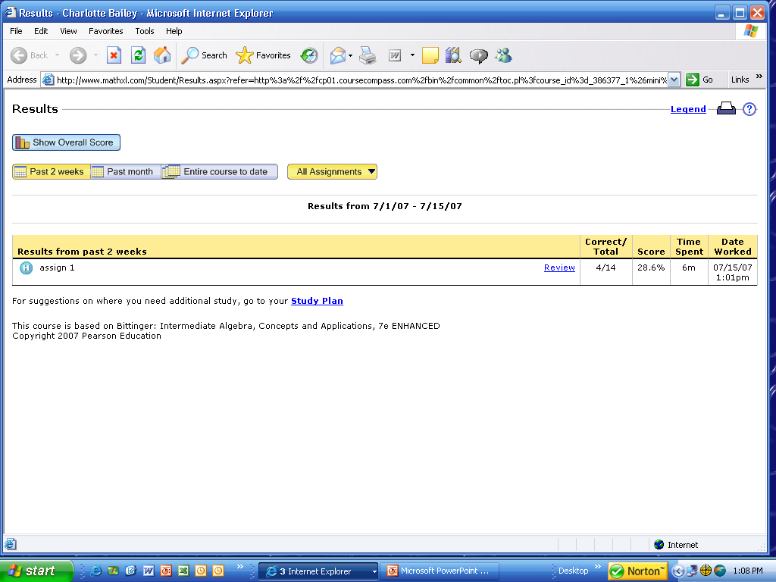
You can view your grades for the past 2 weeks, past month, or entire course.
The gradebook will keep track of your progress on homework problems; number correct, percent correct, time on task, and date/time. If you want to practice some problems after the deadline, click on ‘review’. (You may have to ask for a ‘similar example’ to re-do some problems. Your grade will not be changed.)
Notes:
43

Slide 44
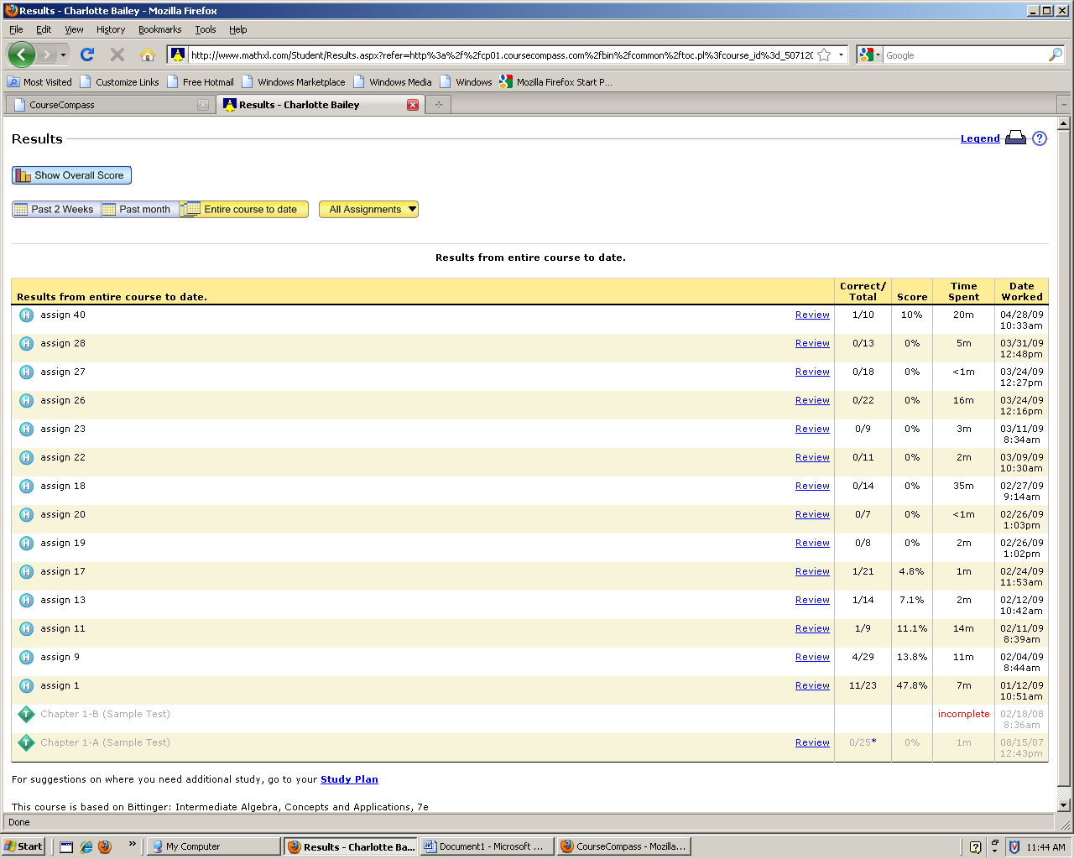
Within the gradebook and after a deadline, you can practice all the homework problems you have completed earlier by clicking on the word ‘review’.
You can only use this link, if you have completed the homework problems. Any assignments that were scored ‘zero’ will not necessary have a review link.

Slide 45
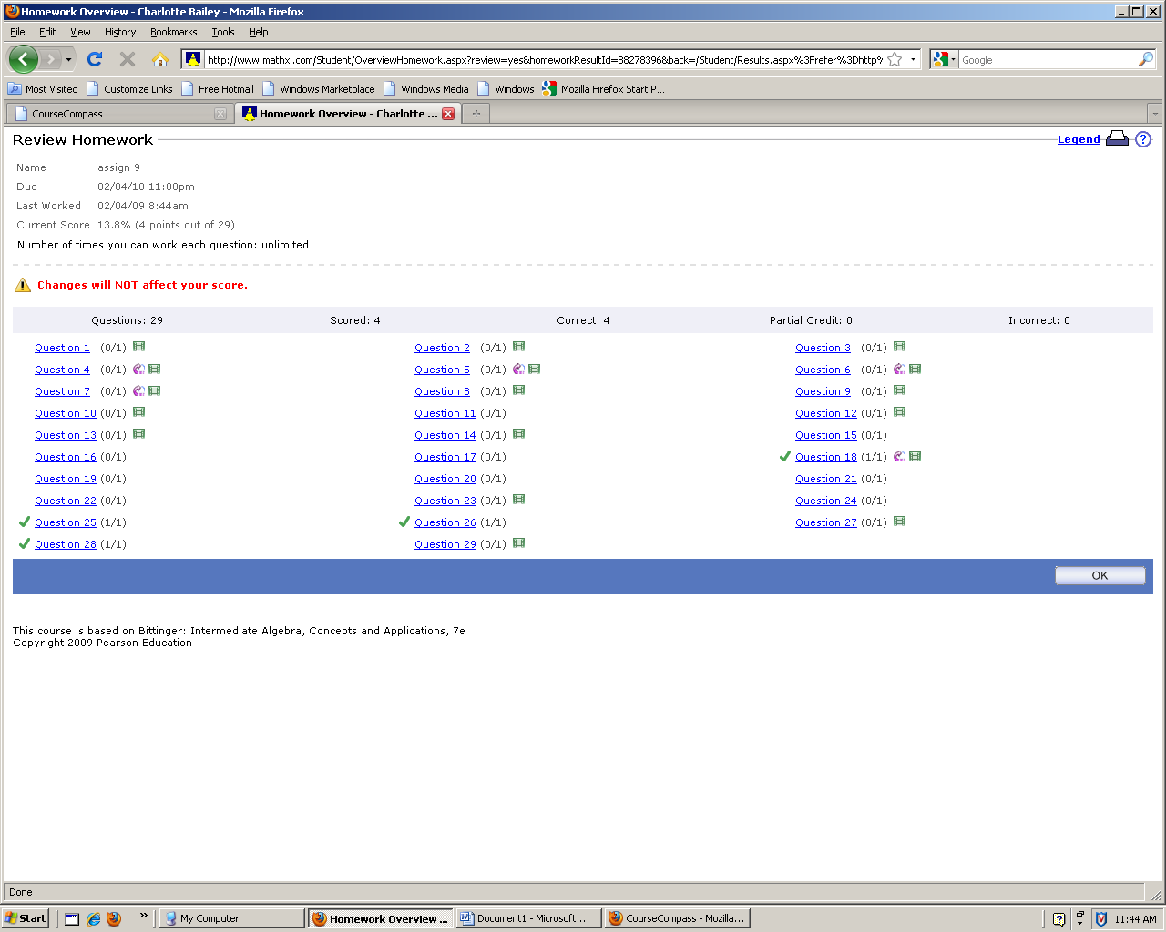
Click on a problem, just as if working an assignment. Your score will not be changed.

Slide 46
There is a ‘help and support’ link that may help you.

Slide 47
Problems???
Contact Student Support at
1-800-677-6337 for technical
support 24 hours a day.
For math tutoring at the Tutor Center call
1-800-435-4084 between 5 PM and midnight Sunday through Thursday.
You must use your MyMathLab course ID or student access code to register or receive help.
Notes:
47

