Slide 1
Introduction to MA 15910 Introduction to Calculus
A Brief Calculus Course
Spring 2016 Semester

Slide 2
Instructor’s Name: Charlotte Bailey Instructor’s Office: MATH 802 Office Phone: 765.496.3145 (I have voice mail, but I prefer an email message.) email address: baileycm@purdue.edu

Slide 3
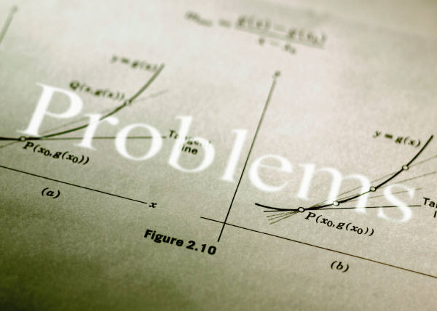
Course Web Page Address www.math.purdue.edu/MA15910

Slide 4
Important Information on Web Page
The course information (syllabus)
The assignment list (corresponding to problems in MyMathLab or paper homework problems)
The class schedule
Directions for Registration (or enrolling in a new class) for MyMathLab
Information on how to use (features of MyMathLab)
Exam information
Resource information
Etc.

Slide 5
My Office Hours
Monday through Friday:
9:30 – 10:30
Monday, Wednesday, & Friday:
8:30 – 9:30, 2:30 – 3:30
Mon., Tues, Wed., Fri.: 1:30 – 2:30
Or by appointment at other times

Slide 6
MATH HELP ROOMS
The math help rooms (MATH 211 and MATH 205)
Usually open Monday – Thursday from 11:30 until 3:30
Help rooms are not open on Friday.
The schedule for these help rooms should eventually be on the web page.
Instructors of classes other than MA 15910 may also help you.

Slide 7
Brief Course Information
Going over this brief information in class does not replace your responsibility to read and understand all policies/procedures on the syllabus (class information).
To view the schedule, syllabus (class info), and assignment sheet (and other information) go to the web page. www.math.purdue.edu/MA15910

Slide 8
Attendance Policy
Students are expected to attend class!
Students cannot take a quiz or turn in papers without attending class (with the exception of very unusual extenuating circumstances).
I recommend students print the lesson notes (found on the web page) and bring to class to complete.

Slide 9
Online and Paper Homework/Assignments
Most lessons have online homework and possibly some paper homework problems (bold problems on assignment sheet) Paper homework may be collected and scored as a quiz.
First online homework completed on MyMathLab is due this Friday, 1/15 at 11 PM.
All online homework deadlines are usually due at 11:00 PM on the day of the next class meeting. Any paper homework, if collected, is generally due at the next class meeting.

Slide 10
No homework scores are dropped or excused.
Only the course coordinator can extend a deadline of an assignment for a student.
You have unlimited attempts at most online problems until the deadline arrives.
Online homework is scaled to 50 points at the end of the semester.
Completing and understanding your homework is the best way to prepare for exams and quizzes. Students who do not understand homework rarely succeed on quizzes or exams!

Slide 11
PowerPoints (or pdf) for MyMathLab
Information is found on web page…
registration in MyMathLab,
enrolling in a new MyMathLab class (for previous MyMathLab users), and
using MyMathLab
View the PowerPoints or pdf documents with this information.

Slide 12
Quizzes
There will be a short quiz about twice a week.
First quiz is this Wednesday 01/13 and/or Friday, 01/15.
No make-up quizzes (or early quizzes) are given. One quiz is excused or the student’s lowest quiz score dropped at the end of the semester.
For more than one to be excused or dropped, there must be documented and extenuating circumstances for ALL absences.
Quizzes are scaled to 50 points at the end of the semester.
Paper homework problems may be collected and scored as a quiz.

Slide 13
Very Important Announcement!
Any student caught cheating on a quiz will lose all his/her quiz points for the entire semester.

Slide 14
EXAMS
The 3 regular exams are Monday, Tuesday, or Thursday evening exams at 6:30 or 8:00 PM. Details will be given on the web page before each exam. (check class calendar)
The final exam is written by the math department and the course coordinator.
Before each exam, an exam memo with suggested ways to prepare/study for the exam will be available on the web page. There will be some ‘old’ exams available also in the exam archive (link from the web page).

Slide 15
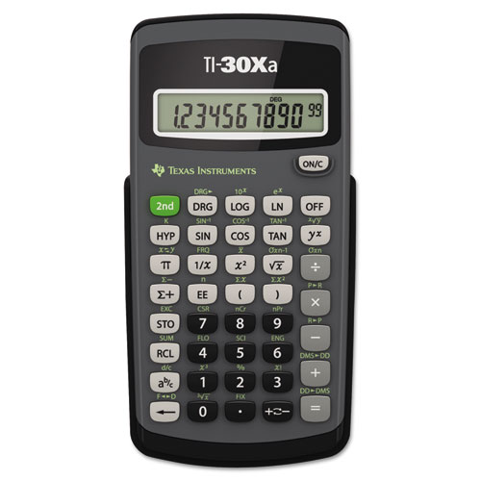
Calculator Policy
A TI-30XA (Xa) basic scientific calculator is the only calculator allowed on quizzes or exams.
A calculator is needed for many homework, quiz, and exam problems.
Students should always bring their calculators to class and exams. The instructor will not usually loan calculators to students. No calculators may be shared during quizzes/exams.
A picture of the newest version of a TI-30Xa (XA) calculator is shown at the right.

Slide 16
Needed Supplies or Materials
Textbook and MyMathLab access code
There are 2 textbooks on reserve in the MATH library (3rd floor of MATH).
A TI-30Xa (XA) basic scientific calculator
Usual paper, pencils, erasers, a few sheets of graph paper
A 3-ring binder to keep notes
and other papers organized
(optional) a 3-hole punch
(optional) a stapler
(optional) A straight-edge
(optional) printed notes found
on the web page

Slide 17
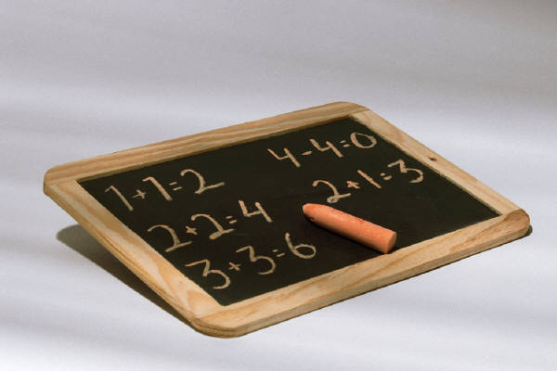
Office Hours
Charlotte’s usual weekly schedule is found on the web page and on her office door. Her office hours are listed on it.
The MATH help rooms (MATH 211 and MATH 205) are open Monday through Thursday from 11:30 until 3:30. (They
are not open on Friday.)

Slide 18
Academic Adjustments
The Department of Mathematics offers alternative testing environments for students who are registered with the Disability Resource Center. Students who need accommodations must deliver a copy of their Accommodation Notification memorandum to the Undergraduate Services Office (MATH 242) and request an information sheet for their course. Memorandums should be delivered to that office within one week of receipt from the Disability Resource Center. The information Sheet explains the process for receiving exam accommodations for your mathematics course. Enlarged copies of the information sheets are available upon request. Students currently undergoing evaluation through the DRC should also request an information sheet.

Slide 19
If you have been certified by the Disability Resource Center (DRC) as eligible for academic adjustments on exams or quizzes see http://www.math.purdue.edu/ada for exam and quiz procedures for your mathematics course or go to MATH 242 for paper copies. In the event that you are waiting to be certified by the Disability Resource Center we encourage you to review our procedures prior to being certified. For all in-class accommodations please see your instructors outside class hours – before or after class or during office hours – to share your Accommodation Memorandum for the current semester and discuss your accommodations as soon as possible.

Slide 20
Grades
Your goal should be to earn as many points as you can. (possible 600 points total)
Homework and quizzes are each scaled to 50 points.
Each of the 3 mid-term exams is worth 100 pts.
Final exam is worth 200 points.
Grades are assigned based on the
percent scale indicated on the
syllabus and on the next page.

Slide 21
Grading Scale Percents
97.5 – 100: A+, 89.5 – 97.49: A 87.5 – 89.49: A –
85.5 – 87.49: B+, 77.5 – 85.49: B 74.5 – 77.49: B-
69.5 – 74.49: C+, 64.5 – 69.49: C
59.5 – 64.49: C –
56.5 – 49.49: D+ 49.5 – 56.49: D
There is no D – 0 – 49.49: F

Slide 22
Cheating Policy
The mathematics department will not tolerate cheating of any sort. Grade penalties will always be imposed by the department and all cases are reported to the Dean of Students Office for disciplinary action.
At an exam, students may be asked to sign that they have read and understand an academic integrity statement.

Slide 23
Placement
Please monitor your course work during the first few weeks. Should you decide that you need to drop this course and add an algebra/precalculus course, the last date you can do so is Monday, February 8th at 5:00 PM.
The sooner you make the move, the better. See your academic advisor and the course coordinator for the course you want to add.

Slide 24
Course Evaluation
You will be provided an opportunity to evaluate this course and your instructor during the last couple of weeks of the semester. This evaluation is completed online.

Slide 25
Campus Emergency Policy
In the event of a major campus emergency; course requirement, deadlines, and grading percentages are subject to changes that may be necessitated by a revised semester calendar or other circumstances beyond the instructor’s control. To get information about any such changes, please see the course web page or read an official email message from your instructor.

Slide 26
Helpful Suggestions
Attend Class!
Complete the majority of online homework prior to the next class meeting.
Seek help as soon as you determine you do not fully understand a topic.
Take responsibility for your learning!

