Slide 1
Quantitative Reasoning
MA 15555 section 348 (4:30)
Copy this down (you may need it!):
Instructor: Alden Bradford
Instructor’s email: bradfoa@purdue.edu
Course coordinator: Tim Delworth
Coordinator’s email: delworth@purdue.edu
Online homework: Loncapa.purdue.edu
Course page (and more online homework): purdue.brightspace.com

Slide 2
Course Format
Tuesday/Thursday here, Monday in Stewart 130 at 8:30 AM
Twice weekly homework on Lon-Capa
Weekly (not every week, but frequent) one-page papers on Brightspace
In-person exams
LOTS AND LOTS of group work and interactions (not much lecture!)
Most students get an A or a B (typically at least 4 in 5 students)

Slide 3
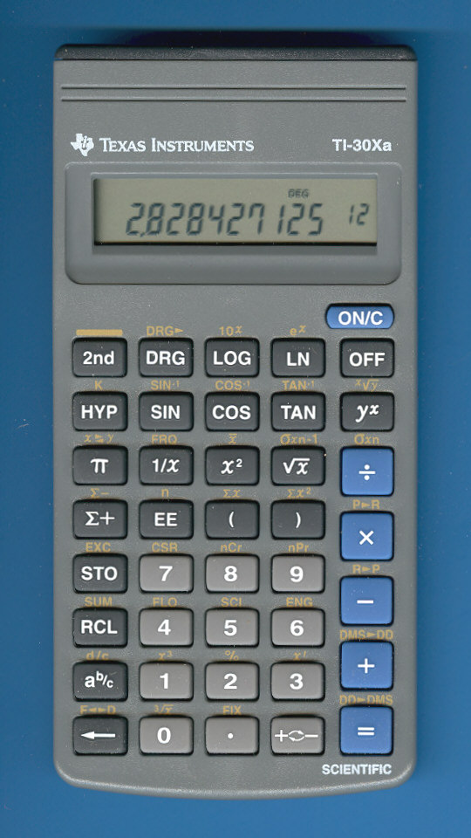

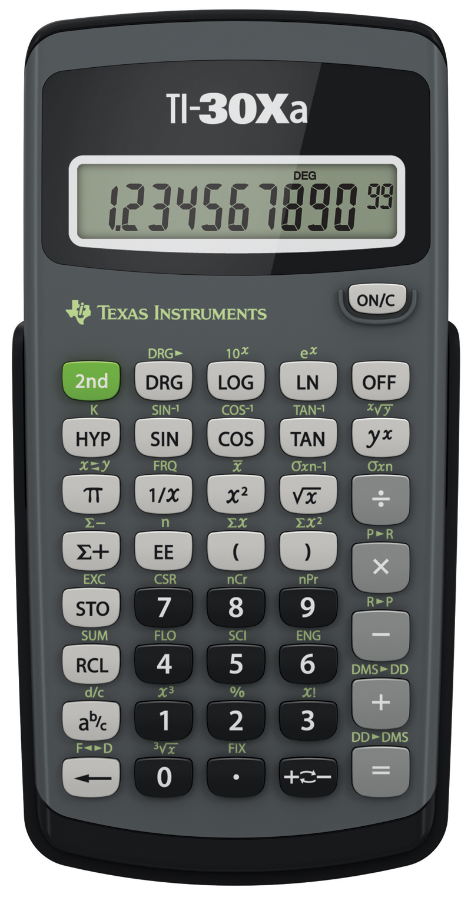


You Need This Calculator (NOT THAT CALCULATOR)
✔
✔
✔

Slide 4
Introductions
What is your name (how should we refer to you?)
What’s something interesting (not math related) you learned recently?
Please make a simple math mistake for us (say something incorrect)

Slide 5
Accommodations
If you need accommodations for a disability, please reach out to the Disability Resource Center (purdue.edu/drc)
If you have a serious illness or some other reason you can’t complete an assignment on time, reach out to Mr. Delworth (it does not hurt to ask!)
Recorded versions of lessons will be available on Brightspace

Slide 6
Advice from Previous Students
I know it’s tempting, but don’t use Chegg / Google answers to the hw. If you do the hw yourself you will understand it better + do better on exams.
Do the homework. It may not be worth a huge amount of your grade but it helps you understand the concepts so you can do well on the exam.
Pay close attention in class & take thorough notes.
Accept you’re going to suffer but study anyways.
I would tell them to go get help when they don’t understand something instead of trying to work it our themselves before so be patient, and watch a lot of Youtube videos!

Slide 7
What do you do to manage stress in math class?
Get help promptly when stuck
Take a timed break/cry
Don’t give up on anything, do come back to it later
Come to class and take notes

Slide 8
What has helped you so far related to pandemic learning?
Use pen and paper instead of a laptop
Instructors send out reminder emails / brightspace posts
Instructors being more lenient with policies
Build a weekly plan/checklist
Rewatch recorded lectures, even if you attend the live ones

Slide 9
Ground rules for conversation & group work
DO NOT suggest, in any way, that any student does not belong here.
DO NOT act in a way which makes anyone here feel unsafe or unwelcome.
DO allow everyone a chance to be heard.
DO treat each person as an individual, not as a representative of their perceived group/class.
DO recognize that others have different experiences from you.
Treat others how you want to be treated
Help others as much as you can

Slide 10
Racism and Bigotry at Purdue
Following are two real stories from Purdue students.
They may be uncomfortable to read.
It is important to be aware of these stories.

Slide 11


Slide 12


Slide 13
Short Exercise: Communicating in pairs
Group up in pairs
We will take turns: decide who will go first
In one minute (I will time you) describe something you enjoyed doing over break. Give as much detail as you can.

Slide 14
Short Exercise: Communicating Part 2
Now person 2 in one minute, tell person 1: what did person 1 just tell you?

Slide 15
Reflect on this exercise as a class
Which was more difficult: sharing, or repeating?
Repeaters: was it hard to remember what you were told?
Tellers: were you surprised by how much your partner remembered?

Slide 16
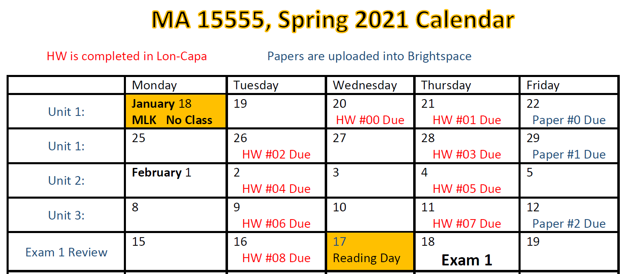
What is coming up

Slide 17
How to do your homework
Loncapa.purdue.edu

