Slide 1
Reminders
NEXT WEDNESDAY QUIZ 5 on
  Volume of Revolutions
    Disks (Lesson 14)
    Washers (Lesson 15)

Slide 2
MA 16020: Lesson 15
Volume By Revolution
Washer Method
By: Alexandra Cuadra

Slide 3
Last Time, we talked about…
How Geometry gave us formulas for simple shapes and solids to find their area or volume, and
How Integration can allow us to find area or volume of ANYTHING !
  How?
  We introduced this notion of cross-sections which can be of the form of
    Disks (Lesson 14), or
    Washers (Lesson 15), or
    Shells (Lesson 17)

Slide 4
Geometry: How to Calculate The Area of a Shaded Region
Suppose we are asked to find the area of a rectangle with a triangle missing from the middle.
How do we calculate that area?

Slide 5
Geometry: How to Calculate The Area of a Shaded Region
First, we would find the area of the rectangle and the area of the triangle separately.

Slide 6
Geometry: How to Calculate The Area of a Shaded Region
Then we would subtract these two values …

Slide 7
Geometry: How to Calculate The Area of a Shaded Region
… to find the remaining area.

Slide 8
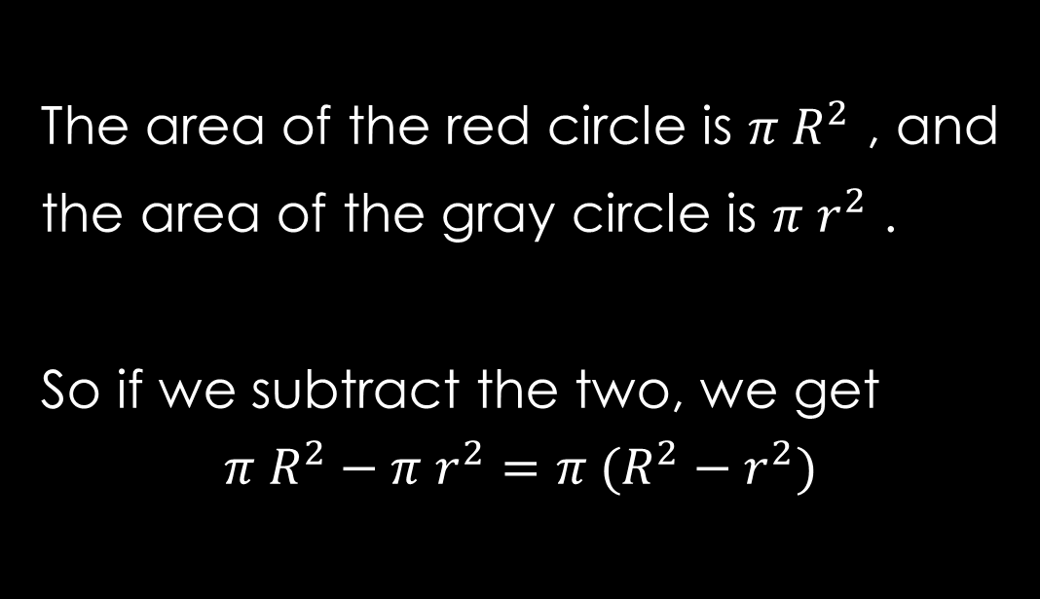
What if we did this with disks?
Let’s find the area of the red annulus.
The area of the red circle is $π R^{2}$ , and
the area of the gray circle is $π r^{2}$ .
So if we subtract the two, we get
$$π R^{2}−π r^{2}=π (R^{2}−r^{2})$$
R
r

Slide 9
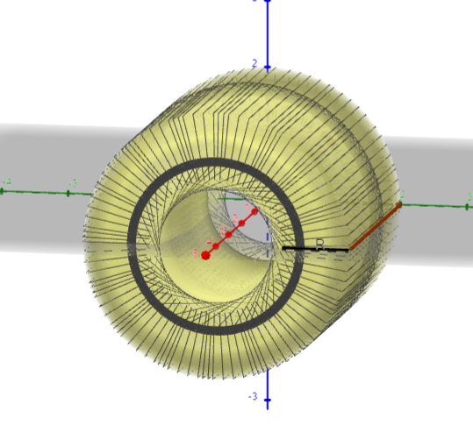
Today’s Lecture
In this lesson, we are going to play with disks, but remove a portion of it.
This method is called the washer method.
https://www.geogebra.org/m/uym6dwyd

Slide 10
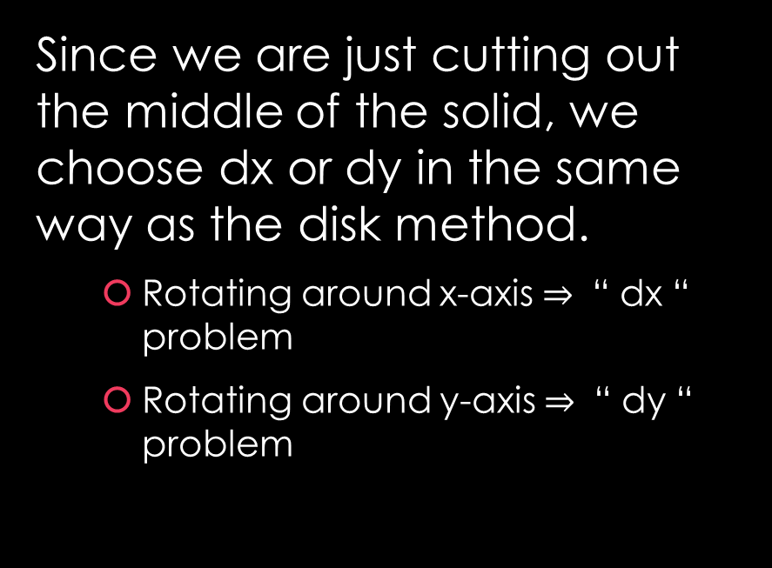
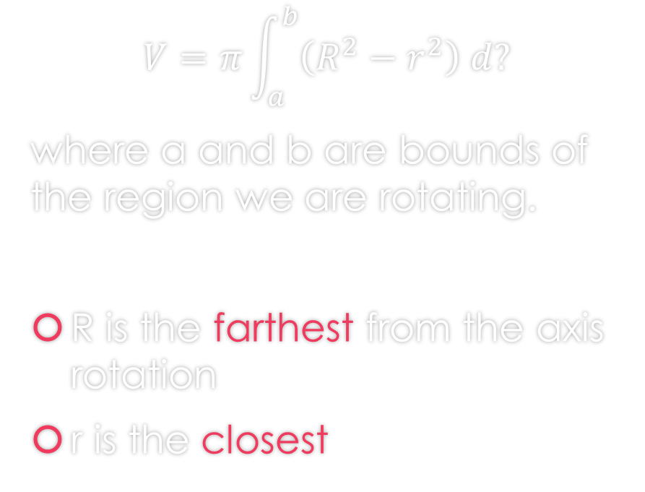
Washer Method Formula
Since we are just cutting out the middle of the solid, we choose dx or dy in the same way as the disk method.
  Rotating around x-axis $⇒$ “ dx “ problem
  Rotating around y-axis $⇒$ “ dy “ problem
$$V=π\int_{a}^{b}{\left(R^{2}−r^{2}\right) d?}$$
where a and b are bounds of the region we are rotating.
R is the farthest from the axis rotation
r is the closest

Slide 11
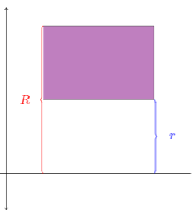
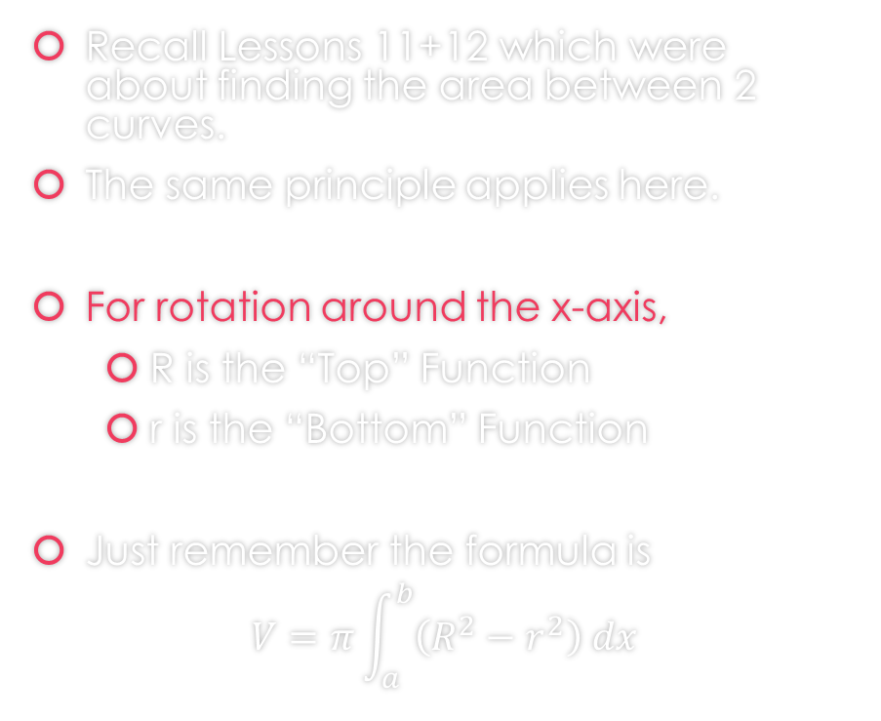
Let’s talk a bit more about R and r
Recall Lessons 11+12 which were about finding the area between 2 curves.
The same principle applies here.
For rotation around the x-axis,
  R is the “Top” Function
  r is the “Bottom” Function
Just remember the formula is
$$V=π\int_{a}^{b}{\left(R^{2}−r^{2}\right) dx}$$

Slide 12
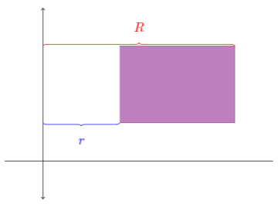
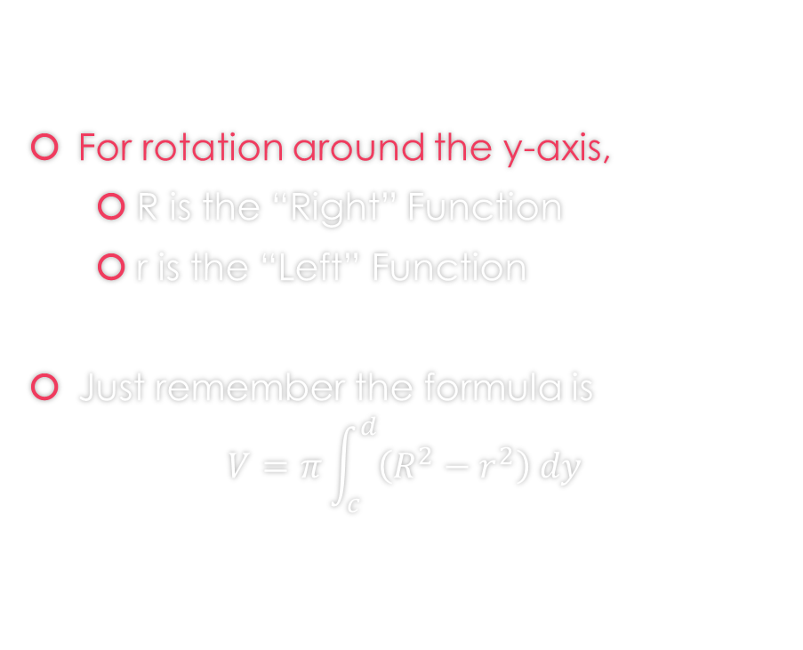
Let’s talk a bit more about R and r
For rotation around the y-axis,
  R is the “Right” Function
  r is the “Left” Function
Just remember the formula is
$$V=π\int_{c}^{d}{\left(R^{2}−r^{2}\right) dy}$$

Slide 13
How to Proceed with Washer Problems
Draw the region
Determine which axis you are rotating on
  If x - axis: Determine Top and Bottom Function
    R is Top
    r is Bottom
  If y - axis: Determine Right and Left Function
    R is Right
    r is Left
Finally, apply the washer formula

Slide 14
Examples

Slide 15

Example 1: Find the volume of the solid that results by revolving the region enclosed by the curves
$y=\frac{x}{2}$, $y=3x$, and $x=2$
About the x-axis.
https://www.geogebra.org/m/m2p2kdmp

Slide 16
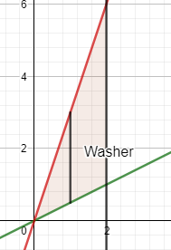
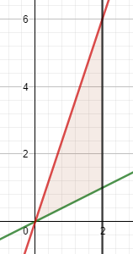

Example 1: Find the volume of the solid that results by revolving the region enclosed by the curves
$y=\frac{x}{2}$, $y=3x$, and $x=2$
About the x-axis.
First draw the region.
https://www.geogebra.org/m/m2p2kdmp

Slide 17
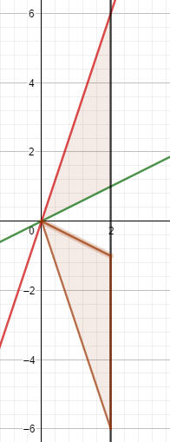

Example 1: Find the volume of the solid that results by revolving the region enclosed by the curves
$y=\frac{x}{2}$, $y=3x$, and $x=2$
About the x-axis.
Rotation about x-axis
https://www.geogebra.org/m/m2p2kdmp

Slide 18
Example 1: Find the volume of the solid that results by revolving the region enclosed by the curves
$y=\frac{x}{2}$, $y=3x$, and $x=2$
About the x-axis.
https://www.geogebra.org/m/m2p2kdmp

Slide 19

Example 1: Find the volume of the solid that results by revolving the region enclosed by the curves
$y=\frac{x}{2}$, $y=3x$, and $x=2$
About the x-axis.
https://www.geogebra.org/m/m2p2kdmp

Slide 20
Example 1: Find the volume of the solid that results by revolving the region enclosed by the curves
$y=\frac{x}{2}$, $y=3x$, and $x=2$
About the x-axis.
You can find the solution in the pdf of the notes. Click here to access it.
https://www.geogebra.org/m/m2p2kdmp

Slide 21

Example 2: Find the volume of the solid that results by revolving the region enclosed by the curves
$y=e^{−x}$, $y=2$, and $x=3$
About the x-axis.
https://www.geogebra.org/m/jfta4b52

Slide 22
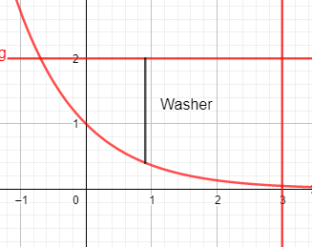

Example 2: Find the volume of the solid that results by revolving the region enclosed by the curves
$y=e^{−x}$, $y=2$, and $x=3$
About the x-axis.
First draw the region.
https://www.geogebra.org/m/jfta4b52

Slide 23
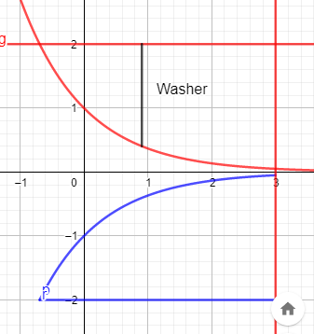

Example 2: Find the volume of the solid that results by revolving the region enclosed by the curves
$y=e^{−x}$, $y=2$, and $x=3$
About the x-axis.
Rotation about x-axis
https://www.geogebra.org/m/jfta4b52

Slide 24
Example 2: Find the volume of the solid that results by revolving the region enclosed by the curves
$y=e^{−x}$, $y=2$, and $x=3$
About the x-axis.
https://www.geogebra.org/m/jfta4b52

Slide 25
Example 2: Find the volume of the solid that results by revolving the region enclosed by the curves
$y=e^{−x}$, $y=2$, and $x=3$
About the x-axis.
https://www.geogebra.org/m/jfta4b52

Slide 26
Example 2: Find the volume of the solid that results by revolving the region enclosed by the curves
$y=e^{−x}$, $y=2$, and $x=3$
About the x-axis.
https://www.geogebra.org/m/jfta4b52

Slide 27
Example 2: Find the volume of the solid that results by revolving the region enclosed by the curves
$y=e^{−x}$, $y=2$, and $x=3$
About the x-axis.
You can find the solution in the pdf of the notes. Click here to access it.
https://www.geogebra.org/m/jfta4b52

Slide 28

Example 3: Find the volume of the solid that results by revolving the region enclosed by the curves
$y=x^{2}$, $x=2$, and $y=0$
About the y-axis.
https://www.geogebra.org/m/znzmhqq7

Slide 29
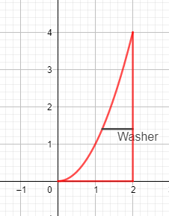

Example 3: Find the volume of the solid that results by revolving the region enclosed by the curves
$y=x^{2}$, $x=2$, and $y=0$
About the y-axis.
First draw the region.
https://www.geogebra.org/m/znzmhqq7

Slide 30
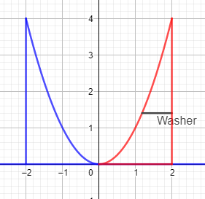

Example 3: Find the volume of the solid that results by revolving the region enclosed by the curves
$y=x^{2}$, $x=2$, and $y=0$
About the y-axis.
Rotation about y-axis
https://www.geogebra.org/m/znzmhqq7

Slide 31
Example 3: Find the volume of the solid that results by revolving the region enclosed by the curves
$y=x^{2}$, $x=2$, and $y=0$
About the y-axis.
https://www.geogebra.org/m/znzmhqq7

Slide 32
Example 3: Find the volume of the solid that results by revolving the region enclosed by the curves
$y=x^{2}$, $x=2$, and $y=0$
About the y-axis.
https://www.geogebra.org/m/znzmhqq7

Slide 33
Example 3: Find the volume of the solid that results by revolving the region enclosed by the curves
$y=x^{2}$, $x=2$, and $y=0$
About the y-axis.
https://www.geogebra.org/m/znzmhqq7

Slide 34
Example 3: Find the volume of the solid that results by revolving the region enclosed by the curves
$y=x^{2}$, $x=2$, and $y=0$
About the y-axis.
You can find the solution in the pdf of the notes. Click here to access it.
https://www.geogebra.org/m/znzmhqq7

Slide 35

Example 4: Find the volume of the solid that results by revolving the region inside the circle $x^{2}+y^{2}=9$ and to the right of the line $x=1$ about the y-axis.
https://www.geogebra.org/m/c2wzbrbf

Slide 36
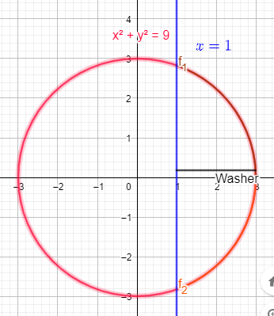

Example 4: Find the volume of the solid that results by revolving the region inside the circle $x^{2}+y^{2}=9$ and to the right of the line $x=1$ about the y-axis.
First draw the region.
https://www.geogebra.org/m/c2wzbrbf

Slide 37
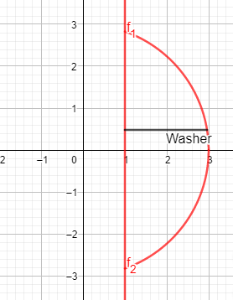
Example 4: Find the volume of the solid that results by revolving the region inside the circle $x^{2}+y^{2}=9$ and to the right of the line $x=1$ about the y-axis.
First draw the region.
Note we are only looking at the right of x=1
https://www.geogebra.org/m/c2wzbrbf

Slide 38
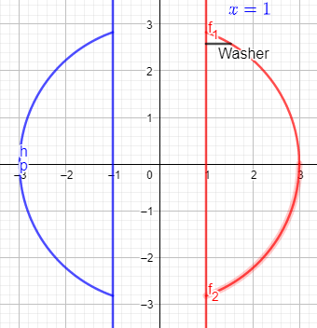
Example 4: Find the volume of the solid that results by revolving the region inside the circle $x^{2}+y^{2}=9$ and to the right of the line $x=1$ about the y-axis.
Rotation about y-axis
https://www.geogebra.org/m/c2wzbrbf

Slide 39
Example 4: Find the volume of the solid that results by revolving the region inside the circle $x^{2}+y^{2}=9$ and to the right of the line $x=1$ about the y-axis.
https://www.geogebra.org/m/c2wzbrbf

Slide 40
Example 4: Find the volume of the solid that results by revolving the region inside the circle $x^{2}+y^{2}=9$ and to the right of the line $x=1$ about the y-axis.
https://www.geogebra.org/m/c2wzbrbf

Slide 41
Example 4: Find the volume of the solid that results by revolving the region inside the circle $x^{2}+y^{2}=9$ and to the right of the line $x=1$ about the y-axis.
https://www.geogebra.org/m/c2wzbrbf

Slide 42
Example 4: Find the volume of the solid that results by revolving the region inside the circle $x^{2}+y^{2}=9$ and to the right of the line $x=1$ about the y-axis.
https://www.geogebra.org/m/c2wzbrbf

Slide 43
Example 4: Find the volume of the solid that results by revolving the region inside the circle $x^{2}+y^{2}=9$ and to the right of the line $x=1$ about the y-axis.
You can find the solution in the pdf of the notes. Click here to access it.
https://www.geogebra.org/m/c2wzbrbf

Slide 44

Example 5: Find the volume of the solid obtained by revolving the region enclosed by the curves
$y^{2}=x$, and $x=y$
a) About the y-axis
https://www.geogebra.org/m/qtt49cqx

Slide 45
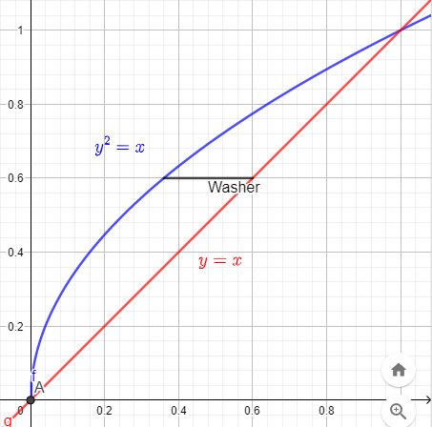
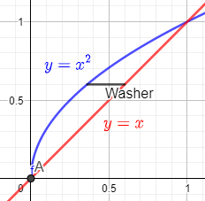

Example 5: Find the volume of the solid obtained by revolving the region enclosed by the curves
$y^{2}=x$, and $x=y$
a) About the y-axis
First draw the region.
https://www.geogebra.org/m/qtt49cqx

Slide 46
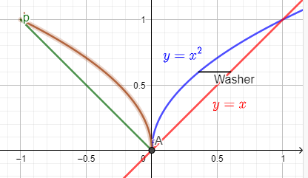
Example 5: Find the volume of the solid obtained by revolving the region enclosed by the curves
$y^{2}=x$, and $x=y$
a) About the y-axis
Rotation about y-axis
https://www.geogebra.org/m/qtt49cqx

Slide 47
Example 5: Find the volume of the solid obtained by revolving the region enclosed by the curves
$y^{2}=x$, and $x=y$
a) About the y-axis
https://www.geogebra.org/m/qtt49cqx

Slide 48
Example 5: Find the volume of the solid obtained by revolving the region enclosed by the curves
$y^{2}=x$, and $x=y$
a) About the y-axis
You can find the solution in the pdf of the notes. Click here to access it.
https://www.geogebra.org/m/qtt49cqx

Slide 49

Example 5: Find the volume of the solid obtained by revolving the region enclosed by the curves
$y^{2}=x$, and $x=y$
b) About the x-axis
https://www.geogebra.org/m/esmxtp7s

Slide 50
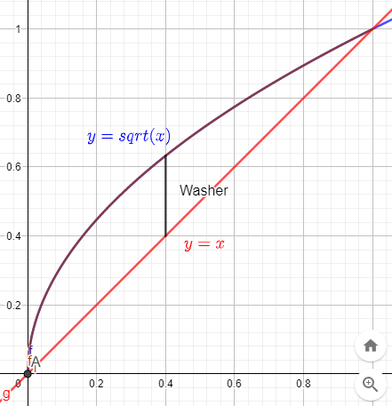

Example 5: Find the volume of the solid obtained by revolving the region enclosed by the curves
$y^{2}=x$, and $x=y$
b) About the x-axis
First draw the region.
https://www.geogebra.org/m/esmxtp7s

Slide 51
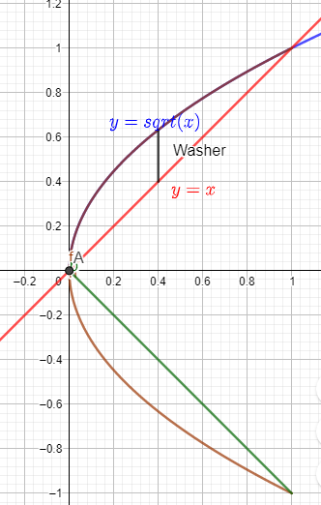
Example 5: Find the volume of the solid obtained by revolving the region enclosed by the curves
$y^{2}=x$, and $x=y$
b) About the x-axis
Rotation about x-axis
https://www.geogebra.org/m/esmxtp7s

Slide 52
Example 5: Find the volume of the solid obtained by revolving the region enclosed by the curves
$y^{2}=x$, and $x=y$
b) About the x-axis
https://www.geogebra.org/m/esmxtp7s

Slide 53
Example 5: Find the volume of the solid obtained by revolving the region enclosed by the curves
$y^{2}=x$, and $x=y$
b) About the x-axis
https://www.geogebra.org/m/esmxtp7s

Slide 54
Example 5: Find the volume of the solid obtained by revolving the region enclosed by the curves
$y^{2}=x$, and $x=y$
b) About the x-axis
You can find the solution in the pdf of the notes. Click here to access it.
https://www.geogebra.org/m/esmxtp7s

Slide 55
When do we apply Disk Method or Washer Method?

Slide 56
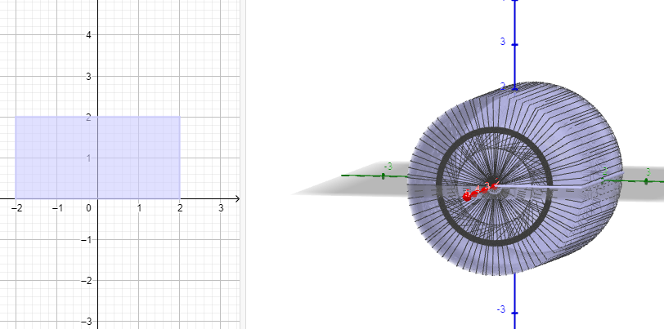
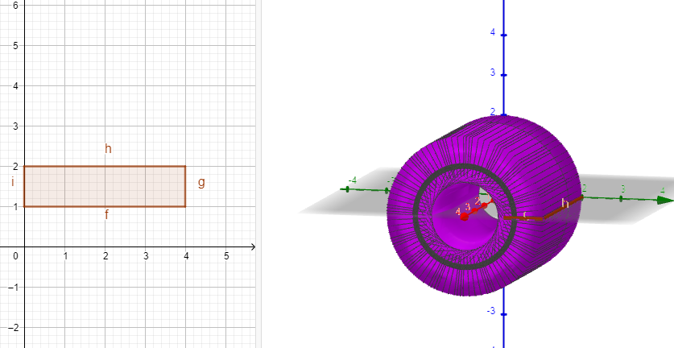
When do apply Disk Method or Washer Method?
Disk Method
Washer Method

Slide 57
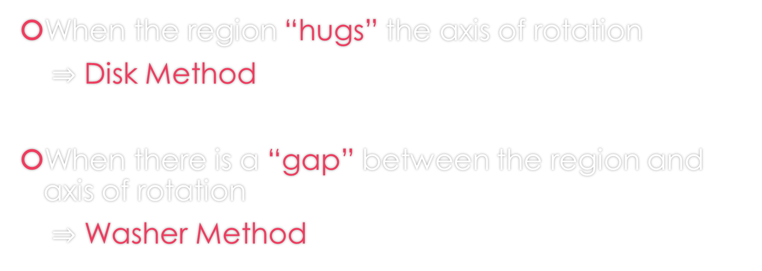
When do we apply Disk Method or Washer Method?
When the region “hugs” the axis of rotation
$⇒$ Disk Method
When there is a “gap” between the region and axis of rotation
$⇒$ Washer Method

Slide 58
GeoGebra Link for Lesson 15
https://www.geogebra.org/m/f73zjxfe
Note click on the play buttons on the left-most screen and the animation will play/pause.

