Slide 1
Reminders
NEXT CLASS QUIZ 5 on
  Volume of Revolutions
    Disks (Lesson 14)
    Washers (Lesson 15)
FRIDAY – NEXT MONDAY => NO CLASS

Slide 2
MA 16020: Lesson 17
Volume By Revolution
Shell Method
By Alexandra Cuadra

Slide 3
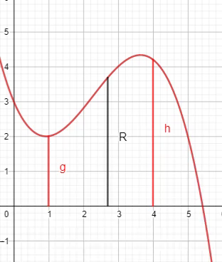
So far…
We have learned how to find the volume of a solid of revolution by integrating
  In the same way, we calculate the area under a curve
    Running a line segment of varying length across the region, and adding them up
https://www.geogebra.org/m/tgceabb2#material/tnnhu7gz

Slide 4
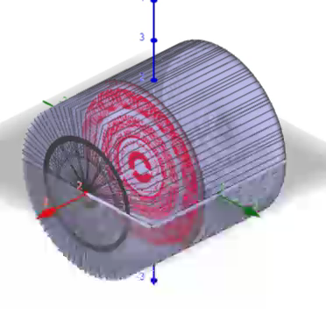
In other words,
We learned to find the volume of a solid of revolution by
  Running some area across a shape and add them up.
  Like in the case of the cylinder shown on the right.
https://www.geogebra.org/m/tgceabb2#material/qcwutumt

Slide 5


But what were those “shapes”?
ANSWER: CROSS-SECTIONS
Sometimes it was a disk
Whose area is $πR^{2}$
Sometimes it was a washer
Whose area is $π{(R}^{2}−r^{2})$
R
R
r

Slide 6
In Today’s Lecture, we will be covering the case, when neither method (Disk nor Washer) is easy.

Slide 7

Example 1: Find the volume obtained by revolving the region bounded by the curves
$y=2x^{2}−x^{3}$ and $y=0$
About the y-axis.
https://www.geogebra.org/m/jqfyndpu

Slide 8
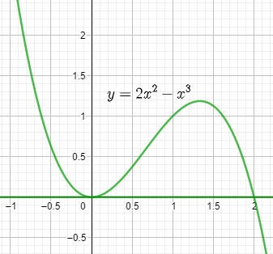

Example 1: Find the volume obtained by revolving the region bounded by the curves
$y=2x^{2}−x^{3}$ and $y=0$
About the y-axis.
Draw the region.
https://www.geogebra.org/m/jqfyndpu

Slide 9
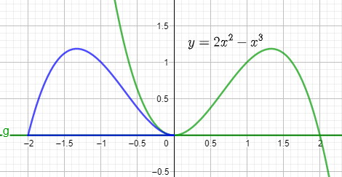
Example 1: Find the volume obtained by revolving the region bounded by the curves
$y=2x^{2}−x^{3}$ and $y=0$
About the y-axis.
Rotation about y-axis
https://www.geogebra.org/m/jqfyndpu

Slide 10
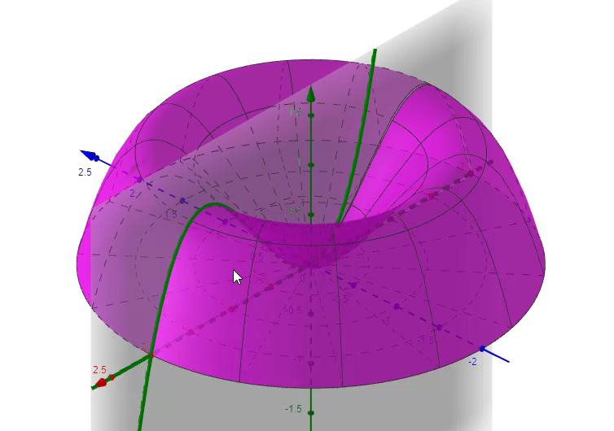
Example 1: Find the volume obtained by revolving the region bounded by the curves
$y=2x^{2}−x^{3}$ and $y=0$
About the y-axis.
WASHER ???
Furthermore, 3-D
https://www.geogebra.org/m/jqfyndpu

Slide 11

Example 1: Find the volume obtained by revolving the region bounded by the curves
$y=2x^{2}−x^{3}$ and $y=0$
About the y-axis.
Technically, yes. It is a Washer Problem.
But there are two issues:
Given we are revolving around y-axis, we want to solve our equations for $x$.
i.e. Solve $y=2x^{2}−x^{3}$ for $x$.
But that is easier said than done.
For washer problems, we need two equations for each radius.
Here we have both radius depend on the same function.
https://www.geogebra.org/m/jqfyndpu

Slide 12
So how can I do this kind of problem without giving myself a headache?
ANSWER: SHELL METHOD

Slide 13
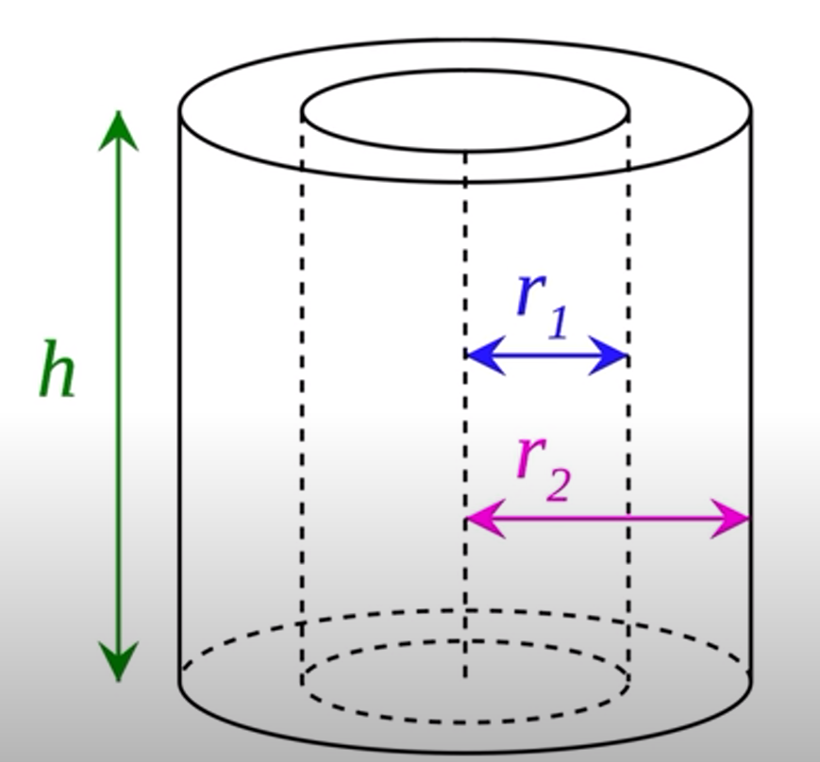
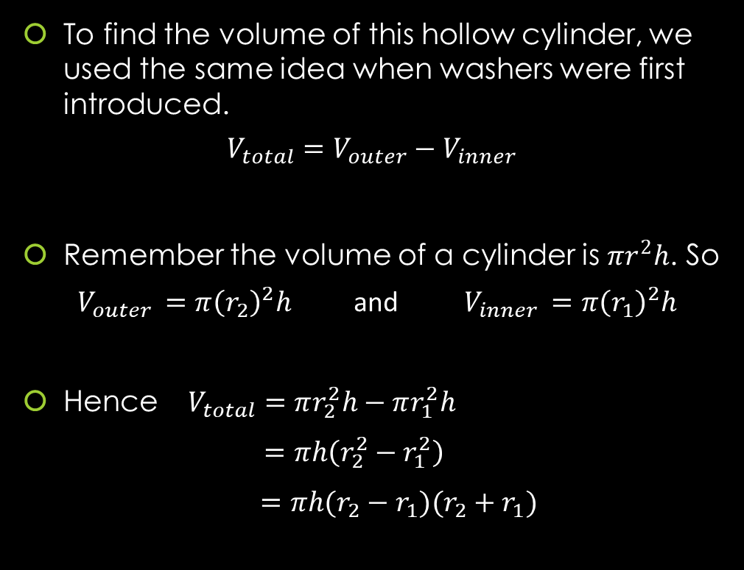
GEOMETRY: Finding The Volume of A Hollow Cylinder
To find the volume of this hollow cylinder, we used the same idea when washers were first introduced.
$$V_{total}=V_{outer}−V_{inner}$$
Remember the volume of a cylinder is $πr^{2}h$. So
$V_{outer }=π{\left(r_{2}\right)}^{2}h$ and $V_{inner }=π{\left(r_{1}\right)}^{2}h$
Hence $V_{total}=πr_{2}^{2}h−πr_{1}^{2}h$
$=πh\left(r_{2}^{2}−r_{1}^{2}\right)$
$=πh(r_{2}−r_{1})(r_{2}+r_{1})$

Slide 14
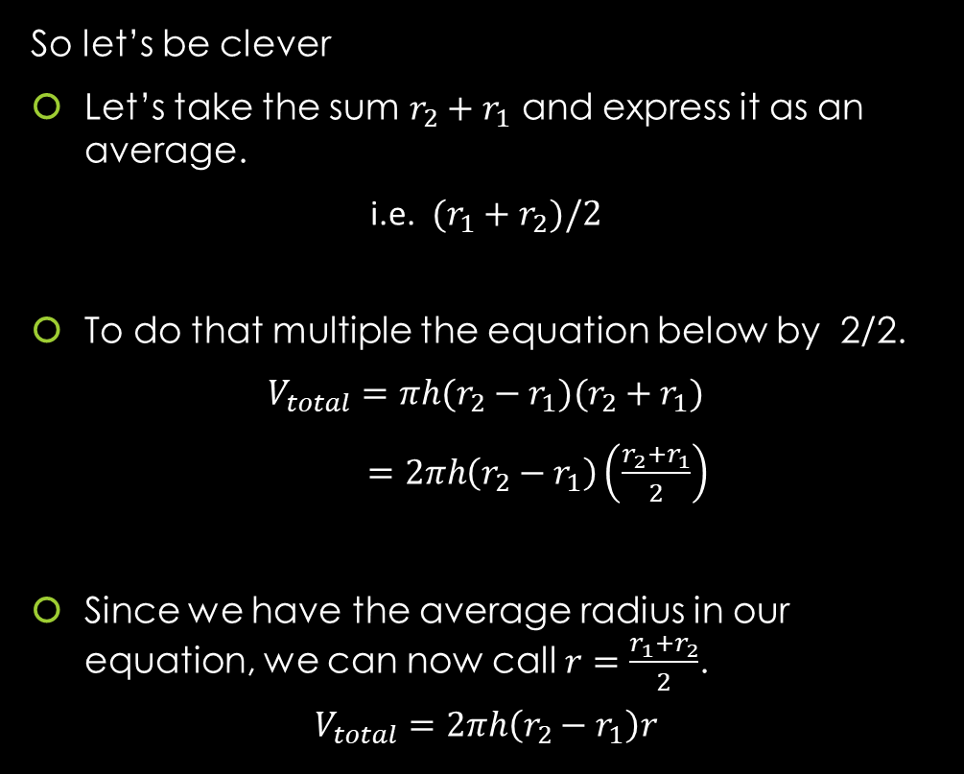
GEOMETRY: Finding The Volume of A Hollow Cylinder
So let’s be clever
Let’s take the sum $r_{2}+r_{1}$ and express it as an average.
i.e. $(r_{1}+r_{2})/2$
To do that multiple the equation below by 2/2.
$$V_{total}=πh(r_{2}−r_{1})(r_{2}+r_{1})$$
$=2πh\left(r_{2}−r_{1}\right)\left(\frac{r_{2}+r_{1}}{2}\right)$
Since we have the average radius in our equation, we can now call $r=\frac{r_{1}+r_{2}}{2}$.
$$V_{total}=2πh\left(r_{2}−r_{1}\right)r$$

Slide 15
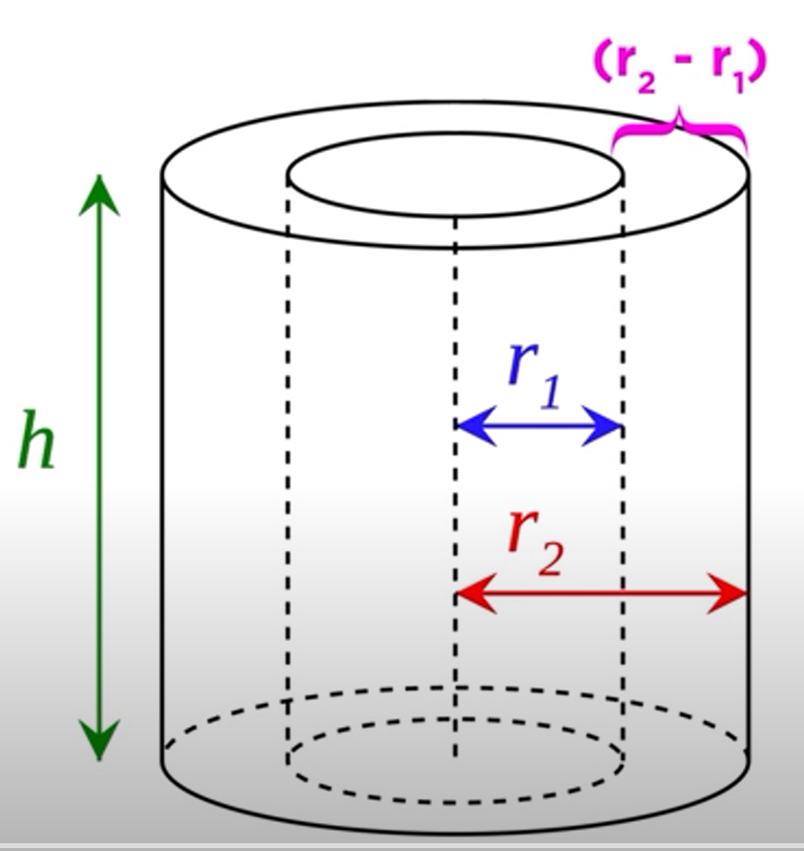
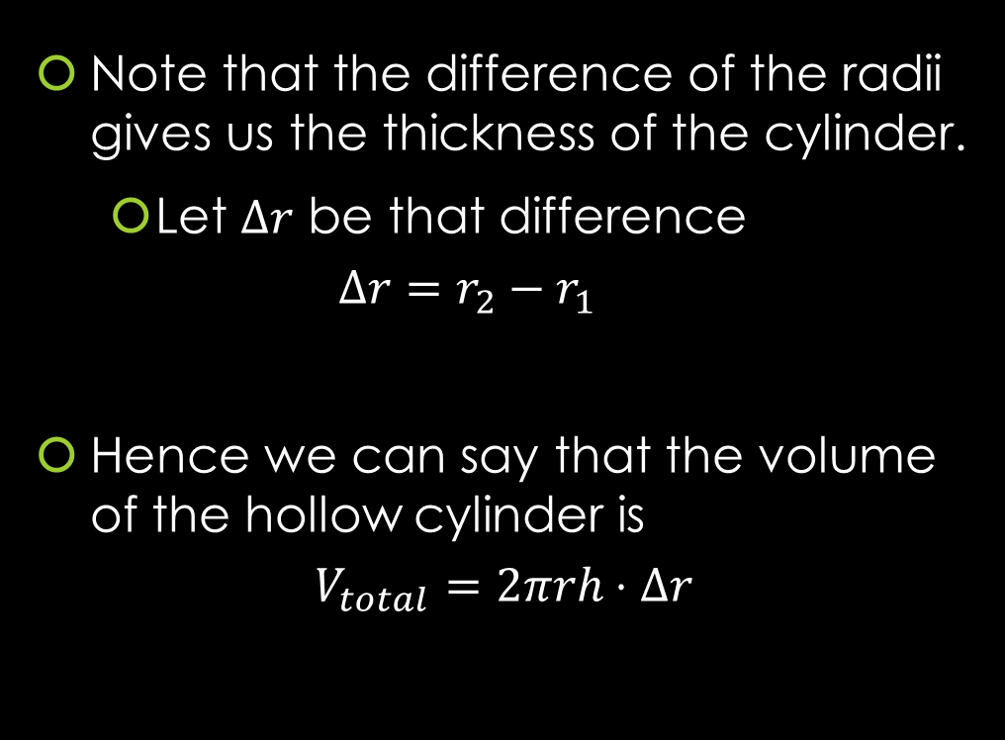
GEOMETRY: Finding The Volume of A Hollow Cylinder
Note that the difference of the radii gives us the thickness of the cylinder.
  Let $Δr$ be that difference
  $$Δr=r_{2}−r_{1}$$
Hence we can say that the volume of the hollow cylinder is
$$V_{total}=2πrh⋅Δr$$

Slide 16
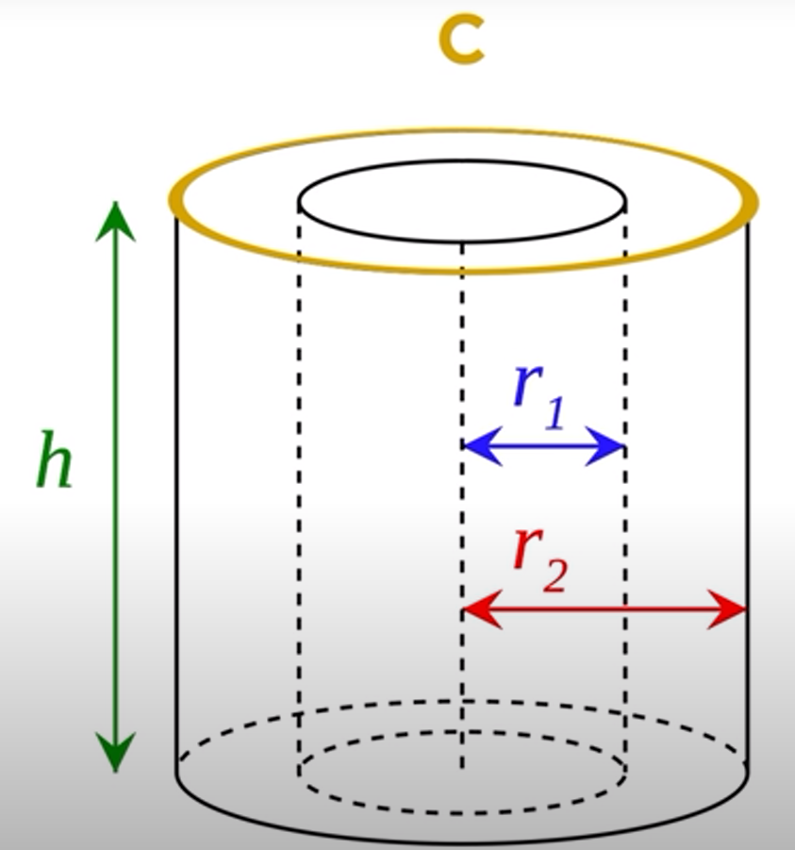
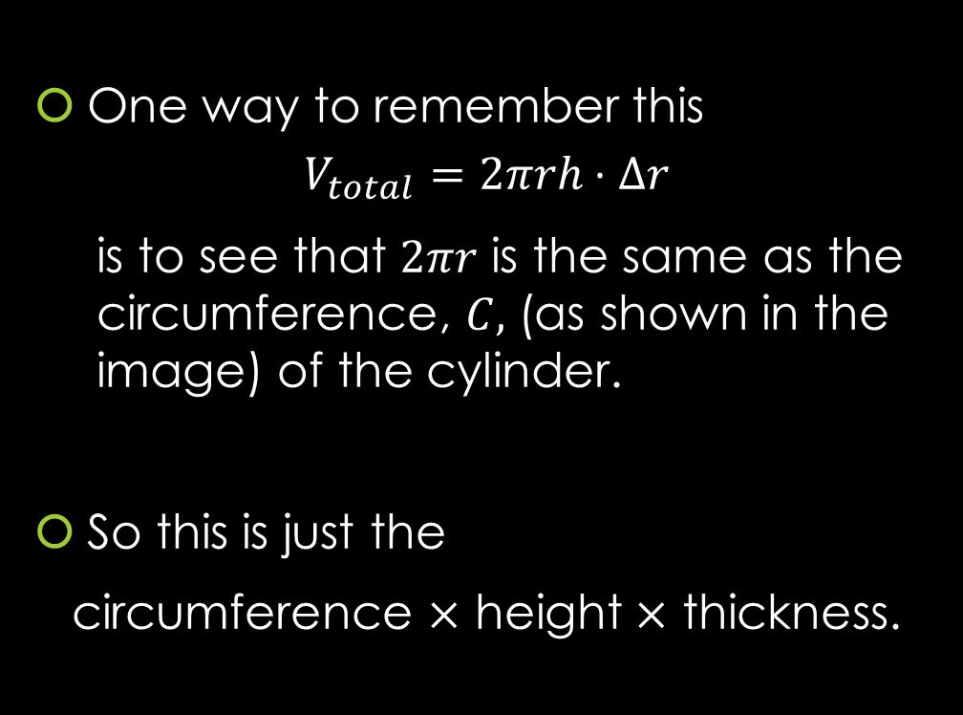
GEOMETRY: Finding The Volume of A Hollow Cylinder
One way to remember this
$$V_{total}=2πrh⋅Δr$$
    is to see that $2πr$ is the same as the circumference, $C,$ (as shown in the image) of the cylinder.
So this is just the
circumference $×$ height $×$ thickness.

Slide 17
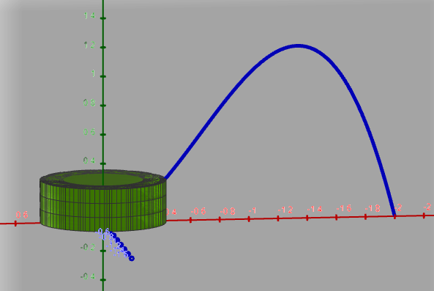
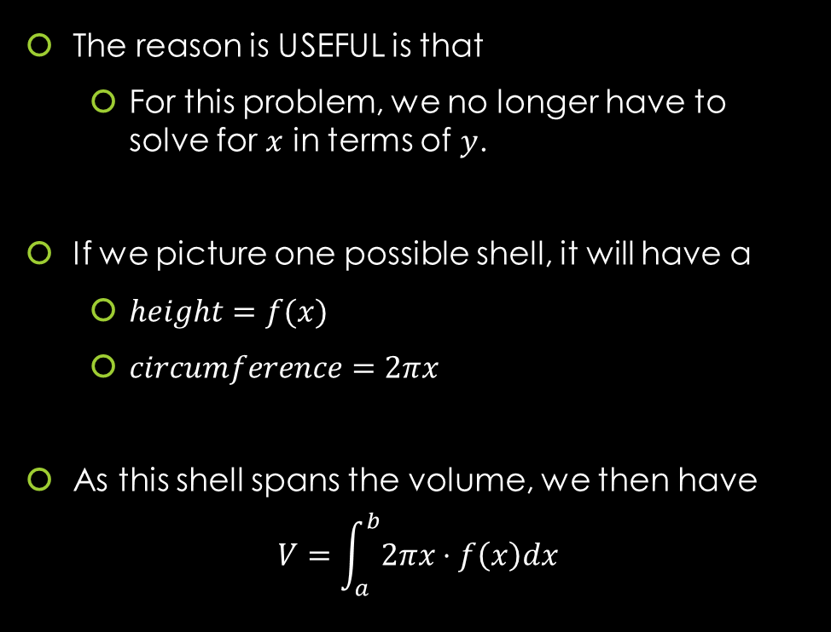
So how does this help us answer Example 1?
The reason is USEFUL is that
  For this problem, we no longer have to solve for $x$ in terms of $y$.
If we picture one possible shell, it will have a
  $height=f(x)$
  $circumference=2πx$
As this shell spans the volume, we then have
$$V=\int_{a}^{b}{2πx⋅f\left(x\right)dx}$$
https://www.geogebra.org/m/jqfyndpu

Slide 18
Example 1: Find the volume obtained by revolving the region bounded by the curves
$y=2x^{2}−x^{3}$ and $y=0$
About the y-axis.
https://www.geogebra.org/m/jqfyndpu

Slide 19
Example 1: Find the volume obtained by revolving the region bounded by the curves
$y=2x^{2}−x^{3}$ and $y=0$
About the y-axis.
https://www.geogebra.org/m/jqfyndpu

Slide 20
Example 1: Find the volume obtained by revolving the region bounded by the curves
$y=2x^{2}−x^{3}$ and $y=0$
About the y-axis.
You can find the solution in the pdf of the notes. Click here to access it.
https://www.geogebra.org/m/jqfyndpu

Slide 21
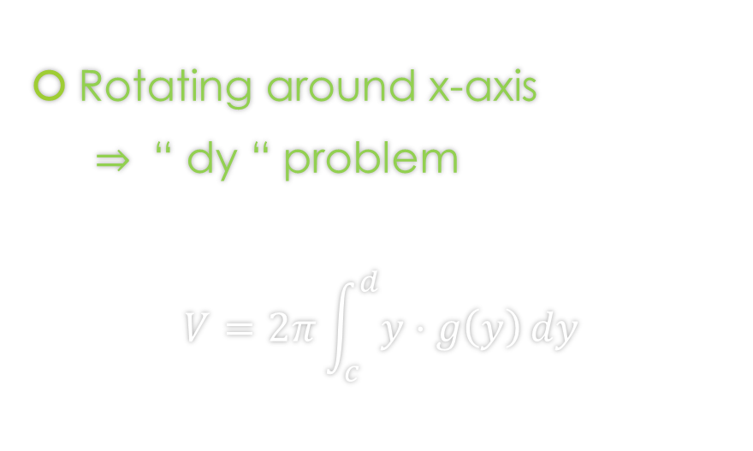
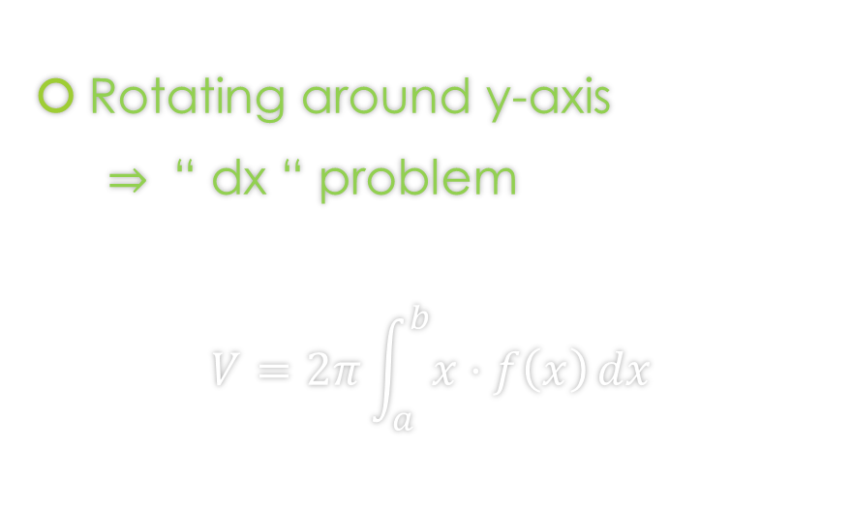
Shell Method Formula
Since we are just cutting out parallel to the axis, we choose dx or dy in the following way:
Rotating around y-axis
$⇒$ “ dx “ problem
$$V=2π\int_{a}^{b}{x⋅f\left(x\right)}dx$$
Rotating around x-axis
$⇒$ “ dy “ problem
$$V=2π\int_{c}^{d}{y⋅g\left(y\right)}dy$$

Slide 22

Example 2: Find the volume obtained by revolving the region bounded by the curves
$y=x^{3}−7x^{2}+15x−9$ , $y=0$, and $1≤x≤3$
About the y-axis.

Slide 23
Example 2: Find the volume obtained by revolving the region bounded by the curves
$y=x^{3}−7x^{2}+15x−9$ , $y=0$, and $1≤x≤3$
About the y-axis.

Slide 24
Example 2: Find the volume obtained by revolving the region bounded by the curves
$y=x^{3}−7x^{2}+15x−9$ , $y=0$, and $1≤x≤3$
About the y-axis.
You can find the solution in the pdf of the notes. Click here to access it.

Slide 25

Example 3: Find the volume obtained by revolving the region bounded by the curves
$y=sin⁡(x^{2})$ where $0≤x≤1$
About the y-axis.

Slide 26
Example 3: Find the volume obtained by revolving the region bounded by the curves
$y=sin⁡(x^{2})$ where $0≤x≤1$
About the y-axis.

Slide 27
Example 3: Find the volume obtained by revolving the region bounded by the curves
$y=sin⁡(x^{2})$ where $0≤x≤1$
About the y-axis.
You can find the solution in the pdf of the notes. Click here to access it.

Slide 28

Example 4: Find the volume obtained by revolving the region bounded by the curves
$x=y−y^{2}$ and $y=0$
About the x-axis.

Slide 29
Example 4: Find the volume obtained by revolving the region bounded by the curves
$x=y−y^{2}$ and $y=0$
About the x-axis.

Slide 30
Example 4: Find the volume obtained by revolving the region bounded by the curves
$x=y−y^{2}$ and $y=0$
About the x-axis.
You can find the solution in the pdf of the notes. Click here to access it.

Slide 31

Example 5: Find the volume obtained by revolving the region bounded by the curves
$x=e^{y^{2}}$ and $0≤y≤2$
About the x-axis.

Slide 32
Example 5: Find the volume obtained by revolving the region bounded by the curves
$x=e^{y^{2}}$ and $0≤y≤2$
About the x-axis.

Slide 33
Example 5: Find the volume obtained by revolving the region bounded by the curves
$x=e^{y^{2}}$ and $0≤y≤2$
About the x-axis.
You can find the solution in the pdf of the notes. Click here to access it.

Slide 34
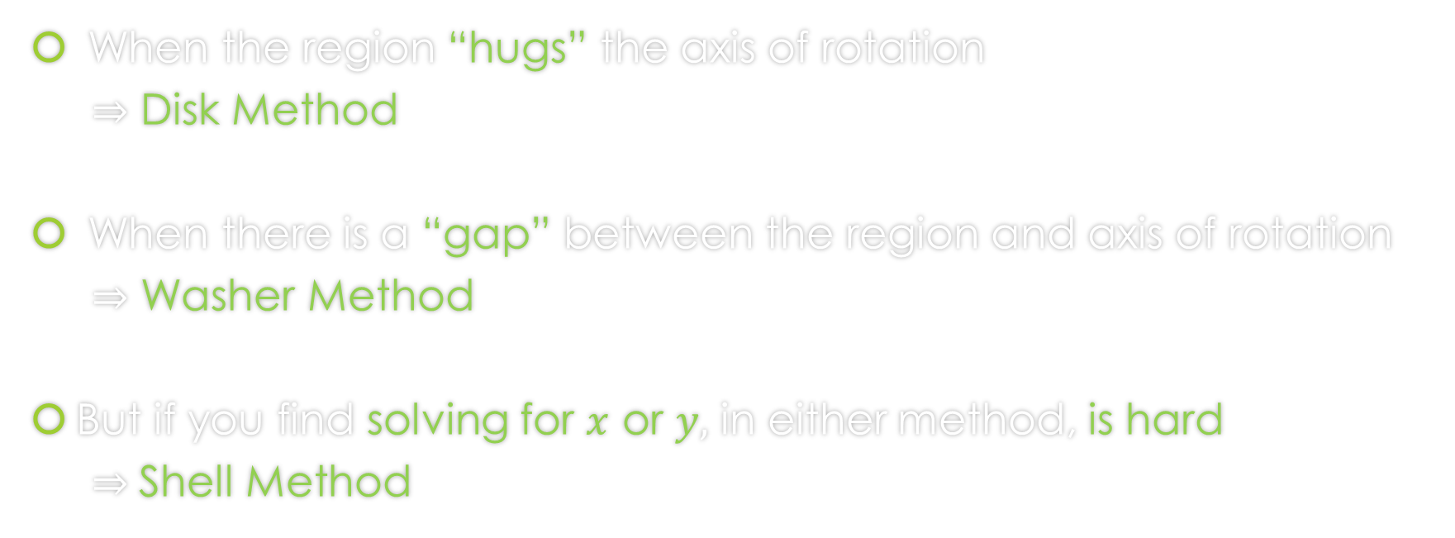
When do we apply Disk Method or Washer Method or Shell Method?
When the region “hugs” the axis of rotation
$⇒$ Disk Method
When there is a “gap” between the region and axis of rotation
$⇒$ Washer Method
But if you find solving for $x$ or $y,$ in either method, is hard
$⇒$Shell Method

Slide 35
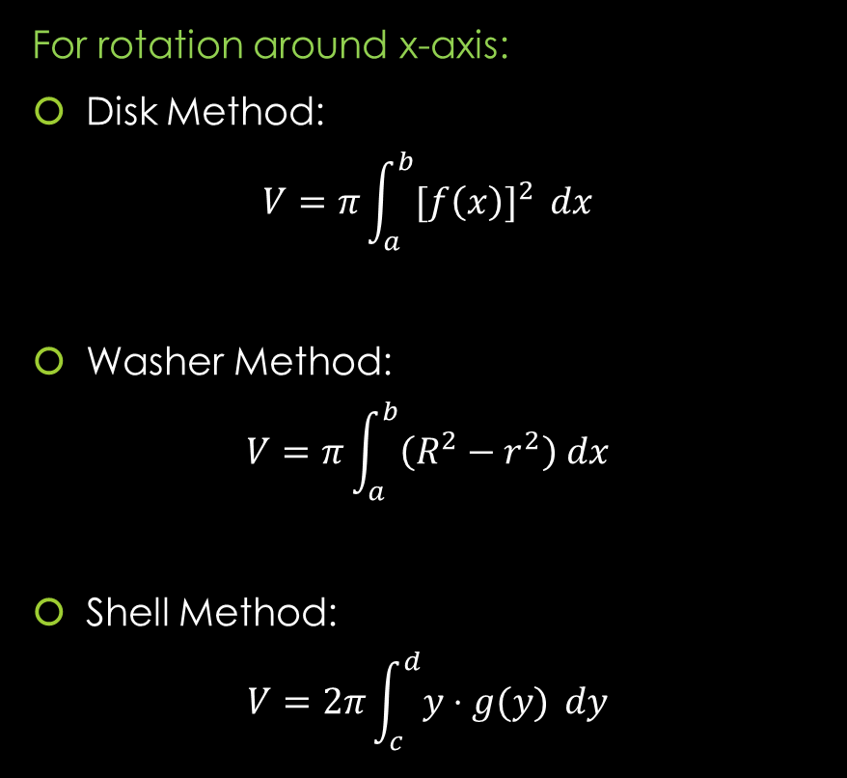
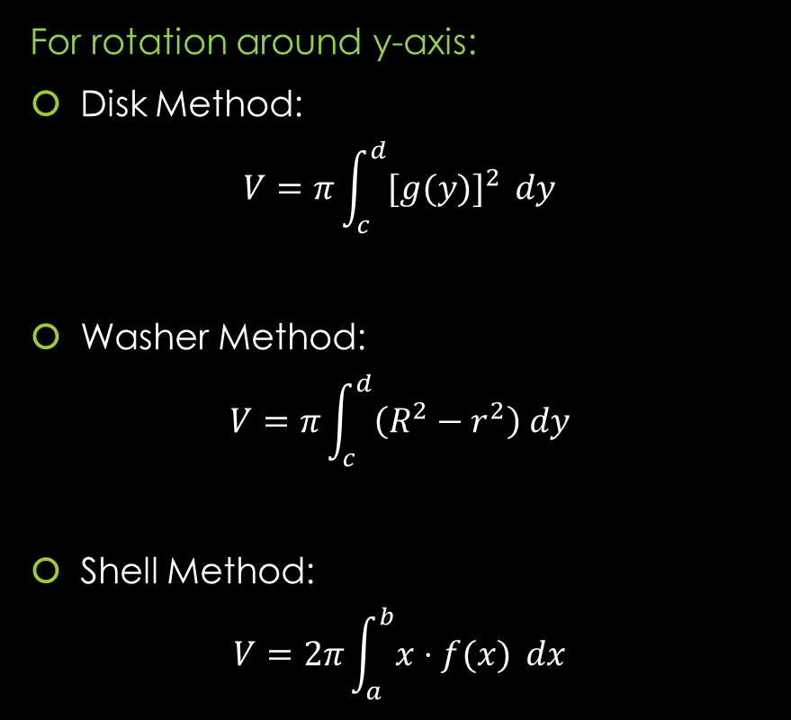
Formulas from Lessons 14 and 15 and 17
For rotation around y-axis:
Disk Method:
$$V=π\int_{c}^{d}{{[g(y)]}^{2} }dy$$
Washer Method:
$$V=π\int_{c}^{d}{\left(R^{2}−r^{2}\right) dy}$$
Shell Method:
$$V=2π\int_{a}^{b}{x⋅f(x)} dx$$
For rotation around x-axis:
Disk Method:
$$V=π\int_{a}^{b}{{[f\left(x\right)]}^{2} }dx$$
Washer Method:
$$V=π\int_{a}^{b}{\left(R^{2}−r^{2}\right) dx}$$
Shell Method:
$$V=2π\int_{c}^{d}{y⋅g(y)} dy$$

Slide 36
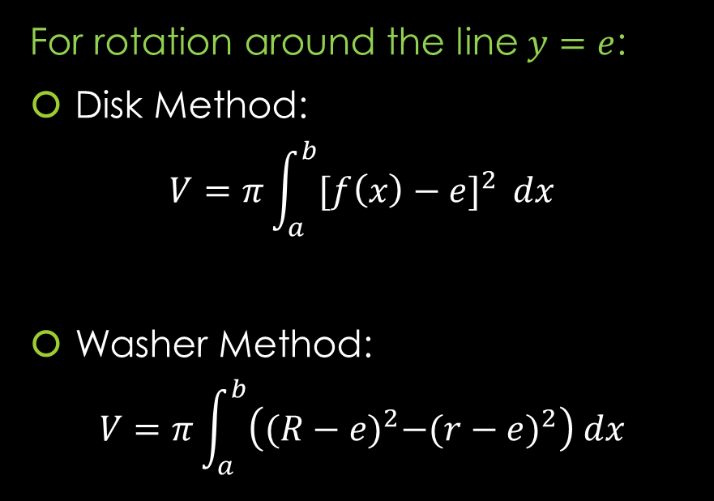
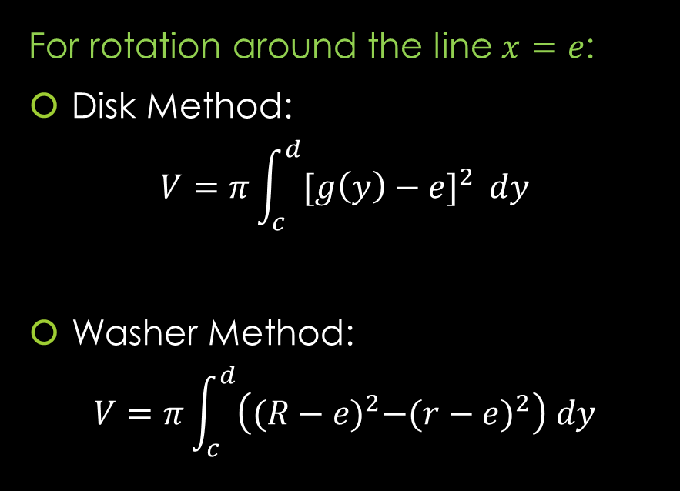
Formulas from Lesson 16
Rotation around any non-Axis Formulas
For rotation around the line $y=e$:
Disk Method:
$$V=π\int_{a}^{b}{{[f\left(x\right)−e]}^{2} }dx$$
Washer Method:
$$V=π\int_{a}^{b}{\left({(R−e)}^{2}−{(r−e)}^{2}\right) dx}$$
For rotation around the line $x=e$:
Disk Method:
$$V=π\int_{c}^{d}{{[g\left(y\right)−e]}^{2} }dy$$
Washer Method:
$$V=π\int_{c}^{d}{\left({(R−e)}^{2}−{(r−e)}^{2}\right) dy}$$
Note: That these formulas work for the case of x-axis ($y=0)$ and y-axis ($x=0$).

Slide 37
GeoGebra Link for Lesson 17
https://www.geogebra.org/m/f3wrypfh
Note click on the play buttons on the left-most screen and the animation will play/pause.

