Slide 1
Reminders
FRIDAY QUIZ 7 on Volume of Revolutions (Lessons 12 – 13 – 14)

Slide 2
MA 16020: Lesson 13
Volume By Revolution
Washer Method
By: Alexandra Cuadra

Slide 3
Last Time, we talked about…
How Geometry gave us formulas for simple shapes and solids to find their area or volume, and
How Integration can allow us to find area or volume of ANYTHING !
  How?
  We introduced this notion of cross-sections which can be of the form of
    Disks (Lesson 12), or
    Washers (Lesson 13)

Slide 4
Geometry: How to Calculate The Area of a Shaded Region
Suppose we are asked to find the area of a rectangle with a triangle missing from the middle.
How do we calculate that area?

Slide 5
Geometry: How to Calculate The Area of a Shaded Region
First, we would find the area of the rectangle and the area of the triangle separately.

Slide 6
Geometry: How to Calculate The Area of a Shaded Region
Then we would subtract these two values …

Slide 7
Geometry: How to Calculate The Area of a Shaded Region
… to find the remaining area.

Slide 8
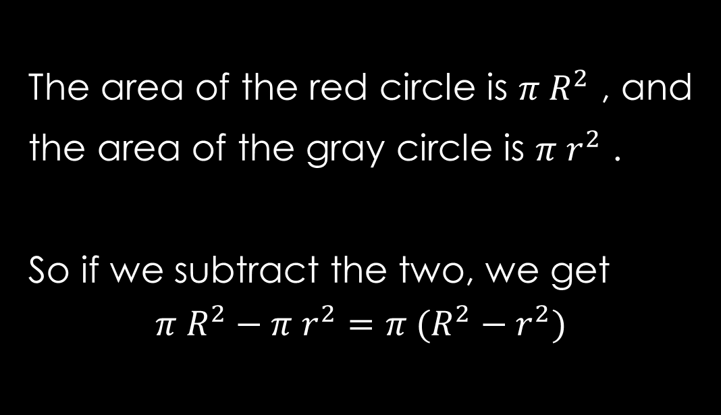
What if we did this with disks?
Let’s find the area of the red annulus.
The area of the red circle is $π R^{2}$ , and
the area of the gray circle is $π r^{2}$ .
So if we subtract the two, we get
$$π R^{2}−π r^{2}=π (R^{2}−r^{2})$$
R
r

Slide 9
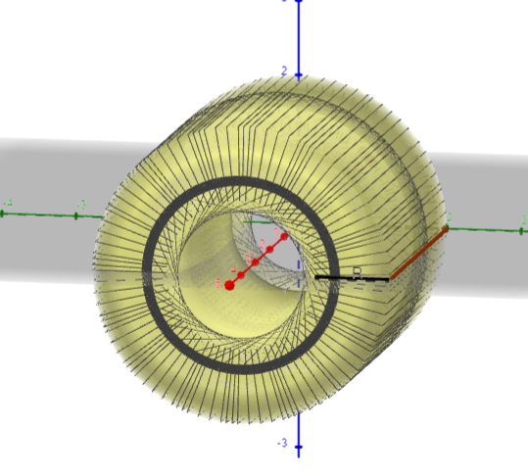
Today’s Lecture
In this lesson, we are going to play with disks, but remove a portion of it.
This method is called the washer method.
https://www.geogebra.org/m/uym6dwyd

Slide 10
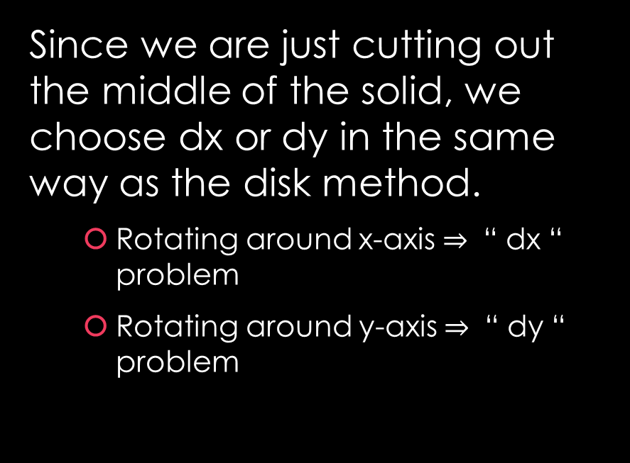
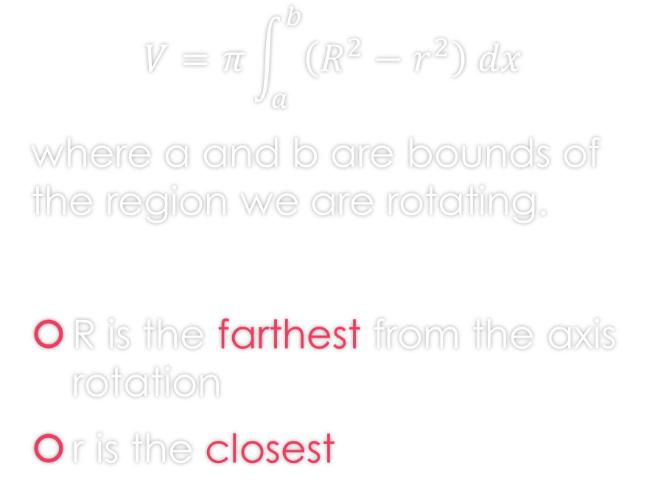
Washer Method Formula
Since we are just cutting out the middle of the solid, we choose dx or dy in the same way as the disk method.
  Rotating around x-axis $⇒$ “ dx “ problem
  Rotating around y-axis $⇒$ “ dy “ problem
$$V=π\int_{a}^{b}{\left(R^{2}−r^{2}\right) dx}$$
where a and b are bounds of the region we are rotating.
R is the farthest from the axis rotation
r is the closest

Slide 11
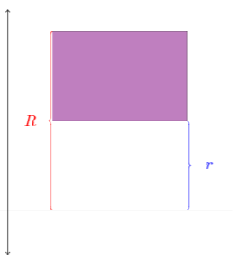
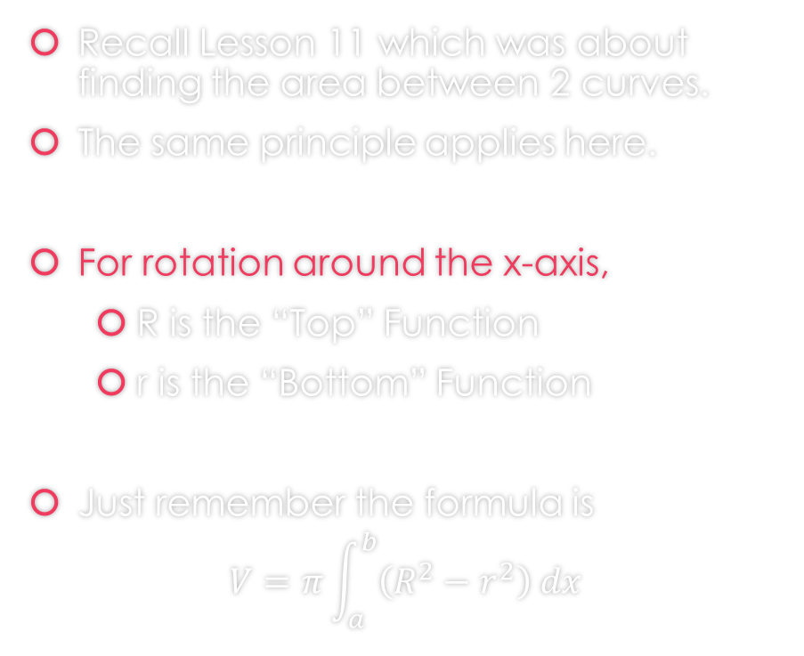
Let’s talk a bit more about R and r
Recall Lesson 11 which was about finding the area between 2 curves.
The same principle applies here.
For rotation around the x-axis,
  R is the “Top” Function
  r is the “Bottom” Function
Just remember the formula is
$$V=π\int_{a}^{b}{\left(R^{2}−r^{2}\right) dx}$$

Slide 12
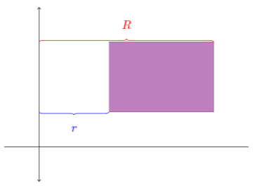
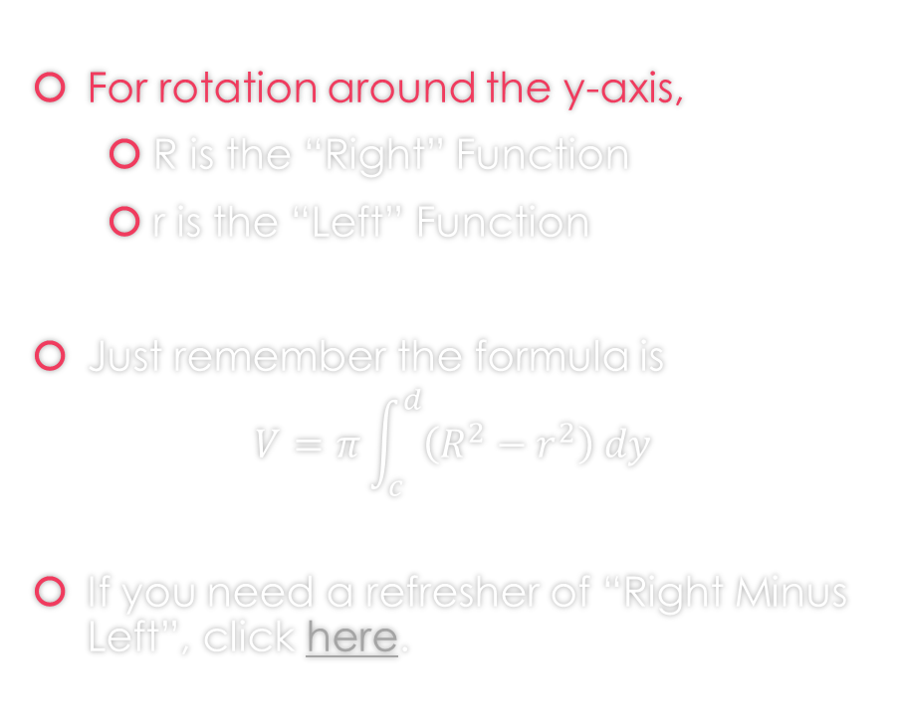
Let’s talk a bit more about R and r
For rotation around the y-axis,
  R is the “Right” Function
  r is the “Left” Function
Just remember the formula is
$$V=π\int_{c}^{d}{\left(R^{2}−r^{2}\right) dy}$$
If you need a refresher of “Right Minus Left”, click here.

Slide 13
How to Proceed with Washer Problems
Draw the region
Determine which axis you are rotating on
  If x - axis: Determine Top and Bottom Function
    R is Top
    r is Bottom
  If y - axis: Determine Right and Left Function
    R is Right
    r is Left
Finally, apply the washer formula

Slide 14
Examples

Slide 15

Example 1: Find the volume of the solid that results by revolving the region enclosed by the curves
$y=−x^{2}+2x+4$, $y=4−x$
About the x-axis.
https://www.geogebra.org/m/f73zjxfe#material/fgy2jzkr

Slide 16
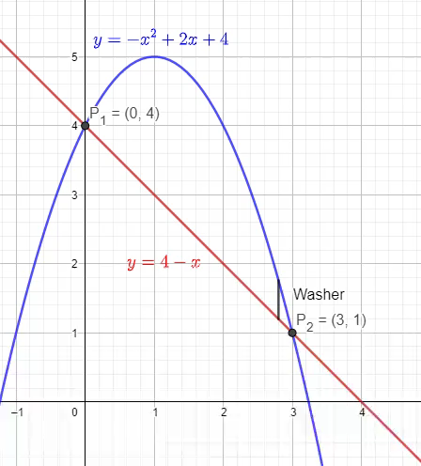
Example 1: Find the volume of the solid that results by revolving the region enclosed by the curves
$y=−x^{2}+2x+4$, $y=4−x$
About the x-axis.
https://www.geogebra.org/m/f73zjxfe#material/fgy2jzkr

Slide 17
Example 1: Find the volume of the solid that results by revolving the region enclosed by the curves
$y=−x^{2}+2x+4$, $y=4−x$
About the x-axis.
You can find the solution in the pdf of the notes. Click here to access it.
https://www.geogebra.org/m/f73zjxfe#material/fgy2jzkr

Slide 18

Example 2: Find the volume of the solid that results by revolving the region enclosed by the curves
$y=x^{2}$, $y=x$
About the y-axis.
https://www.geogebra.org/m/f73zjxfe#material/qtt49cq
x

Slide 19
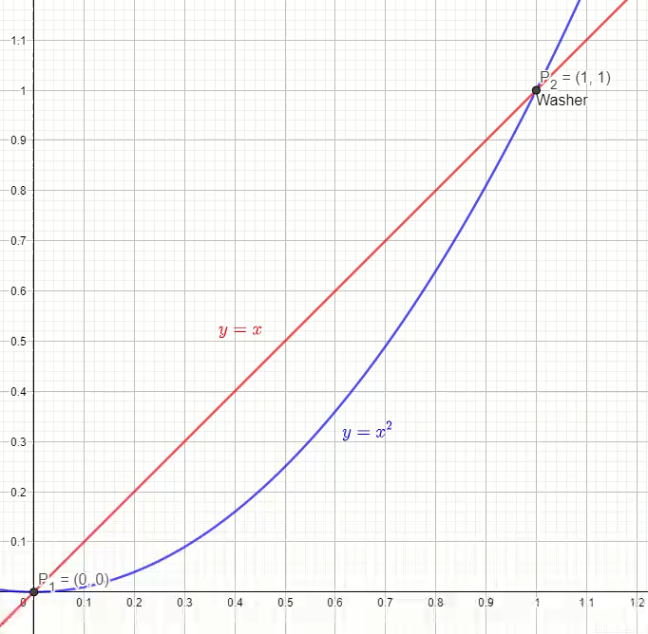
Example 2: Find the volume of the solid that results by revolving the region enclosed by the curves
$y=x^{2}$, $y=x$
About the y-axis.
https://www.geogebra.org/m/f73zjxfe#material/qtt49cq
x

Slide 20
Example 2: Find the volume of the solid that results by revolving the region enclosed by the curves
$y=x^{2}$, $y=x$
About the y-axis.
You can find the solution in the pdf of the notes. Click here to access it.
https://www.geogebra.org/m/f73zjxfe#material/qtt49cq
x

Slide 21

Example 3: Find the volume of the solid that results by revolving the region inside the circle $x^{2}+y^{2}=9$ and to the right of the line $x=1$ about the y-axis.
https://www.geogebra.org/m/f73zjxfe#material/c2wzbrbf

Slide 22
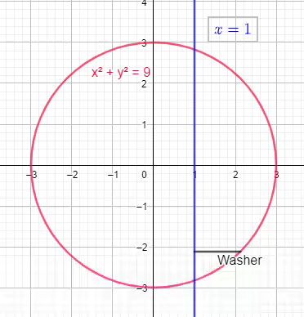
Example 3: Find the volume of the solid that results by revolving the region inside the circle $x^{2}+y^{2}=9$ and to the right of the line $x=1$ about the y-axis.
https://www.geogebra.org/m/f73zjxfe#material/c2wzbrbf

Slide 23
Example 3: Find the volume of the solid that results by revolving the region inside the circle $x^{2}+y^{2}=9$ and to the right of the line $x=1$ about the y-axis.
You can find the solution in the pdf of the notes. Click here to access it.
https://www.geogebra.org/m/f73zjxfe#material/c2wzbrbf

Slide 24
RECAP: Disk vs. Washer Method

Slide 25
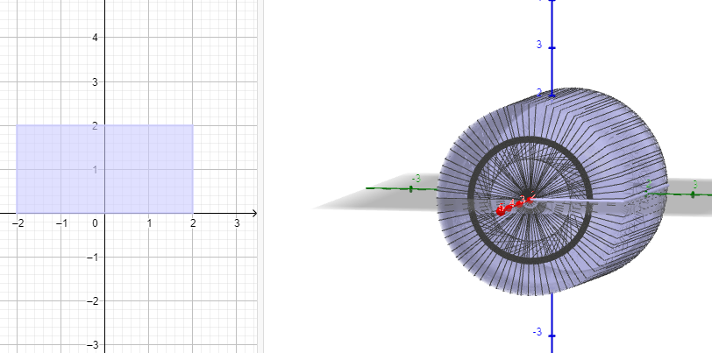
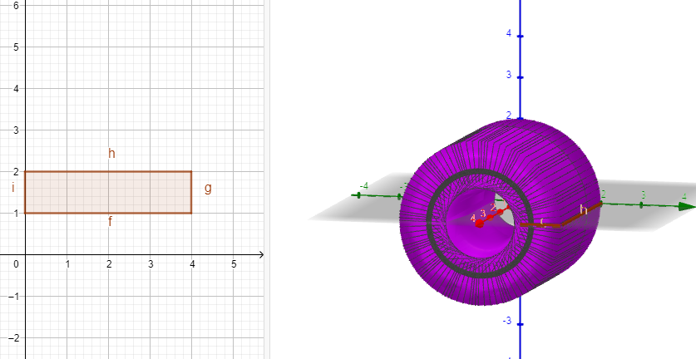
When do apply Disk Method or Washer Method?
Disk Method
Washer Method

Slide 26
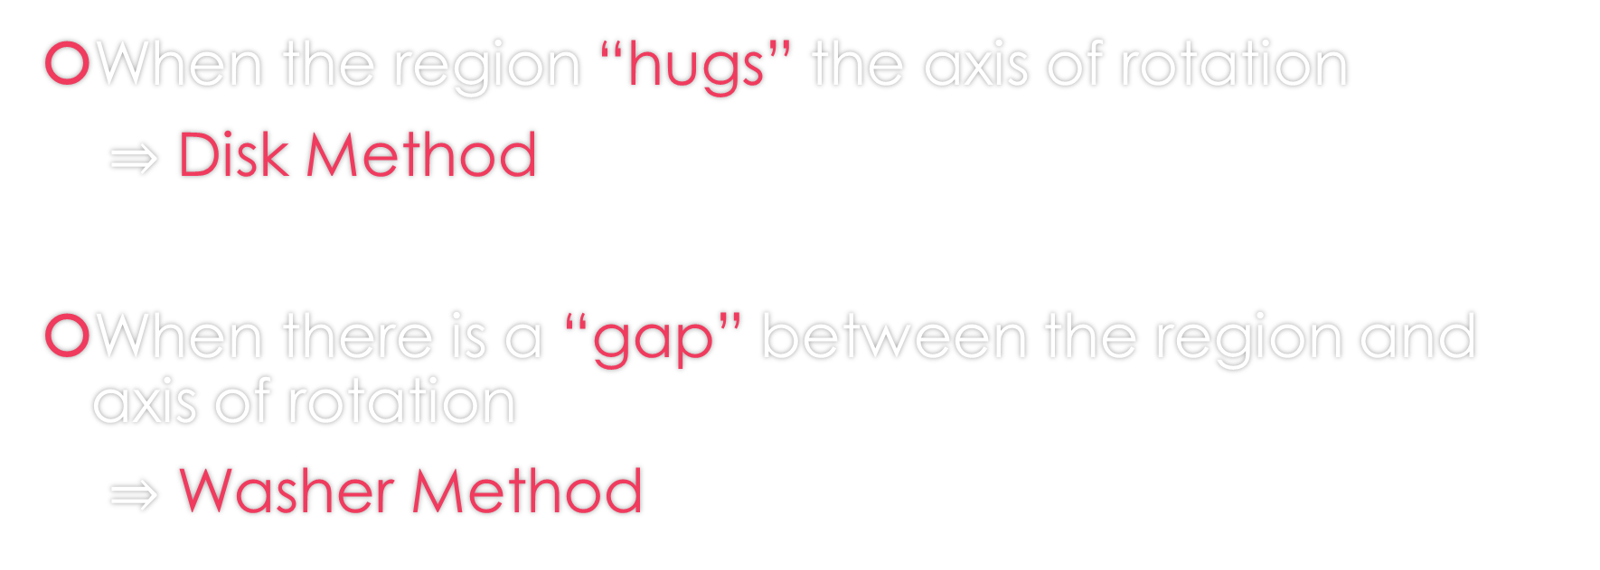
When do we apply Disk Method or Washer Method?
When the region “hugs” the axis of rotation
$⇒$ Disk Method
When there is a “gap” between the region and axis of rotation
$⇒$ Washer Method

Slide 27

Example 4: Find the volume of the solid that results by revolving the region enclosed by the curves
$y=\sqrt{5x}+\sqrt{\frac{x}{5}}$, $x=3$ , $x=4$
About the x-axis.
https://www.geogebra.org/m/f73zjxfe#material/tahfrdpa

Slide 28
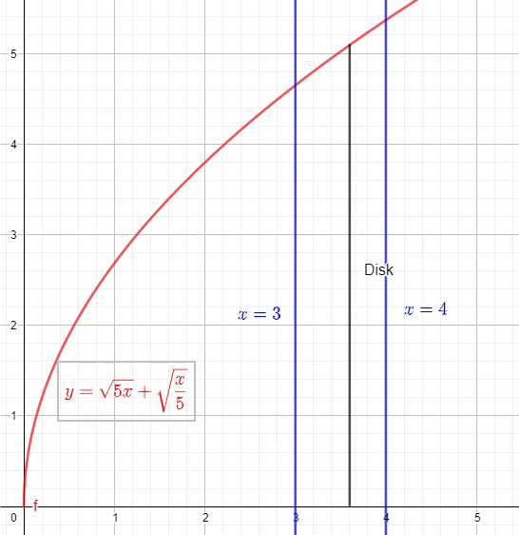
Example 4: Find the volume of the solid that results by revolving the region enclosed by the curves
$y=\sqrt{5x}+\sqrt{\frac{x}{5}}$, $x=3$ , $x=4$
About the x-axis.
https://www.geogebra.org/m/f73zjxfe#material/tahfrdpa

Slide 29
Example 4: Find the volume of the solid that results by revolving the region enclosed by the curves
$y=\sqrt{5x}+\sqrt{\frac{x}{5}}$, $x=3$ , $x=4$
About the x-axis.
You can find the solution in the pdf of the notes. Click here to access it.
https://www.geogebra.org/m/f73zjxfe#material/tahfrdpa

Slide 30
GeoGebra Link for Lesson 13
https://www.geogebra.org/m/f73zjxfe
Note click on the play buttons on the left-most screen and the animation will play/pause.

