Slide 1
Reminders
FRIDAY QUIZ 7 on Volume of Revolutions (Lessons 12 – 13 – 14)
2-Week Reminder: EXAM 2 on 3/10 (Lessons 7 – 19)
WEDNESDAY QUIZ 8 on Improper Integrals (Lesson 15)

Slide 2
MA 16020: Lesson 14
Volume By Revolution
Rotation around any non-Axis
By Alexandra Cuadra

Slide 3
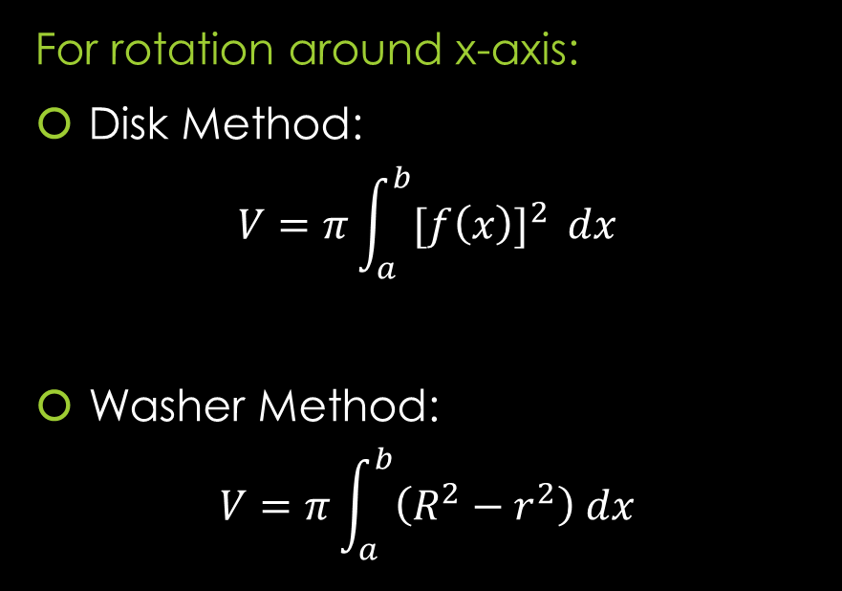
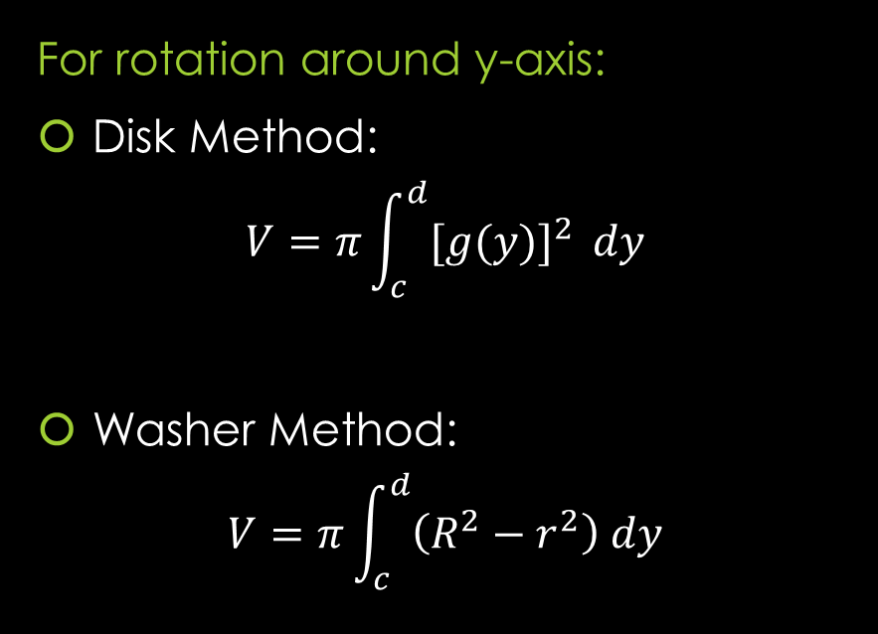
RECAP of Formulas from Lesson 12 and 13
For rotation around x-axis:
Disk Method:
$$V=π\int_{a}^{b}{{[f\left(x\right)]}^{2} }dx$$
Washer Method:
$$V=π\int_{a}^{b}{\left(R^{2}−r^{2}\right) dx}$$
For rotation around y-axis:
Disk Method:
$$V=π\int_{c}^{d}{{[g(y)]}^{2} }dy$$
Washer Method:
$$V=π\int_{c}^{d}{\left(R^{2}−r^{2}\right) dy}$$

Slide 4
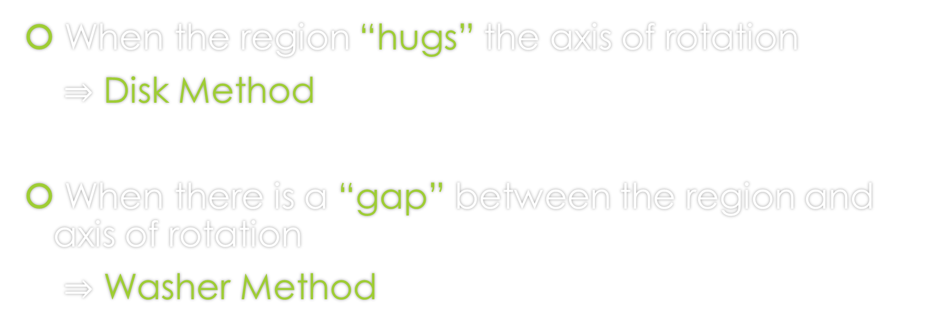
RECAP: When do we apply Disk Method or Washer Method?
When the region “hugs” the axis of rotation
$⇒$ Disk Method
When there is a “gap” between the region and axis of rotation
$⇒$ Washer Method

Slide 5
Today’s Lecture
In the previous two lessons, we looked at rotations around the x-axis or y-axis.
Today we are going to rotate about ANY arbitrary axis.
  Don’t worry. We are going to limit ourselves to any vertical or horizontal line parallel to the x-axis or y-axis

Slide 6

Example 1: Let $R$ be the region of the $xy$-plane bounded by the curves $x^{3}y=8$ below by the line $y=1$, on the left by the line $x=1$. Find the volume of the solid obtained by rotating $R$ around
the x-axis
You can find the solution in the pdf of the notes. Click here to access it.

Slide 7

Example 1: Let $R$ be the region of the $xy$-plane bounded by the curves $x^{3}y=8$ below by the line $y=1$, on the left by the line $x=1$. Find the volume of the solid obtained by rotating $R$ around
B) the y-axis
You can find the solution in the pdf of the notes. Click here to access it.

Slide 8
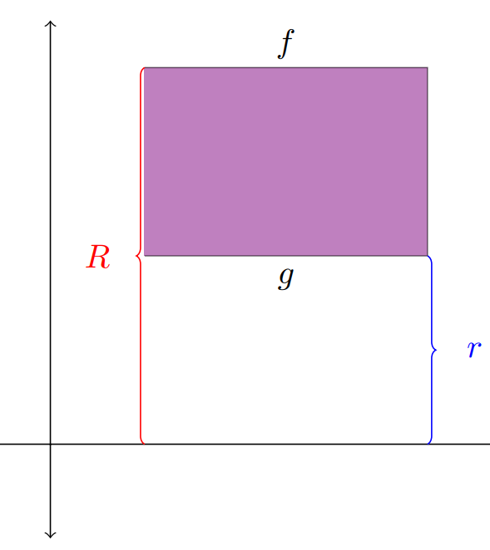

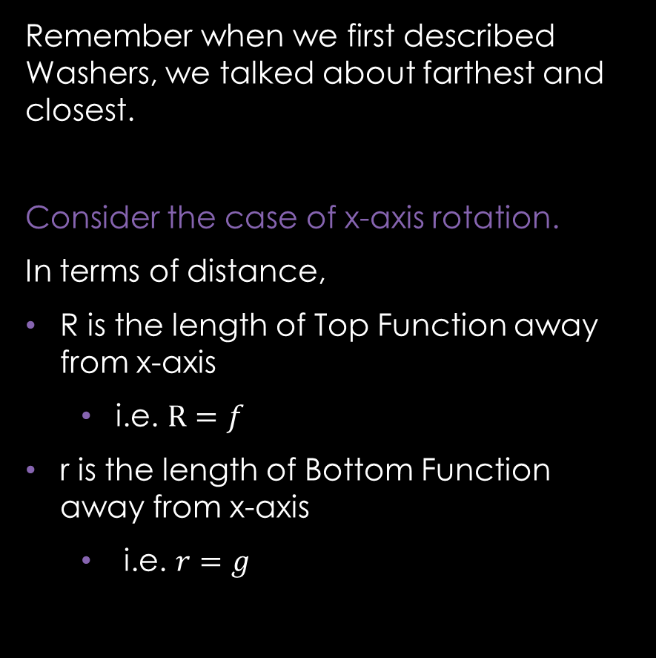
Let’s Backtrack a Bit…
Remember when we first described Washers, we talked about farthest and closest.
Consider the case of x-axis rotation.
In terms of distance,
R is the length of Top Function away from x-axis
  i.e. $R=f$
r is the length of Bottom Function away from x-axis
  i.e. $r=g$

Slide 9
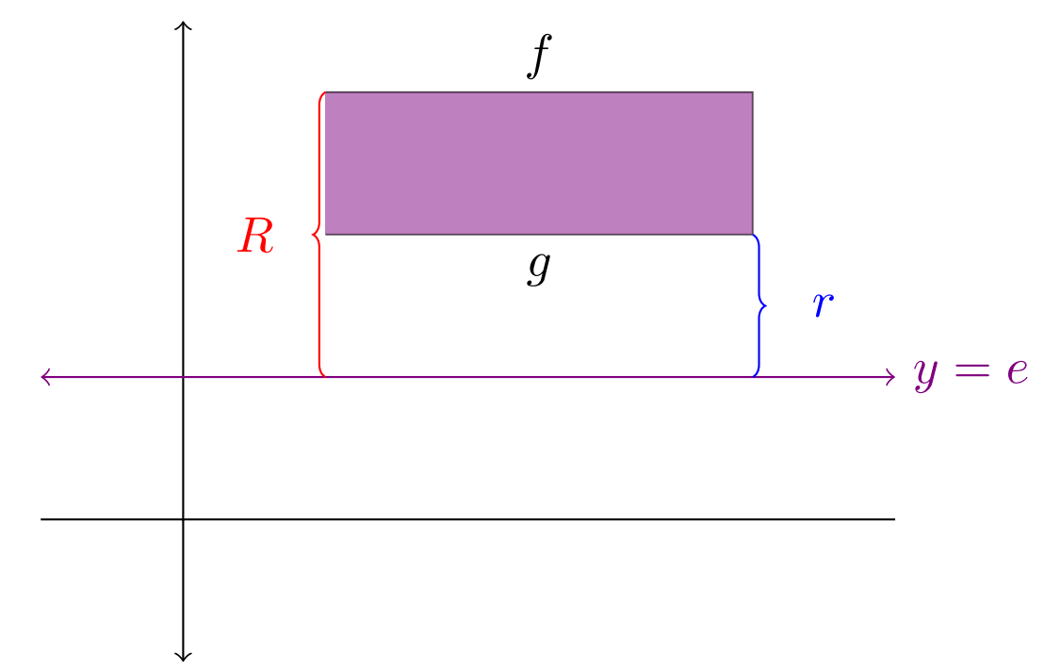
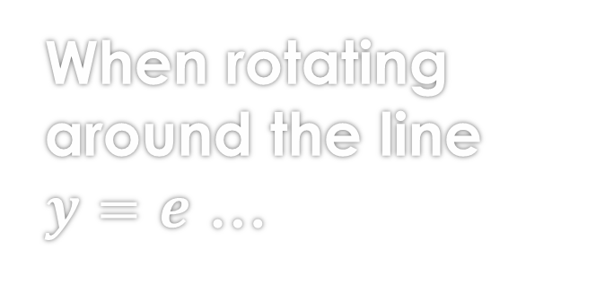


When rotating around the line $y=e$ …
So, what is the distance between $f$ (or $g$) and $y=e$ ?
  Distance b/w $f$ and $y=e$ is
  $$R=f−e$$
  Distance b/w $g$ and $y=e$ is
  $$r=g−e$$
Note this formula is also true for the x-axis case, because the x-axis is simply the line $y=0$

Slide 10
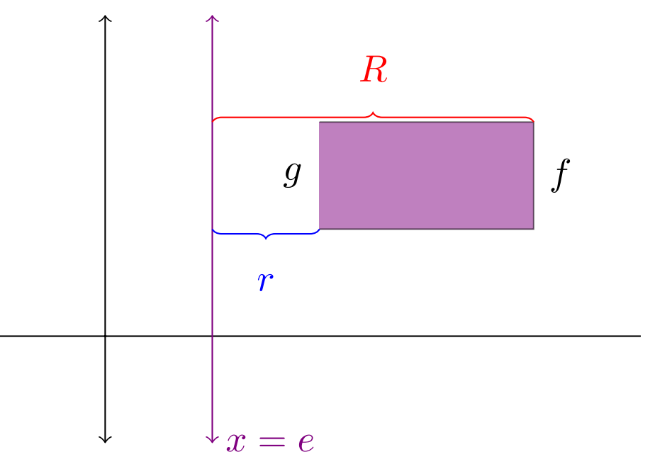


GOOD NEWS EVERYBODY:
When rotating around the line $x=e$ …
The same formulas, for $R$ and $r$, from the case of $y=e$ applies.
So, the distance between $f$ (or $g$) and $x=e$ are as follows:
  $R=f−e$
  $r=g−e$
Note that though we did all this calculation for the Washer Problems; this also applies for the Disk Problems.

Slide 11
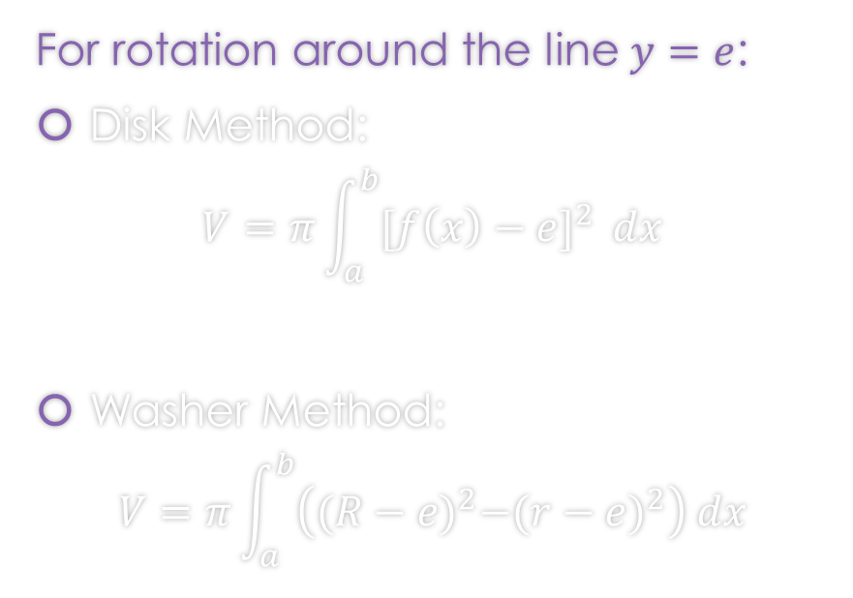
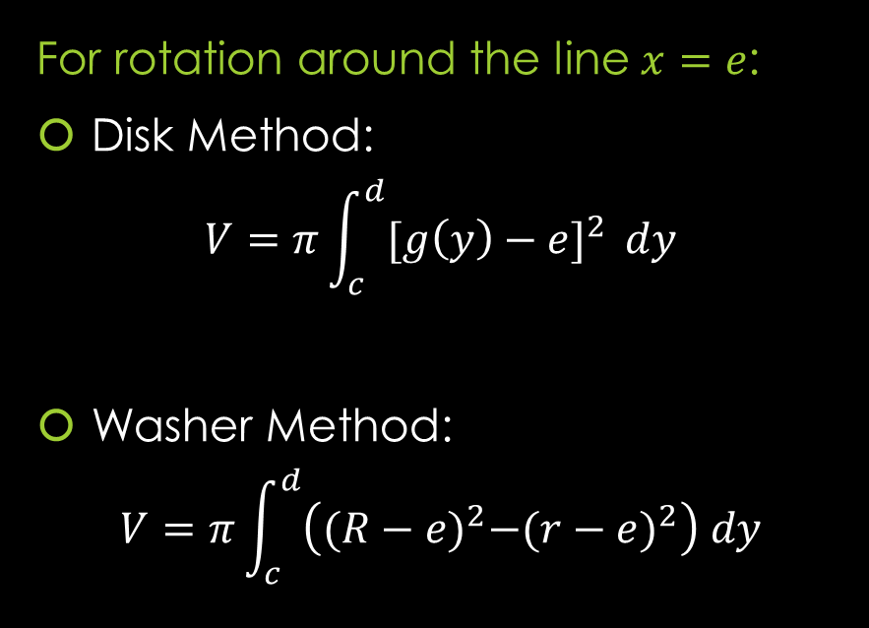
Rotation around any non-Axis Formulas
For rotation around the line $y=e$:
Disk Method:
$$V=π\int_{a}^{b}{{[f\left(x\right)−e]}^{2} }dx$$
Washer Method:
$$V=π\int_{a}^{b}{\left({(R−e)}^{2}−{(r−e)}^{2}\right) dx}$$
For rotation around the line $x=e$:
Disk Method:
$$V=π\int_{c}^{d}{{[g\left(y\right)−e]}^{2} }dy$$
Washer Method:
$$V=π\int_{c}^{d}{\left({(R−e)}^{2}−{(r−e)}^{2}\right) dy}$$
Note: That these formulas work for the case of x-axis ($y=0)$ and y-axis ($x=0$).

Slide 12

Example 1: Let $R$ be the region of the $xy$-plane bounded by the curves $x^{3}y=8$ below by the line $y=1$, on the left by the line $x=1$. Find the volume of the solid obtained by rotating $R$ around
C) the line $y=1$
You can find the solution in the pdf of the notes. Click here to access it.

Slide 13

Example 1: Let $R$ be the region of the $xy$-plane bounded by the curves $x^{3}y=8$ below by the line $y=1$, on the left by the line $x=1$. Find the volume of the solid obtained by rotating $R$ around
D) the line $x=1$
You can find the solution in the pdf of the notes. Click here to access it.

Slide 14

Example 2: Find the volume of the solid generated by revolving the given region about the line $x=9$:
$y=\sqrt{x}$ , $y=0$ , $x=4$
You can find the solution in the pdf of the notes. Click here to access it.

Slide 15

Example 3: Find the volume of the solid generated by revolving the given region about the line $y=10$:
$y=−x^{2}+2x+3$ , $y=3−x$
You can find the solution in the pdf of the notes. Click here to access it.

Slide 16
For Next Class,
Optional Homework
Next Class, we are reintroducing Limits. As a refresher there is a limit document online.

