Slide 1
MA 16020 applied Calculus II
Day 1 Slides

Slide 2
MA 16020 - applied Calculus II
Section 160: 3:30 - 4:20 PM
Section 150: 4:30 - 5:20 PM
Room: SCHM (or REC) 122
Instructor: Alexandra Cuadra ; Email: fernan87@purdue.edu
Course Coordinator: Dave Norris ; Email: norris@purdue.edu

Slide 3
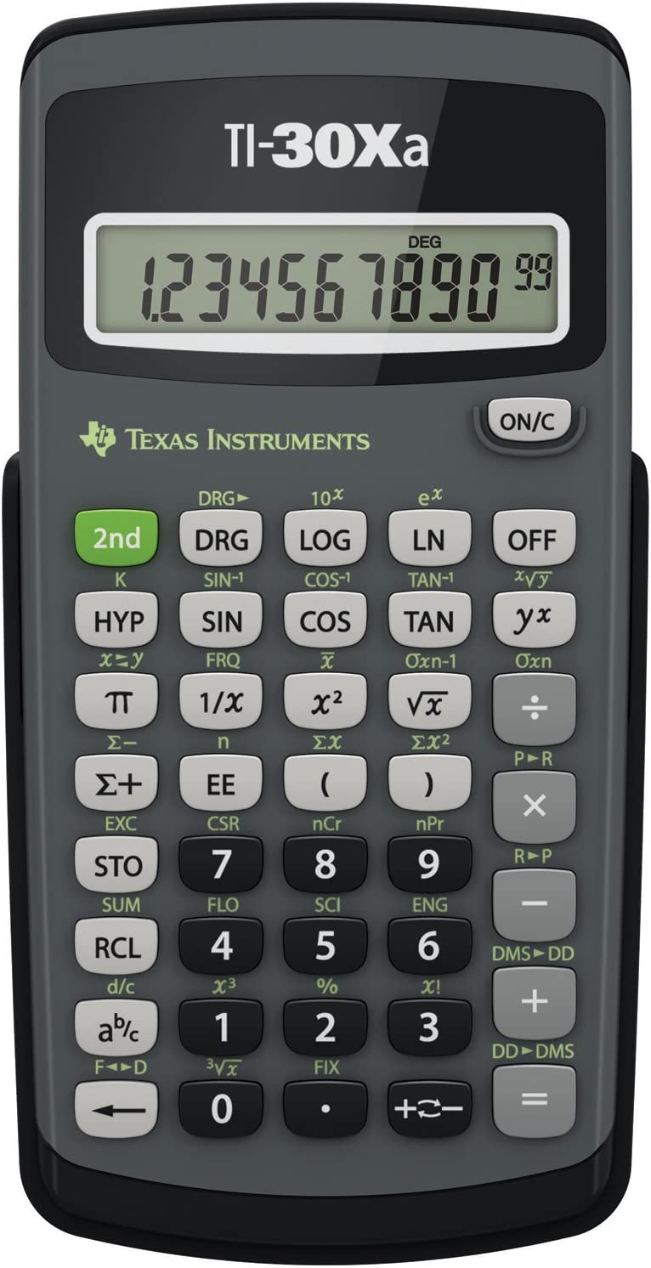
Calculator usage
TI-30Xa Calculator. ~ $10 on Amazon or at the campus bookstore
(ONLY ACCEPTABLE CALCULATOR)

Slide 4
Important WEBSITES
Please bookmark them into your favorite browser.
Class Website: https://www.math.purdue.edu/~fernan87/FA23_MA16020.html
Brightspace: https://purdue.brightspace.com/
LON-CAPA: https://loncapa.purdue.edu/
Piazza: https://piazza.com/class/lldwx4v1hxw1x9
Google Classroom: https://classroom.google.com/

Slide 5
Brightspace
Log-in at https://purdue.brightspace.com/
with your PURDUE CREDENTIALS + BOILERKEY
Here is where you can find
Syllabus for the course
Gradebook including
Homework Scores
Quiz Scores
Exam Scores
Overall Grade in the course
Exam Memos

Slide 6
Class website
Go to https://www.math.purdue.edu/~fernan87/FA23_MA16020.html
Here is where you can find
Course Calendar (for my sections) including
Notes (Recommend)
Writing Assignment Deadlines (I’ll talk about this more later)
Exam Dates
Practice Exams (Recommend)
Study Guides for Exams

Slide 7
Homework Assignments
Log-in at https://loncapa.purdue.edu/
with your PURDUE CREDENTIALS + BOILERKEY
Here is where you can find
Homework Assignments
Additional Notes
Additional Review Problems for Exams
Again, there are 34 graded HWs and 1 optional HW.
Due at 11pm the day of the next lesson
Two lowest homework scores are dropped at the end of the semester.

Slide 8
DISCUSSION FORUM
Log-in at https://piazza.com/class/lldwx4v1hxw1x9
with your PURDUE CREDENTIALS (no BOILERKEY)
Here is you can get help on homework assignments and on practice exams.

Slide 9
Quizzes
This semester, your quiz grade will be based on the completion of writing assignments.
For every 2 writing assignments completed, you will be awarded 1 quiz grade.
For example, For Quiz 1, the Writing Assignments that needed to be completed are
Writing Assignment 1 on SINGLE VARIABLE DERIVATIVES
Writing Assignment 2 on INTEGRATION
But wait WRITING in math?!?!? Yep.
Writing Assignments will be grade on COMPLETION!

Slide 10
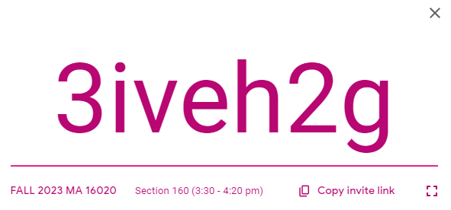
Writing Assignments
Writing Assignments will be grade on COMPLETION!
To receive full credit on each assignment, you must thoughtfully answer each line/box with a response. Each empty line/box will result in a deduction of 1 point from your final grade on each assignment.
Log-in at https://classroom.google.com/ with the code below
SECTION 160 SECTION 150
Here is where you can will be turning in each Writing Assignments.

Slide 11
EXAMS
DATES:
EXAM 1 ON MONDAY 9/11 @ 6:30 – 7:30 PM
EXAM 2 ON MONDAY 10/16 @ 6:30 – 7:30 PM
EXAM 3 ON WEDNESDAY 11/8 @ 6:30 – 7:30 PM
IF YOU HAVE TO MISS OR RESCHEDULE EXAM, e-mail me
Within 1 week if there is an exam conflct
Within 24 hours (before or after the exam) if you are sick or there is an emergency
OTHERWISE, THERE WILL NOT BE ANY MAKE-UP EXAMS.

