Slide 1
MA 16020: Lesson 16
Volume By Revolution
Rotation around any non-Axis
By Alexandra Cuadra

Slide 2
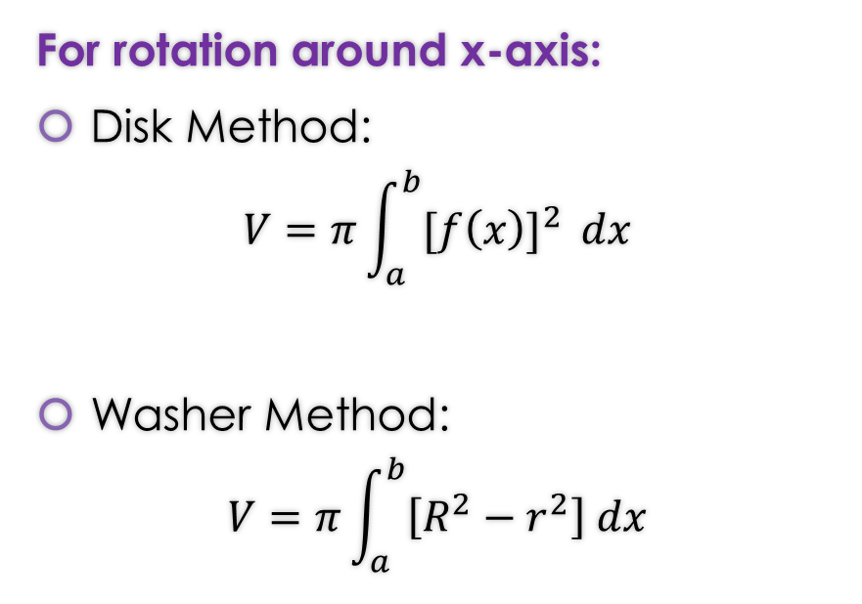
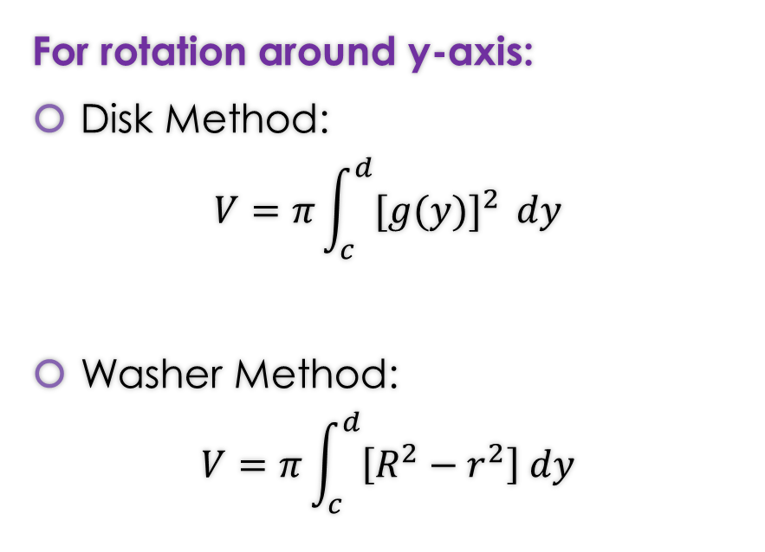
RECAP of Formulas from Lessons 14 and 15
For rotation around x-axis:
Disk Method:
$$V=π\int_{a}^{b}{{[f\left(x\right)]}^{2} }dx$$
Washer Method:
$$V=π\int_{a}^{b}{\left[R^{2}−r^{2}\right] dx}$$
For rotation around y-axis:
Disk Method:
$$V=π\int_{c}^{d}{{[g(y)]}^{2} }dy$$
Washer Method:
$$V=π\int_{c}^{d}{\left[R^{2}−r^{2}\right] dy}$$

Slide 3
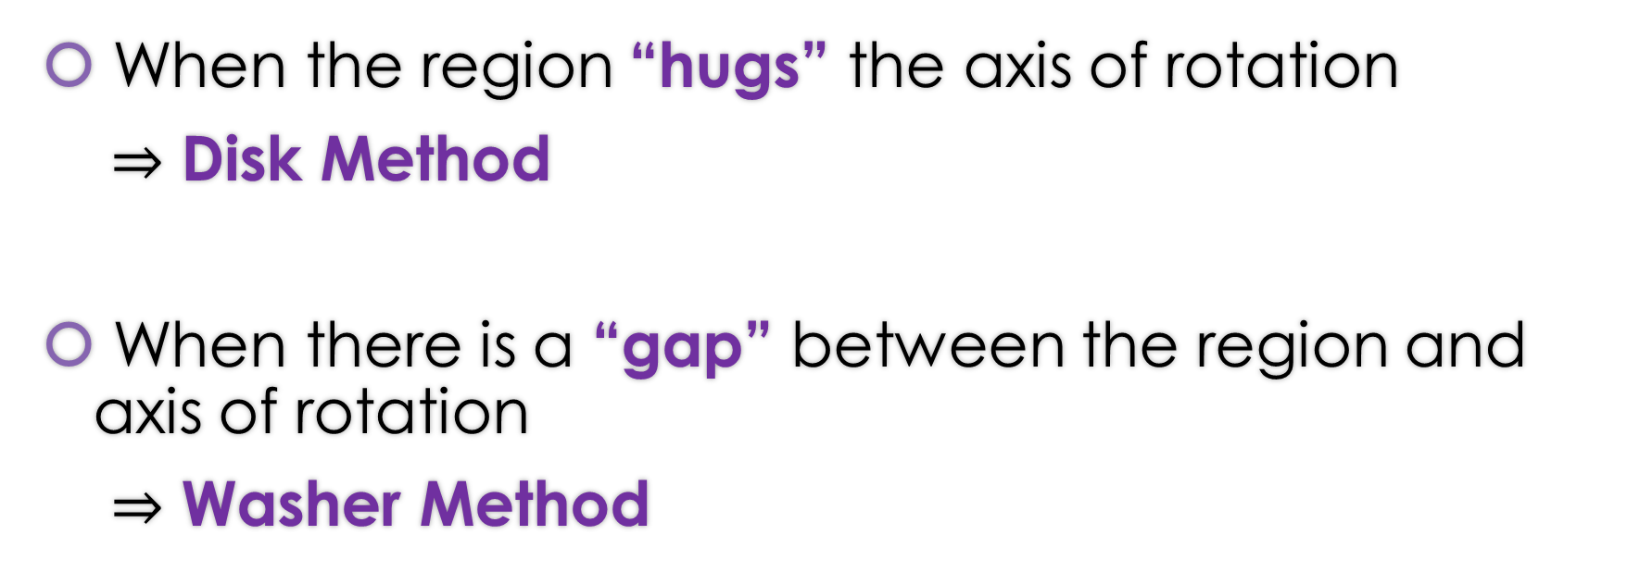
RECAP: When do we apply Disk Method or Washer Method?
When the region “hugs” the axis of rotation
$⇒$ Disk Method
When there is a “gap” between the region and axis of rotation
$⇒$ Washer Method

Slide 4
Today’s Lecture
In the previous two lessons, we looked at rotations around the x-axis or y-axis.
Today we are going to rotate about ANY arbitrary axis.
  Don’t worry. We are going to limit ourselves to any vertical or horizontal line parallel to the x-axis or y-axis

Slide 5
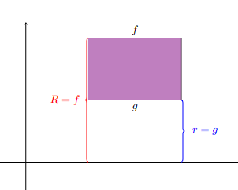
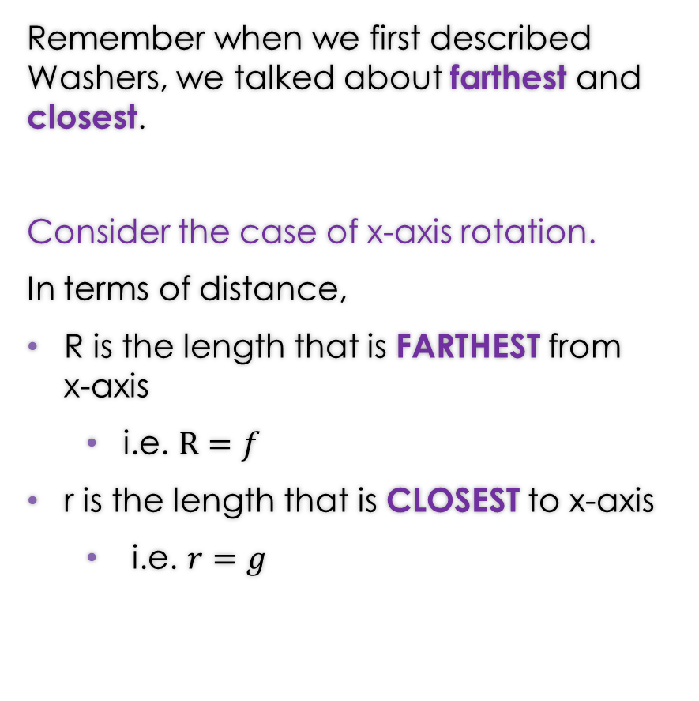

Let’s Backtrack a Bit…
Remember when we first described Washers, we talked about farthest and closest.
Consider the case of x-axis rotation.
In terms of distance,
R is the length that is FARTHEST from x-axis
  i.e. $R=f$
r is the length that is CLOSEST to x-axis
  i.e. $r=g$

Slide 6
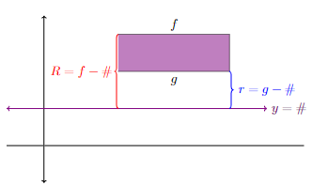



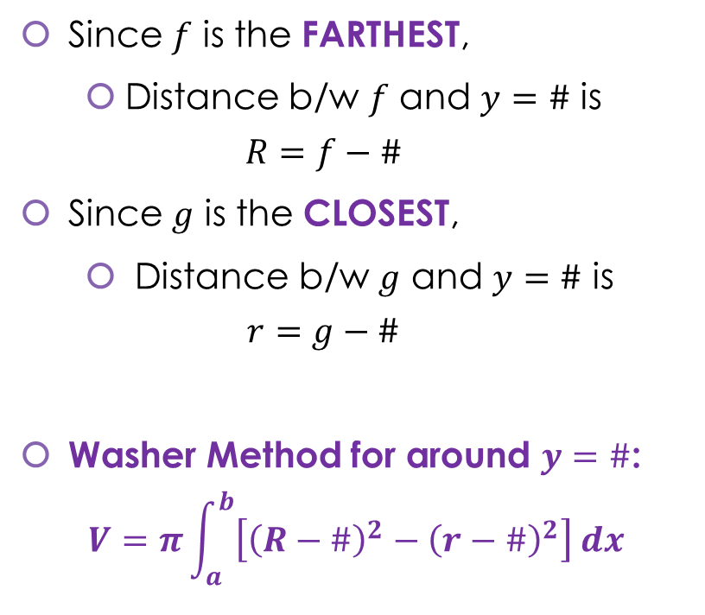
When rotating around the line $y=\#$ …
Since $f$ is the FARTHEST,
  Distance b/w $f$ and $y=\#$ is
  $$R=f−\#$$
Since $g$ is the CLOSEST,
  Distance b/w $g$ and $y=\#$ is
  $$r=g−\#$$
Washer Method for around $y=\#$:
$$V=π\int_{a}^{b}{\left[{\left(R−\#\right)}^{2}−{\left(r−\#\right)}^{2}\right] dx}$$
Note this formula is also true for the x-axis case, because the x-axis is simply the line $y=0$

Slide 7
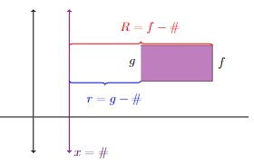
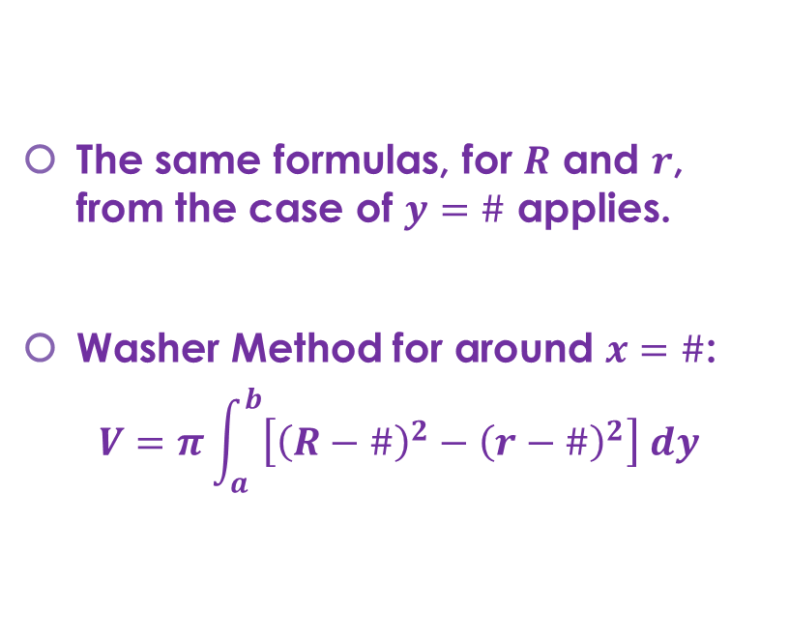


GOOD NEWS EVERYBODY:
When rotating around the line $x=\#$ …
The same formulas, for $R$ and $r$, from the case of $y=\#$ applies.
Washer Method for around $x=\#$:
$$V=π\int_{a}^{b}{\left[{\left(R−\#\right)}^{2}−{\left(r−\#\right)}^{2}\right] dy}$$
Note this formula is also true for the y-axis case, because the y-axis is simply the line $x=0$

Slide 8
Note that though we did all these calculations for the Washer Problems; this idea also applies for the Disk Problems.

Slide 9
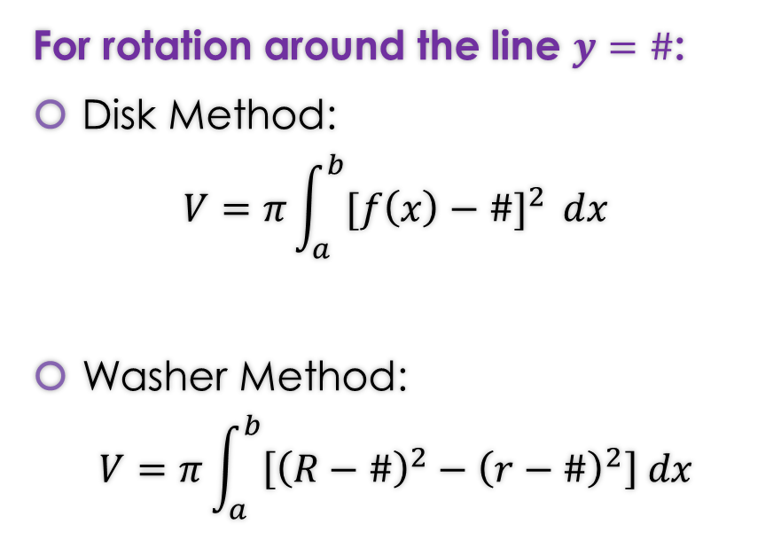
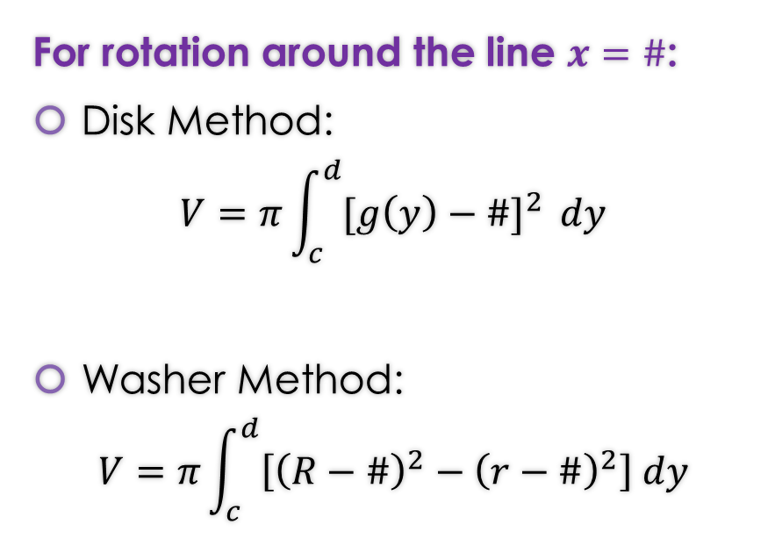
Rotation around any non-Axis Formulas
For rotation around the line $y=\#$:
Disk Method:
$$V=π\int_{a}^{b}{{[f\left(x\right)−\#]}^{2} }dx$$
Washer Method:
$$V=π\int_{a}^{b}{\left[{\left(R−\#\right)}^{2}−{\left(r−\#\right)}^{2}\right] dx}$$
For rotation around the line $x=\#$:
Disk Method:
$$V=π\int_{c}^{d}{{[g\left(y\right)−\#]}^{2} }dy$$
Washer Method:
$$V=π\int_{c}^{d}{\left[{\left(R−\#\right)}^{2}−{\left(r−\#\right)}^{2}\right] dy}$$
Note: That these formulas work for the case of x-axis ($y=0)$ and y-axis ($x=0$).

Slide 10

Note that
If you replace # with 0, and
Remember that
  x-axis => $y=0$
  y-axis => $x=0$
you get the formulas from Lessons 14 and 15 which are…

Slide 11

Rotation around any Axis Formulas
For rotation around x-axis:
Disk Method:
$$V=π\int_{a}^{b}{{[f\left(x\right)]}^{2} }dx$$
Washer Method:
$$V=π\int_{a}^{b}{[R^{2}−r^{2}] dx}$$
For rotation around y-axis:
Disk Method:
$$V=π\int_{c}^{d}{{[g(y)]}^{2} }dy$$
Washer Method:
$$V=π\int_{c}^{d}{\left[R^{2}−r^{2}\right] dy}$$

Slide 12
AGAIN: When do we apply Disk Method or Washer Method?
When the region “hugs” the axis of rotation
$⇒$ Disk Method
When there is a “gap” between the region and axis of rotation
$⇒$ Washer Method

Slide 13

Example 1: Let $R$ be the region of the $xy$-plane bounded by the curves $x^{2}y=4$ below by the line $y=1$, on the left by the line $x=1$. Find the volume of the solid obtained by rotating $R$ around
the x-axis
https://www.geogebra.org/m/wrj2euhf

Slide 14
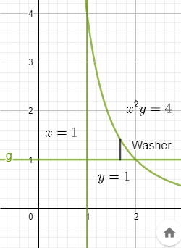
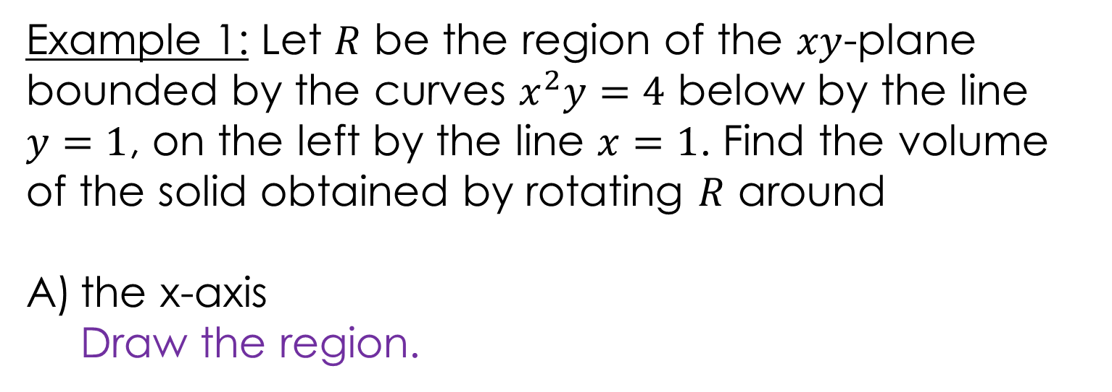
Example 1: Let $R$ be the region of the $xy$-plane bounded by the curves $x^{2}y=4$ below by the line $y=1$, on the left by the line $x=1$. Find the volume of the solid obtained by rotating $R$ around
the x-axis
Draw the region.
https://www.geogebra.org/m/wrj2euhf

Slide 15
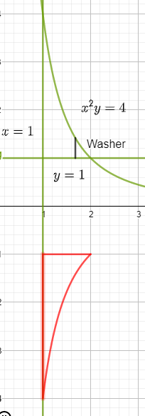


Example 1: Let $R$ be the region of the $xy$-plane bounded by the curves $x^{2}y=4$ below by the line $y=1$, on the left by the line $x=1$. Find the volume of the solid obtained by rotating $R$ around
the x-axis
WASHER PROBLEM
Rotation about x-axis
https://www.geogebra.org/m/wrj2euhf

Slide 16
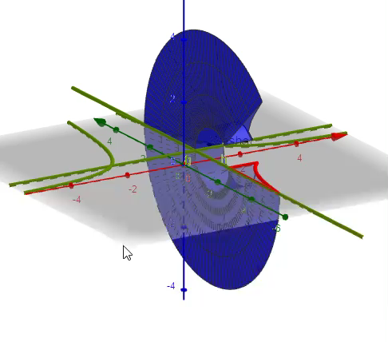
Example 1: Let $R$ be the region of the $xy$-plane bounded by the curves $x^{2}y=4$ below by the line $y=1$, on the left by the line $x=1$. Find the volume of the solid obtained by rotating $R$ around
the x-axis
WASHER PROBLEM
Furthermore, 3-D
https://www.geogebra.org/m/wrj2euhf

Slide 17
Example 1: Let $R$ be the region of the $xy$-plane bounded by the curves $x^{2}y=4$ below by the line $y=1$, on the left by the line $x=1$. Find the volume of the solid obtained by rotating $R$ around
the x-axis
https://www.geogebra.org/m/wrj2euhf

Slide 18
Example 1: Let $R$ be the region of the $xy$-plane bounded by the curves $x^{2}y=4$ below by the line $y=1$, on the left by the line $x=1$. Find the volume of the solid obtained by rotating $R$ around
the x-axis
https://www.geogebra.org/m/wrj2euhf

Slide 19
Example 1: Let $R$ be the region of the $xy$-plane bounded by the curves $x^{2}y=4$ below by the line $y=1$, on the left by the line $x=1$. Find the volume of the solid obtained by rotating $R$ around
the x-axis
https://www.geogebra.org/m/wrj2euhf

Slide 20
Example 1: Let $R$ be the region of the $xy$-plane bounded by the curves $x^{2}y=4$ below by the line $y=1$, on the left by the line $x=1$. Find the volume of the solid obtained by rotating $R$ around
the x-axis
https://www.geogebra.org/m/wrj2euhf

Slide 21
Example 1: Let $R$ be the region of the $xy$-plane bounded by the curves $x^{2}y=4$ below by the line $y=1$, on the left by the line $x=1$. Find the volume of the solid obtained by rotating $R$ around
the x-axis
You can find the solution in the pdf of the notes. Click here to access it.
https://www.geogebra.org/m/wrj2euhf

Slide 22

Example 1: Let $R$ be the region of the $xy$-plane bounded by the curves $x^{2}y=4$ below by the line $y=1$, on the left by the line $x=1$. Find the volume of the solid obtained by rotating $R$ around
B) the line $y=1$
https://www.geogebra.org/m/n2jzwh8f

Slide 23
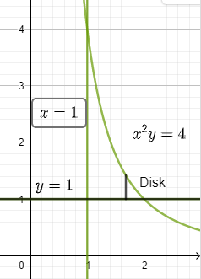
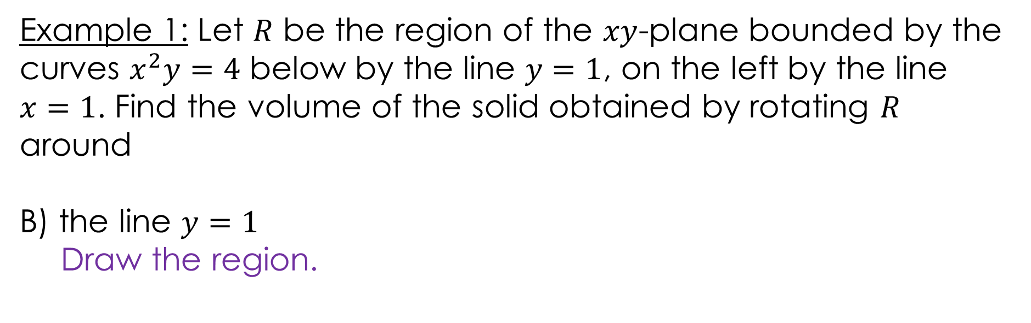
Example 1: Let $R$ be the region of the $xy$-plane bounded by the curves $x^{2}y=4$ below by the line $y=1$, on the left by the line $x=1$. Find the volume of the solid obtained by rotating $R$ around
B) the line $y=1$
Draw the region.
https://www.geogebra.org/m/n2jzwh8f

Slide 24
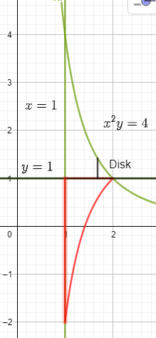

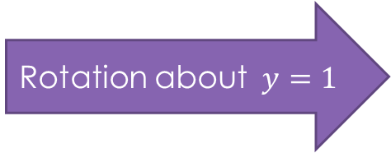
Example 1: Let $R$ be the region of the $xy$-plane bounded by the curves $x^{2}y=4$ below by the line $y=1$, on the left by the line $x=1$. Find the volume of the solid obtained by rotating $R$ around
B) the line $y=1$
DISK PROBLEM
Rotation about$y=1$
https://www.geogebra.org/m/n2jzwh8f

Slide 25
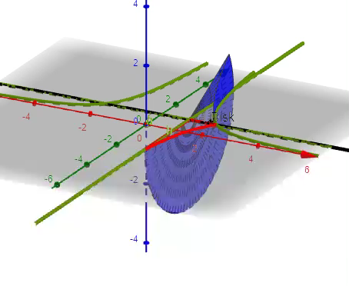
Example 1: Let $R$ be the region of the $xy$-plane bounded by the curves $x^{2}y=4$ below by the line $y=1$, on the left by the line $x=1$. Find the volume of the solid obtained by rotating $R$ around
B) the line $y=1$
DISK PROBLEM
Furthermore, 3-D
https://www.geogebra.org/m/n2jzwh8f

Slide 26
Example 1: Let $R$ be the region of the $xy$-plane bounded by the curves $x^{2}y=4$ below by the line $y=1$, on the left by the line $x=1$. Find the volume of the solid obtained by rotating $R$ around
B) the line $y=1$
https://www.geogebra.org/m/n2jzwh8f

Slide 27
Example 1: Let $R$ be the region of the $xy$-plane bounded by the curves $x^{2}y=4$ below by the line $y=1$, on the left by the line $x=1$. Find the volume of the solid obtained by rotating $R$ around
B) the line $y=1$
https://www.geogebra.org/m/n2jzwh8f

Slide 28
Example 1: Let $R$ be the region of the $xy$-plane bounded by the curves $x^{2}y=4$ below by the line $y=1$, on the left by the line $x=1$. Find the volume of the solid obtained by rotating $R$ around
B) the line $y=1$
You can find the solution in the pdf of the notes. Click here to access it.
https://www.geogebra.org/m/n2jzwh8f

Slide 29

Example 1: Let $R$ be the region of the $xy$-plane bounded by the curves $x^{2}y=4$ below by the line $y=1$, on the left by the line $x=1$. Find the volume of the solid obtained by rotating $R$ around
C) the y-axis
https://www.geogebra.org/m/wzbm2xbt

Slide 30

Example 1: Let $R$ be the region of the $xy$-plane bounded by the curves $x^{2}y=4$ below by the line $y=1$, on the left by the line $x=1$. Find the volume of the solid obtained by rotating $R$ around
C) the y-axis
Draw the region.
https://www.geogebra.org/m/wzbm2xbt

Slide 31
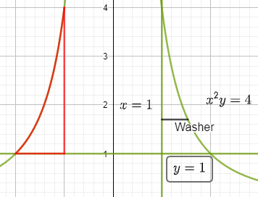


Example 1: Let $R$ be the region of the $xy$-plane bounded by the curves $x^{2}y=4$ below by the line $y=1$, on the left by the line $x=1$. Find the volume of the solid obtained by rotating $R$ around
C) the y-axis
WASHER PROBLEM
Rotation about y-axis
https://www.geogebra.org/m/wzbm2xbt

Slide 32
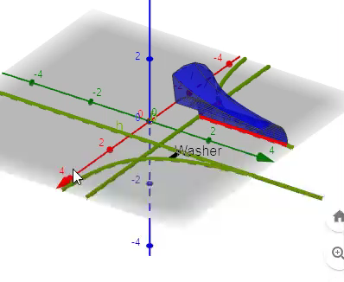
Example 1: Let $R$ be the region of the $xy$-plane bounded by the curves $x^{2}y=4$ below by the line $y=1$, on the left by the line $x=1$. Find the volume of the solid obtained by rotating $R$ around
C) the y-axis
WASHER PROBLEM
Furthermore, 3-D
https://www.geogebra.org/m/wzbm2xbt

Slide 33
Example 1: Let $R$ be the region of the $xy$-plane bounded by the curves $x^{2}y=4$ below by the line $y=1$, on the left by the line $x=1$. Find the volume of the solid obtained by rotating $R$ around
C) the y-axis
https://www.geogebra.org/m/wzbm2xbt

Slide 34
Example 1: Let $R$ be the region of the $xy$-plane bounded by the curves $x^{2}y=4$ below by the line $y=1$, on the left by the line $x=1$. Find the volume of the solid obtained by rotating $R$ around
C) the y-axis
https://www.geogebra.org/m/wzbm2xbt

Slide 35
Example 1: Let $R$ be the region of the $xy$-plane bounded by the curves $x^{2}y=4$ below by the line $y=1$, on the left by the line $x=1$. Find the volume of the solid obtained by rotating $R$ around
C) the y-axis
https://www.geogebra.org/m/wzbm2xbt

Slide 36
Example 1: Let $R$ be the region of the $xy$-plane bounded by the curves $x^{2}y=4$ below by the line $y=1$, on the left by the line $x=1$. Find the volume of the solid obtained by rotating $R$ around
C) the y-axis
You can find the solution in the pdf of the notes. Click here to access it.
https://www.geogebra.org/m/wzbm2xbt

Slide 37

Example 1: Let $R$ be the region of the $xy$-plane bounded by the curves $x^{2}y=4$ below by the line $y=1$, on the left by the line $x=1$. Find the volume of the solid obtained by rotating $R$ around
D) the line $x=1$
https://www.geogebra.org/m/cppyhnqk

Slide 38
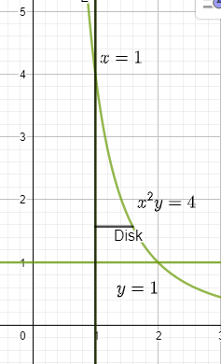

Example 1: Let $R$ be the region of the $xy$-plane bounded by the curves $x^{2}y=4$ below by the line $y=1$, on the left by the line $x=1$. Find the volume of the solid obtained by rotating $R$ around
D) the line $x=1$
Draw the region.
https://www.geogebra.org/m/cppyhnqk

Slide 39
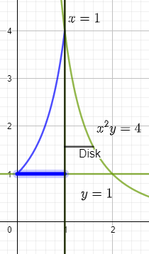
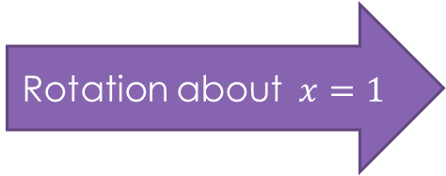

Example 1: Let $R$ be the region of the $xy$-plane bounded by the curves $x^{2}y=4$ below by the line $y=1$, on the left by the line $x=1$. Find the volume of the solid obtained by rotating $R$ around
D) the line $x=1$
DISK PROBLEM
Rotation about$x=1$
https://www.geogebra.org/m/cppyhnqk

Slide 40
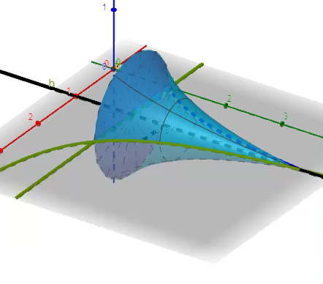

Example 1: Let $R$ be the region of the $xy$-plane bounded by the curves $x^{2}y=4$ below by the line $y=1$, on the left by the line $x=1$. Find the volume of the solid obtained by rotating $R$ around
D) the line $x=1$
DISK PROBLEM
Furthermore, 3-D
https://www.geogebra.org/m/cppyhnqk

Slide 41
Example 1: Let $R$ be the region of the $xy$-plane bounded by the curves $x^{2}y=4$ below by the line $y=1$, on the left by the line $x=1$. Find the volume of the solid obtained by rotating $R$ around
D) the line $x=1$
https://www.geogebra.org/m/cppyhnqk

Slide 42
Example 1: Let $R$ be the region of the $xy$-plane bounded by the curves $x^{2}y=4$ below by the line $y=1$, on the left by the line $x=1$. Find the volume of the solid obtained by rotating $R$ around
D) the line $x=1$
https://www.geogebra.org/m/cppyhnqk

Slide 43
Example 1: Let $R$ be the region of the $xy$-plane bounded by the curves $x^{2}y=4$ below by the line $y=1$, on the left by the line $x=1$. Find the volume of the solid obtained by rotating $R$ around
D) the line $x=1$
You can find the solution in the pdf of the notes. Click here to access it.
https://www.geogebra.org/m/cppyhnqk

Slide 44

Example 2: Find the volume of the solid generated by revolving the given region about the line $x=6$:
$y=\sqrt{x}$ , $y=0$ , $x=4$
https://www.geogebra.org/m/eyabfyya

Slide 45
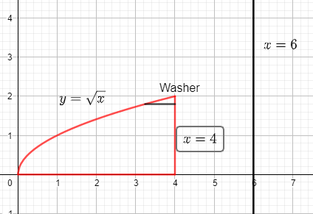
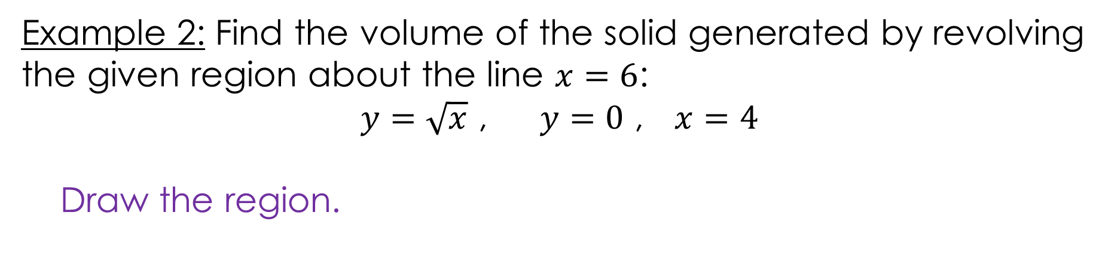
Example 2: Find the volume of the solid generated by revolving the given region about the line $x=6$:
$y=\sqrt{x}$ , $y=0$ , $x=4$
Draw the region.
https://www.geogebra.org/m/eyabfyya

Slide 46
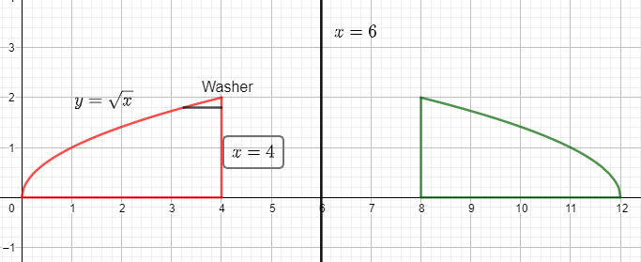

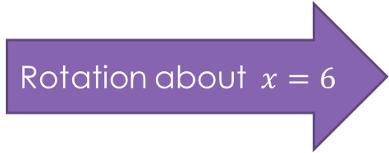
Example 2: Find the volume of the solid generated by revolving the given region about the line $x=6$:
$y=\sqrt{x}$ , $y=0$ , $x=4$
WASHER PROBLEM
Rotation about$x=6$
https://www.geogebra.org/m/eyabfyya

Slide 47
Example 2: Find the volume of the solid generated by revolving the given region about the line $x=6$:
$y=\sqrt{x}$ , $y=0$ , $x=4$
https://www.geogebra.org/m/eyabfyya

Slide 48
Example 2: Find the volume of the solid generated by revolving the given region about the line $x=6$:
$y=\sqrt{x}$ , $y=0$ , $x=4$
https://www.geogebra.org/m/eyabfyya

Slide 49
Example 2: Find the volume of the solid generated by revolving the given region about the line $x=6$:
$y=\sqrt{x}$ , $y=0$ , $x=4$
https://www.geogebra.org/m/eyabfyya

Slide 50
Example 2: Find the volume of the solid generated by revolving the given region about the line $x=6$:
$y=\sqrt{x}$ , $y=0$ , $x=4$
https://www.geogebra.org/m/eyabfyya

Slide 51
Example 2: Find the volume of the solid generated by revolving the given region about the line $x=6$:
$y=\sqrt{x}$ , $y=0$ , $x=4$
You can find the solution in the pdf of the notes. Click here to access it.
https://www.geogebra.org/m/eyabfyya

Slide 52

Example 3: Find the volume of the solid generated by revolving the given region about the line $y=2$:
$y=2x$ , $x=0$, $y=2$
https://www.geogebra.org/m/z6tjgnn9

Slide 53
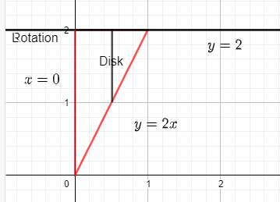
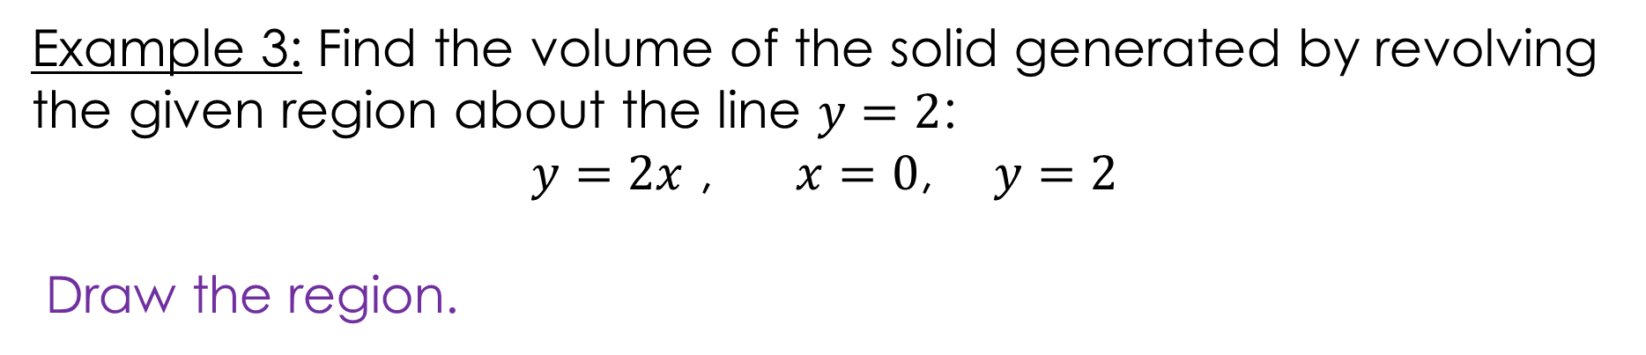
Example 3: Find the volume of the solid generated by revolving the given region about the line $y=2$:
$y=2x$ , $x=0$, $y=2$
Draw the region.
https://www.geogebra.org/m/z6tjgnn9

Slide 54
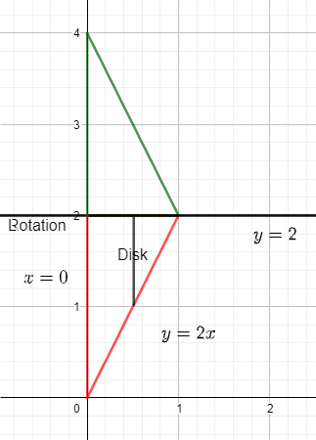
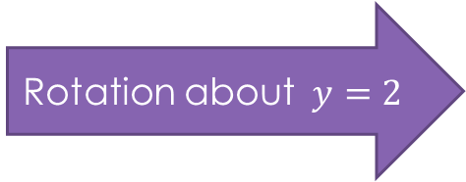
Example 3: Find the volume of the solid generated by revolving the given region about the line $y=2$:
$y=2x$ , $x=0$, $y=2$
DISK PROBLEM
Rotation about$y=2$
https://www.geogebra.org/m/z6tjgnn9

Slide 55
Example 3: Find the volume of the solid generated by revolving the given region about the line $y=2$:
$y=2x$ , $x=0$, $y=2$
https://www.geogebra.org/m/z6tjgnn9

Slide 56
Example 3: Find the volume of the solid generated by revolving the given region about the line $y=2$:
$y=2x$ , $x=0$, $y=2$
https://www.geogebra.org/m/z6tjgnn9

Slide 57
Example 3: Find the volume of the solid generated by revolving the given region about the line $y=2$:
$y=2x$ , $x=0$, $y=2$
You can find the solution in the pdf of the notes. Click here to access it.
https://www.geogebra.org/m/z6tjgnn9

Slide 58
GeoGebra Link for Lesson 16
https://www.geogebra.org/m/y4pqm3mr
Note click on the play buttons on the left-most screen and the animation will play/pause.

