Slide 1
Reminders
Writing Assignment 4 due Tonight on Brightspace
  Topic: Area Between Two Curves

Slide 2
MA 16020: Lesson 10
Volume By Revolution
Disk Method
By: Alexandra Cuadra

Slide 3
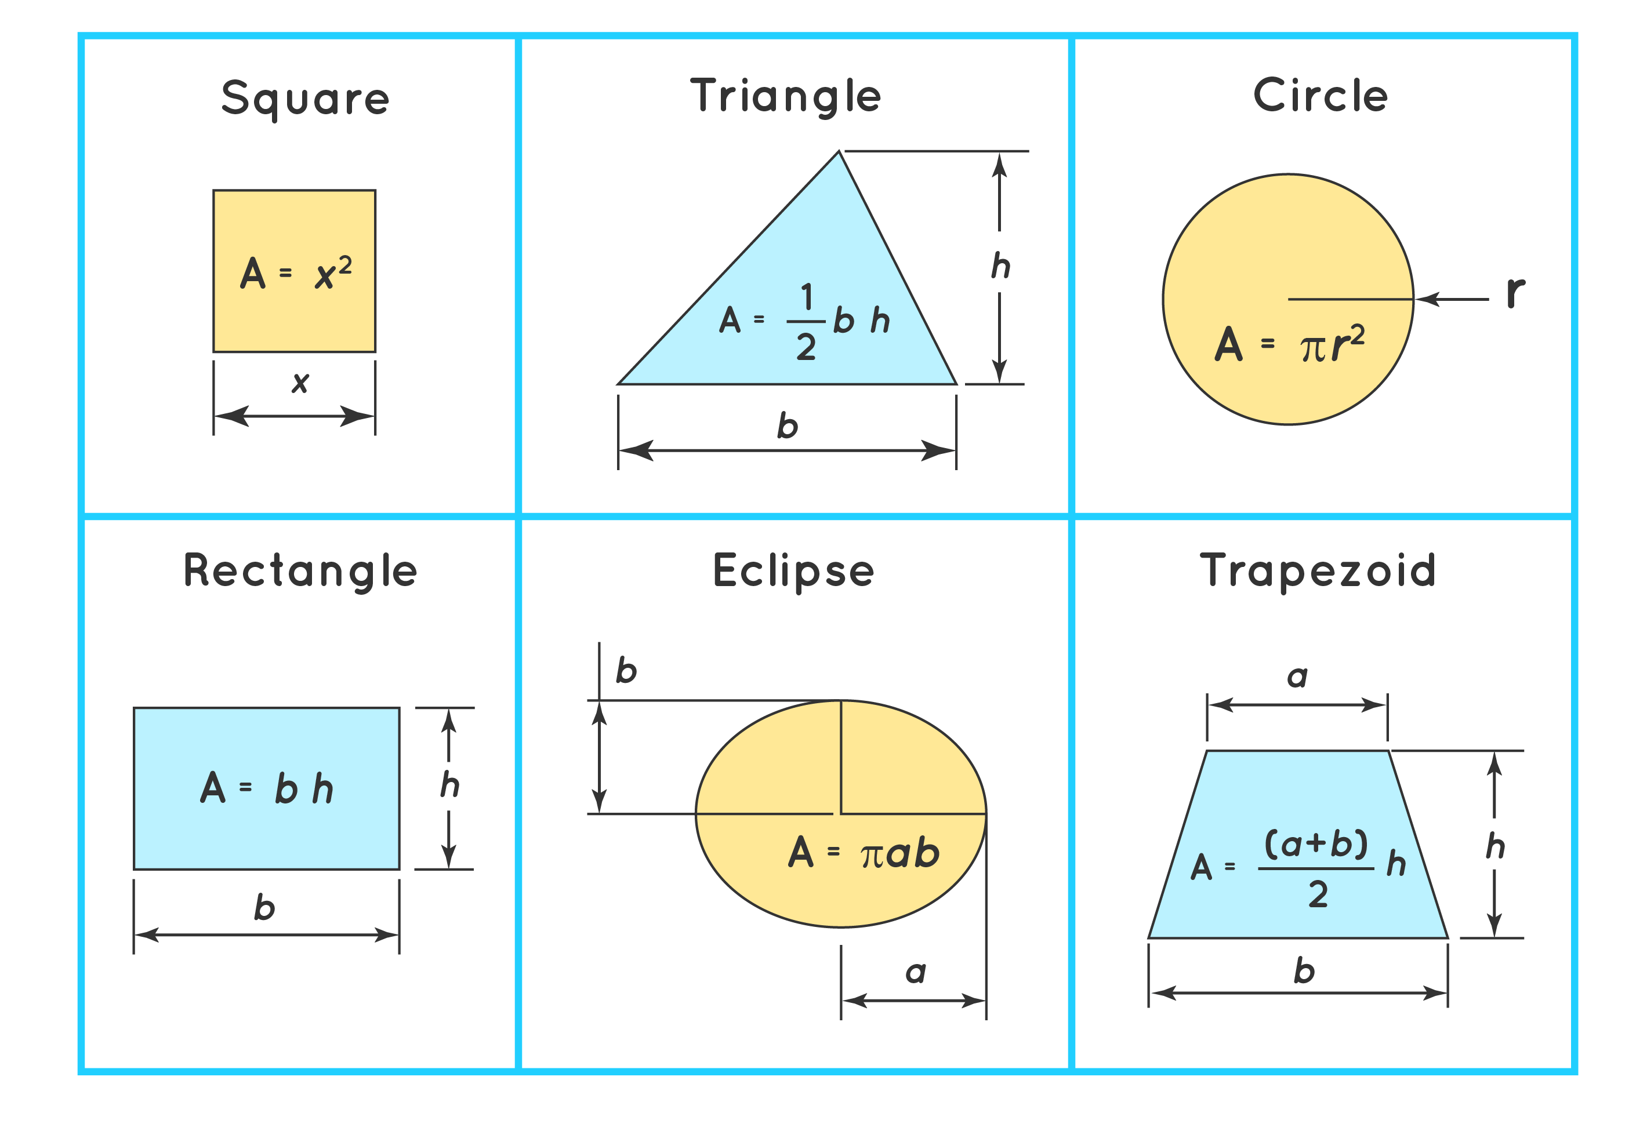
In Geometry,
When we first talked about the concept of area, we did this by going over all the formulas for the area of different polygons.

Slide 4
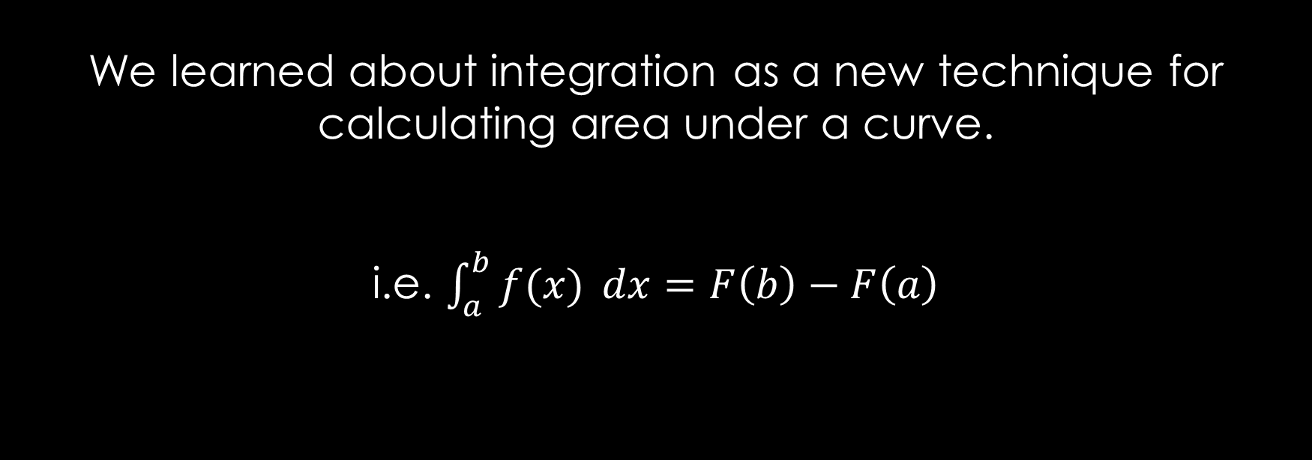
In Calculus I,
We learned about integration as a new technique for calculating area under a curve.
i.e. $\int_{a}^{b}{f(x)} dx=F\left(b\right)−F\left(a\right)$

Slide 5
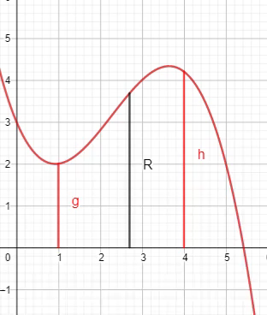
Last Class,
We recapped how to take some region
  Between a curve and an axis, or
  2 curves
  And find it’s area by integration.
Essentially, finding a length and sending it across the region.
`
https://www.geogebra.org/m/tgceabb2#material/tnnhu7gz

Slide 6
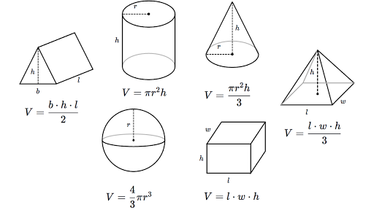
In Geometry,
We also learned about 3-D figures, like cubes and prisms.
We described the volume of these objects by the amount of 3-D space that they contained.
We calculated the volume with formulas like the ones on the right.

Slide 7
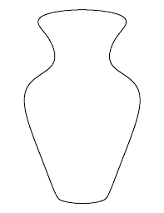
But once curves, like the one below, get involved all these formulas are USELESS.

Slide 8
In the same way, we run a line segment across a 2-D region to calculate its area,
  we can run a plane region, or a cross section, across a 3-D region to calculate its volume.
  i.e. Running a 2-D plane across a 3-D volume.
`
https://www.geogebra.org/m/tgceabb2#material/tnnhu7gz

Slide 9
So we have integration again; just with an extra dimension.
Instead of adding up tiny rectangles under a curve, we are adding up infinitely thin cross sections, which we can call
  Disks (Lesson 10), or
  Washers (Lesson 11), or
  Shells (Lesson 13)
Since each of these cross sections are 2-D, taking the integral of an area function will gives us volume.

Slide 10
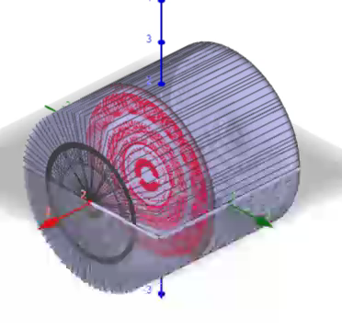
Let’s look at a cylinder.
Remember a cylinder is made up of many circles like the red circle.
So, we can think of our integral to be sum of all these circles.
`
https://www.geogebra.org/m/tgceabb2#material/qcwutumt

Slide 11
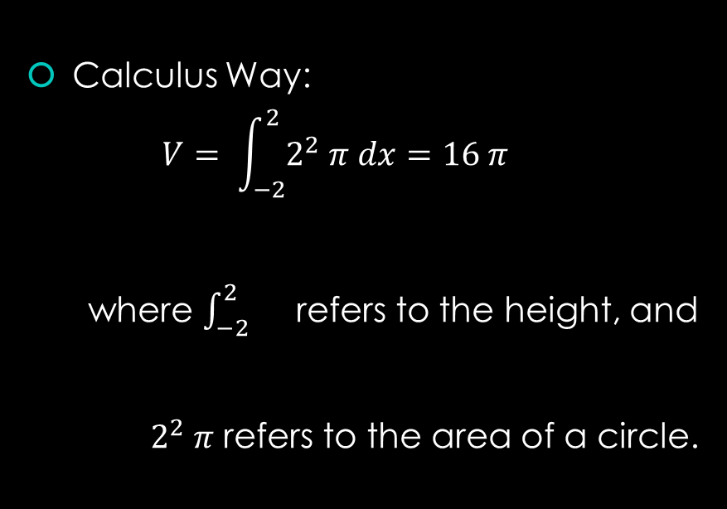
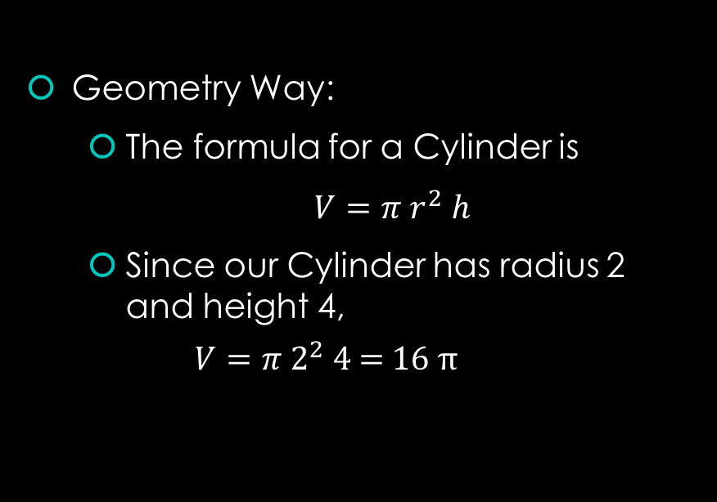
Volume of that Cylinder
Geometry Way:
  The formula for a Cylinder is
  $V=π r^{2} h$
  Since our Cylinder has radius 2 and height 4,
  $$V=π 2^{2} \text{4 = 16} π$$
Calculus Way:
  $$V= \int_{−2}^{2}{2^{2} π dx}=16 π$$
  where $\int_{−2}^{2}{}$ refers to the height, and
  $2^{2} π$ refers to the area of a circle.

Slide 12
Purpose of all of this…
So in the case of a cylinder, this might be overkill.
But this is the way we want to think of these questions.
  Essentially find the cross section by graphing the lines given and apply the appropriate formula
  ( found on the next slide. )

Slide 13
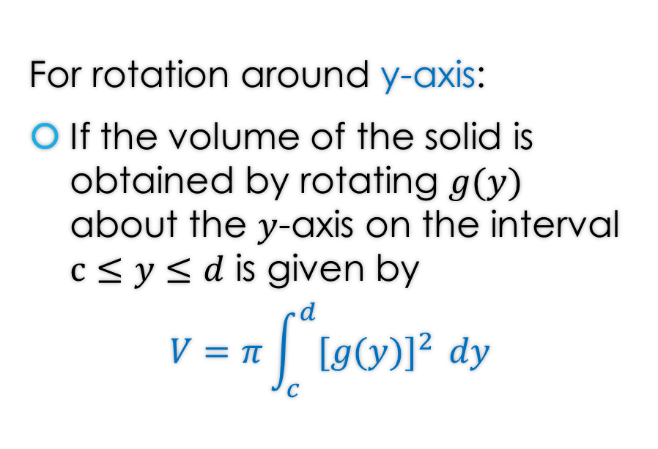
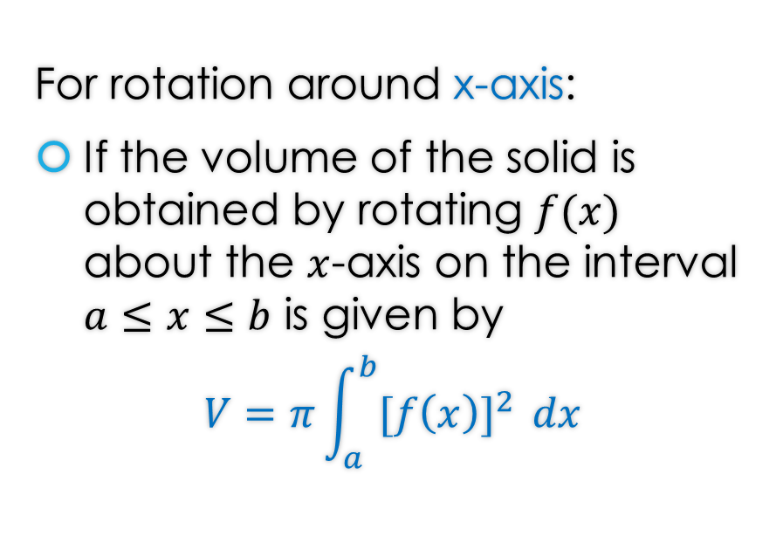
Disk Method Formula(s)
For rotation around x-axis:
If the volume of the solid is obtained by rotating $f(x)$ about the $x$-axis on the interval $a≤x≤b$ is given by
$$V=π\int_{a}^{b}{{[f\left(x\right)]}^{2} }dx$$
For rotation around y-axis:
If the volume of the solid is obtained by rotating $g(y)$ about the $y$-axis on the interval $c≤y≤d$ is given by
$$V=π\int_{c}^{d}{{[g(y)]}^{2} }dy$$

Slide 14
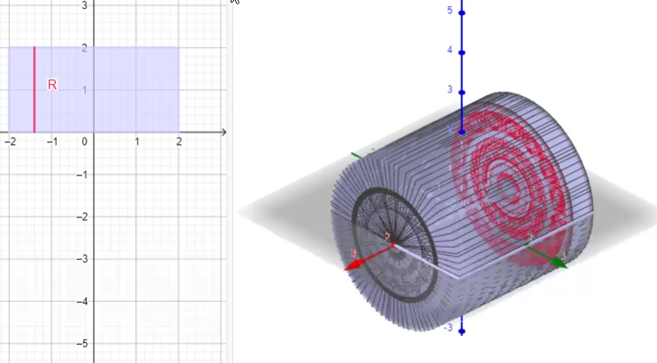

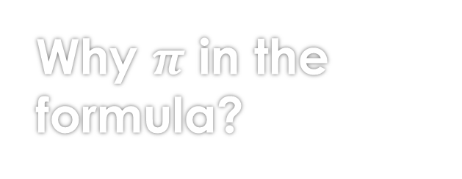
Why $π$ in the formula?
Note the $π$ in both formulas comes from the fact we are playing with Disks.
So you can see the graph on the left shows the radius and the right shows the Disks.
`
https://www.geogebra.org/m/tgceabb2#material/qcwutumt

Slide 15
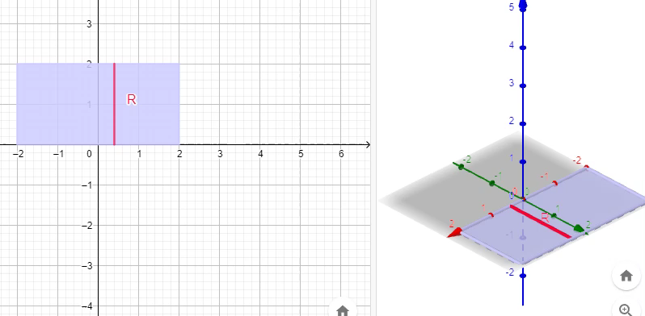
But wait…
How is the left graph becoming the cylinder?
Answer: If you rotate the left graph, you get the cylinder.
`
https://www.geogebra.org/m/tgceabb2#material/qcwutumt

Slide 16
Examples

Slide 17

Example 1: Find the volume of the solid that results by revolving the region enclosed by the curves
$y=x$, $y=0$, $x=1$, $x=3$
About the x-axis.

Slide 18
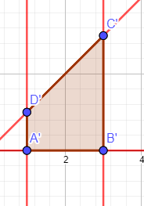
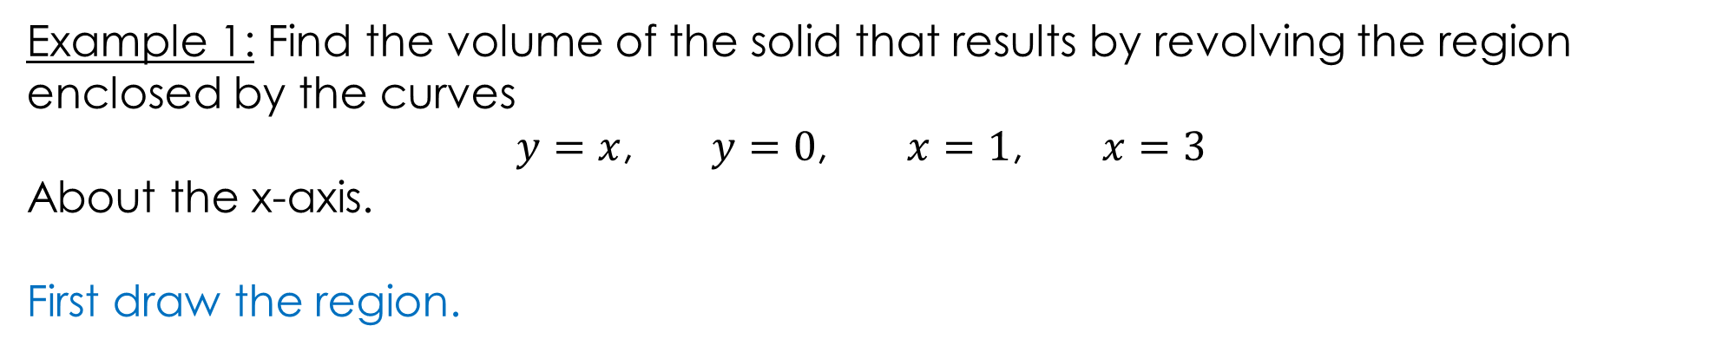
Example 1: Find the volume of the solid that results by revolving the region enclosed by the curves
$y=x$, $y=0$, $x=1$, $x=3$
About the x-axis.
First draw the region.
https://www.geogebra.org/m/tgceabb2#material/w8mk9dgp

Slide 19
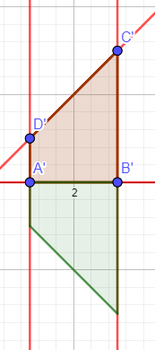
Example 1: Find the volume of the solid that results by revolving the region enclosed by the curves
$y=x$, $y=0$, $x=1$, $x=3$
About the x-axis.
Rotation about x-axis
https://www.geogebra.org/m/tgceabb2#material/w8mk9dgp

Slide 20
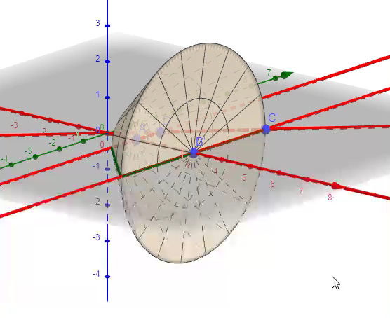
Example 1: Find the volume of the solid that results by revolving the region enclosed by the curves
$y=x$, $y=0$, $x=1$, $x=3$
About the x-axis.
Furthermore, 3-D
https://www.geogebra.org/m/tgceabb2#material/w8mk9dgp

Slide 21
Example 1: Find the volume of the solid that results by revolving the region enclosed by the curves
$y=x$, $y=0$, $x=1$, $x=3$
About the x-axis.
https://www.geogebra.org/m/tgceabb2#material/w8mk9dgp

Slide 22
Example 1: Find the volume of the solid that results by revolving the region enclosed by the curves
$y=x$, $y=0$, $x=1$, $x=3$
About the x-axis.
You can find the solution in the pdf of the notes. Click here to access it.
https://www.geogebra.org/m/tgceabb2#material/w8mk9dgp

Slide 23

Example 2: Find the volume of the solid that results by revolving the region enclosed by the curves
$y=sec⁡(x)$, $y=0$, $x=0$, $x=1$
About the x-axis.

Slide 24
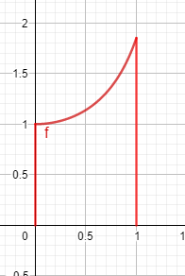
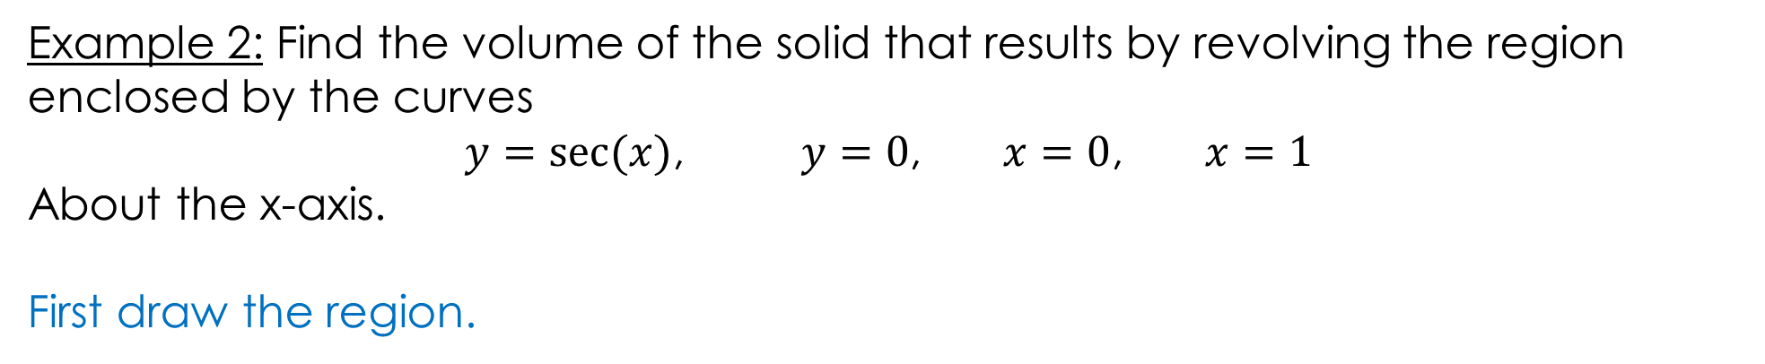
Example 2: Find the volume of the solid that results by revolving the region enclosed by the curves
$y=sec⁡(x)$, $y=0$, $x=0$, $x=1$
About the x-axis.
First draw the region.
https://www.geogebra.org/m/tgceabb2#material/vte3zdjx

Slide 25
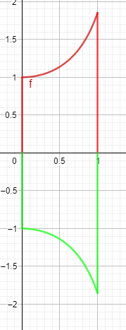
Example 2: Find the volume of the solid that results by revolving the region enclosed by the curves
$y=sec⁡(x)$, $y=0$, $x=0$, $x=1$
About the x-axis.
Rotation about x-axis
https://www.geogebra.org/m/tgceabb2#material/vte3zdjx

Slide 26
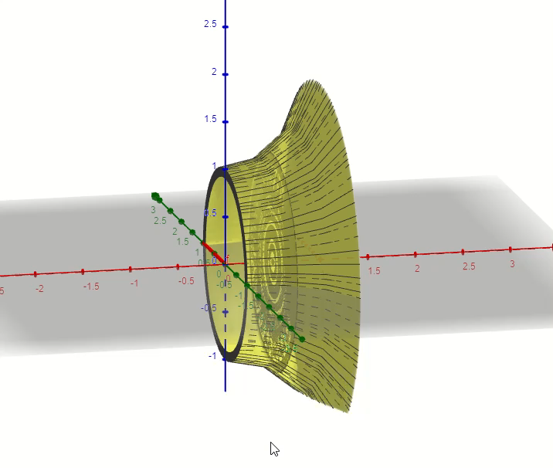
Example 2: Find the volume of the solid that results by revolving the region enclosed by the curves
$y=sec⁡(x)$, $y=0$, $x=0$, $x=1$
About the x-axis.
Furthermore, 3-D
https://www.geogebra.org/m/tgceabb2#material/vte3zdjx

Slide 27
Example 2: Find the volume of the solid that results by revolving the region enclosed by the curves
$y=sec⁡(x)$, $y=0$, $x=0$, $x=1$
About the x-axis.
https://www.geogebra.org/m/tgceabb2#material/vte3zdjx

Slide 28
Example 2: Find the volume of the solid that results by revolving the region enclosed by the curves
$y=sec⁡(x)$, $y=0$, $x=0$, $x=1$
About the x-axis.
You can find the solution in the pdf of the notes. Click here to access it.
https://www.geogebra.org/m/tgceabb2#material/vte3zdjx

Slide 29

Example 3: Find the volume of the solid that results by revolving the region enclosed by the curves
$y=\sqrt{6x}+\sqrt{\frac{x}{6}}$, $x=2$ , $x=4$
About the x-axis.

Slide 30
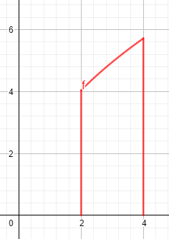
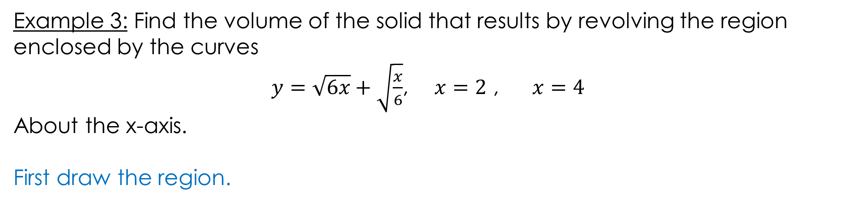
Example 3: Find the volume of the solid that results by revolving the region enclosed by the curves
$y=\sqrt{6x}+\sqrt{\frac{x}{6}}$, $x=2$ , $x=4$
About the x-axis.
First draw the region.
https://www.geogebra.org/m/tgceabb2#material/njkxvte3

Slide 31
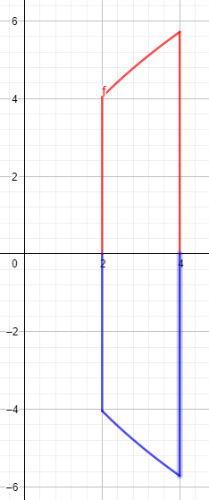
Example 3: Find the volume of the solid that results by revolving the region enclosed by the curves
$y=\sqrt{6x}+\sqrt{\frac{x}{6}}$, $x=2$ , $x=4$
About the x-axis.
Rotation about x-axis
https://www.geogebra.org/m/tgceabb2#material/njkxvte3

Slide 32
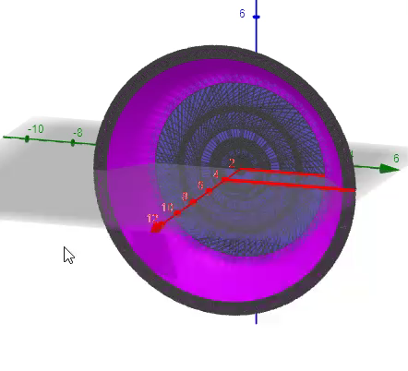
Example 3: Find the volume of the solid that results by revolving the region enclosed by the curves
$y=\sqrt{6x}+\sqrt{\frac{x}{6}}$, $x=2$ , $x=4$
About the x-axis.
Furthermore, 3-D
https://www.geogebra.org/m/tgceabb2#material/njkxvte3

Slide 33
Example 3: Find the volume of the solid that results by revolving the region enclosed by the curves
$y=\sqrt{6x}+\sqrt{\frac{x}{6}}$, $x=2$ , $x=4$
About the x-axis.
https://www.geogebra.org/m/tgceabb2#material/njkxvte3

Slide 34
Example 3: Find the volume of the solid that results by revolving the region enclosed by the curves
$y=\sqrt{6x}+\sqrt{\frac{x}{6}}$, $x=2$ , $x=4$
About the x-axis.
https://www.geogebra.org/m/tgceabb2#material/njkxvte3

Slide 35
Example 3: Find the volume of the solid that results by revolving the region enclosed by the curves
$y=\sqrt{6x}+\sqrt{\frac{x}{6}}$, $x=2$ , $x=4$
About the x-axis.
You can find the solution in the pdf of the notes. Click here to access it.
https://www.geogebra.org/m/tgceabb2#material/njkxvte3

Slide 36

Example 4: Find the volume of the solid that results by revolving the region enclosed by the curves
$y=4x^{2}$, $x=0$, $y=4$
About the y-axis.

Slide 37
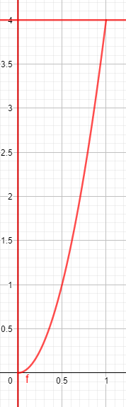
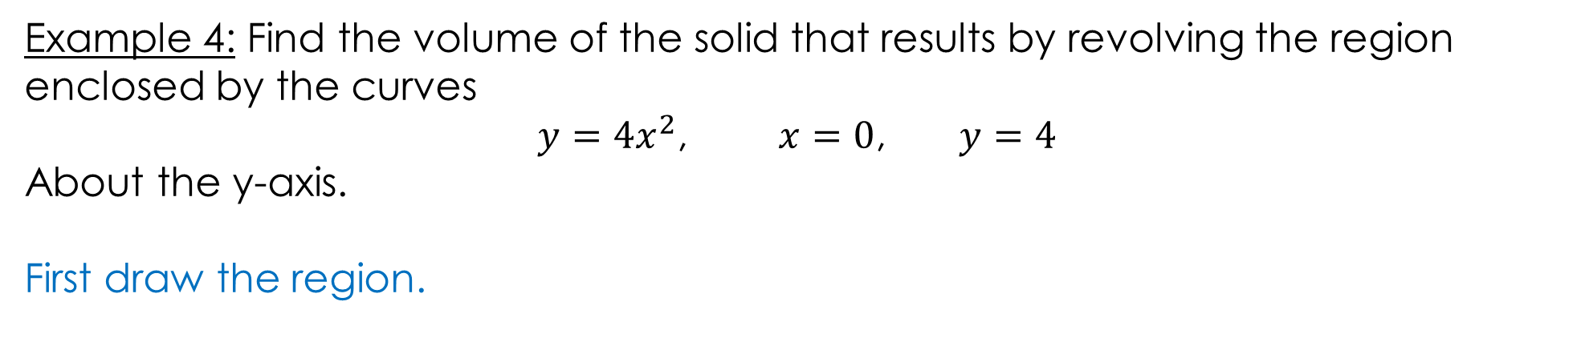
Example 4: Find the volume of the solid that results by revolving the region enclosed by the curves
$y=4x^{2}$, $x=0$, $y=4$
About the y-axis.
First draw the region.
https://www.geogebra.org/m/tgceabb2#material/afywnvhr

Slide 38
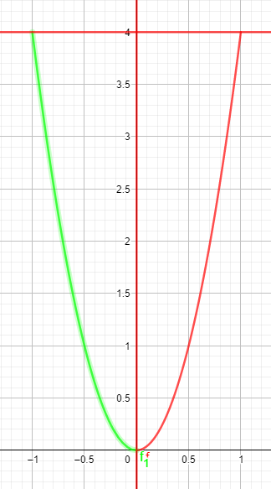
Example 4: Find the volume of the solid that results by revolving the region enclosed by the curves
$y=4x^{2}$, $x=0$, $y=4$
About the y-axis.
Rotation about y-axis
https://www.geogebra.org/m/tgceabb2#material/afywnvhr

Slide 39
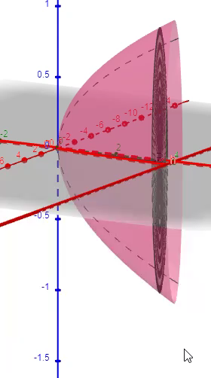
Example 4: Find the volume of the solid that results by revolving the region enclosed by the curves
$y=4x^{2}$, $x=0$, $y=4$
About the y-axis.
Furthermore, 3-D
https://www.geogebra.org/m/tgceabb2#material/afywnvhr

Slide 40
Example 4: Find the volume of the solid that results by revolving the region enclosed by the curves
$y=4x^{2}$, $x=0$, $y=4$
About the y-axis.
https://www.geogebra.org/m/tgceabb2#material/afywnvhr

Slide 41
Example 4: Find the volume of the solid that results by revolving the region enclosed by the curves
$y=4x^{2}$, $x=0$, $y=4$
About the y-axis.
https://www.geogebra.org/m/tgceabb2#material/afywnvhr

Slide 42
Example 4: Find the volume of the solid that results by revolving the region enclosed by the curves
$y=4x^{2}$, $x=0$, $y=4$
About the y-axis.
You can find the solution in the pdf of the notes. Click here to access it.
https://www.geogebra.org/m/tgceabb2#material/afywnvhr

Slide 43

Example 5: Find the volume of the solid that results by revolving the region enclosed by the curves
$y=\sqrt{144−x^{2}}$, $x=0$, $y=0$
About the y-axis.

Slide 44
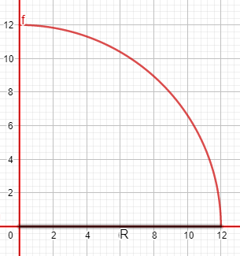
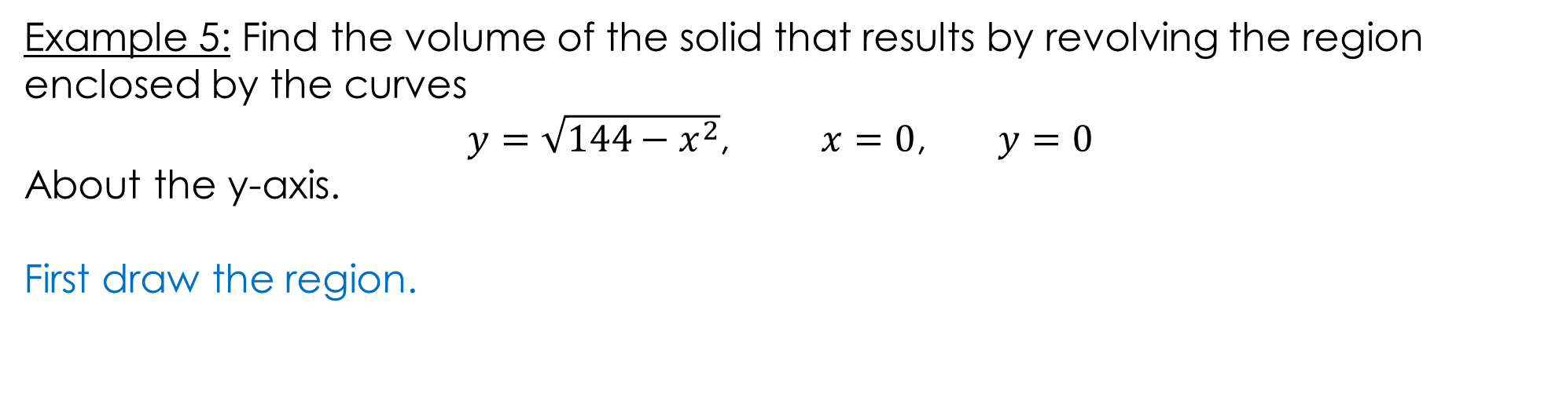
Example 5: Find the volume of the solid that results by revolving the region enclosed by the curves
$y=\sqrt{144−x^{2}}$, $x=0$, $y=0$
About the y-axis.
First draw the region.
https://www.geogebra.org/m/tgceabb2#material/a5s4n8u7

Slide 45


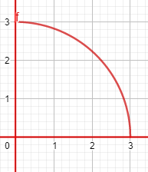
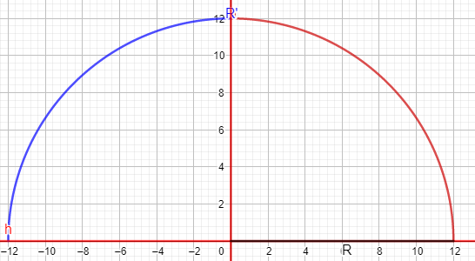
Example 5: Find the volume of the solid that results by revolving the region enclosed by the curves
$y=\sqrt{144−x^{2}}$, $x=0$, $y=0$
About the y-axis.
Rotation about y-axis
https://www.geogebra.org/m/tgceabb2#material/a5s4n8u7

Slide 46
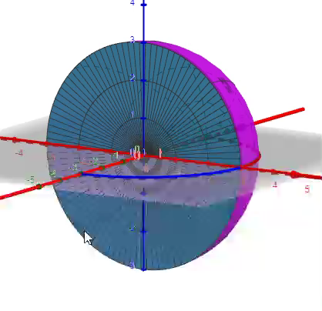
Example 5: Find the volume of the solid that results by revolving the region enclosed by the curves
$y=\sqrt{144−x^{2}}$, $x=0$, $y=0$
About the y-axis.
Furthermore, 3-D
https://www.geogebra.org/m/tgceabb2#material/a5s4n8u7

Slide 47
Example 5: Find the volume of the solid that results by revolving the region enclosed by the curves
$y=\sqrt{144−x^{2}}$, $x=0$, $y=0$
About the y-axis.
https://www.geogebra.org/m/tgceabb2#material/a5s4n8u7

Slide 48
Example 5: Find the volume of the solid that results by revolving the region enclosed by the curves
$y=\sqrt{144−x^{2}}$, $x=0$, $y=0$
About the y-axis.
https://www.geogebra.org/m/tgceabb2#material/a5s4n8u7

Slide 49
Example 5: Find the volume of the solid that results by revolving the region enclosed by the curves
$y=\sqrt{144−x^{2}}$, $x=0$, $y=0$
About the y-axis.
You can find the solution in the pdf of the notes. Click here to access it.
https://www.geogebra.org/m/tgceabb2#material/a5s4n8u7

Slide 50
GeoGebra Link for Lesson 10
https://www.geogebra.org/m/tgceabb2
Note click on the play buttons on the left-most screen and the animation will play/pause.

