Slide 1
Universidad de Buenos Aires (UBA), Argentina, Hohai University, Nanjing,
China and Purdue University, Indiana, USA
From Mineralogy to Mechanical Properties: integrating core data and rock physics simulations for stiffness tensor estimation in Vaca Muerta organic-rich mudrock
Juan E. Santos
In collaboration with A. Sánchez Camus (UNLP), G. B. Savioli (UBA), and P. Gauzellino (UNLP)
Summary
From a mechanical perspective, organic mudrocks are viscoelastic media whose anisotropy can be accurately represented using a vertical transverse isotropy (VTI) model. These reservoirs exhibit ultra-low permeability, typically in the range of nano to microdarcies, and possess a complex pore structure. Such characteristics, along with different oil, gas and water
fluids saturations, significantly impact the hydraulic properties and mechanical behavior of the reservoir during production.
This study introduces a practical methodology to estimate the stiffness tensor of dry rock using theoretical models of rock physics, incorporating mechanical, mineralogical, and petrophysical data from a core extracted from the lower section of the Vaca Muerta Formation (VMF), located in the Neuquén Basin, Argentina. This core was extracted from a block located in the maximum oil generation window of the VMF at a depth of 3100 m. The dry-rock stiffness tensor is initially computed and validated against laboratory phase velocity measurements at 1 MHz, showing discrepancies below 10 percent. The synthetic sample is subsequently saturated with hydrocarbon fluids to evaluate attenuation and dispersion effects associated with wave-induced fluid flow (WIFF) and the resulting mode conversions. Fluid-saturated simulations reveal that phase velocities decrease markedly with increasing gas content, with frequency variations depending on the fluid mixture, particularly above 100 Hz. Patchy gas-oil saturation yields higher velocities than uniformly mixed fluids, while exhibiting significantly greater attenuation due to enhanced WIFF. The frequency-dependent peak attenuation shifts toward lower frequencies in patchy cases, in agreement with mesoscopic pressure diffusion theory. These results emphasize the critical role of fluid composition and spatial distribution in seismic velocity and attenuation in unconventional reservoir characterization.
Methodology
The objective of this study is to apply the two-dimensional numerical model —a physically grounded, non-phenomenological formulation based on Biot’s theory of poroelasticity to investigate the anisotropic poroelastic response of the VMF, an organic-rich marlstone situated in the Neuquén Basin, Argentina, under variable fluid saturation conditions and the seismic frequency range. As a basis for the numerical modeling, we employ the rock physics theory which integrates mineralogical and petrophysical data from a core sample extracted from the VMF. This approach enables the estimation of the dry bulk modulus K_{m} and shear modulus μ_{m} of the multi-mineral porous matrix. The VMF is assumed to consist of a sequence of very thin horizontal layers composed of kerogen (as the primary organic constituent) and mineral aggregates, within which Biot’s theory in the diffusive frequency range is applicable. At long wavelengths compared with the average layer thickness VMF behaves as a transversely isotropic anisotropy with a vertical axis - VTI. To determine the p_{i j} stiffness coefficients of the equivalent VTI medium, a set of five boundary value problems (BVPs) based on Biot’s diffusive equations are formulated in the space–frequency domain. Each BVP defines a compressibility or shear test, which is solved using the Finite Element (FE) method across a range of relevant frequencies. These tests are first applied to a dry synthetic sample to compute the stiffness tensor and derive the corresponding dry-rock phase velocities. The simulated phase velocities exhibit very good agreement with laboratory measurements, with discrepancies remaining below 10 percent. Following the dry-rock analysis, the synthetic sample is saturated with gas, oil, and water to investigate attenuation and dispersion effects associated with mode conversions caused by wave-induced fluid flow (WIFF). Additionally, the case of patchy gas–oil saturation is examined and compared against scenarios of uniform saturation, in order to evaluate the effects of fluid distribution on seismic velocity and attenuation.

Slide 2
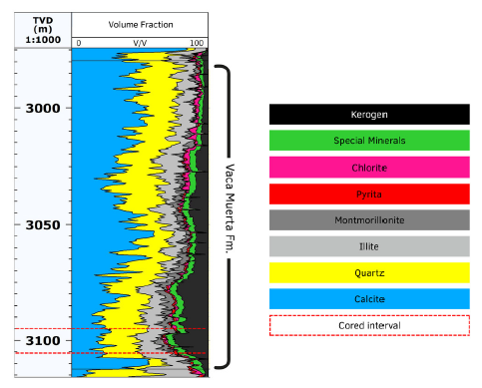
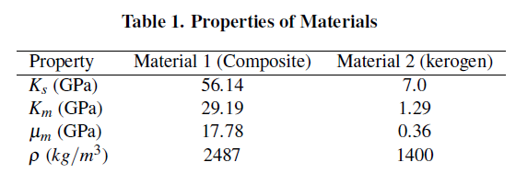
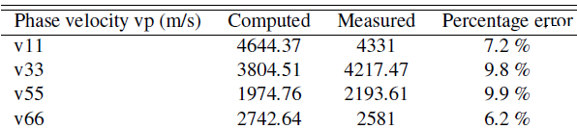
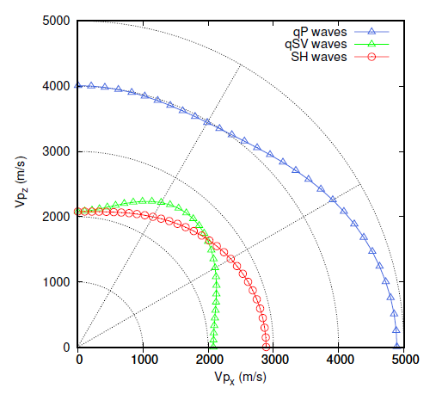
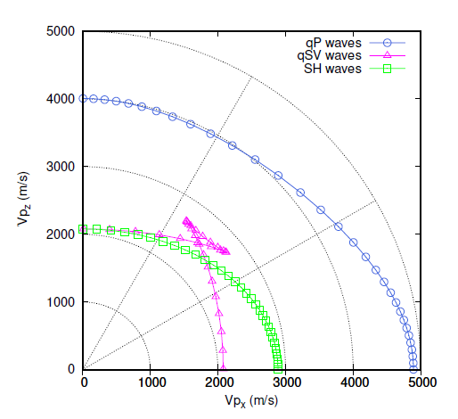
Results
A dry core from the VMF is the source of the measured data, which consist of rock mineralogy and phase velocities, vp11, vp33, vp55 and vp66 of the core at 3100 m depth. This core corresponds to the window of maximum oil generation in the formation; its location is marked with a red rectangle in Figure 1.
To estimate of the elastic tensor coefficients p_{i j}, we assume that VMF consists of a periodic alternation of two porous materials, each with a porosity of 6 percent and 2.75 10⁻¹⁸ m² permeability
Material 1 is composed of seven minerals, including 23 % kerogen, 37.27 % Clay, 14.61 % Quartz, 10.68 % Calcite, 2.57 % Plagioclase, 2.37 % Dolomite and 3.5 % Pyrite. Using the solid grains density, bulk and shear moduli of each mineral and a generalized Krief model, we obtained the values K_{s}, K_{m}, μ_{m} for the dry core as shown in Table 1 as well as its average density. Besides, the single layer of Material 2 consists of dry kerogen. Its properties can be seen in Table 1
Figure 1: Location of the core area, marked with a red rectangle. The green region corresponds to the the oil-generating window in the VMF.
The harmonic simulations were performed on a representative dry square sample with a side length of 2 mm, consisting of four repetitions of a periodic sequence composed of 49 layers of Material 1 and one layer of Material 2 per period. Each layer has a uniform thickness of 10⁻⁵ m. The computational domain was discretized using a 200×200 mesh.
Computed VTI phase velocities using the dry-core data
Since the phase velocity data corresponds to a dry sample, the numerical experiment consider air as the saturating fluid. Table 2 summarizes the results of the VTI experiments.
Table 2. Phase velocities computed, measured and error percentage
Figure 2-3 shows polar representation of phase and energy velocities of qP, qSV and SH waves of the dry core at 1 MHz. Anisotropy is clearly observed in the behavior of the velocities of the three wave modes.
Figure 2: Polar representation of phase velocities of qP, qSV and SH waves computed using the FE method. Frequency is 1 MHz.
Figure 3: Polar representation of energy velocities of qP, qSV and SH waves computed using the FE method. Frequency is 1 MHz.

Slide 3
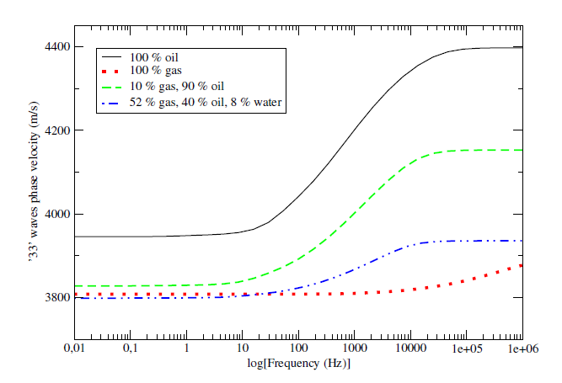
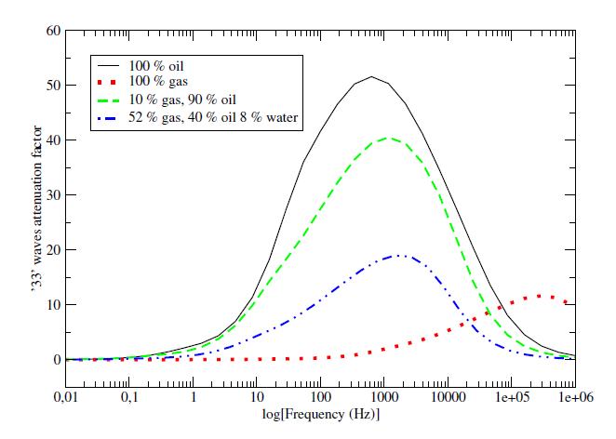
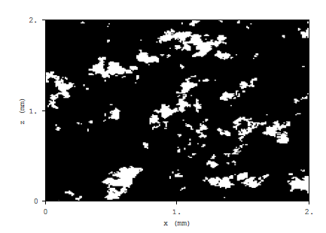
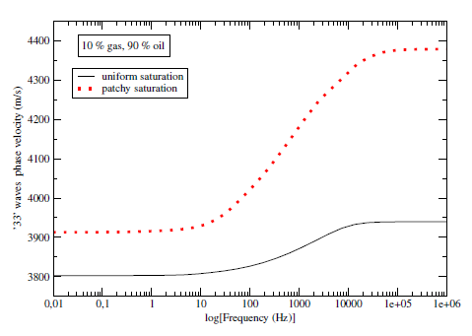
Phase velocities and attenuation using using hydrocarbon
saturated samples
Figures 4 and 5 present the phase velocity and attenuation behavior of qP waves traveling normal to the bedding, denoted as ’33’ waves’ (p33 mode) under four fluid saturation scenarios: 100 percent oil, 100 percent gas, 10 percent gas plus 90 percent oil, and a ternary fluid mixture consisting of 40 percent gas, 52 percent oil, and 8 percent water, obtained from the well’s fluid saturation log at the depth corresponding to the core sample.
Figure 4: ’33’ waves phase velocity as function of frequency.
Figure 5: Attenuation factor 1000/Q33 as function of frequency for ’33’ waves.
Patchy Saturation
To consider fractal variations of gas and oil saturations we use the von Karman self-similar correlation function. Figure 6 illustrates the binary patchy saturation map used to model patchy fluid distributions, where white and black regions correspond to fully gas- and oil-saturated zones, respectively. This spatial heterogeneity introduces local contrasts in fluid properties, particularly in compressibility and viscosity, which signficantly affect wave propagation through mesoscopic-scale WIFF mechanisms.
Figure 6: Fractal patchy gas-oil spatial distribution.
Figure 7: Phase velocity of ’33’ waves as function of frequency for 10 % gas, 90 % oil and uniform and patchy saturation
The uniform case assumes perfect mixing at the pore scale, producing a single-phase effective fluid with increased compressibility, resulting in lower velocities. In contrast, the patchy case consists of spatially segregated gas- and oil-filled regions. Wave propagation is governed by the stiffer oil-saturated zones, leading to higher velocities across the frequency spectrum. The divergence between the two models becomes particularly evident above 100 Hz, consistent with mesoscopic WIFF activation.

Slide 4
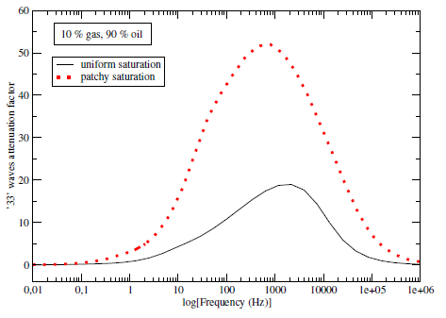
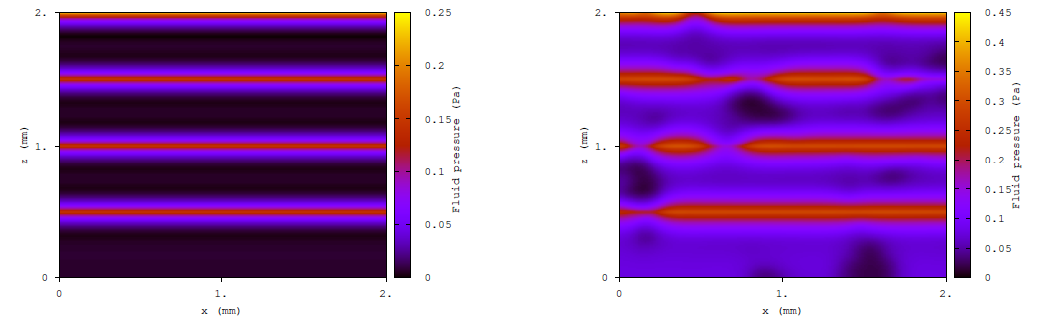
Figure 8: Attenuation factor of ’33’ waves as function of frequency for 10 % gas, 90 % oil and uniform and patchy saturation.
Patchy saturation in Figure 8 results in markedly higher attenuation due to enhanced WIFF at gas– oil interfaces. These effects promote localized pressure gradients and viscous fluid movement, leading to increased energy dissipation. Additionally, the attenuation peak is shifted to lower frequencies under patchy saturation, reflecting the longer diffusion times associated with larger- scale heterogeneities and limited pressure
communication between fluid patches.
Figure 9: Fluid pressure for the case of 10 % gas, 90 % oil and uniform saturation (left) and patchy saturation (right).
In the uniform case (left), the absence of spatial heterogeneity results in smooth pressure gradients and relatively low pressure peak values (up to 0.25 Pa), indicating limited WIFF. In contrast, the patchy saturation case exhibits a markedly irregular pressure field, with high- pressure concentrations developing at the interfaces between gas- and oil-filled regions. The complex geometry of the fluid domains leads to heterogeneous pressure diffusion, higher amplitude variations (up to 0.45 Pa), and stronger WIFF effects. These results underscore the essential role of fluid distribution geometry in modulating pore pressure responses and energy dissipation mechanisms during wave propagation.
Conclusions
A physically grounded, non-phenomenological methodology for estimating the effective anisotropic behavior of organic-rich mudrock reservoirs is presented.
The numerical simulations were performed on a two-dimensional, finely layered synthetic medium representative of a core sample from the VMF.
The procedure yielded frequency-dependent stiffness tensors that showed good agreement with laboratory-measured phase velocities exhibiting the strong VTI anisotropy of the formation.
The model does not use empirical calibration but is derived from first principles, integrating mineralogical, petrophysical, and mechanical properties in a physically consistent manner.
The inclusion of both patchy and uniformly mixed fluid saturation scenarios further emphasized the critical influence of mesoscale fluid heterogeneities on seismic wave dispersion and attenuation.
The results obtained show excellent agreement with well-log data, further validating the model's applicability under in-situ reservoir conditions.

