Slide 1
A Biot model describing wave propagation in a porous solid saturated by a three-phase fluid
Juan E. Santos^{1,2} and Gabriela B. Savioli¹
1 - Instituto del Gas y del Petróleo, Facultad de Ingeniería,
Universidad de Buenos Aires
2 - Department of Mathematics, Purdue University
Universidad Nacional de La Plata, CONICET
SUMMARY
We present a model for the propagation of waves in a poroelastic medium saturated by a three-phase viscous, compressible fluid: oil, water and gas.
The kinetic and dissipative energy density functions in the equations of motions are determined in terms of the mass densities of the solid and
fluid phases.
It is assumed that the flow is laminar, obeys Darcy’s law for the three phases and is described in terms of the absolute permeability and three-phase relative permeability functions. The pressure differences between the oil and water phases and the oil and gas phases are included in the model using two capillary pressure functions.
The elastic constants in the stress-strain relations are determined employing gedanken experiments that generalize those of Biot’s theory for single-phase fluids.
The presence of capillary forces imply the existence of four compressional waves, one fast and three slow, denoted Type I, II, III and IV waves,
and one shear wave.
Numerical examples show the phase velocities and attenuation coefficients of all waves for a sample of Nivelsteiner sandstone saturated by oil, gas and water.
THE MODEL
S_{o} , S_{w} , S_{g} : oil, water and gas saturations,
S_{o} + S_{w} + S_{g} = 1
solid and θ -fluid displacements averaged over the
bulk material, θ = o, w, g
: strain tensor, ,
: total stress of the bulk material
: stress tensor in the solid
: θ -fluid pressure,
: reference pressure
Capillary pressures:

Slide 2
Generalized forces
where
Stress-strain relations :
The elastic constants can be determined employing
a set of gedanken experiments, generalizing those of Biot for single-phase fluids.
Equation of motion :
: mass coupling 12X12 symmetric positive definite matrix, defined in terms of the mass coefficients of the individual phases
: viscous coupling 12X12 symmetric non-negative matrix, defined in terms of the viscosity of the individual fluid phases, the absolute permeability and the three phase relative permeabilities.
A plane wave analysis shows the existence of four compressional waves, denoted by Type I, II, III and IV, and one S or shear wave

Slide 3
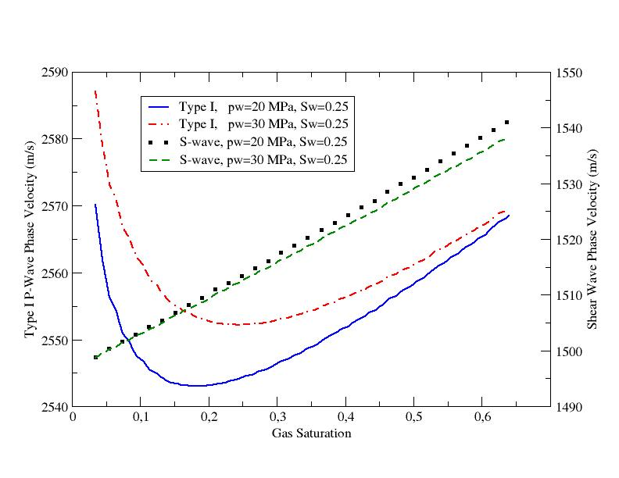
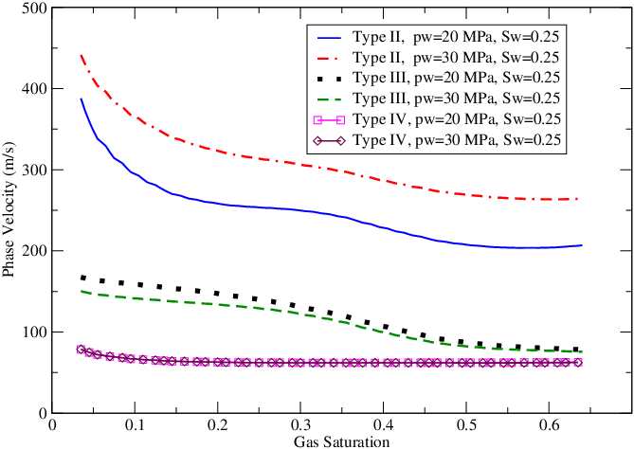
NUMERICAL EXAMPLES
The phase velocities and attenuation coefficients as function of frequency are computed for a sample of Nivelsteiner Sandstone with properties:
φ = 0.33 ; k= 5 D; ρs = 2.65 gr/cm³, Ks = 36 GPa, Km= 6.21 GPa; N= 4.55 GPa
We choose two reference water pressures: = 20 and 30 MPa
Capillary pressure functions :
Relative permeability functions:
PURELY ELASTIC CASE (zero viscosities)
Type I P and S wave phase velocities as function of gas saturation at S_{w}= 0.25 and p_{w}= 20 and 30 MPa
Type II, III and IV P-wave phase velocities as function of gas saturation at S_{w} = 0.25 and p_{w} = 20 and 30 MPa
Type I P-wave phase velocities show the characteristic decreasing behavior as gas saturation S_{g} increases until a threshold value at which velocities start to increase.
S-wave phase velocities are increasing functions of S_{g} .
Notice that as p_{w} increases, velocities of Type I waves increase while S-waves velocities decrease.
Type II and III P-wave phase velocities decrease as S_{g} increases, with higher values for increasing values of p_{w}.
Phase velocities of Type IV waves are almost independent of S_{g} , with their values increasing as p_{w} increases.

Slide 4
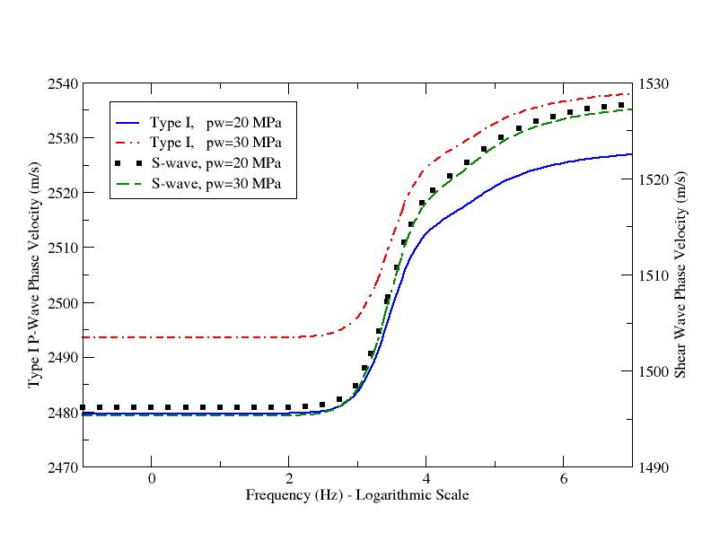
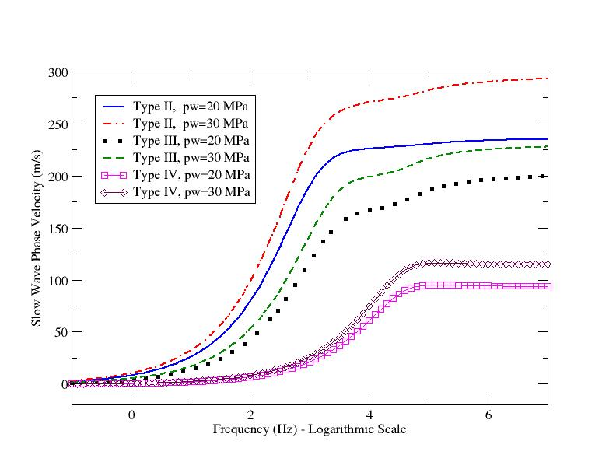
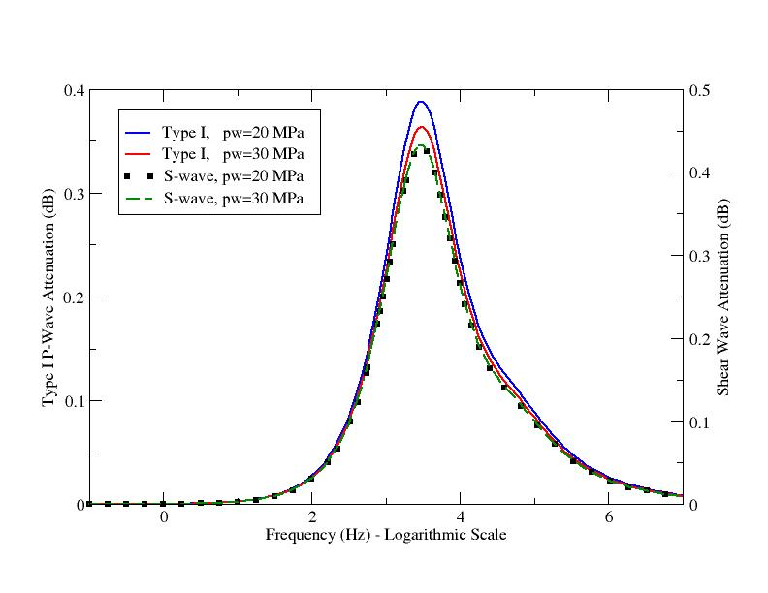
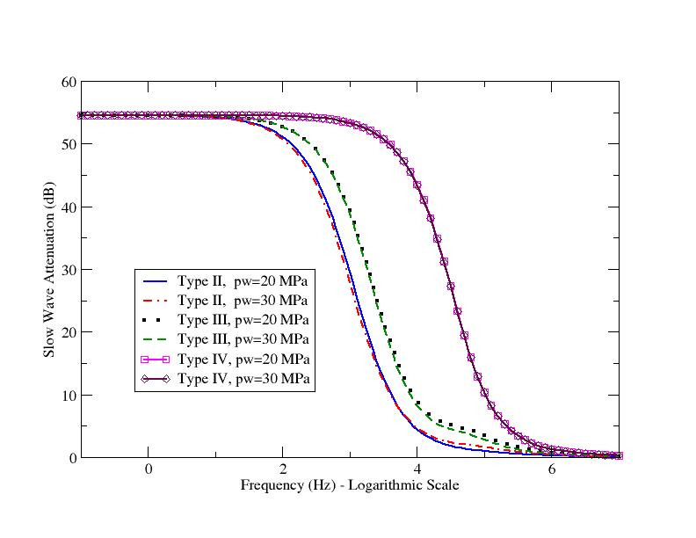
THE GENERAL DISSIPATIVE CASE
Type I P and S wave phase velocities as function of frequency at S_{w} = 0.25, S_{g} =0.1 and p_{w} = 20, 30 MPa
Type II, III and IV P-wave phase velocities as function of frequency at S_{w} = 0.25, S_{g} =0.1 and p_{w} = 20, 30 MPa
Phase velocities for Type I and S-waves show no dispersion for frequencies below 1 kHz and very little above.
As p_{w} increases, velocities of Type I waves increase while S-waves velocities slightly decrease.
Phase velocities of Type II, III and IV waves are almost zero at low frequencies, behaving as diffusion-type waves. At high frequencies they stabilize, with higher values for increasing values of p_{w}.
Type I P and S wave attenuations (dB) as function of frequency at S_{w} = 0.25, S_{g} =0.1 and p_{w} = 20, 30 MPa
Type II, III and IV P-wave attenuations (dB) as function of frequency at S_{w} = 0.25, S_{g} =0.1 and p_{w} = 20, 30 MPa
Type I and S-wave attenuations are almost zero at low frequencies and very small at high frequencies, with attenuation peaks located at the same frequency for both waves. Attenuation for Type I waves is higher for lower p_{w}, while for S-waves is independent of p_{w}.
Attenuation for Type II, III and IV
waves is very high at low frequencies and decay at high frequencies, where they become truly propagating waves.
Besides, attenuation is almost independent of p_{w}.
CONCLUSIONS
We presented a model to describe wave propagation in a poroelastic solid saturated by a three-phase fluid. The analysis shows that the Type I, Type II and S-waves behave as in the single-phase Biot theory (Biot, M.A., 1956). The Type III and IV compressional waves are diffusion-type slow waves at low frequencies, becoming truly propagating waves at high frequencies. Their existence is due to the presence of capillary forces between the three immiscible fluids saturating the pore space. Further analysis of the behavior of all the waves predicted by this model is the subject of current research.

