Slide 1


Electrical and Computer Engineering
Accuracy Directly Controlled Fast Direct Solutions of General H²-Matrices
Dan Jiao
School of Electrical and Computer Engineering
Purdue University, West Lafayette, IN 47907, USA

Slide 2
Outline
Introduction
Proposed Fast Direct Solvers of Explicitly Controlled Accuracy
Numerical Results
Conclusions

Slide 3
Application Background

Slide 4
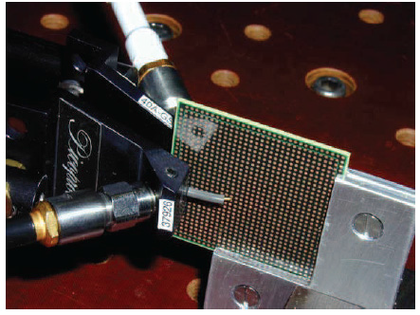
Electronic Package

Slide 5
Finite Element Methods
Second-order vector-wave equation
(1)
(2)
on S₁
on S₂
(3)
A is sparse of O(N) nonzero elements

Slide 6
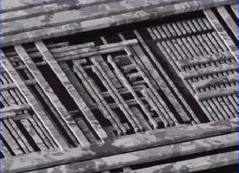
On-Chip Interconnect Capacitance (C) Extraction

Slide 7




Integral Equation Formulation
MOM solution
( G is dense)
(diagonal entry)

Slide 8

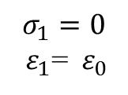


Volume Integral Equation (VIE) for Scattering
$$σ_{2}{ ε}_{2}$$
$$E^{inc}$$
(1)
$$σ_{1}=0$$
${ ε}_{1}$=${ ε}_{0}$
Face
$$σ_{1}{ ε}_{1}$$
(2)
Tetrahedron
(3)

Slide 9
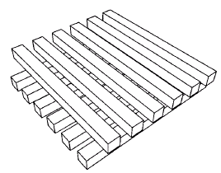
Surface IE For Full-wave Analysis
Impedance Extraction in Multiple Dielectrics
where
Finite conductivity σ_{i}
Embedded in multiple dielectrics

Slide 10
Resultant Irregular Matrix System
where, “id” and “ic” denote dielectric regions and conducting regions, respectively

Slide 11
Motivation of This Research

Slide 12
PDE Methods for Electromagnetic (EM) Analysis
A x = B
Sparse Matrix
Direct Solutions
  Best Complexity: O(N²) for 3-D problems
Iterative Solutions
  Complexity: O(N_{it}N_{rhs}N)
    N_{it} : number of iterations;
    N_{rhs} : number of right hand sides.

Slide 13
Integral Equation (IE) Methods for EM Analysis
A x = B
Dense Matrix
Direct Solutions:
  Conventional Complexity: O(N³)
Iterative Solutions
  Conventional Complexity: O(N_{it}N_{rhs}N²)
  Fast Solvers’ Complexity: O(N_{it}N_{rhs}N) or O(N_{it}N_{rhs}NlogN)
    FMM-based methods
    FFT-based methods
    Hierarchical algorithms
    Low-rank based methods
    Others

Slide 14
For a problem with N unknowns, in general, the optimal computational complexity is O(N)
Direct solvers have a potential to achieve such a complexity
Continued need for reducing the complexity of computational EM methods

Slide 15


What We Pursue:
Data-sparse O(N) repre-sentation
O(N) storage, MVM, MMP inverse, factorization
Original dense/sparse system
$$ε$$
$$ε$$
Generic, applicable to both PDE & IE solvers

Slide 16
Introduction
H²-matrix
  W. Hackbusch, B. Khoromskij, and S. Sauter, “On H²–matrices,” Lecture on Applied Mathematics, H. Bun-gartz, R. Hoppe, and C. Zenger, eds., pp. 9-29, 2000.
We consider it a good mathematical framework for developing faster solvers of further reduced complexity
Both PDE and IE operators in EM can be represented as H² with controlled accuracy (Chai/Jiao TAP 2009, Liu/Jiao TMTT 2010, …)

Slide 17
Introduction
H²-matrix complexity in math literature
O(N) storage, MVM, MMP for constant rank H²
Our O(N) inverse of constant-rank H²-matrices
W. Chai, D. Jiao, and C. C. Koh, “A Direct Integral-Equation Solver of Linear Complexity for Large-Scale 3D Capacitance and Impedance Extraction,” the 46th ACM/EDAC/IEEE Design Automation Conference (DAC), pp. 752-757, July 2009.
W. Chai and D. Jiao, “Dense matrix inversion of linear complexity for integral-equation based large-scale 3-D capacitance extraction," IEEE Trans. MTT., vol. 59, no. 10, pp. 2404-2421, Oct. 2011.

Slide 18
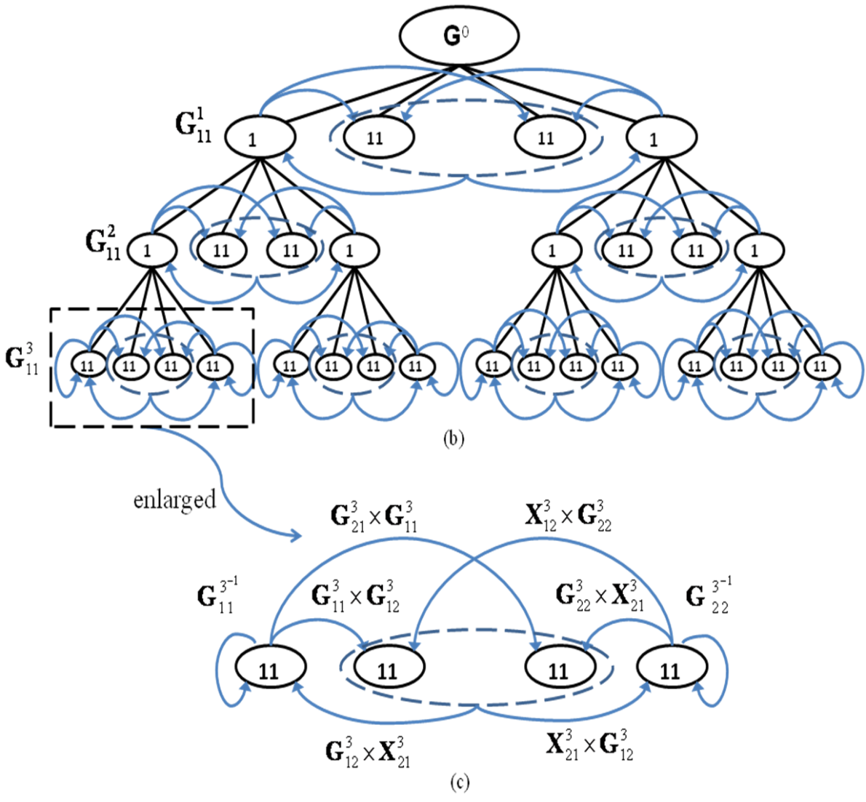
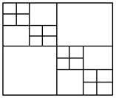

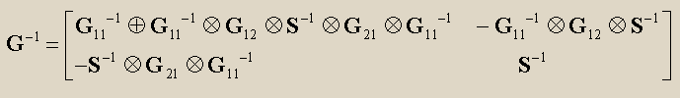
H² Inverse

Slide 19
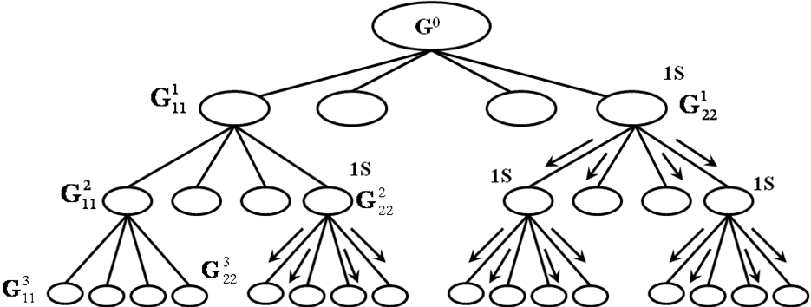
O(N) H² Inverse Algorithm [*]
Instantaneous collect operation
Auxiliary admissible block forms R
Modified block matrix multiplications
Instantaneous split operation
[*] W. Chai and D. Jiao, “Dense matrix inversion of linear complexity for integral-equation based large-scale 3-D capacitance extraction," IEEE Trans. MTT., vol. 59, no. 10, pp. 2404-2421, Oct. 2011.

Slide 20
Introduction
The aforementioned direct solution of H²-matrix lacks explicit accuracy control
  Formatted additions and multiplications
  Cluster bases of the original H²-matrix used for inverse and LU
The same is observed in H² matrix-matrix multiplications reported in literature

Slide 21
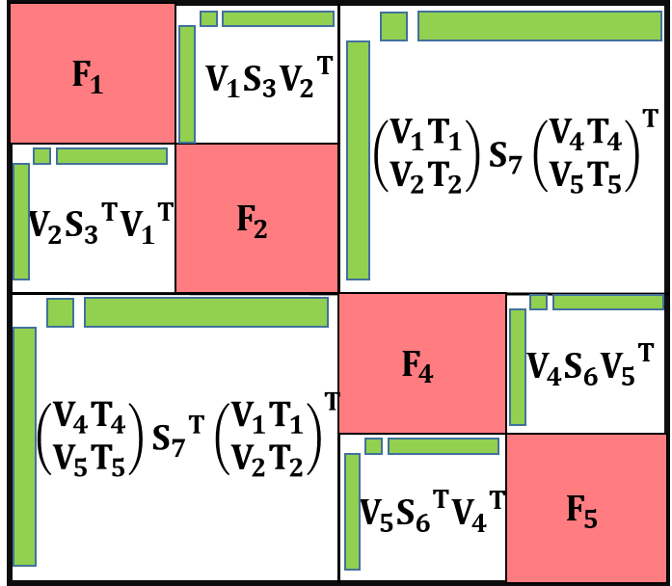
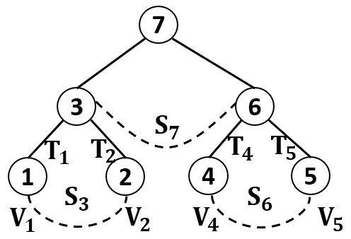
Introduction
HSS matrix— a special class of H² matrix
O(N) direct solution of constant-rank HSS exists in exact arithmetic:
  J. Xia, S. Chandrasekaran, M. Gu, and X. S. Li, “Fast algorithms for hierarchically semiseparable matrices,” Numer. Linear Algebra with Applications, vol. 17, pp. 953-976, 2010.

Slide 22
Achieved in This Work
Direct solutions of general H²-matrices with explicitly controlled accuracy
  Perform multiplications and additions as they are without using formatted operations
  Each operation is either exact or strictly controlled by accuracy
  O(N) complexity for constant-rank H²
  O(NlogN) complexity for electrically large VIE
  Outperform state-of-the-art direct solutions of H²-matrices in both accuracy and efficiency

Slide 23
Accuracy Directly Controlled Fast Direct Solutions of General H²-Matrices &
O(N) and O(NlogN) Direct IE Solvers
Silicon

Slide 24
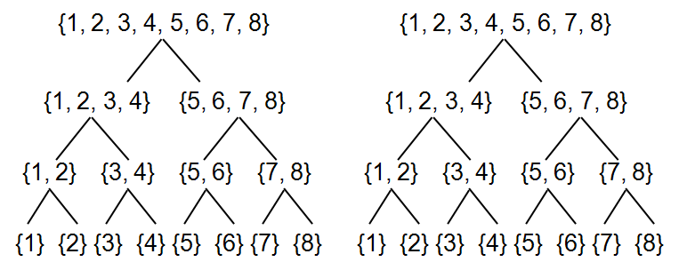
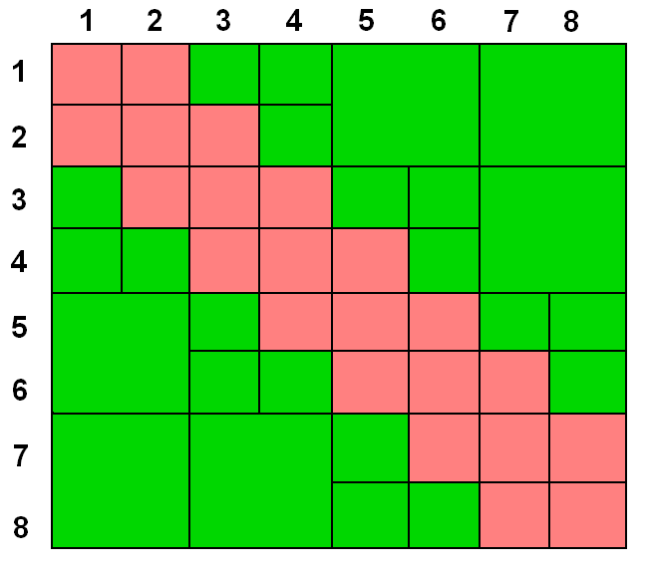

An H²-matrix
inadmissible
Admissible
Admissibility condition:
$$max\left\{diam\left(Ω_{t}\right),diam\left(Ω_{s}\right)\right\}≤ηdist(Ω_{t},Ω_{s})$$
No of blocks formed by a single cluster is bounded by C_{sp}.

Slide 25
Real H²-matrix examples
H²-matrix of a square plate.
(a) N = 1160. (b) N = 3605.

Slide 26





An H²-matrix
Admissible Blocks:
$$V_{}^{1}S^{1,5}{(V^{5})}^{T}$$
: Nested Cluster Bases
: Rank of
: Coupling Matrix
Inadmissible Blocks:
$\left[\begin{aligned}{\text{V}}^{1} 0 \\ 0 {\text{V}}^{2}\end{aligned}\right]\left[\begin{aligned}{\text{T}}^{1} \\ {\text{T}}^{2}\end{aligned}\right]$S${\left[\begin{aligned}{\text{T}}^{7} \\ {\text{T}}^{8}\end{aligned}\right]}^{T}{\left[\begin{aligned}{\text{V}}^{7} 0 \\ 0 {\text{V}}^{8}\end{aligned}\right]}^{T}$
$${\tilde{G}}_{}^{t,s}=G^{t,s}$$
$$V^{t}$$
$$V^{s}$$

Slide 27


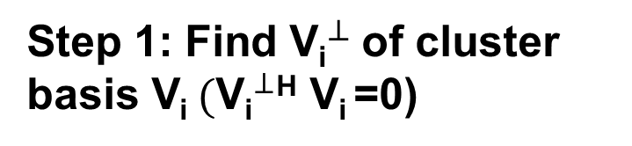

Proposed Direct Solution: Leaf level
For cluster i=1
Step 1: Find ${\text{V}\text{i}}^{⊥}$of cluster basis V_{i}$({\text{V}\text{i}}^{⊥}$^{H} $\text{V}\text{i}$=0)
$$i=1$$
$$i=2$$
.
.
.
Property:
$$i=m$$

Slide 28
Proposed Direct Solution: Leaf level
For cluster i=1
Step 1: Find ${\text{V}\text{i}}^{⊥}$of cluster basis V_{i}$({\text{V}\text{i}}^{⊥}$^{H} $\text{V}\text{i}$=0)
Property:
Step 2: Compute

Slide 29
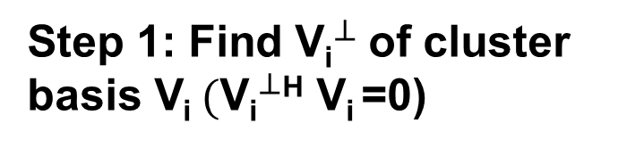
Proposed Direct Solution: Leaf level
Step 1: Find ${\text{V}\text{i}}^{⊥}$of cluster basis V_{i}$({\text{V}\text{i}}^{⊥}$^{H} $\text{V}\text{i}$=0)
Property:
Step 2: Compute

Slide 30
Proposed Direct Solution: Leaf level
Step 1: Find ${\text{V}\text{i}}^{⊥}$of cluster basis V_{i}$({\text{V}\text{i}}^{⊥}$^{H} $\text{V}\text{i}$=0)
Step 2: Compute
Step 3: Partial LU factorization to eliminate first ( ) unknowns

Slide 31

Proposed Direct Solution: Leaf level
For cluster and others
Step 0: Update cluster basis to account for the fill-ins
$$G_{i}\underset{⇒}{∈}V_{i}^{add}Σ{(V_{i}^{add})}^{H}$$

Slide 32

Proposed Direct Solution: Leaf level
For cluster and others
Step 0: Update cluster basis to account for the fill-ins
$$G_{i}\underset{⇒}{∈}V_{i}^{add}Σ{(V_{i}^{add})}^{H}$$

Slide 33
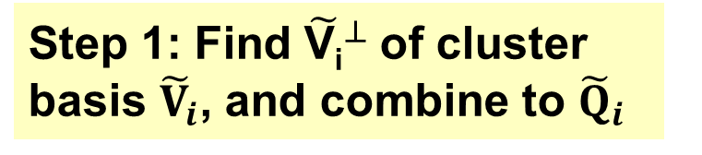
Proposed Direct Solution: Leaf level
For cluster and others
Step 0: Update cluster basis to account for the fill-ins
$$G_{i}\underset{⇒}{∈}V_{i}^{add}Σ{(V_{i}^{add})}^{H}$$
Step 1: Find ${\tilde{\text{V}\text{i}}}^{⊥}$of cluster basis ${\tilde{V}}_{i}$, and combine to ${\tilde{Q}}_{i}$

Slide 34
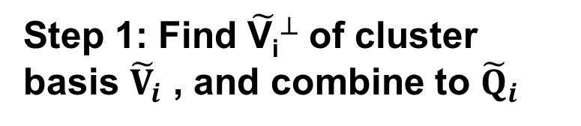
Proposed Direct Solution: Leaf level
For cluster and others
Step 0: Update cluster basis to account for the fill-ins
Step 1: Find ${\tilde{\text{V}\text{i}}}^{⊥}$of cluster basis ${\tilde{V}}_{i}$ , and combine to ${\tilde{Q}}_{i}$
Step 2: Compute

Slide 35
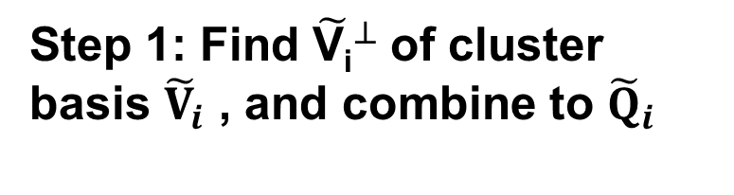
Proposed Direct Solution: Leaf level
For cluster and others
Step 0: Update cluster basis to account for the fill-ins
Step 1: Find ${\tilde{\text{V}\text{i}}}^{⊥}$of cluster basis ${\tilde{V}}_{i}$ , and combine to ${\tilde{Q}}_{i}$
Step 2: Compute
Step 3: Partial LU factorization to eliminate first ( ) unknowns

Slide 36
Proposed Direct Solution: Leaf level
For cluster and others
Step 0: Update cluster basis to account for the fill-ins
Step 1: Find ${\tilde{\text{V}\text{i}}}^{⊥}$of cluster basis ${\tilde{V}}_{i}$ , and combine to ${\tilde{Q}}_{i}$
Step 2: Compute
Step 3: Partial LU factorization to eliminate first ( ) unknowns

Slide 37
Proposed Direct Solution: Leaf level
Matrix obtained after leaf clusters are factorized:
Two more steps:
Update leaf-level coupling matrices
Update transfer matrix at one level higher

Slide 38

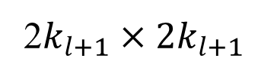
Proposed Direct Solution: Leaf level
Level l+1
Level l
Merge
2^{l} clusters
$$k_{l+1}×k_{l+1}$$
2$k_{l+1}×{2k}_{l+1}$

Slide 39
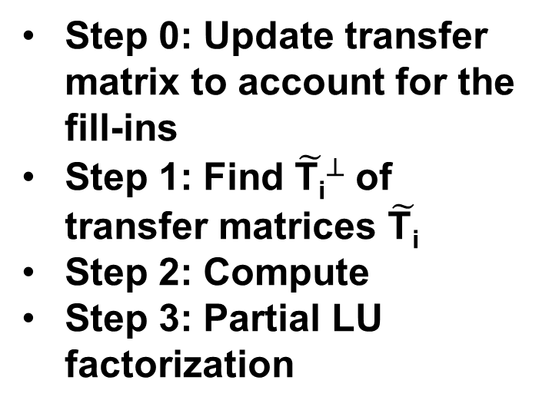
Proposed Direct Solution: Non-Leaf
Second: Repeat step 0~3 the same as leaf level
Step 0: Update transfer matrix to account for the fill-ins
Step 1: Find ${\tilde{\text{T}\text{i}}}^{⊥}$of transfer matrices $\tilde{\text{T}\text{i}}$
Step 2: Compute
Step 3: Partial LU factorization

Slide 40
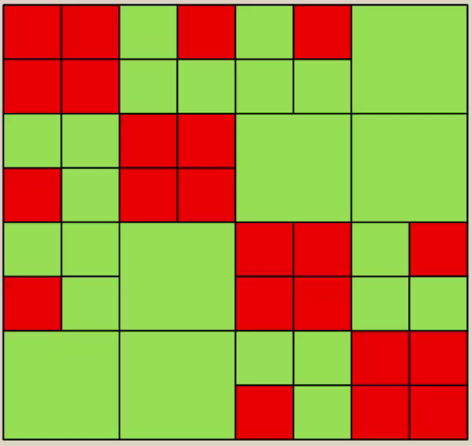

Proposed Direct Solution: Overall
Step 0: Update cluster basis to account for the fill-ins
Step 1: Find ${\tilde{\text{V}\text{i}}}^{⊥}$(${\tilde{\text{T}\text{i}}}^{⊥}$)
Step 2: Compute
Step 3: Partial LU factorization to eliminate first ( ) unknowns

Slide 41
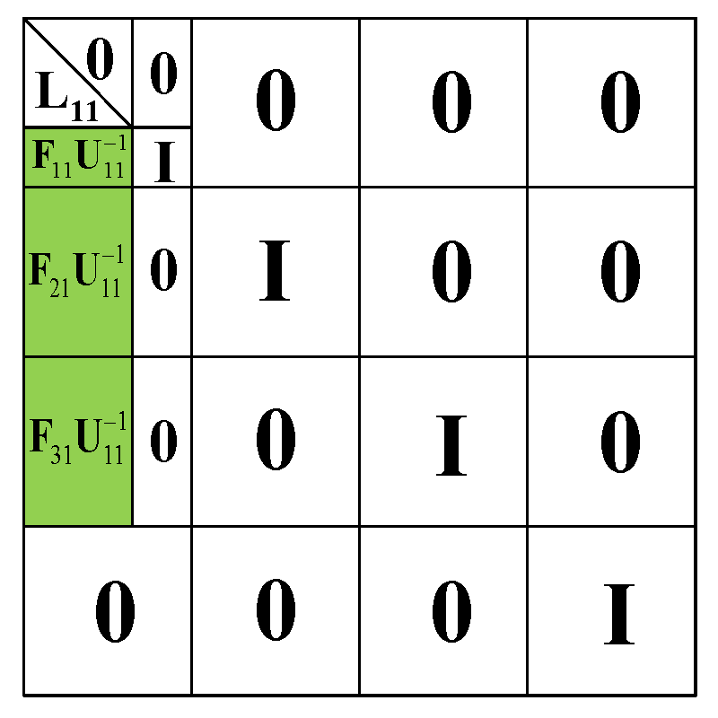
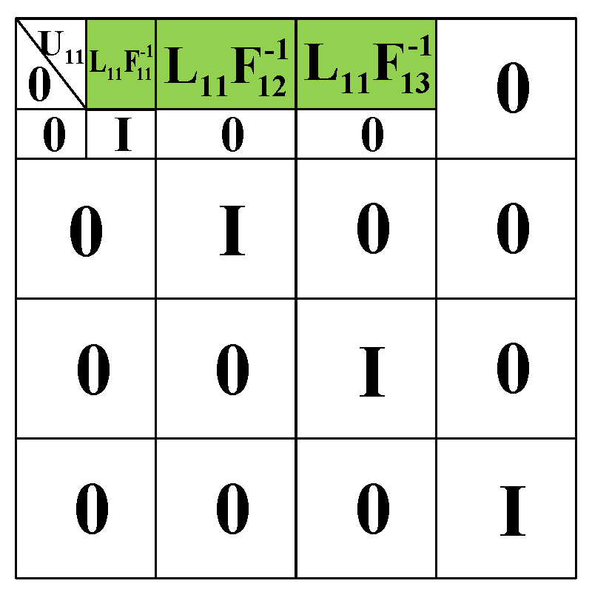

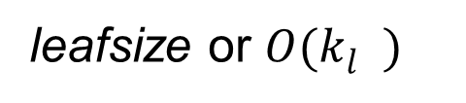
Proposed Direct Solution
Proposed factorization for general H²-matrices
leafsize or $O(k_{l}^{})$
leafsize or $O(k_{l}^{})$

Slide 42
Proposed Direct Solution
Proposed inversion for general H²-matrices

Slide 43
Proposed Direct Solution
Proposed solution:

Slide 44


Proposed Direct Solution
Accuracy Analysis:
$$ε_{H^{2}}$$
$$ε$$
Original dense system
Equivalent H² matrix
Inverse and Factorization

Slide 46
Proposed Direct Solution
Complexity Analysis:
Time Complexity:
Solution & Storage:

Slide 47
Complexity for Electrically Large Analysis
In VIE, theoretically ^{[1]}
Proposed Factorization and Inverse Time:
Proposed Solution Time and Memory:
[1] W. Chai and D. Jiao, “ A theoretical study on the rank of integral operators for broadband electromagnetic modeling from static to electrodynamic frequencies,” IEEE Trans. on Components, Packaging and Manufacturing Tech., Dec. 2013

Slide 48
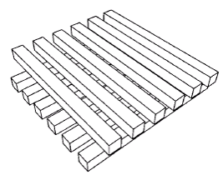
Numerical Results
2-Layer cross bus
Bus unit: 1×1×(2*m+1) m³
Spacing: 1 m
8×8 to 256×256 arrays
N: from 4,480 to 4,206,592
Computer used: 3 GHz, single core, Intel(R) Xeon(R) CPU E5-2690 v2

Slide 49
Numerical Results
Time v.s. N

Slide 50
Numerical Results
Memory v.s. N

Slide 51
Numerical Results
Capacitance Error v.s. N

Slide 52
Numerical Results
Large-scale array of on-chip buses
Bus: 1 µm × 1 µm × 20 µm
Horizontal distance: 20 µm
Vertical distance: 40 µm
Conductivity: 5.8e+7 S/m
Frequency: 30 GHz
4×4 to 64×64 arrays
N: from 5,152 to 1,318,912
A 16×16 on-chip bus array

Slide 53
Numerical Results

Slide 54
Numerical Results

Slide 55
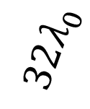
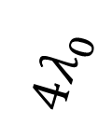


Numerical Results
Large-scale dielectric slab at 3e+8 Hz
$$32λ_{0}$$
$$4λ_{0}$$
$$4λ_{0}$$
$$32λ_{0}$$
N: from 22560 to 1,434,880

Slide 56
Numerical Results

Slide 57
Numerical Results

Slide 58
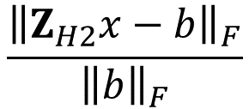
Numerical Results
Relative residual error:
$$\frac{{\left\|Z_{H2}x−b\right\|}_{F}}{{\left\|b\right\|}_{F}}$$
N | 22,560 | 89,920 | 359,040 | 1,434,880
 | 0.44% | 0.60% | 1.23% | 0.59%
 | 0.19% | 0.25% | 1.88% | 0.53%
 | 0.085% | 0.15% | 0.58% | 0.37%
Performance comparison:
N | 89,920 | 359,040 | 1,434,880
Factorization (s) [This] | 380 | 1,690 | 7,335
Solution (s) [This] | 1.66 | 8.55 | 40.06
Inversion (s) [1] | 2,750 | 16,500 | 93,100
  [1] D. Jiao and S. Omar, “Minimal-rank H²-matrix based iterative and direct volume integral equation solvers for large-scale scattering analysis,” Proc. IEEE Int. Symp. Antennas Propag., Jul. 2015.

Slide 59
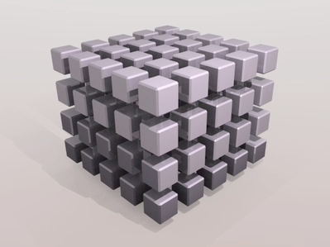
Numerical Results
Large-scale 3D dielectric cube array scattering
Cube unit: 0.3m×0.3m×0.3m
Spacing: 0.3 m
Relative permittivity: 4
Frequency: 3e+8 Hz
ε in direct sol.: 1e-5
2×2×2 to 14×14×14 arrays
N: from 3024 to 1,037,232
Computer used: 3 GHz, single core, Intel(R) Xeon(R) CPU E5-2690 v2

Slide 60
Numerical Results (Memory)
N=1,037,23
 | Mem.
Factor. | 44 GB
Matrix | 21 GB

Slide 61
Numerical Results (Time)
N=1,037,23 | Factorization | Solution
Time (s) | 19,118 | 65

Slide 62
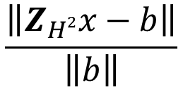
Numerical Results (Accuracy)
Relative Residual:
$$\frac{\left\|Z_{H2}x−b\right\|}{\left\|b\right\|}$$

Slide 63
Numerical Results (Error Control)

Slide 64
Numerical Results
On-chip Lossy Interconnects
[*] M. Ma and D. Jiao. Accuracy directly controlled fast direct solution of general H2-matrices and its application to solving electrodynamic volume integral equations, IEEE Trans, MTT, vol. 66, no. 1, pp. 35-48, Jan. 2018.

Slide 65
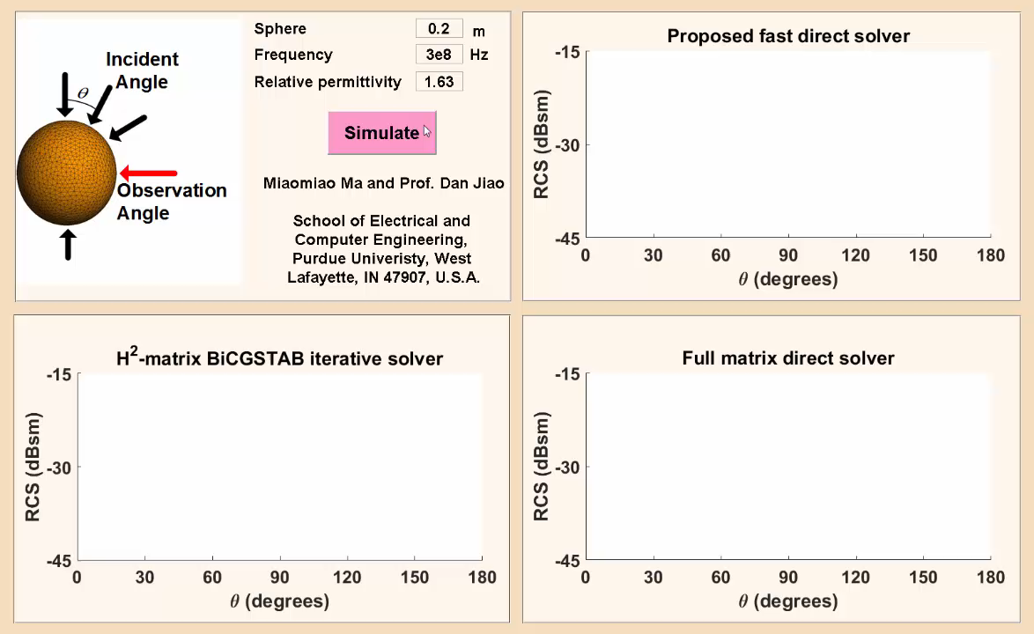

Slide 66
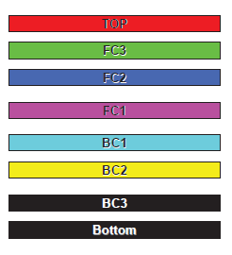
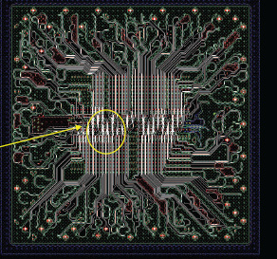
IBM Full-Package Simulation
AIR
IBM Plasma Package
Product-level full package structure with 8 metal layers and 7 dielectric layers
Delivered in industrial design file
Over 96,000 circuit elements including vias, interconnects and metal planes
AIR
Source: Dr. Jason Morsey from IBM

Slide 67
IBM Full-Package Simulation

Slide 68
IBM Full-Package Simulation

Slide 69
IBM Full-Package Simulation
Geometry detail
8 metal layers
7 dielectric layers
2 air layers
Simulation spec.
Number of unknowns
  22,848,800
CPU time (at 30 GHz)
  16.38 h
Memory
  224.98 GB
Solution error
  3.60501e-4
Magnitude of E field in log scale
at fan-out layer (30 GHz)

Slide 70
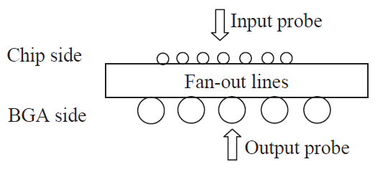
IBM Full-Package Simulation
Measurement setup
Source: Dr. Jason Morsey from IBM

Slide 71
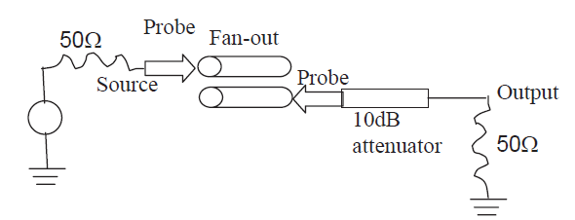
IBM Full-Package Simulation
Correlation with Measurements
FEN Line 6 coupled to Line 2

Slide 72
Performance Benchmark
Comparison with State-of-the-art Direct Sparse Solvers
State-of-the-art direct sparse solvers:
PARDISO, in Intel MKL 12.0.0, highly optimized binary
MUMPS 4.10.0, open source
UMFPACK 5.6.2, open source
SuperLU 4.3, open source
19 Test structures

Slide 73
Performance Benchmark
N: from 31,276 to 15,850,600
Comparison with State-of-the-art Direct Sparse Solvers
Time Complexity
Memory Complexity

Slide 74
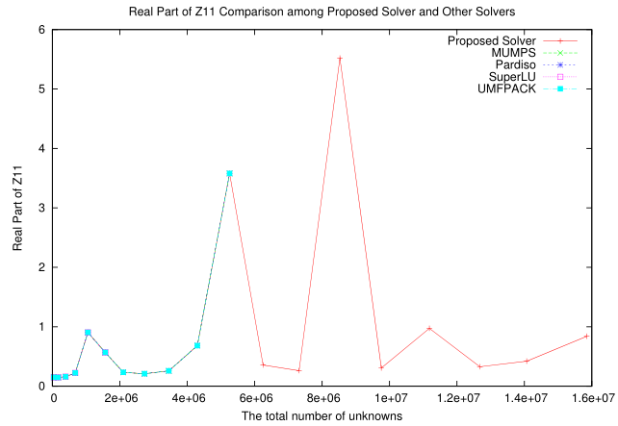
Performance Benchmark
Solution Error
Z Parameter Comparison

Slide 75
Conclusions
  Accuracy Controlled Direct Solution of General H²
    Direct solution controlled by required accuracy
    Applicable to IE and PDE operators
    For electrically small and moderate problems
      O(N) factorization, inversion, solution, storage
    For electrically large volume IEs
      O(NlogN) factorization and inverse
      O(N) solution and memory
      Outperform state-of-the-art H²-direct solvers in accuracy and computational efficiency

Slide 76
References
[1] W. Chai, D. Jiao, and C. C. Koh, “A Direct Integral-Equation Solver of Linear Complexity for Large-Scale 3D Capacitance and Impedance Extraction,” the 46th ACM/EDAC/IEEE Design Automation Conference (DAC), pp. 752-757, July, 2009.
[2] W. Chai and D. Jiao, “Dense Matrix Inversion of Linear Complexity for Integral-Equation Based Large-Scale 3-D Capacitance Extraction,” IEEE Trans. MTT, 2011.
[3] W. Chai and D. Jiao, “An LU Decomposition Based Direct Integral Equation Solver …,” IEEE Trans. Advanced Packaging, vol. 33, no. 4, pp. 794-803, Nov. 2010.
[4] W. Chai and D. Jiao, “Direct Matrix Solution of Linear Complexity for Surface Integral-Equation Based Impedance Extraction of High Bandwidth Interconnects,” the 48th ACM/EDAC/IEEE Design Automation Conference (DAC), pp. 206-211, June 2011.
[5] W. Chai and D. Jiao, “Direct Matrix Solution of Linear Complexity for Surface Integral-Equation Based Impedance Extraction of Complicated 3-D Structures,” Proceedings of the IEEE, special issue on “Large Scale Electromagnetic Computation for Modeling and Applications,” vol. 101, no. 2, pp. 372-388, Feb. 2013. (Invited)
[6] W. Chai and D. Jiao, “Linear-Complexity Direct and Iterative Integral Equation Solvers Accelerated by a New Rank-Minimized H²-Representation for Large-Scale 3-D Interconnect Extraction,” IEEE Trans. MTT, vol. 61, no. 8, pp. 2792-2805, Aug. 2013.

Slide 77
References
[7] S. Omar and D. Jiao, “A linear complexity direct volume integral equation solver for full-wave 3-D circuit extraction in inhomogeneous materials,” IEEE Trans. Microw. Theory Techn., vol. 63, no. 3, pp. 897-912, Mar. 2015.
[8] S. Omar and D. Jiao, “A Linear Complexity H²-matrix Based Direct Volume Integral Solver for Broadband 3-D Circuit Extraction in Inhomogeneous Materials,” 2014 IEEE International Microwave Symposium (IMS).
[9] S. Omar and D. Jiao, “An O(N) Direct Volume IE Solver with a Rank-Minimized H²-Representation for Large-Scale 3-D Circuit Extraction in Inhomogeneous Materials,” 2014 IEEE International Symposium on Antennas and Propagation.
[10] W. Chai and D. Jiao, “A Theoretical Study on the Rank of Integral Operators for Broadband Electromagnetic Modeling from Static to Electrodynamic Frequencies,” IEEE Trans. on Components, Packaging and Manufacturing Technology, vol. 3, no. 12, pp. 2113-2126, December 2013.
[11] S. Omar and D. Jiao, “An O(N) iterative and O(NlogN) direct volume integral equation solvers for large-scale electrodynamic analysis,” the 2014 International Conference on Electromagnetics in Advanced Applications (ICEAA), Aug. 2014.

Slide 78
References
[12] H. Liu and D. Jiao, “Existence of H-matrix Representations of the Inverse Finite-Element Matrix of Electrodynamic Problems and H-Based Fast Direct Finite-Element Solvers,” IEEE Trans. MTT, vol. 58, no. 12, pp. 3697-3709, Dec. 2010.
[13] B. Zhou and D. Jiao, “A Direct Finite-Element Solver of Linear Complexity for Electromagnetics-Based Analysis of 3-D Circuits,” the 2013 International Annual Review of Progress in Applied Computational Electromagnetics (ACES), March, 2013.
[14] B. Zhou and D. Jiao, “A Linear Complexity Direct Finite Element Solver for Large-Scale 3-D Electromagnetic Analysis,” the IEEE International Symposium on Antennas and Propagation, July 2013.
[15] B. Zhou and D. Jiao, “A Direct Finite Element Solver of Linear Complexity for Large-Scale 3-D Circuit Extraction in Multiple Dielectrics,” the 50th ACM/EDAC/IEEE Design Automation Conference (DAC), June 2013.
[16] B. Zhou and D. Jiao, “Direct Finite Element Solver of Linear Complexity for Large-Scale 3-D Electromagnetic Analysis and Circuit Extraction," IEEE Trans. Microw. Theory Tech., vol. 63, no. 10, pp. 3066-3080, Oct. 2015.”
[17] M. Ma and D. Jiao. Accuracy directly controlled fast direct solution of general H2-matrices and its application to solving electrodynamic volume integral equations, IEEE Trans, MTT, vol. 66, no. 1, pp. 35-48, Jan. 2018.

