Slide 1
Gradient Descent Method
Optimization Methods

Slide 2
Algorithm
x_{k+1} = x_k - α ∇f(x_k)
Problem: minimize f(x) where f: ℝⁿ → ℝ is differentiable
Parameters: step size α > 0, tolerance ε > 0
Algorithm Steps:
1. Initialize x₀, set k = 0
2. Compute gradient ∇f(x_k)
3. Update: x_{k+1} = x_k - α ∇f(x_k)
4. If ‖∇f(x_k)‖ < ε, stop; else k ← k+1, go to 2
Assumptions: f is L-smooth (∇f is Lipschitz continuous)

Slide 3
Convergence Analysis
f(x_k) - f(x*) ≤ O(1/k) for convex f
Theorem: For L-smooth convex f with step size α ∈ (0, 1/L]:
f(x_k) - f* ≤ ‖x₀ - x*‖² / (2αk)
For μ-strongly convex f: linear convergence
‖x_k - x*‖ ≤ (1 - μ/L)^k ‖x₀ - x*‖
Condition number κ = L/μ affects convergence speed
Comparison: Slower than Newton (quadratic) but no Hessian needed
Step size selection: Fixed, diminishing, or line search

Slide 4
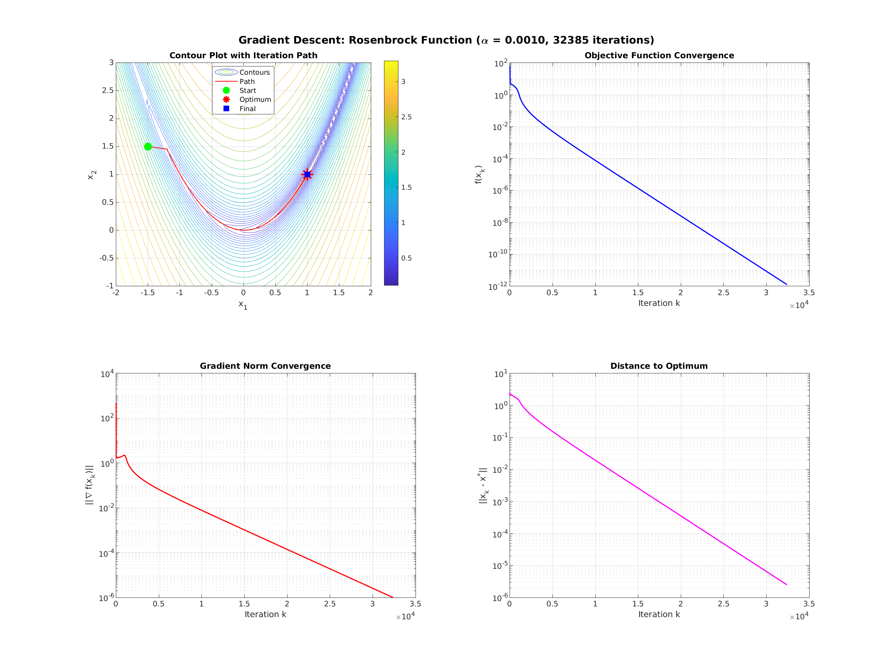
Numerical Results
Rosenbrock function, 32385 iterations, final accuracy ‖x - x*‖ ≈ 2.5×10⁻⁶

