Slide 1
The Poisson Equation
PDE & Variational Methods

Slide 2
Strong Form of Poisson Equation
Problem: Find u such that
-Δu = f in Ω
u = g on Γ_D (Dirichlet BC)
∂u/∂n = h on Γ_N (Neumann BC)
Where:
• Ω ⊂ ℝⁿ is a bounded domain
• Δ = ∇² is the Laplacian operator
• f is the source term

Slide 3
Weak (Variational) Formulation
Multiply by test function v ∈ H¹₀(Ω) and integrate:
Find u ∈ H¹(Ω) such that:
a(u,v) = L(v) ∀v ∈ H¹₀(Ω)
Bilinear form (after integration by parts):
a(u,v) = ∫_Ω ∇u · ∇v dx
Linear functional:
L(v) = ∫_Ω fv dx + ∫_{Γ_N} hv ds

Slide 4
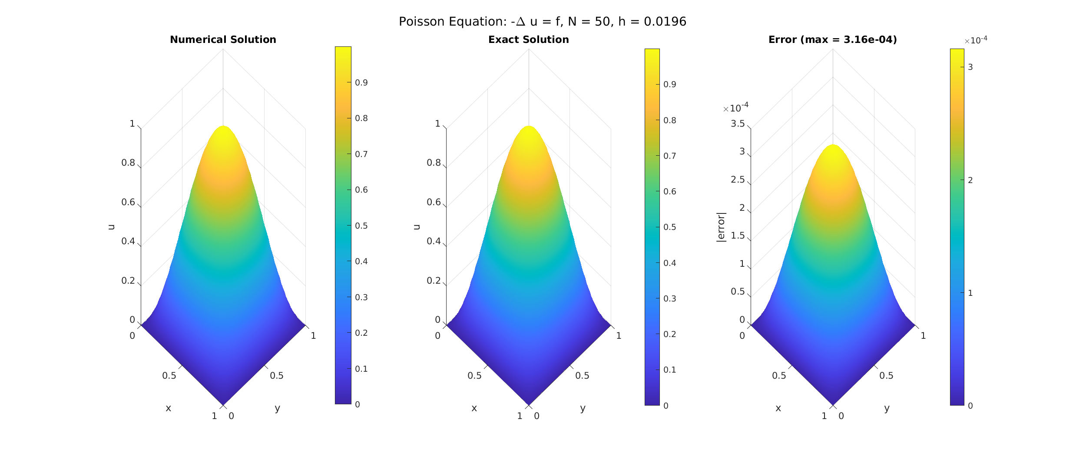
Numerical Results: Finite Difference Method
Grid: 50x50 interior points | Max Error: 3.16e-04 | L2 Error: 1.58e-04

