Slide 1
Wave Equation
PDE & Variational Methods

Slide 2
Strong Form
∂²u/∂t² − c²Δu = f in Ω×(0,T]
• Governing equation: ∂²u/∂t² − c²Δu = f, where c > 0 is the wave speed
• Domain: Ω ⊂ ℝⁿ, time interval (0, T]
• Boundary condition (Dirichlet): u = 0 on ∂Ω × (0, T]
• Initial displacement: u(x, 0) = u₀(x) in Ω
• Initial velocity: ∂u/∂t(x, 0) = v₀(x) in Ω
• Hyperbolic PDE — finite speed of propagation, preserves wave structure

Slide 3
Weak Form
Find u(t) ∈ H¹₀(Ω): (∂²u/∂t², v) + c²·a(u,v) = (f, v) ∀v ∈ H¹₀(Ω)
• Function space: u(·,t) ∈ H¹₀(Ω), ∂u/∂t(·,t) ∈ L²(Ω)
• Bilinear form: a(u, v) = ∫_Ω ∇u · ∇v dx
• Derived via integration by parts: −∫_Ω c²Δu · v dx = c² ∫_Ω ∇u · ∇v dx (boundary term vanishes for v ∈ H¹₀)
• Time discretization: central difference (uⁿ⁺¹ − 2uⁿ + uⁿ⁻¹)/Δt² + c² A uⁿ = fⁿ
• Energy conservation: E(t) = ½‖∂u/∂t‖² + ½c²‖∇u‖² is constant when f = 0
• CFL stability condition: c·Δt/Δx ≤ 1 (for explicit schemes)

Slide 4
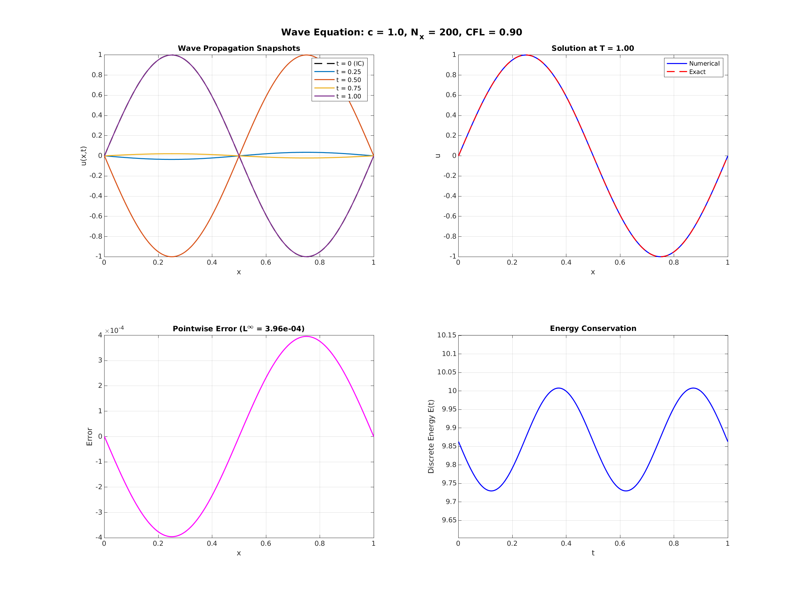
Numerical Results
1D Wave Equation (c=1, Nx=200, CFL=0.90): Central differences in space and time. L2 error = 2.80e-04, L∞ error = 3.96e-04 at T=1.0. Energy is conserved by the scheme.

