Slide 1
Introduction to Trust Region Method
Jielin Yang¹
¹Department of Mathematics, Purdue University
yang1659@purdue.edu
Based on: Numerical Optimization, Jorge Nocedal and Stephen J. Wright

Slide 2
Review of Line Search Methods:
Consider unconstraint optimization:
Line search methods:
Wolfe conditions:

Slide 3
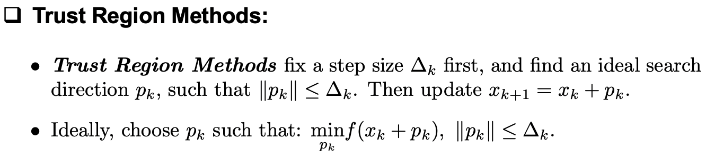
Trust Region Methods:
Essential idea of line search methods:

Slide 4
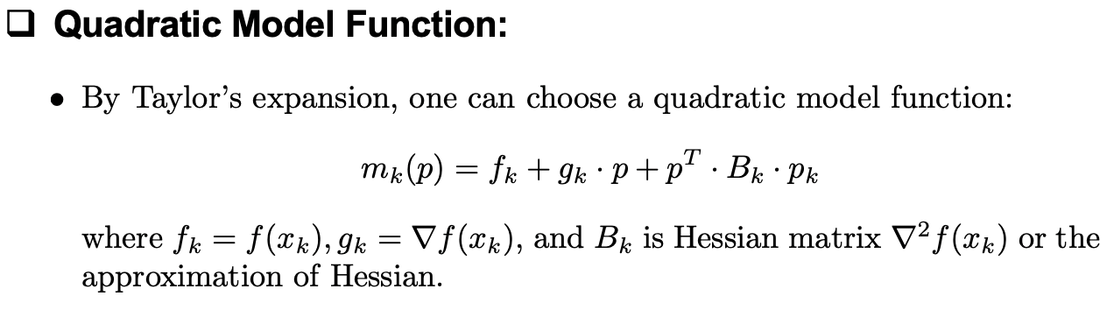
Trust Region Methods:
Trust Region Subproblem:

Slide 5
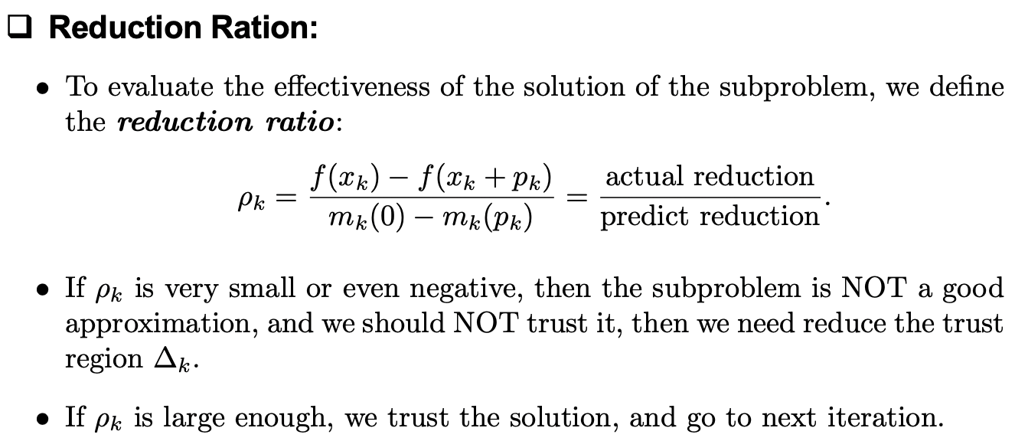
Trust Region Methods:
Trust Region Subproblem:

Slide 6
Trust Region Methods:
Accept or reject this step
Modify the trust region

Slide 7
Global Convergence:

Slide 8
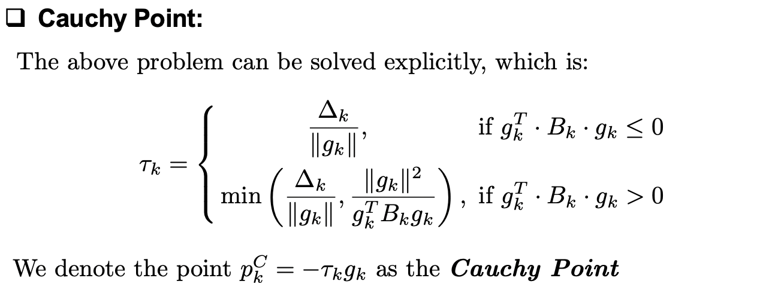
Cauchy Points Methods:
What if in the gradient descent direction…..

Slide 9
Cauchy Points Methods:
Global Convergence:
Pros and Cons:

Slide 10
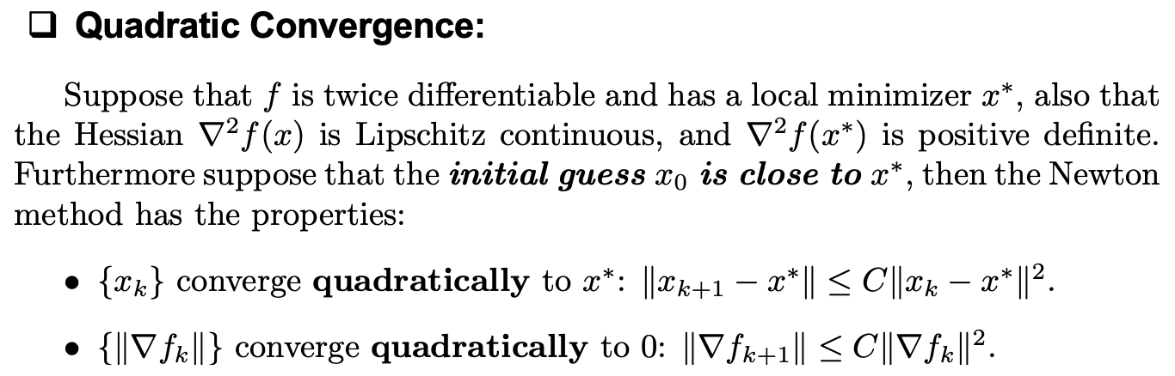
Newton Methods:
Newton Methods:

Slide 11
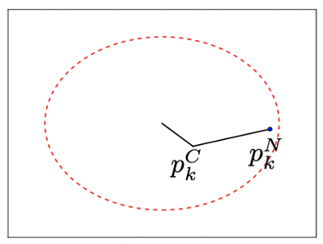
Dogleg Methods:
Dogleg Path:

Slide 12
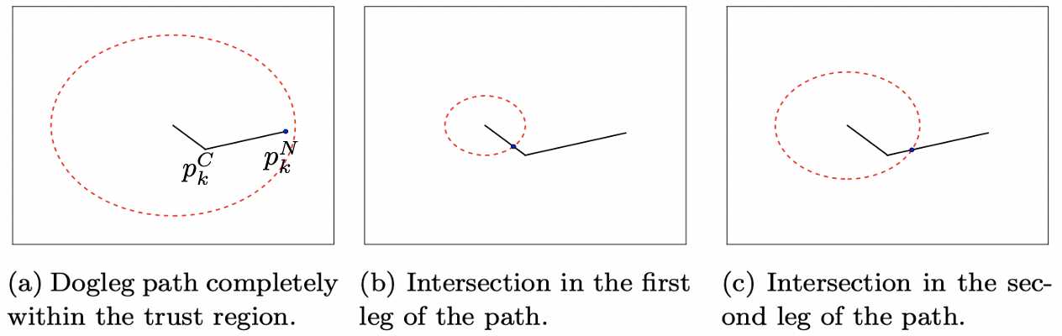
Dogleg Methods:
Property of Dogleg Methods:

Slide 13
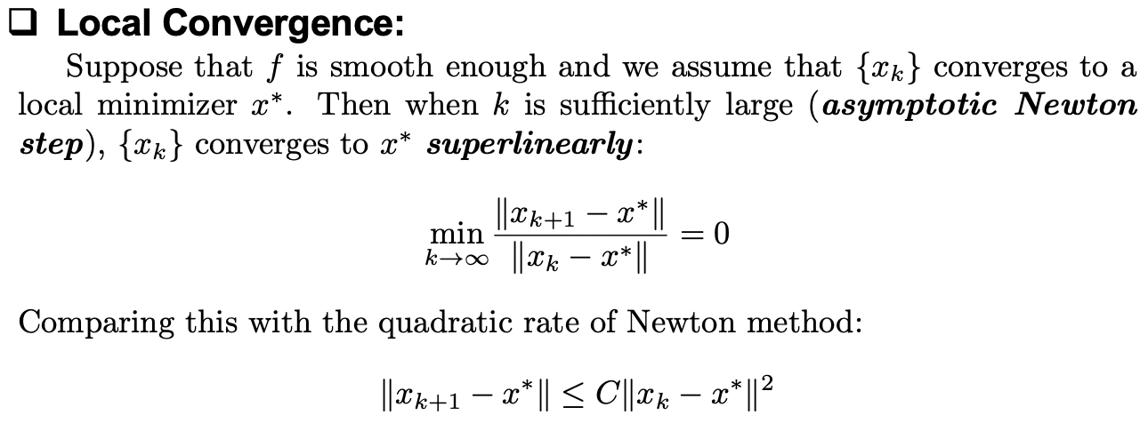
Dogleg Methods:
Global Convergence:

Slide 14
Truncated Conjugate Gradient:
Pros and Cons:

Slide 15
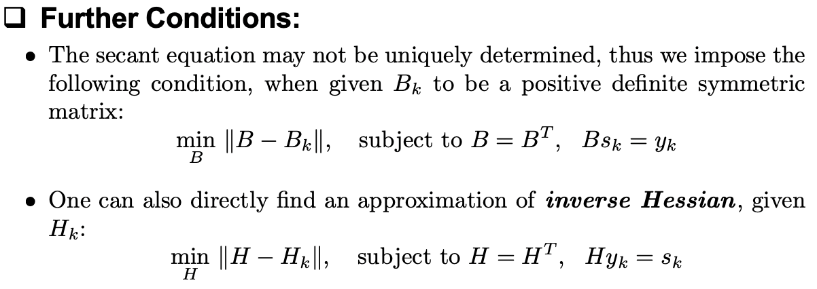
Quasi Newton Methods:
Approximate Hessian Matrix:

Slide 16
Quasi Newton Methods:
BFGS formula:
Convergence rate:

Slide 17
Numerical Examples:
Rosenbrock Function:

Slide 18
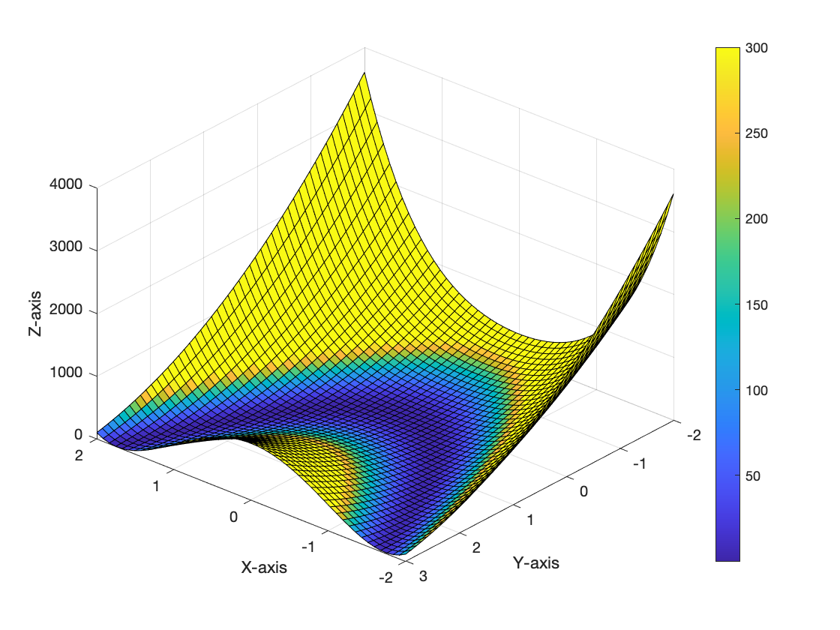
Numerical Examples:

Slide 19
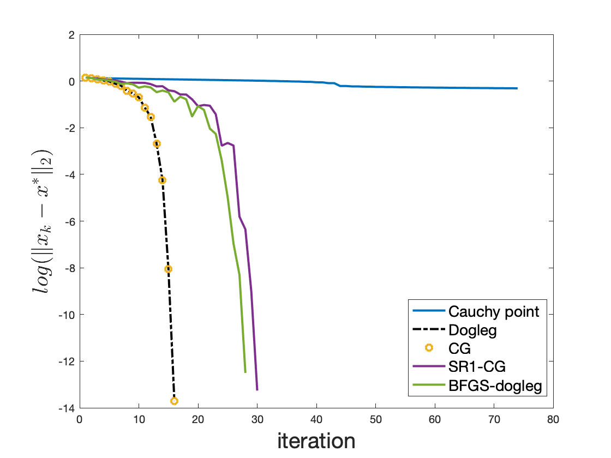
Numerical Examples:

Slide 20
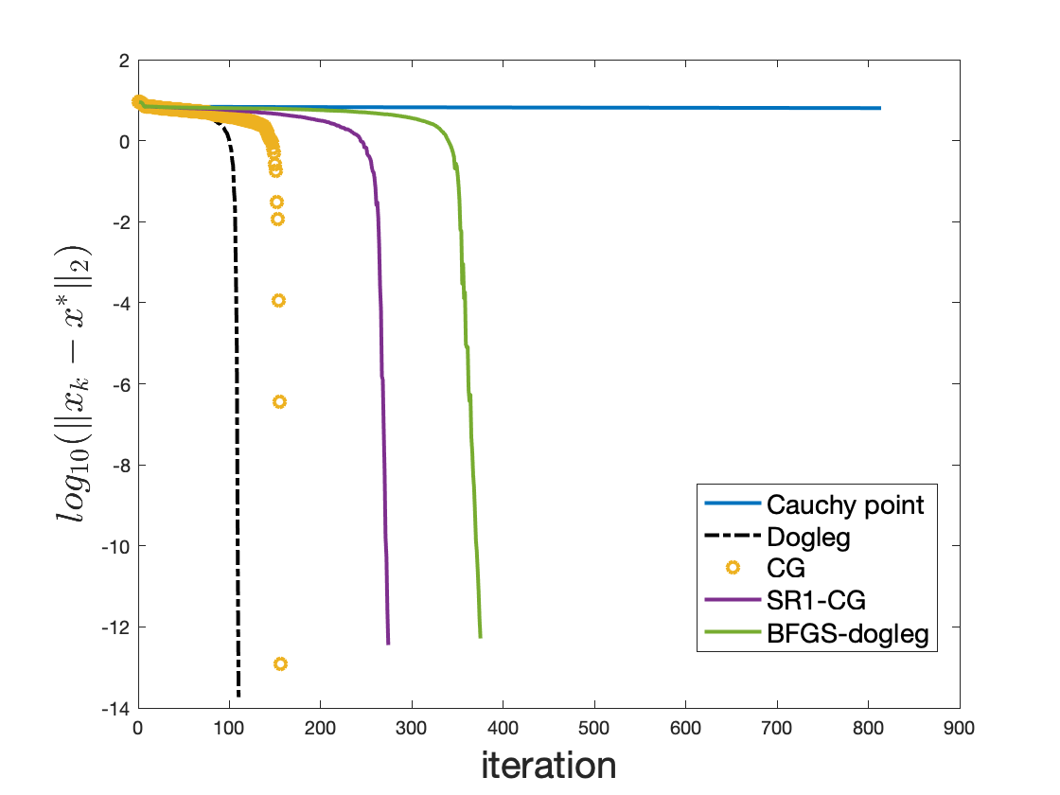
Numerical Examples:

Slide 21
Thank You.

